Slide 1
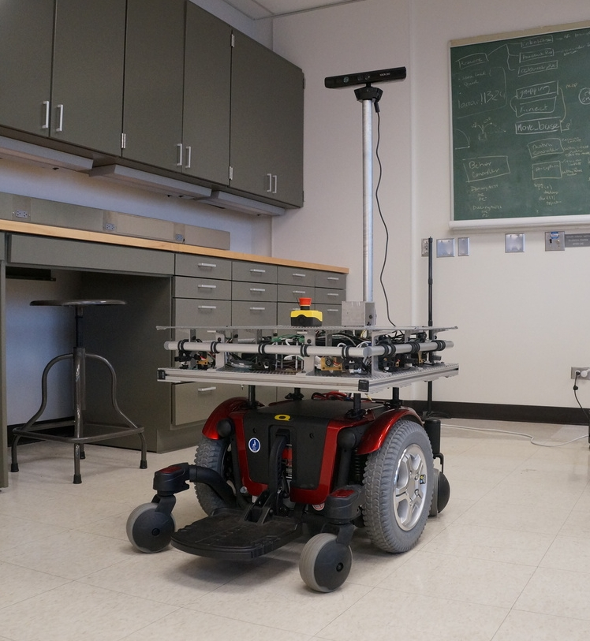


The Question of Control for
Interactions with Assistive Robots
Brenna Argall
CS, MechE & PMR, Northwestern University
Rehabilitation Institute of Chicago
argallab
assistive & rehabilitation robotics laboratory
INRIA Workshop on Algorithmic Human-Robot Interaction :: 22 July 2016

Slide 2

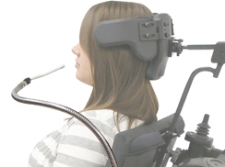
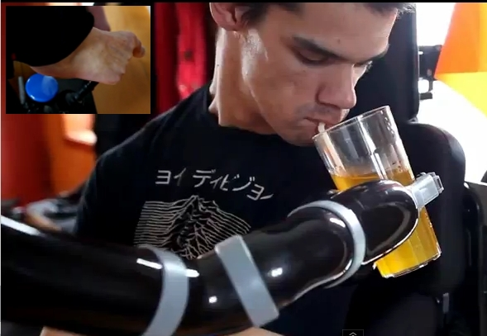
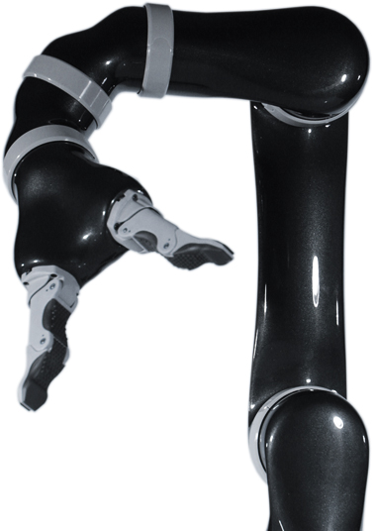
Control Challenges
Limited interfaces
Motor impairments
Machine Complexity
Non-static abilities

Slide 4








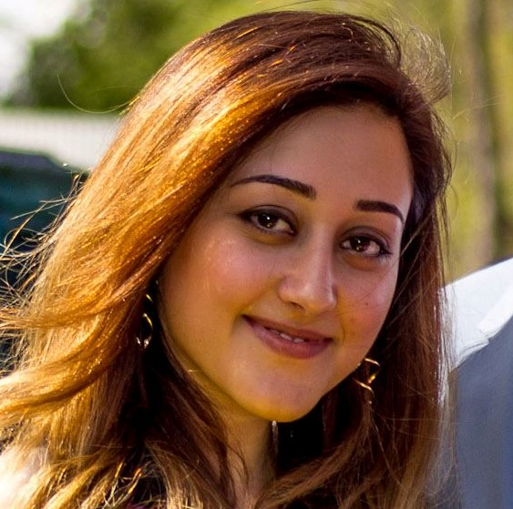
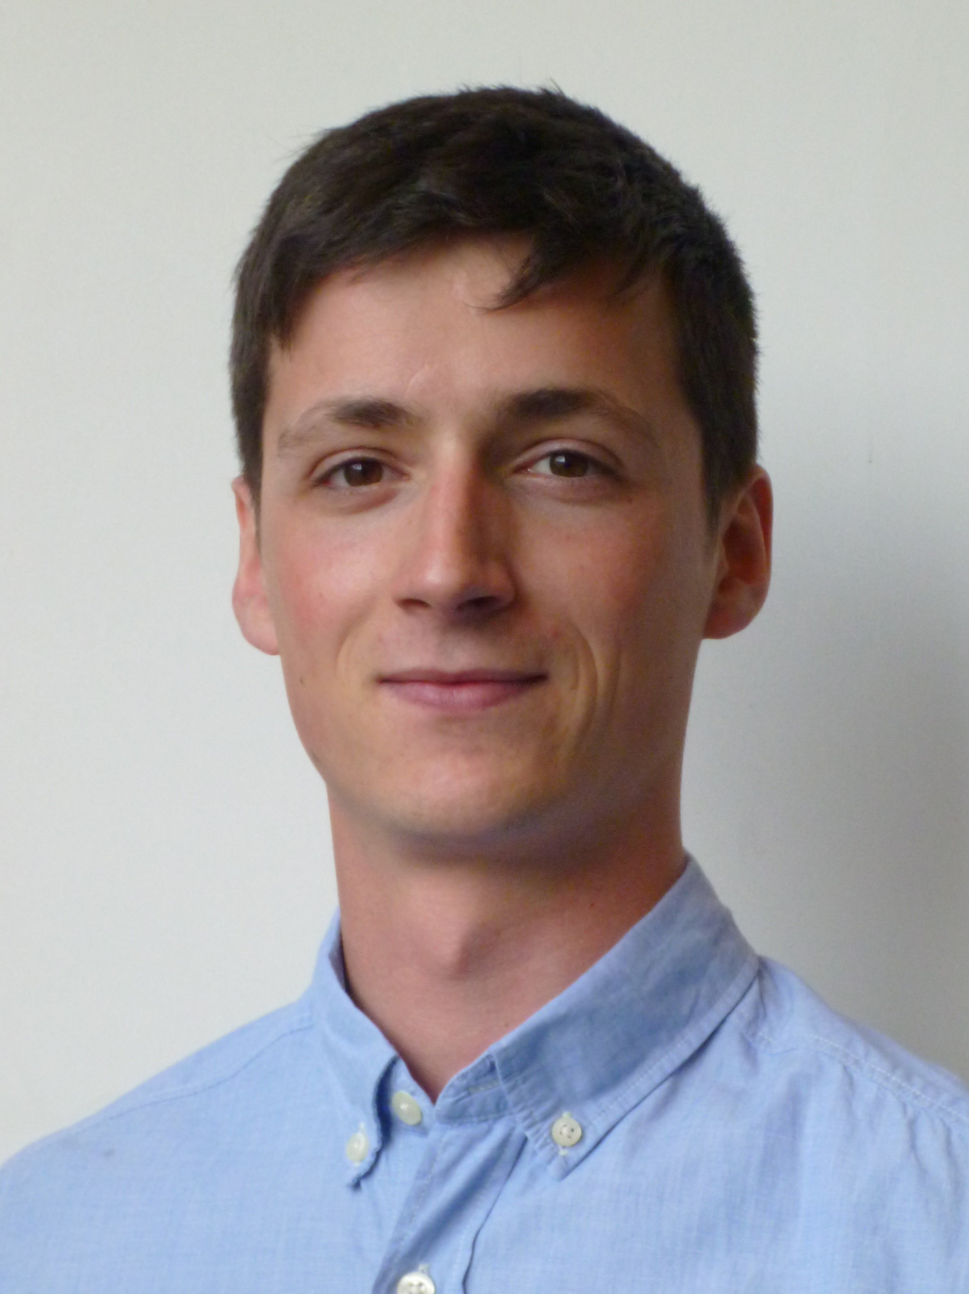
argallab
assistive & rehabilitation robotics laboratory
Assistive robots that make humans more able, through
autonomy that is customizable, teachable and adaptable.
Thank you!
Alex Broad
Matt Derry
Ahmetcan Erdogan
Deepak Gopinath
Siddarth Jain
Mahdieh Nejati
Pascal Egli

