Slide 1


User-Driven Customization of Shared Autonomy in Assistive Robotics
Deepak E. Gopinath, Siddarth Jain and Brenna D. Argall
<number>
Notes:
Hi, I am Deepak Gopinath and I am here from Northwestern University and my work is on about Customization of shared autonomy in Assistive robotics.
<number>

Slide 2
Why customization?
Full Teleoperation
Pre-defined assistance levels need not remain optimal
User and task variability
Is there an optimal level of assistance?
SHARED CONTROL
??????
Optimal
Assistance
??????
Full Autonomy
<number>
Notes:
Control sharing in shared control assistive systems extends from full teleoperation at one end to full autonomy. Customization of assistance levels in these systems can become important because pre-defined assistance levels need not remain optimal in the long run as users’ ability to control these device will likely be deteriorating due to degenerative diseases or improving due to successful rehabilitation. Furthermore, user preferences and task variability can also be important reasons for customization. So the question will be, is there an optimal level of assistance and if so, how we attain it?
<number>

Slide 3

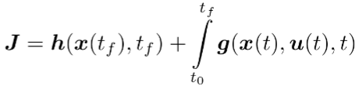

Customization as Optimization
Autonomous control
command
Final control
command
Arbitration
Parameters
Human control
command
Terminal Cost
Running cost
The exact nature of the cost function and system dynamics is left indeterminate.
<number>
Notes:
Let beta be the arbitration function which arbitrates between the human control command and the autonomous control command and is paramterized by parameters theta(t) to produce a final control command ub(t). Customization of assistance level can then be formulated as an optimization problem in which a cost function J is minimized with respect to parameters theta(t). J is dependent on theta(t) through the system dynamics. However, standard optimization requires the specification of the form of cost function. In our work we do not try to make an attempt to determine the exact nature of the cost function or system dynamics.
<number>

Slide 4
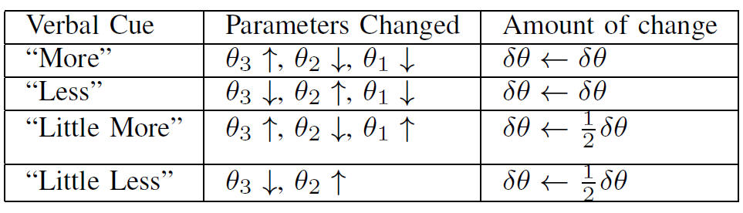
User-driven customization
Human-in-the-loop performs the optimization procedure
Interactive and iterative optimization process (Exploratory approach)
Example Mappings
<number>
Notes:
Instead of relying on standard optimization tools we have the human who is in-the-loop to perform the optimization procedure. Verbal requests for changes in assistance from the subjects are mapped to parameter changes in a pre-specified manner.
<number>

Slide 5
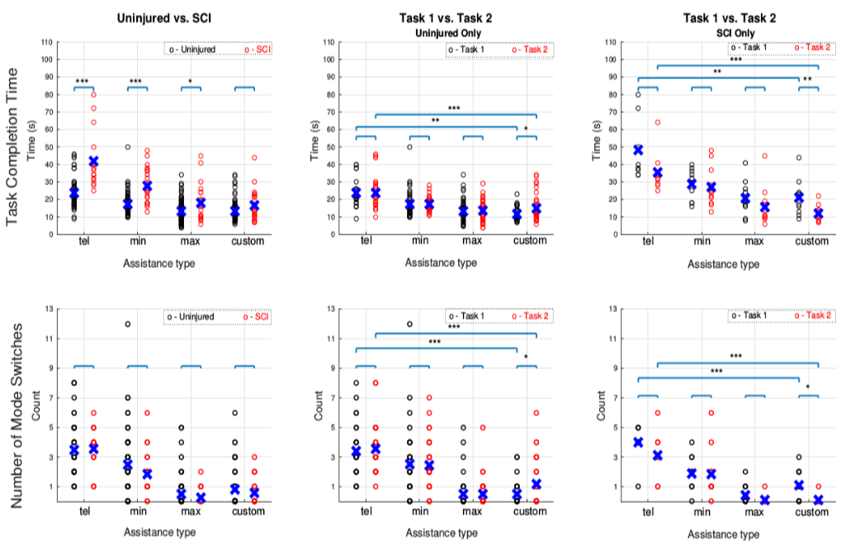
Results
User Study (13 Uninjured, 4 Spinal Cord Injury)
True cost function may be more complex.
<number>
Notes:
From our study we saw that with customization spinal cord injury subjects were able to achieve comparable task completion times to that of uninjured subjects. Furthermore, the results also suggested that the true cost function that the user is optimizing might be more complex than a simple time-optimal or minimum-effort cost function. We also conducted subjective evaluation through post-experiment questionnaires. Subjects felt that the user and system are equally contributed to task success and the system was able to perceive the goals quite accurately and take the right actions at the right time.
<number>

Slide 6
THANK YOU
<number>
Notes:
For more details about the study and the experiment do come see the poster. Thank you very much!
<number>

