Slide 1


Mode Switch Assistance to Maximize
Human Intent Disambiguation
Deepak Gopinath and Brenna D. Argall
argallab
assistive & rehabilitation robotics laboratory
Notes:
Hi everyone. I am Deepak Gopinath and I am here from Northwestern University in Chicago and I will be talking about “title”, work that I did in collaboration with Siddarth Jain and Dr. Brenna Argall.

Slide 2
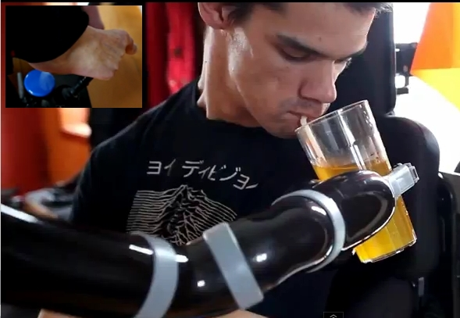
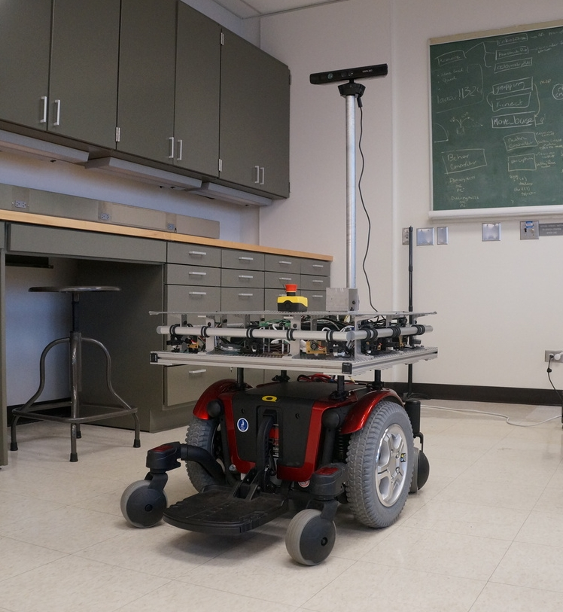
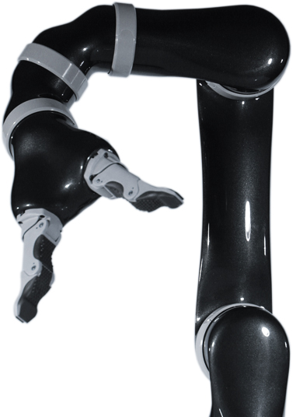
Overview (Assistive Robotics)
Robotic technologies for motor impairments
Greater independence
Notes:
The field of assistive and rehabilitation robotics aims to build robotic technologies for people who suffer from motor impairments as a result of spinal cord injuries or brain injuries. The goal is that these technologies will help them become more independent and reduce their dependence on caretakers. It also will enable to perform activities of daily lives in a more effective way thereby improving their quality of life. However, there are many challenges that makes the use of assistive robotics relatively hard.

Slide 3

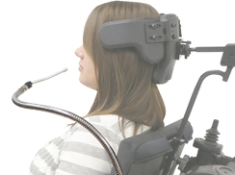
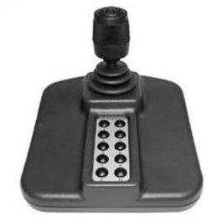
Overview (Challenges)
Challenges in assistive robotics
  High dimensionality (machine complexity)
  Limited control interfaces (low-dimensional, low-bandwidth)
7 DOF
2D, discrete
1D, discrete
2-3D,
continuous
Notes:
For example, here we have a 6DOF robotic manipulator. That is, in order to have complete control of the end effector a user should be able to control 6 dimensions simultaneously.. Due to the high dimensionality and complexity, manual control of these machines therefore become much harder. On the hand,
Here we can see some of these devices that are typically used. More sophisticated ones exist in some cases (BCI, BMIs).
Different types of interfaces
Therefore we need shared autonomy in assistive robotics.

Slide 4
Overview (Control Modes)
Control modes = Partitions of control space
Control Modes
Union of modes covers the entire space
Intersection need not always be null
Control Space
Notes:
.
Notion of modes, and modal control.
Why is modal control hard.
Due to the dimensionality mismatch between the robotic device and the control interface it becomes necessary for the entire control space to be partitioned into subsets which can then be controlled by these interfaces. These partitions are called control modes.
The cardinality of the control space typically depends on the robotic platform and the number of modes depends on the interface and the mappings used.
This is pictorially represented here. Here, the entire control space is represented by this blob and is partitioned into 4 subsets.
The union of the all the modes cover the entire control space. It can also be that these modes have overlap..That is intersection need not be a null set always
For example, in a 6DOF space

Slide 5
Overview (Control Modes - Example)
Control space = Cartesian pose + gripper (7 DOF)
Control Interface = 2D joystick
What makes modal control hard?
[x,y]
[x,z]
[x, y, z, roll, pitch, yaw, gripper]
[roll, pitch]
[yaw]
7DOF Control Space
[gripper]
Notes:
To ground it even further, in the example of a robotic arm, the dimensionality of the control space is seven. Let us consider a 2d joystick as our control interface.
Here is one possible mapping.
Then, what makes modal control hard?
Mode switching results in increased cognitive and physical burden on the user thereby having a detrimental effect on task performance and user satisfaction. Depending on the mapping paradigm used, control can be very counterintuitive.
Shared control hopes to alleviate and address these issues by letting the system take responsibility to some extent, thereby reducing the human effort in achieving a goal.

Slide 6



Overview (Shared Autonomy)
Intent Inference
Human
control command
Shared Autonomy
Final
control command
Heirarchical,
Blending,
Behavioral
Robot
control
command
http://cliparts.co/cliparts/pTo/54E/pTo54Eenc.jpg
http://www.azorobotics.com/images/Article_Images/ImageForArticle_193(1).jpg
Notes:
Block Diagram showing different components of shared control.
Different types of shared control.
Heirarchical. Blending, Mode Switch Assistance,
Explain different parts and finally nail down the intent inference/comunication part.
Emphasize the fact the present research is mainly focused on improving the intent inference component of shared autonomy.

Slide 7
Related Work (Intent Inference)
Notes:
Intent inference:
Cue Based - Dragan
Model Based – POMDP (Shervin, Trautman, Tenenbaum (bayesian schemes)
Bakcground work on intent inference, mode switch assistance etc.
Cue Based
Model Based – Cognitive scientist
Mode Switch
Perception based.
Inten communication paradigms – click interfaces, laser pointers, speech based. Biosignal based.

Slide 8
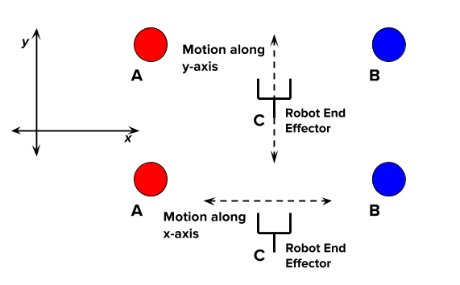
Motivation (Disambiguation and Inverse Legibility)
...
...
Time
Intent expressive, legible motion
Disambiguation

Slide 9
Goal
Mode switch assistance by identifying control dimensions/modes that disambiguate human intent maximally by eliciting more legible commands from the user.
Notes:
Bakcground work on intent inference, mode switch assistance etc.
Cue Based
Model Based – Cognitive scientist
Mode Switch
Perception based.
Inten communication paradigms – click interfaces, laser pointers, speech based. Biosignal based.

Slide 10


Measuring Intent (Confidence Functions)
Confidence Function – Heuristic to capture the system's estimate of its prediction of human intent
Maximal Intent Disambiguation via Maximal Confidence Disambiguation
Proximity Based - C1
“Directedness Based”- C2
Confidence
Confidence as Belief over goals
g1
g2
Notes:
Bakcground work on intent inference, mode switch assistance etc.
Confidence can be also thought of a distribution over the goals (not technically. Because not normalized.
This is a simplistic representation of confidence. Confidence is actually a surface in a higher dimensional space. The project of this function along each dimension however will be like this. And this is crucial in the upcoming section

Slide 11
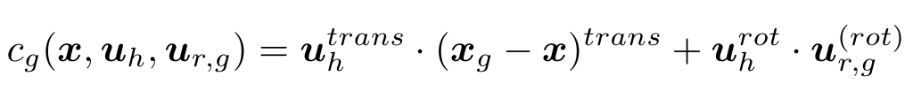
Formalism (Notation)
k₂
Let g^{i} ∈ G with n_{g} = |G|
Let c^{i} ∈ C
k₁
Let k^{i} ∈ K with n_{k} = |K|
Let m^{i} ∈ M

Slide 12
Formalism (Notation)
k₂
Projection of confidences onto control dimensions
k₁
Projection
Onto k₁
...
g1
g2
g3
g1
g2
g3
Projection
Onto k₂
...
g1
g2
g3
g1
g2
g3
Time

Slide 13
Formalism (Notation)
k₂
rate of change of confidence along each control dimension
k₁
Disambiguation Metric for each control dimension k
Disambiguation Metric for each control mode m

Slide 14
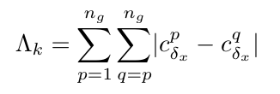
Formalism (Disambiguation Metric)
Four considerations for D_{k}
Confidence
1) Separation in confidences upon moving an small amount
g1
g2
g3

Slide 15

Formalism (Disambiguation Metric)
Four considerations for D_{k}
Confidence
2) Maximum confidence
g1
g2
g3

Slide 16

Formalism (Disambiguation Metric)
Four considerations for D_{k}
Confidence
3) Difference between max and second max
g1
g2
g3

Slide 17
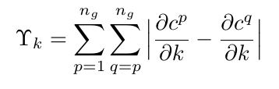
Formalism (Disambiguation Metric)
Four considerations for D_{k}
4) Separation of gradients
Confidence
Confidence
...
g1
g2
g3
g1
g2
g3

Slide 18
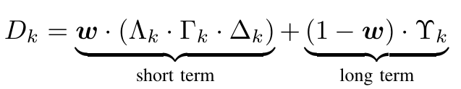
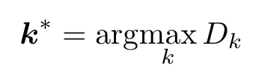
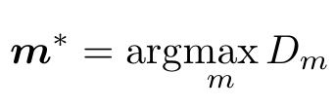
Formalism (Disambiguation Metric)
User-defined weight

Slide 19
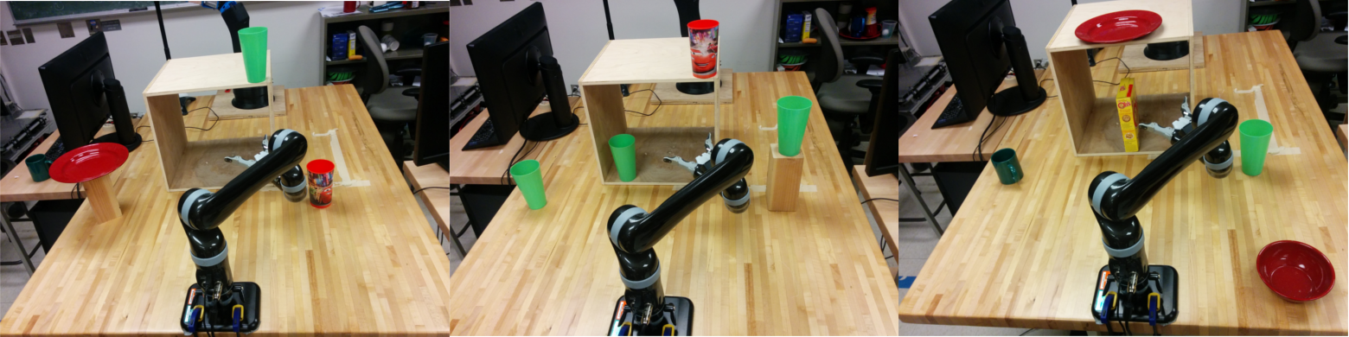
User Study (Setup)
Experimental Setup for pilot study. 4 subjects (lab members)
Simple Reaching (R)
Reaching with Same Grasp
(RsG)
Reaching with Different Grasp
(RdG)

Slide 20
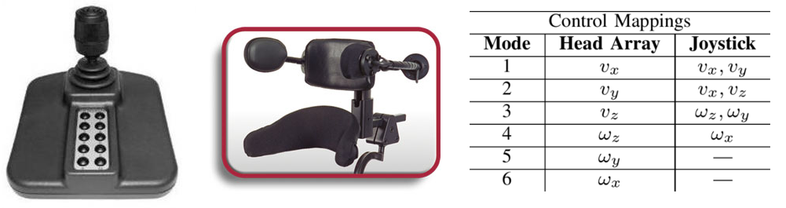
User Study (Interfaces and Paradigms)
Paradigms
  Manual - All mode switches performed by the user
  Disambiguation - Algorithm selects mode only at the beginning of the task
  On Demand - User can “request” assistance anytime
Phase I and II
Metrics – Task completion time, number of mode switches

Slide 21
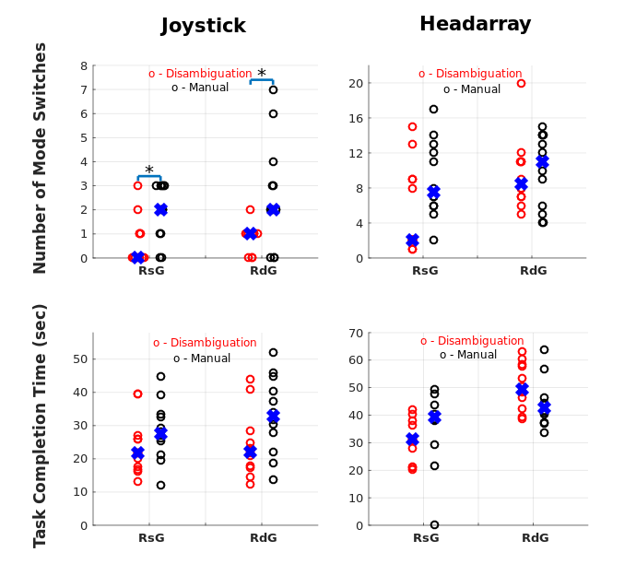
User Study (Results)
Decreasing trend for number of mode switches
Decreasing trend for task completion time, except for one combination
o – Manual o - Disambiguation

Slide 22
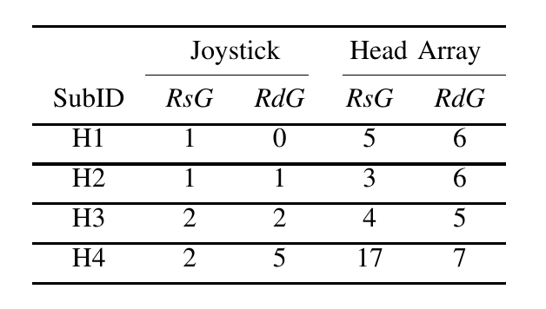
User Study (Results)
Wide disparity between users
General increase of request with increase in task difficulty

Slide 23
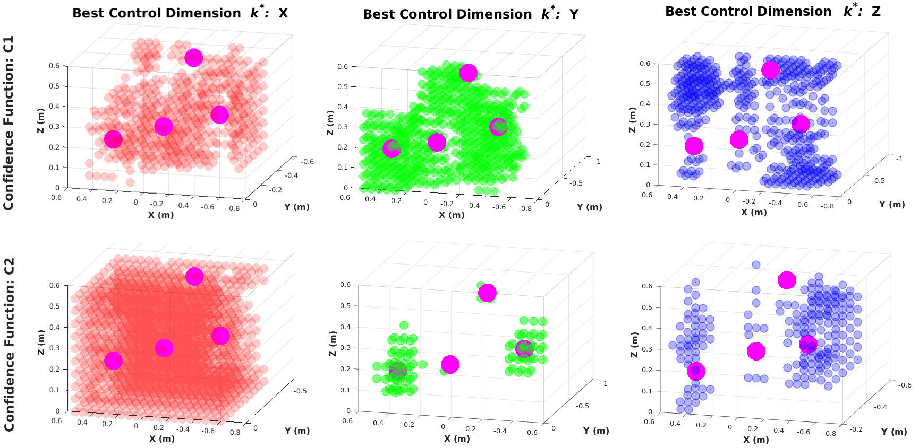
Simulations (Confidence Functions)
Choice of confidence functions
C1 (proximity based) and C2 (“directedness”). Goal configuration – RsG
Uniform sampling of workspace

Slide 24
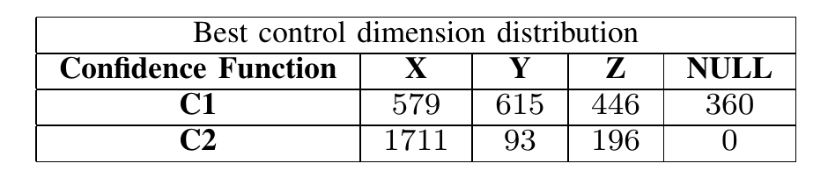
Simulations (Confidence Functions)
Choice of confidence functions
C1 (proximity based) and C2 (“directedness”). Goal configuration – RsG
Uniform sampling of workspace

Slide 25
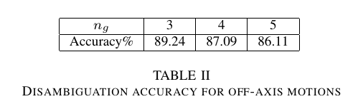
Simulations (Robustness of Simplifying Assumptions)
D_{m} is computed using orthogonal control dimensions
Control command can be in arbitrary directions
Simplifying assumption. Robust?
Compute m* for different points. Randomly perturb and recompute m*
k₂
k₁

Slide 26
Limitations and Future Work
Does not incorporate past history of control commands
Currently, algorithm is concerned only about what is best for the robot
Does not have a notion of utility value for the human as well
Incorporate memory. ODEs? Confidences as a dynamical system
Full scale user study with SCI subjects
Model-based intent inference?

Slide 27
Conclusions
Mode switch assistance for maximal intent disambiguation was developed
A disambiguation metric was designed
Pilot study
  General decrease in task effort
Simulation results
  Confidence function based on “directedness” performs better
  Simplifying assumptions are fairly robust

Slide 28



Questions?
Thank you!
This work was supported by by the National Institute of Biomedical Imaging and Bioengineering and the National Institute of Child
Health and Human Development of the National Institutes of Health under award number R01EB019335

