Slide 1
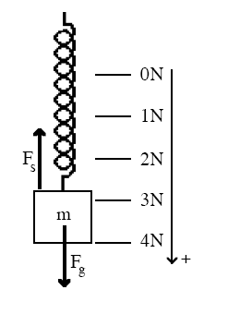


Chapter 13: Oscillatory Motions
Simple harmonic motion
Spring and Hooke’s law
y
When a mass hanging from a spring and
in equilibrium, the Newton’s 2nd law says:
This means the force due to the spring is
equal to the force by gravity and opposite
in direction when the spring is stretched.
Hooke’s law states that increasing the
weight by equal amounts increases the
stretch of the spring by equal amount.
Therefore, the force due to the spring must be proportional to the
stretch of the spring.
x is deviation from the spring w/o weight
This is also true when the spring shrinks

Slide 2
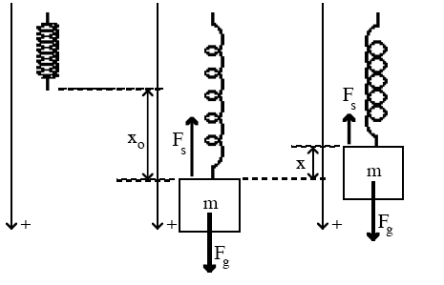
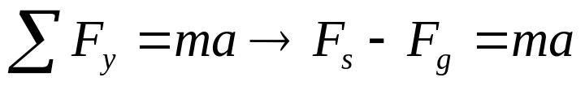
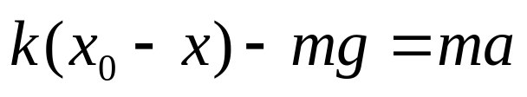

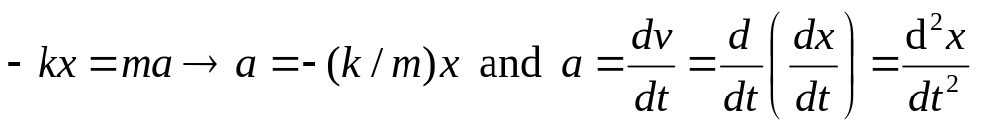
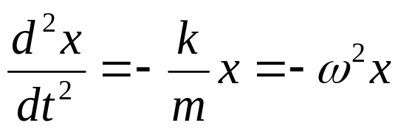
Simple harmonic motion
Simple harmonic motion (SHM)
y
y
y
Let’s study a motion of the
mass m. When the mass is
attached to the spring, the
spring stretches by x₀. Then
lift the mass by A and release
it.
The initial stretch is x₀-x and from Hooke’s law:
Since in equilibrium
Equation for SHM

Slide 3
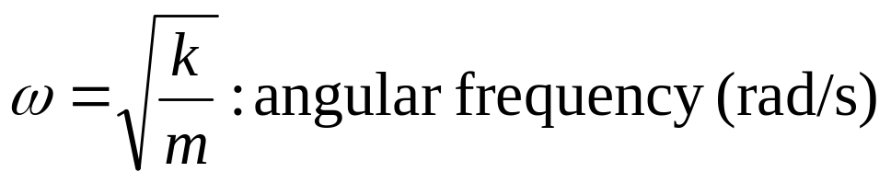
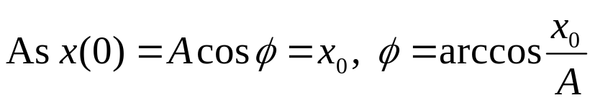

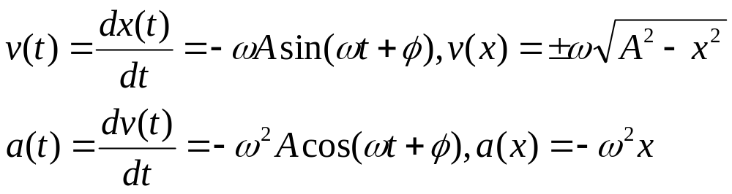
Simple harmonic motion
Simple harmonic motion (SHM) (cont’d)
phase constant
Solution:
Hz
s
velocity
acceleration

Slide 4
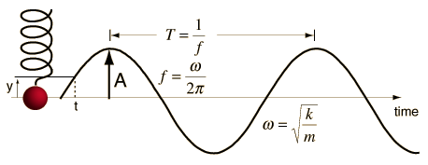
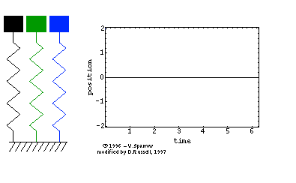
Simple harmonic motion
Simple harmonic motion (SHM) (cont’d)
Solution:
f=ω/(2π)
Acosφ
What is SHM/SHO?
t=-φ/ω
t=0
A simple harmonic motion is the motion
of an oscillating system which satisfies
the following condition:
Motion is about an equilibrium position
at which point no net force acts on the system.
The restoring force is proportional to
and oppositely directed to the
displacement.
3. Motion is periodic.
ω=ω₀; ω=2ω₀ ; ω=3ω₀
By Dr. Dan Russell, Kettering University

Slide 5
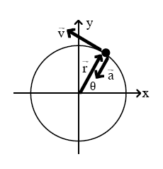
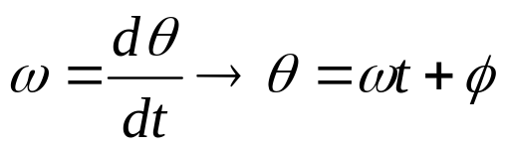


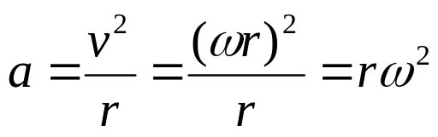
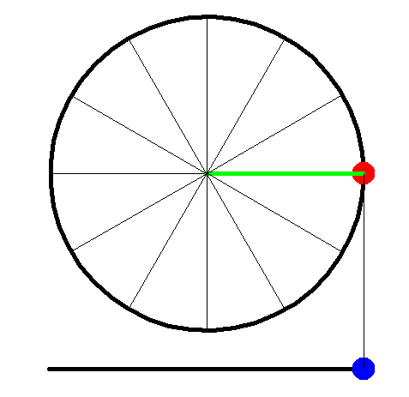
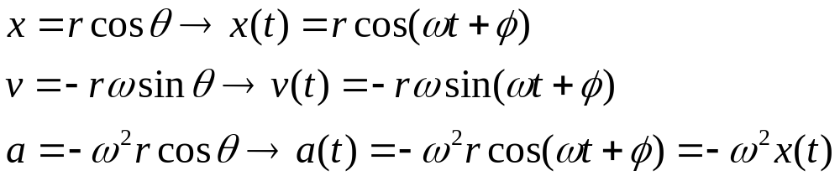
Simple harmonic motion
Connection between SHM and circular motion
For an object in circular motion, the angular
velocity is defined as,
The tangential velocity is related to the
angular velocity :
The centripetal acceleration is also related
to the angular velocity:
The position, velocity and acceleration
of the object as a function of time are:
SHM!

Slide 6
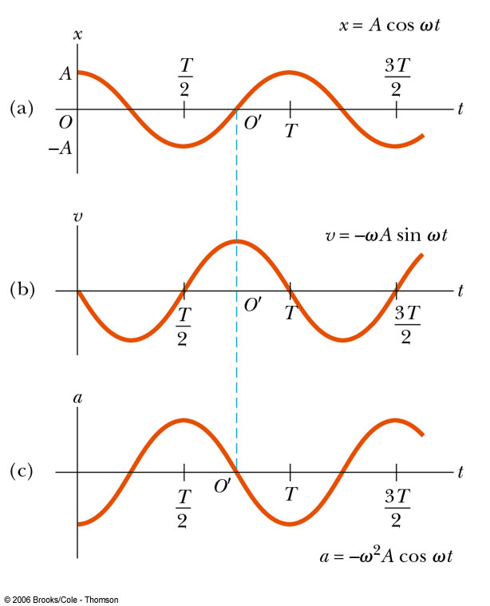


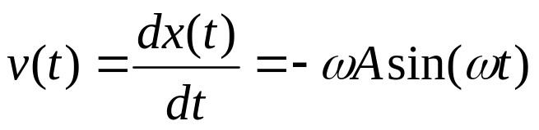
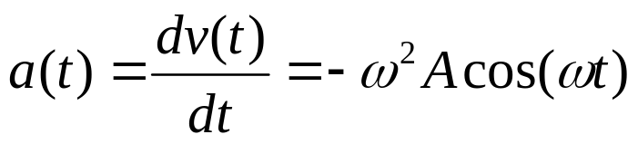
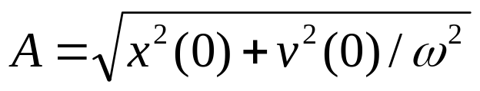
Simple harmonic motion
Displacement, velocity and acceleration in SHM
Displacement
Velocity
Acceleration
Note:

Slide 7
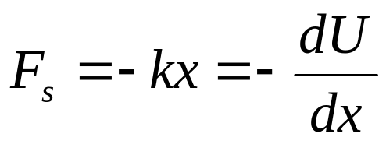

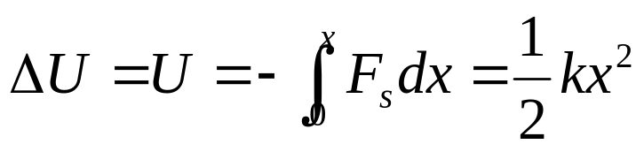
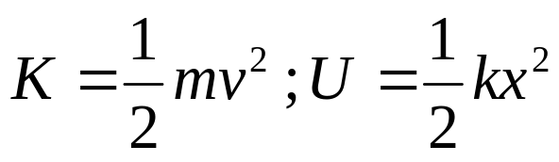
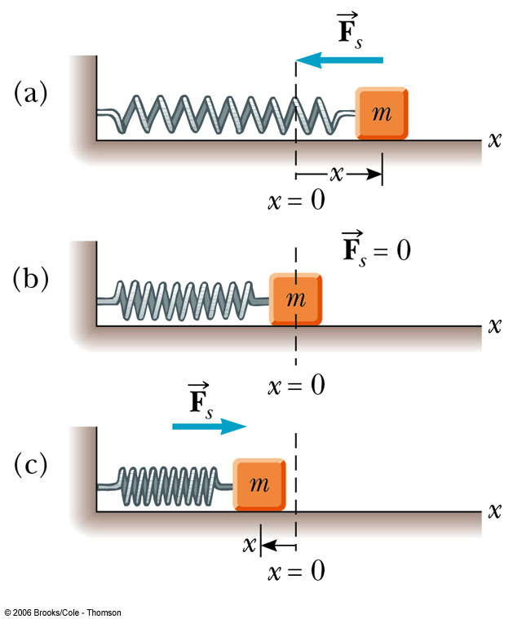
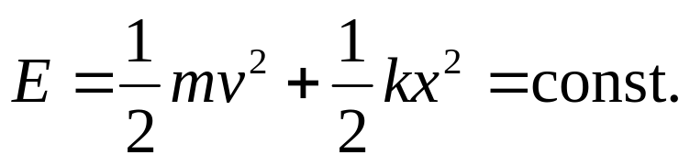
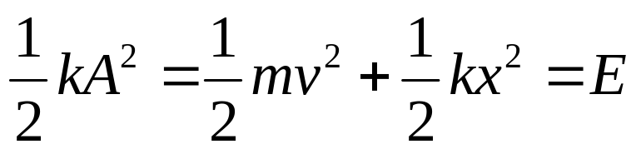
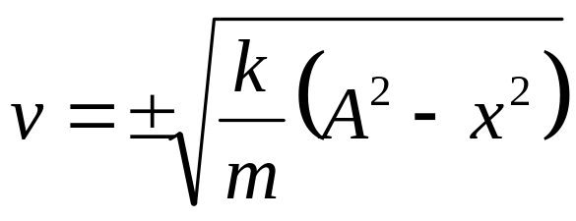
Energy in SHM
Energy conservation
Ch.7
Energy conservation in a SHM
No friction
BTW:
ω²

Slide 8
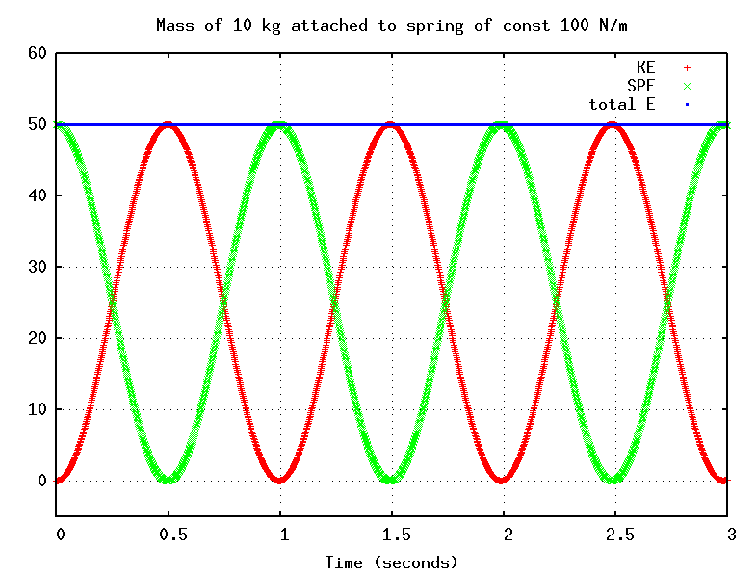
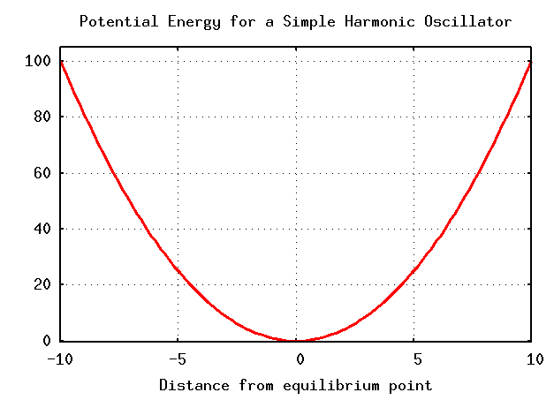
Energy in SHM
Energy conservation in a SHM (cont’d)
kinetic energy
E
energy
energy
distance from equilibrium point
Time
potential energy

Slide 9
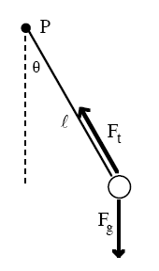
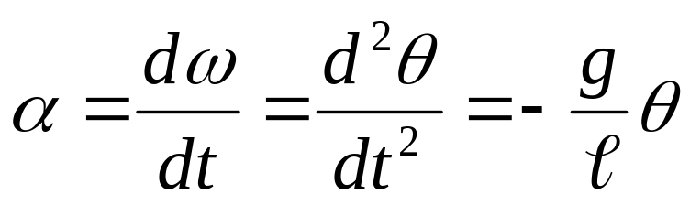
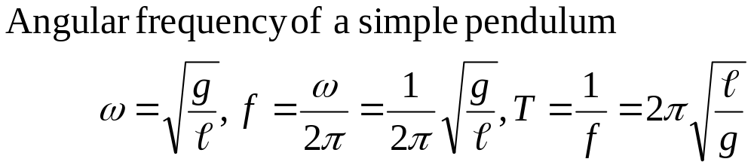
Applications of SHM
Simple pendulum
The forces on the mass at the end are
gravity and the tension. The tension, however,
exerts no torque about the top of the string.
mg

Slide 10
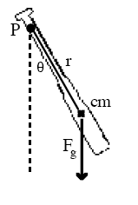
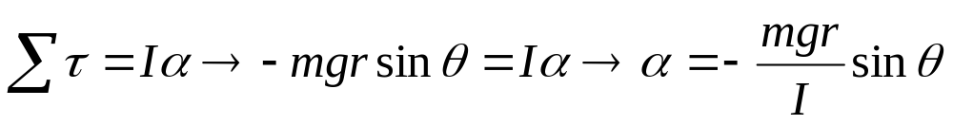
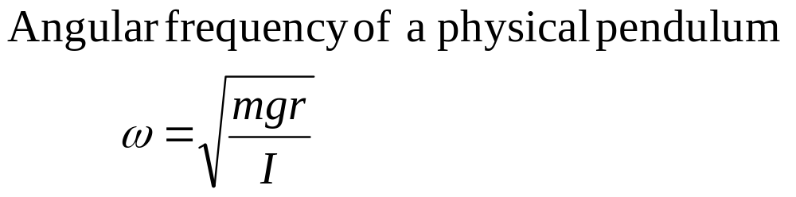
Applications of SHM
Physical pendulum
A simple pendulum has all its mass concentrated
at a point and oscillates due to gravitational torques.
Objects that do not have their mass concentrated at
a point also oscillate due to gravitational torques.

Slide 11
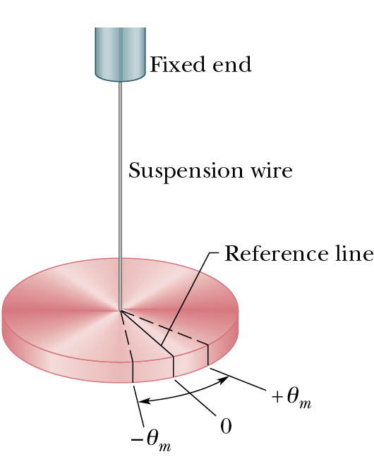
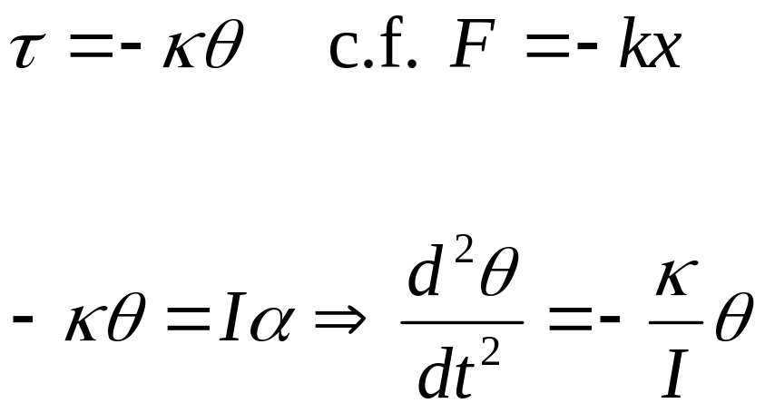
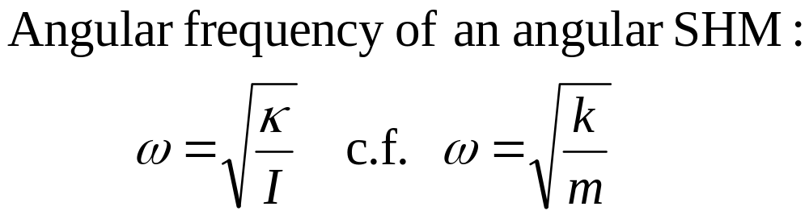
Applications of SHM
Angular SHM
An angular version of SHM is called torsion
oscillation and shown on the right.
A disk suspended by a wire experiences a
restoring torsion when rotated by a small
angle θ :
κ: torsion constant

Slide 12
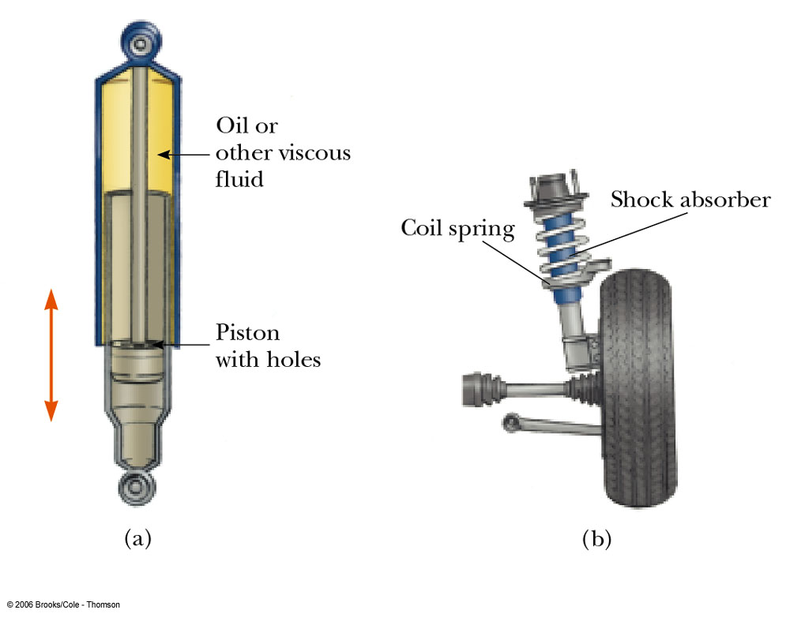
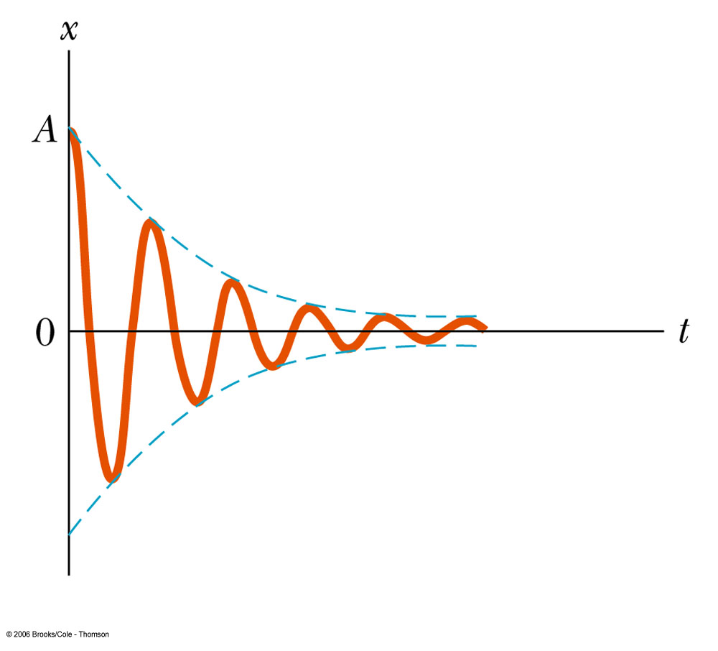
Damped oscillations
Oscillation with friction
In real world dissipative forces such as friction between a block and
a table exist. Such a dissipative force will decrease the amplitude of an
oscillation – damped oscillation.
The friction reduces the mechanical energy of the system as time
passes, and the motion is said to be damped.

Slide 13
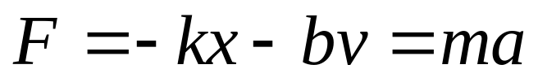
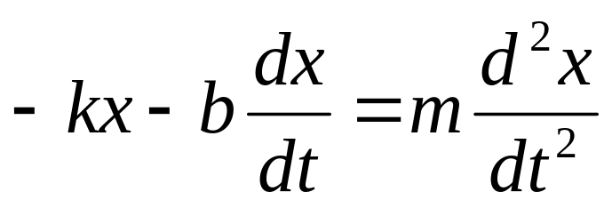
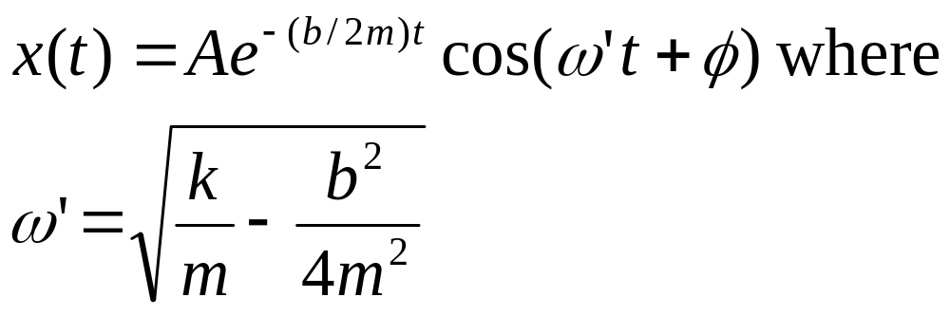
Damped oscillations
A simple example of damped oscillation
Consider a simple harmonic oscillation with a frictional damping
force that is directly proportional to the velocity of the oscillating
object.
If the damping force is relatively small, the motion is described by:

Slide 14
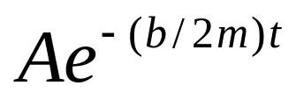
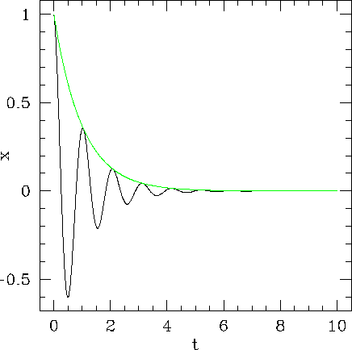
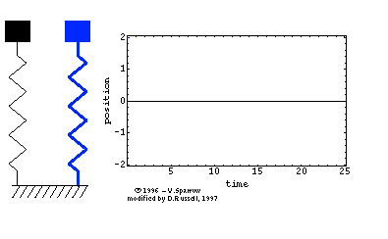
Damped oscillations (cont’d)
A simple example of damped oscillation
By Dr. Dan Russell, Kettering University

Slide 15
Forced oscillations and resonance
Driving force
An example of resonantly driven damped harmonic oscillator
Push
Wait 1 period

Slide 16
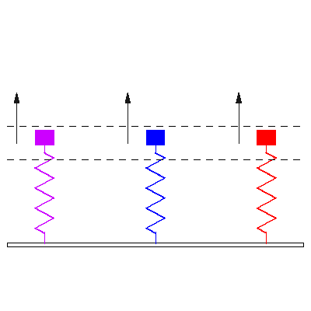
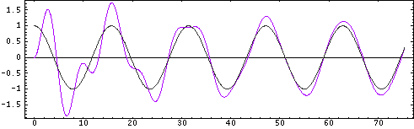
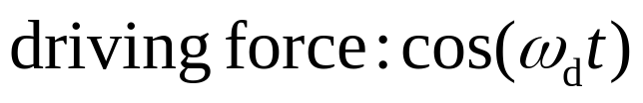
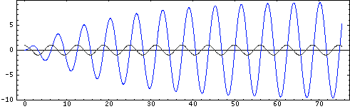

Forced oscillations and resonance
Driving force (cont’d)
The additional force that pushed by the person in the animation
on the previous page is called a driving force.
When a periodically varying driving force with angular frequency
ω_{d} is applied to a damped harmonic oscillator, the resulting motion
is called a forced oscillation.
ω_{d}=0.4ω
ω_{d}=1.01ω
ω_{d}=1.6ω
By Dr. Dan Russell, Kettering University

Slide 17



Forced oscillations and resonance
Forced oscillation and resonance
Damped SHM
Forced damped SHM
Fixed
Moving/driving force
natural frequency
Damped

Slide 18



Forced oscillations and resonance
Forced oscillation and resonance (cont’d)
Amplitude for a forced damped oscillation:
resonance:
The fact that there is
an amplitude peak at
driving frequencies close
to the natural frequency
of the system is called
resonance
A
angular freq. of driving force
natural frequency

Slide 19


Exercises
Problem 1
The speed of the pan and the steak
immediately after the collision (total
inelastic collision):
k=400 N/m
Initial speed of the meat just before the
collision:
Final speed of the meat-pan just after the
collision:
M=2.2 kg
h=0.40 m
m=0.20 kg

Slide 20



Exercises
Problem 1(cont’d)
b) The amplitude of the subsequent motion:
When the steak hits the pan, the pan is
Mg/k above the new equilibrium position.
k=400 N/m
So the amplitude is:
M=2.2 kg
h=0.40 m
m=0.20 kg
c) The period:

Slide 21



Exercises
Problem 2
k
Each:M/2, R
cylinders
rolls w/o
slipping
stretched by x
and then released
kx
α
f

Slide 22




Exercises
Problem 3
Two identical, thin rods, each with mass m
and length L, are joined at right angles to
form an L-shaped object. This object is
balanced on top of a sharp edge. If the L-
shaped object is deflected slightly, it oscillates.
Find the frequency of the oscillation.
L
L
Solution:
The moment of inertia about the pivot:
The center of gravity is located when balanced at a distance
below the pivot.
Think the L-shaped object as a physical
pendulum and is represented by the center
of gravity. The period T is:
L
L

Slide 23








Exercises
Problem 4
Find the effective spring constant.
F₁=-k₁x₁
F₂=-k₂x₂
F₁=-k₁x
F₂=-k₂x

