Slide 1

Report- Code Refactoring and Bug Fixing

Slide 2
About me
• My name is Deepakkumar G S I am a 3rd year B.TECH Student
• I want to pursue my carrier in data science
• LinkedIn- www.linkedin.com/in/deepak-kumar-gs
• GitHub- https://github.com/deepakgs135

Slide 3
Objective
The objective of this report is to conduct a comprehensive analysis of the provided Python and HTML code to identify and document any existing bugs, errors, or potential issues. The report aims to highlight areas of concern within the codebase and provide recommendations for resolution or improvement. Through examination and testing, the report will focus on identifying logical errors, syntax issues

Slide 4
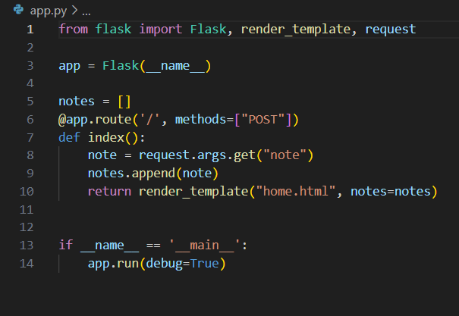
Python code with bugs

Slide 5
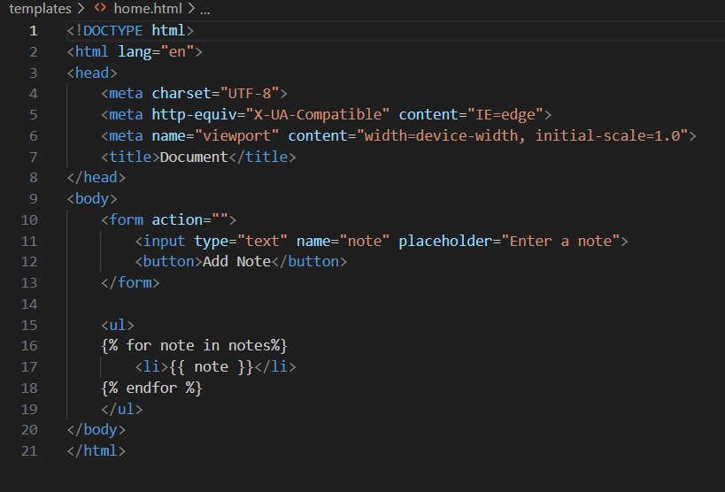
Html code with bugs

Slide 6
Bugs in html code
1. Bug: The form action is an empty string (`action=""`).
Explanation:The HTML form's action attribute is present, it is set to an empty string, which doesn't specify where the form data should be submitted. There is issues in the routing of form submissions.
2.Missing of POST method in form tag
Explanation :the Flask route expects the form to submit data to `'/'` through a `POST` request. This can cause a mismatch between the form submission and the route handling it.

Slide 7
Bugs in python code
1. Bug: Incorrect method used to access form data.
Explanation: In the Flask route `index()`, the code tries to retrieve form data using `request.args.get("note")`. As this is incorrect for `POST` requests. Instead, `request.form.get("note")` should be used to access form data.
2. Bug: There is same route for get and post request this creates confusion of routing.

Slide 8
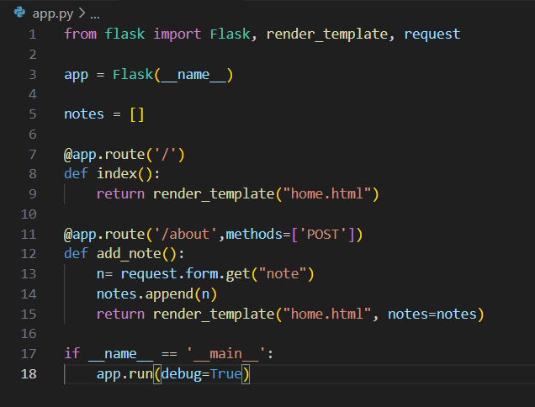
Corrected Python code

Slide 9
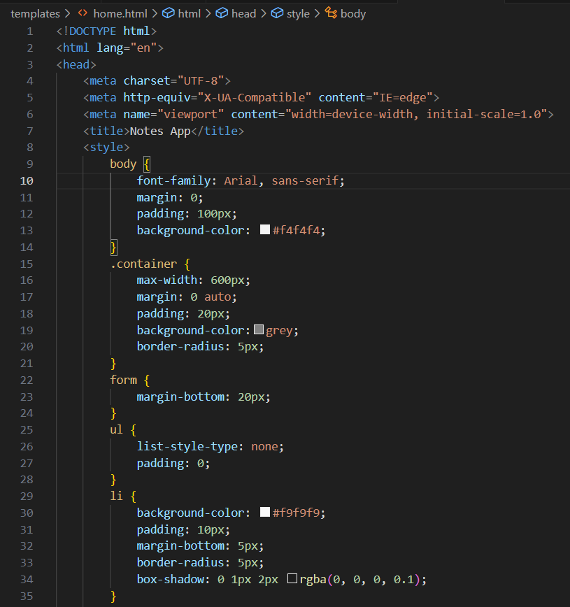
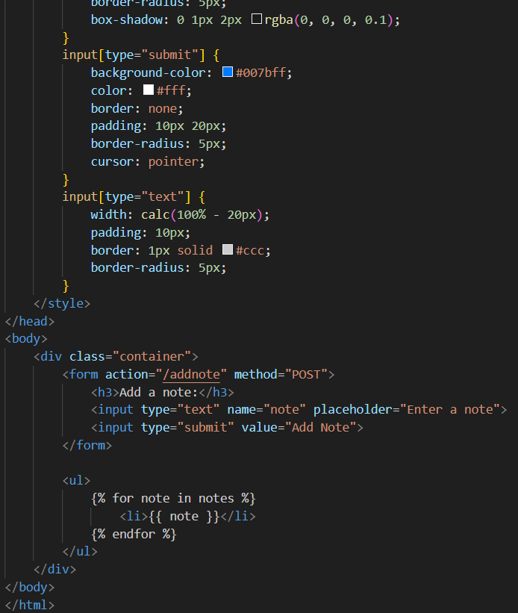
Corrected Html code

Slide 10
Solutions of bugs
I defined a separate route `/about` for handling the `POST` request to add notes. As This makes code organsized by making separate routes
I used `request.form.get("note")` to access the form data in the `add_note()` function. This ensures that you retrieve the value of the `note` input field from the form submitted via `POST`.
In the `add_note()` function I append the note to the `notes` list and then render the `home.html` template with the updated `notes` list.

Slide 11
I kept the existing `/` route for rendering the `home.html` template initially.
I also applied some Inline CSS to make the Notemaking application better
Conclusion
This code is now working correctly, allowing users to add notes via the form and displaying the notes on the home page.

Slide 12
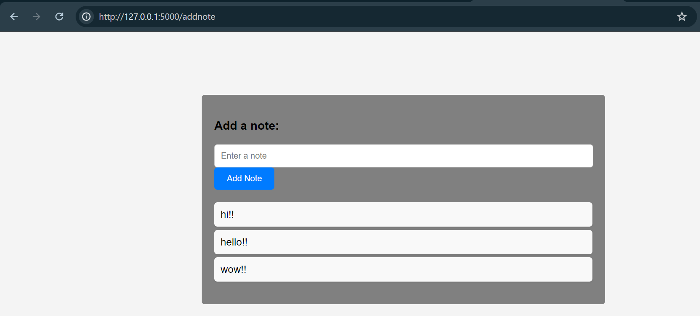

Slide 13

THANK YOU

