Slide 1
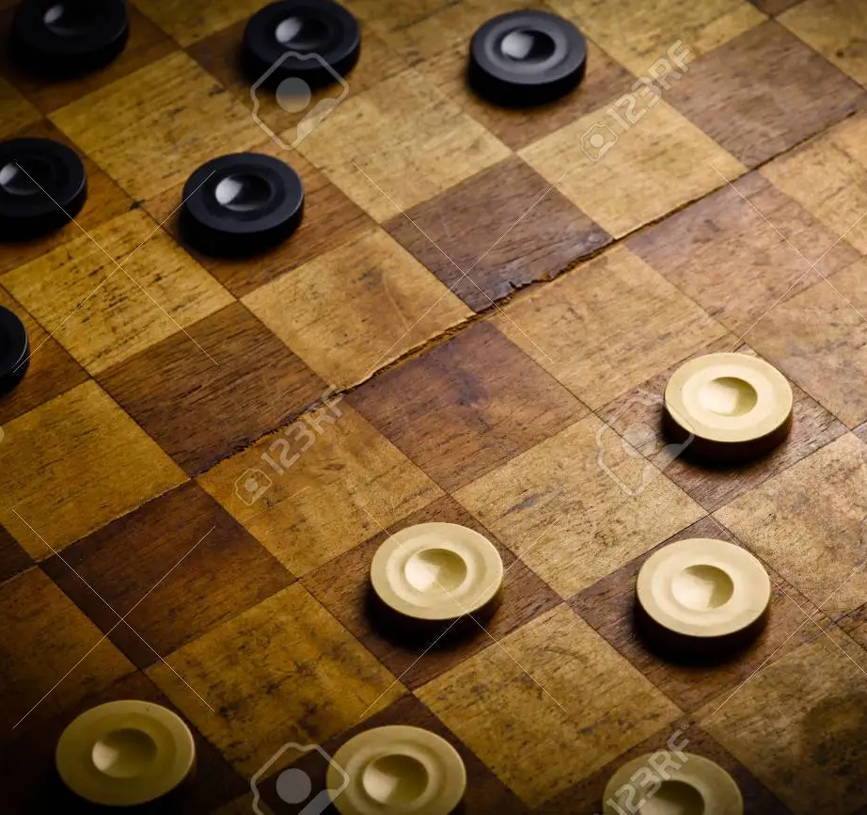
Project Demonstration : Draught game implementation in C
Prepared By : Karthick Srinivas

Slide 2

Agenda :
1.) Introduction of the team members.
2.) Analysis and explanation of the objective and the problem statement.
3.) Live demonstration of the game feature using preset demo boards.
4.) Explanation of the additional features added by the programmers which were not a part of the original problem statement.
5.) Statement of the contributions of each team member.

Slide 3

Segment 1 : Team Introduction

Slide 4
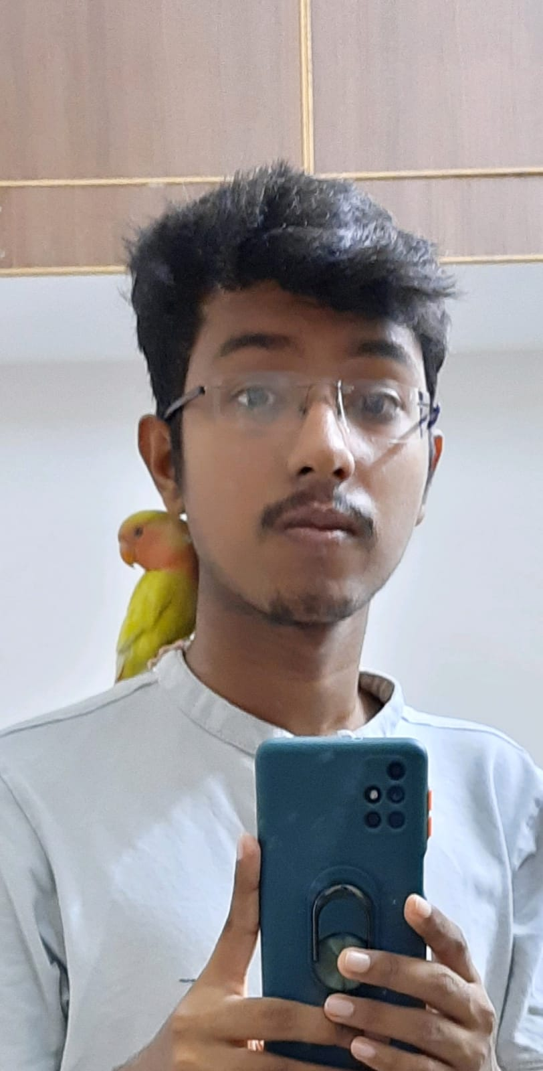
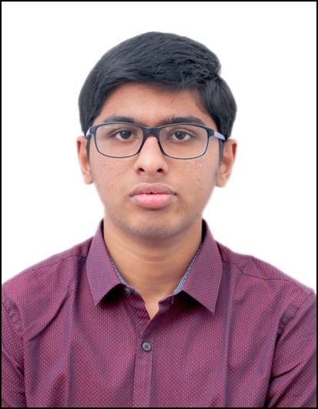
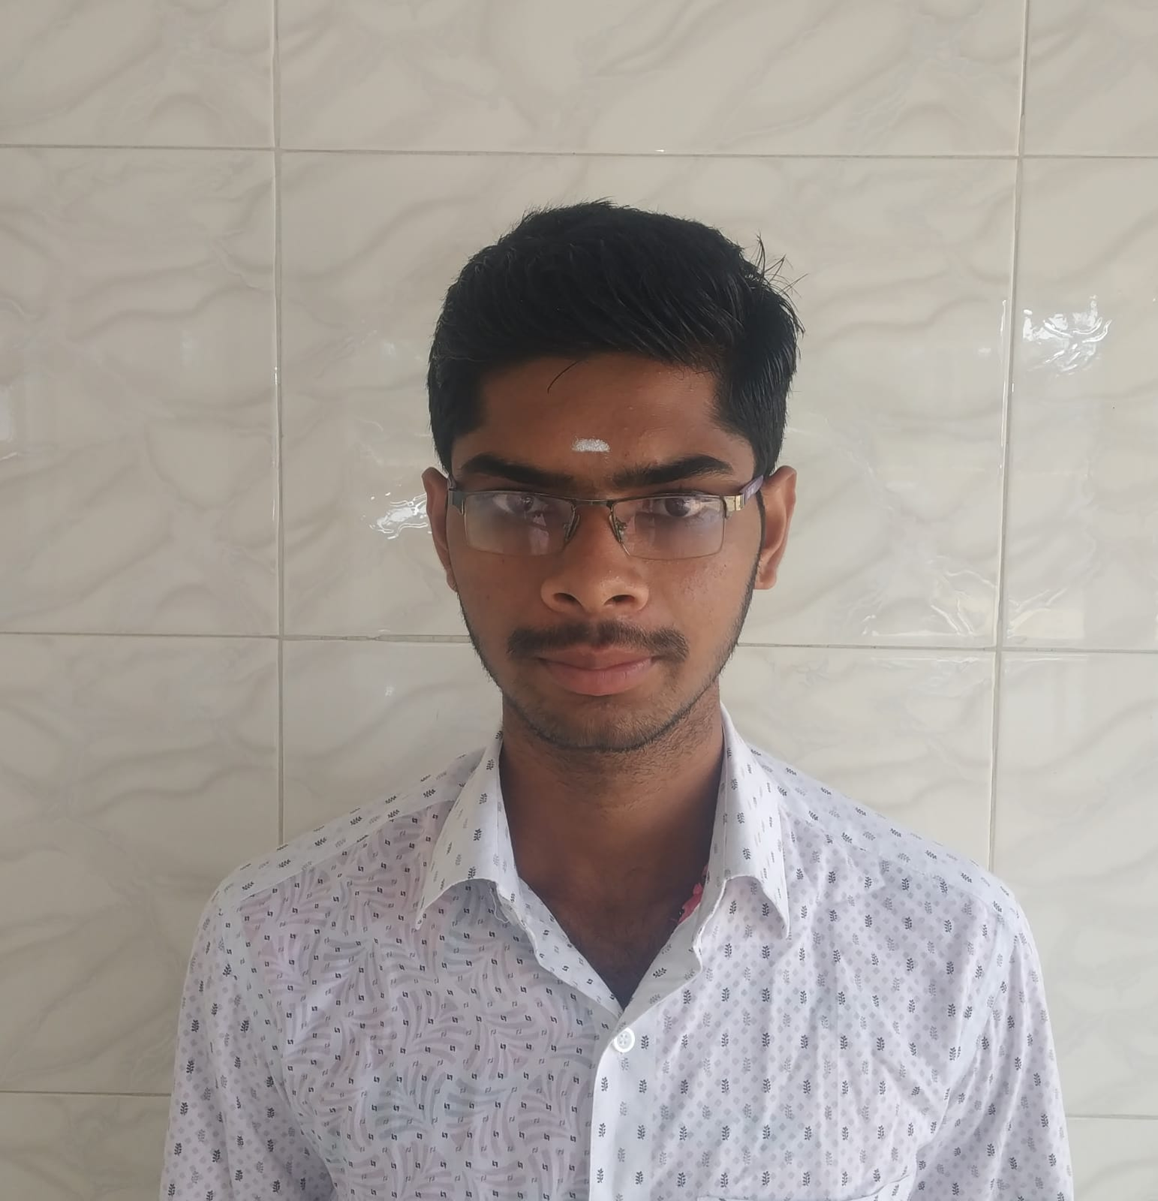
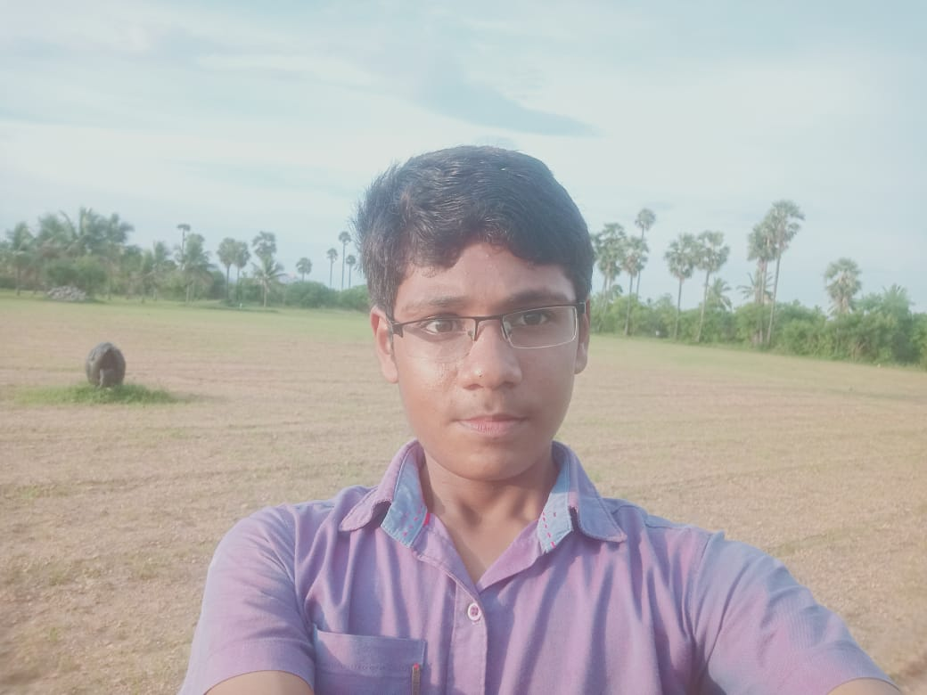
Team :
Bala Saatvik
Karthick Srinivas
(Lead.)
Deepak Kumar
Kavin T

Slide 5
Segment 2 : Objective & Problem statement Analysis

Slide 6
Objective of the Assignment:
Practical implementation of Core “C” Concepts like :
- Arrays (1-D & 2-D)
- Functions (Returning type & void)
- Control statements (Conditionals , Iteration statements etc.)
- Pointers
- File Handling
- String Handling etc.

Slide 7
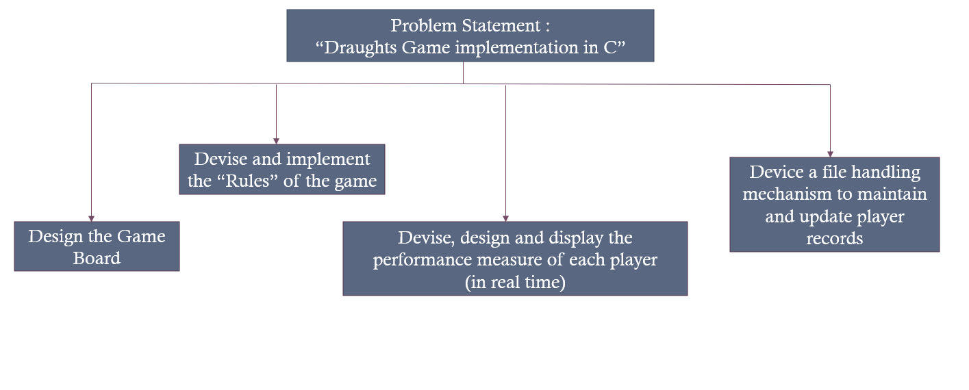
Problem statement breakdown

Slide 8
Other General Requirements :
1.) Conform to the Procedural Programming Paradigm.
2.) The input/output process must be carried out through the command prompt window.
3.) No Pre-set Program structure – The designing of the program structure was left to the team members.
4.) Preparation of the required documentation using MS Word and the addition of comments / testing data in the main program.

Slide 9
Segment 3 : live demonstration of game features.

Slide 10
Segment 4 : Explanation of Additional Features.

Slide 11
Additional Features :
1.) Board Architecture used as reference to devise a co-ordinate system which is used as a basis for movement of checkers.
Eg : X axis : a to h & Y axis : 1 to 8
2.) System validation for wrong inputs and invalid moves.
Eg : Direction of checker movement, Co-ordinates entered by the user is out of bounds etc.
3.) Tracking and generation of game numbers.
4.) Displaying all the rules of the Checkers game at the start of play.

Slide 12
Segment 5 : Statement of contributions.

Slide 13
Bala Saatvik :
Core Contribution : helped to develop the procedures which involved the display of the checkerboard and movement of the Draught coins.
Other contribution : Authored the Project Report.

Slide 14
Karthick Srinivas :
Core Contribution : helped to develop the procedures which involved movement and capturing of the Draught coins.
Other contribution : Added comments to the final version of the program which will enhance the readability of the program. Also Proof read and applied editing and formatting wherever required in the project report and brief.

Slide 15
Deepak kumar :
Core Contribution : helped to develop the system of storing and updating the player records and the file handling system.
Other contribution : Authored the Project Brief

Slide 16
Kavin T :
Core Contribution : Helped to develop the algorithms and logic for the development of all the major procedures, also Contributed to Testing and bug fixing of methods and other code.
Other Contributions : Constructed the Pseudo Code

Slide 17
The End !

