Slide 1
SMARTBRIDGE HACKATHON
Team Name : TECHNICAL IMMORTALS
S.NAVEEN KUMAR
M.ROHITH REDDY
G.DEEPAK
E.RAVI TEJA

Slide 2
PREDICTION OF ALCOHOL CONSUMPTION
Alcohol Consumption means the amount of alcohol consumed per year with respect to unemployment and tax rate. A systematic search for international guidelines for measuring alcohol consumption in population surveys was undertaken. The common core recommendations for alcohol consumption measures and survey instruments were identified.

Slide 3
MULTIPLE LINEAR REGRESSION :
Regression is a statistical measure that attempts to determine the strength of the relationship between one dependent variable usually denoted by Y and a series of other changing variables known as independent variables. Regression model which contain more than two predictor variables are called Multiple Regression Model.
Multiple regression model is of the form: Y=b0+b1x1 +b2x2 +b3x3+ b4x4+...e where, b0,b1,b2,b3,b4 are regression coefficient e is unexplained portion of dependent variable with zero mean and constant variance.
Multiple regression fits a model to predict a dependent (Y) variable from two or more independent (X) variables.

Slide 4
DATA COLLECTION :
Data has been collected through administrative data Alcohol consumption data from national surveys are essential for epidemiological and public health research purposes, and existing international guidelines are broadly consistent in their recommendations for how alcohol consumption should be measured in these surveys.This an effective data collection method for key consumption outcome measures when compared with alternative alcohol consumption data collection methods.

Slide 5
DATA PREPROCESSING:
Step1: Import libraries and dataset. Import the important libraries and the dataset we are using to perform MultiLinear Regression.
Step2: Check for datatype and null values.
Step 3: Dividing the dataset into 2 components. Divide dataset into two components that is X and y. X will contain the Column between 0 and 5. y will contain the 6 column.(i.e (:,-1:)).
Step 4: Fitting MultiLinear Regression to the dataset.Fitting the Multilinear Regression model on two components X and y.
Step 5: Calculate the r2_score.

Slide 6
CONCLUSION :
In conclusion, future surveys should aim to use methodologies that reduce their inherent biases, but should also strive to retain consistency of core indicators of alcohol epidemiology that are essential for monitoring public health and evaluating alcohol control policies and other interventions.

Slide 7
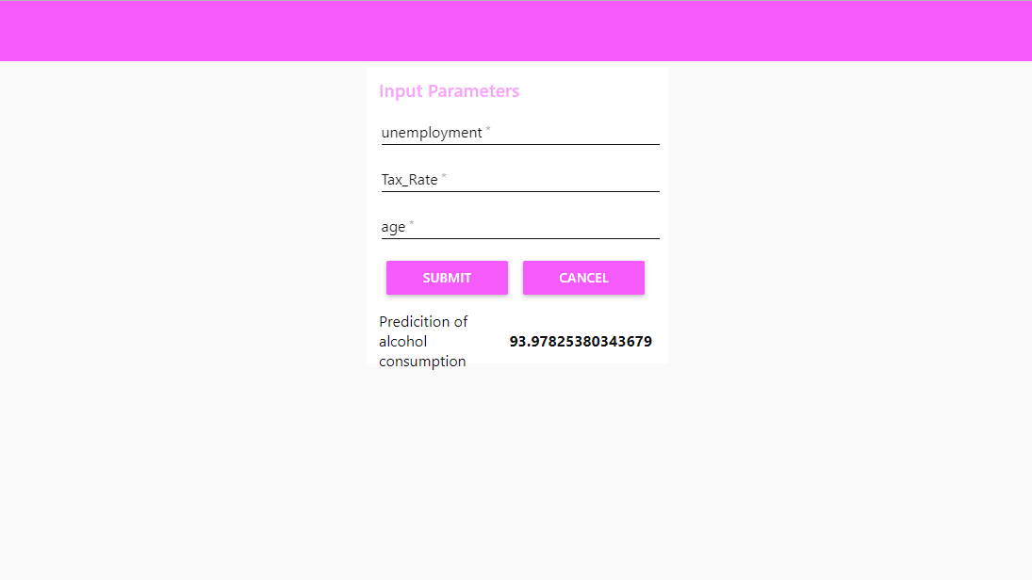
User Interface :

