Slide 1
Parallelizing CitationKNN on GPU
Deepak Gupta (dgupta22@ncsu.edu)
Shawn Shadrix (shshadri@ncsu.edu)
Github link: https://github.ncsu.edu/dgupta22/citationKNN_GPU
(shared with htseng3 and zqiu2)

Slide 2
What is Citation KNN
Citation KNN is a lazy learning algorithm which tries to classify a bag of instances by using labelled bags of instances.
CitationKNN is one of the most popular algorithms for solving multiple-instance learning (MIL) problems

Slide 3
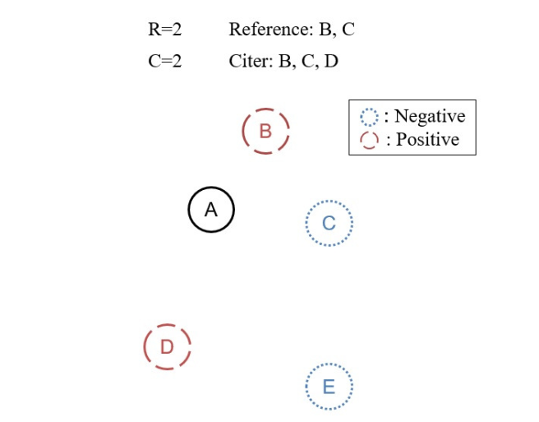
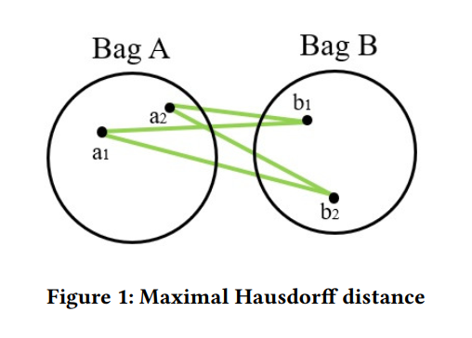
What is Citation KNN

Slide 4
Why Citation KNN
Citation KNN is popular due to its
Effectiveness
Usability
E.g.
Used for solving musky molecule prediction task
Used for image classification
Examining medical images to find tumors
Web mining
Spam detection
Remote sensing
Stock selection
Usability and Data Intensive calculations makes CitationKNN a suitable candidate for parallization

Slide 5
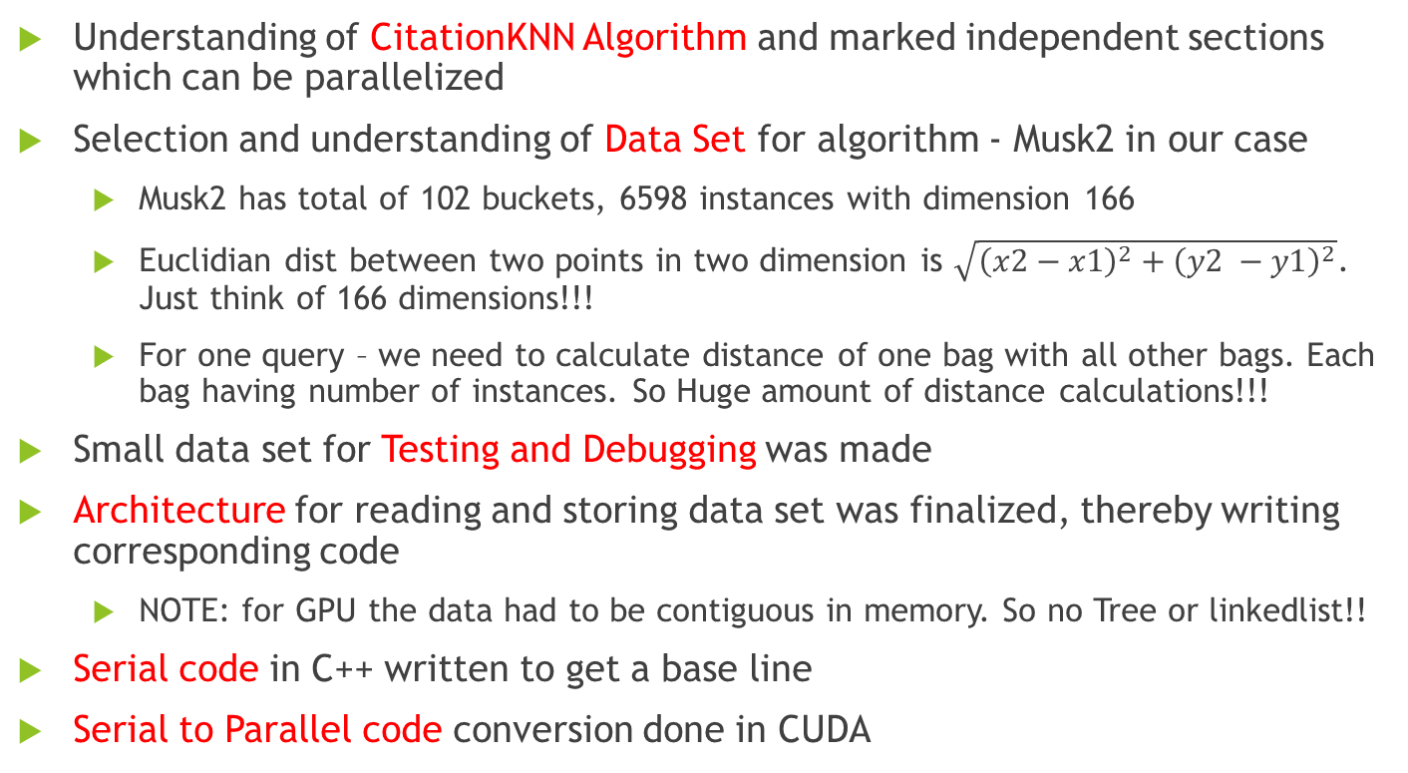
Solution Approach
Understanding of CitationKNN Algorithm and marked independent sections which can be parallelized
Selection and understanding of Data Set for algorithm - Musk2 in our case
Musk2 has total of 102 buckets, 6598 instances with dimension 166
Euclidian dist between two points in two dimension is $\sqrt{{\left(x2−x1\right)}^{2}+{\left(y2 −y1\right)}^{2}}$. Just think of 166 dimensions!!!
For one query – we need to calculate distance of one bag with all other bags. Each bag having number of instances. So Huge amount of distance calculations!!!
Small data set for Testing and Debugging was made
Architecture for reading and storing data set was finalized, thereby writing corresponding code
NOTE: for GPU the data had to be contiguous in memory. So no Tree or linkedlist!!
Serial code in C++ written to get a base line
Serial to Parallel code conversion done in CUDA

Slide 6
Results
For Musk2 data
Serial code took 4 min 33 sec to finish
On GTX 1080 it took 6 sec
Speedup of 45.5x
Accuracy of both serial and parallel implementation is same (matches accuracy given in original citationKNN paper).

Slide 7
Execution time Ver 1 to Last version
Execution time of Ver1 on GPU = 18 min
Execution time of final version on GPU = 6 sec
HOW??

Slide 8
Learning 1 – Breakdown the task
Initially launched 102*102 threads. Each thread was to do heavy computation – especially Euclidian distance calculations
Later launched two kernels
One for calculating Euclidian distances – block dim (207*207) and each block with 1024 threads
Other for calculating bucket distances with 102*102 threads

Slide 9
Learning 2 – No redundant calculations
For bucket size of 102*102 distance[i][j] = distance[j][i]
Ealier each thread was calculating distance
Later returned from thread calculating distance[j][i] and copied it from thread calculating distance[i][j].
int i = blockIdx.x;
int j = threadIdx.x;
if(i > j)
return;

Slide 10
Learning 3 – Less access to global memory
for(int x = bucketLocArr[i]; x<bucketLocArr[i]+bucketSizeArr[i]; x++)
Vs
int x_start = bucketLocArr[i];
int x_end = bucketLocArr[i]+bucketSizeArr[i];
for(int x = x_start ; x<x_end; x++)

Slide 11

Notes:
Source: https://www.pinterest.com/pin/305400418455388551/?lp=true

