Slide 1

ME710-Vibration course project
Vibration Signal Analysis of Beard Trimmer
Under the supervision of : Prof. V Karthik
Deepak Kumar Thakur (213101001)
Yogesh S Sale (213100061)

Slide 2

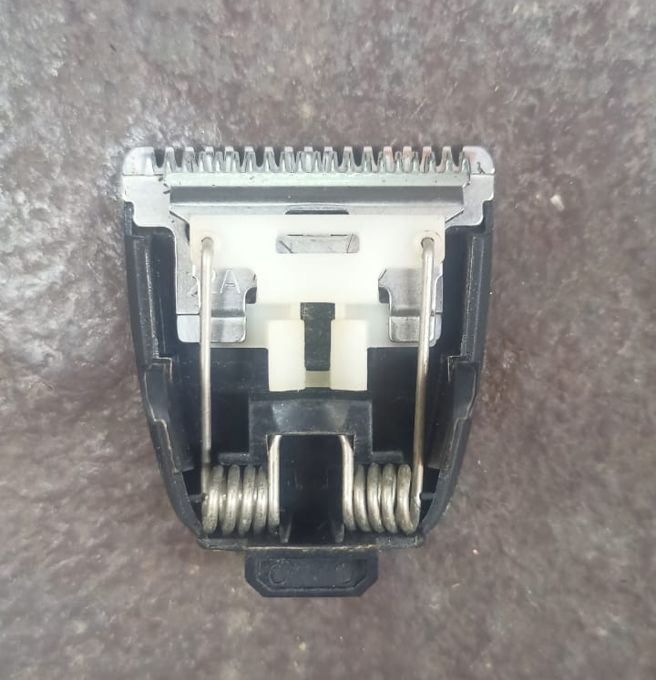
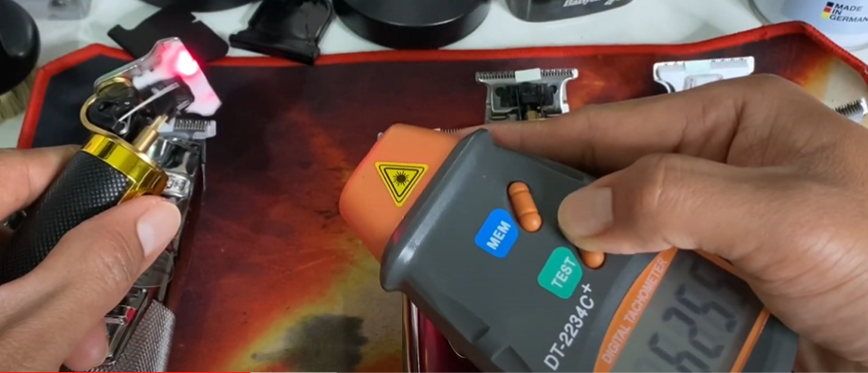
Introduction
In beard trimmer, movable blade oscillate at a quick pace with the help of DC motor.
When the movable and stationary blades overlap each other, trimming effect takes place and hairs are pinched off the skin.
Average RPM of beard trimmers varies from 5000 to 8000.
Measuring rpm of trimmer using tachometer [1 ]
Trimmer internal parts
Trimmer movable blades

Slide 3
Data acquisition
Setup:
Mobile phone was mounted on a horizontal table with the help of double sided tape in such a way that the screen faces the ceiling (Z axis).
Trimmer attached to a mobile phone with the help of double tape.
Movable blade adjusted in such a way that it oscillates along Z axis of mobile phone.

Slide 4
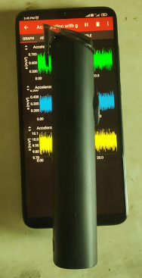
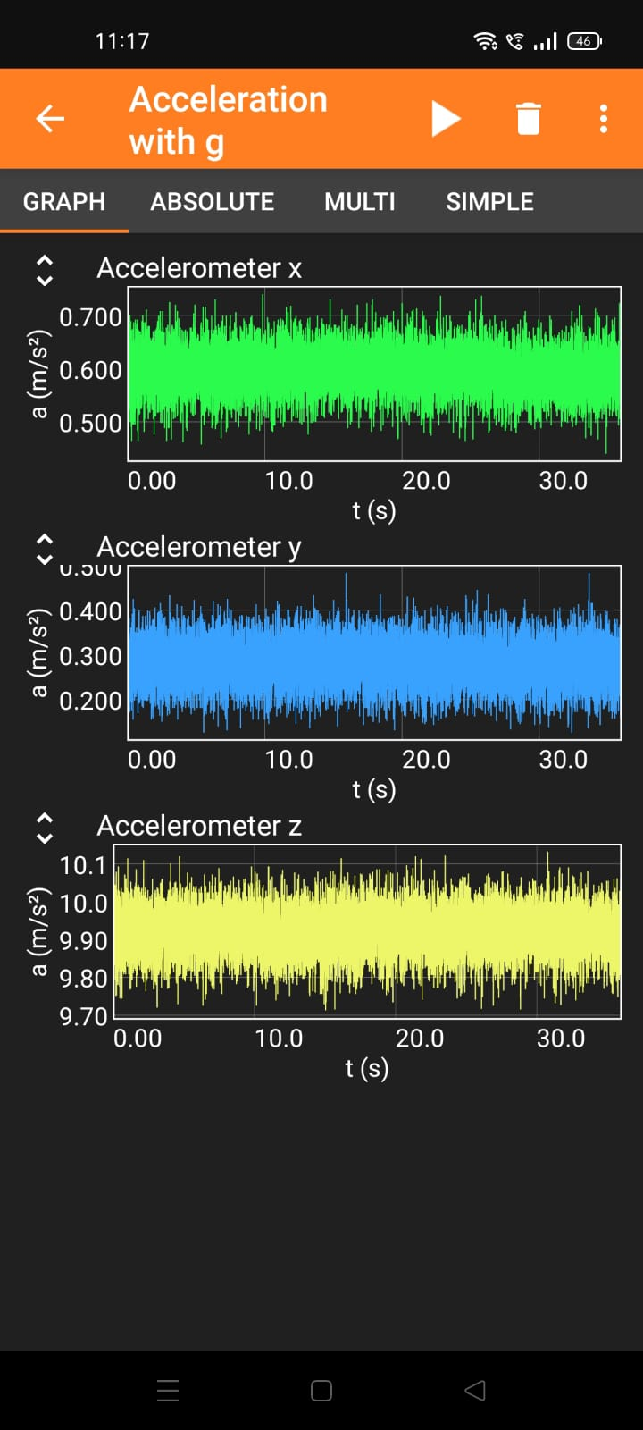
Data acquisition
Y axis
X axis
Acceleration along X axis
Z axis (Out of screen)
Acceleration along Y axis
Trimmer
Acceleration along Z axis
Table

Slide 5
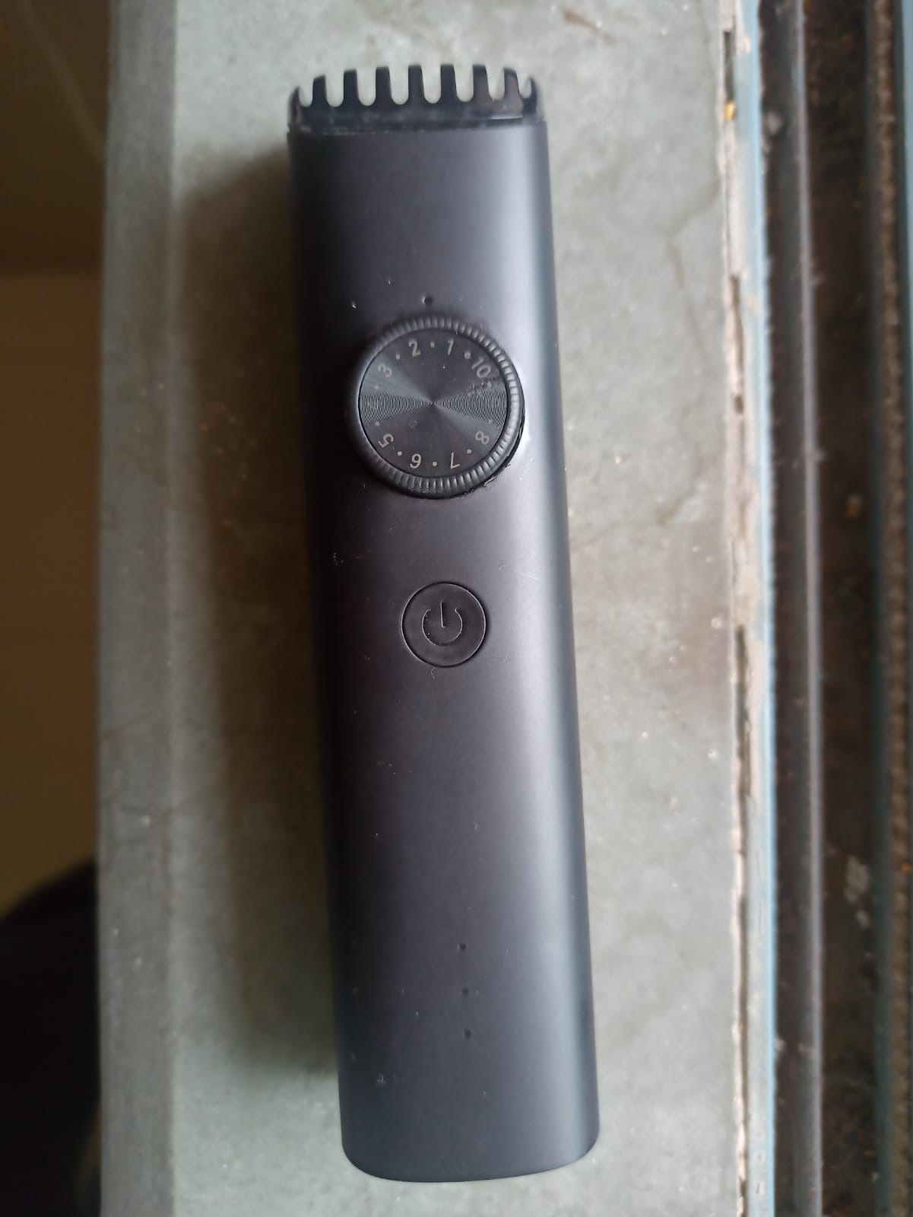
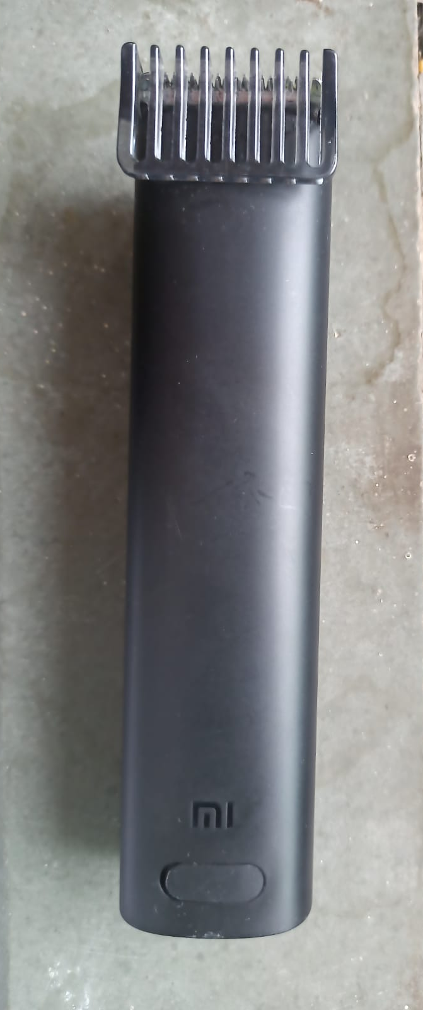
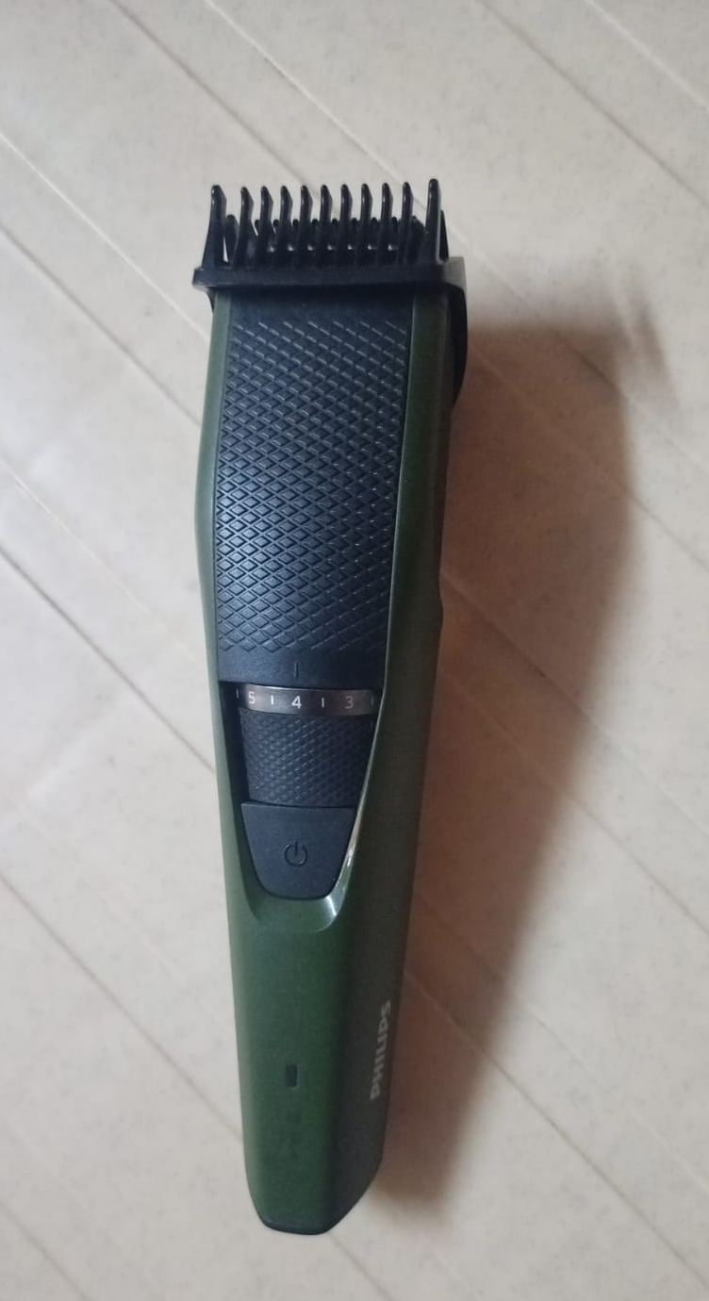
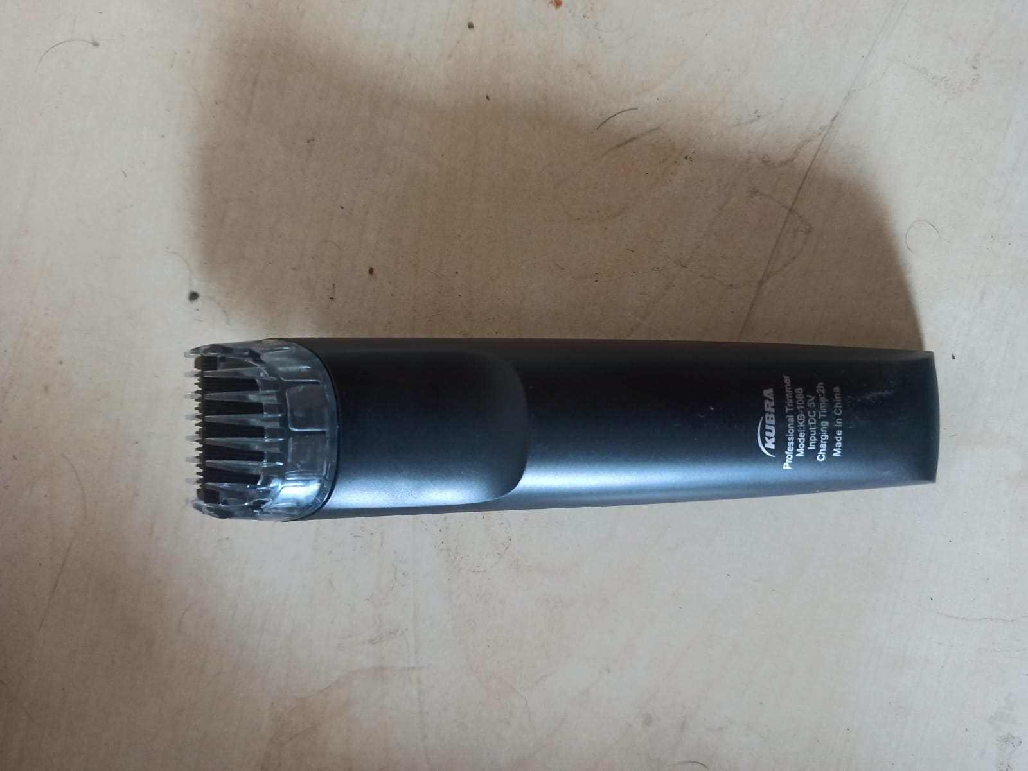
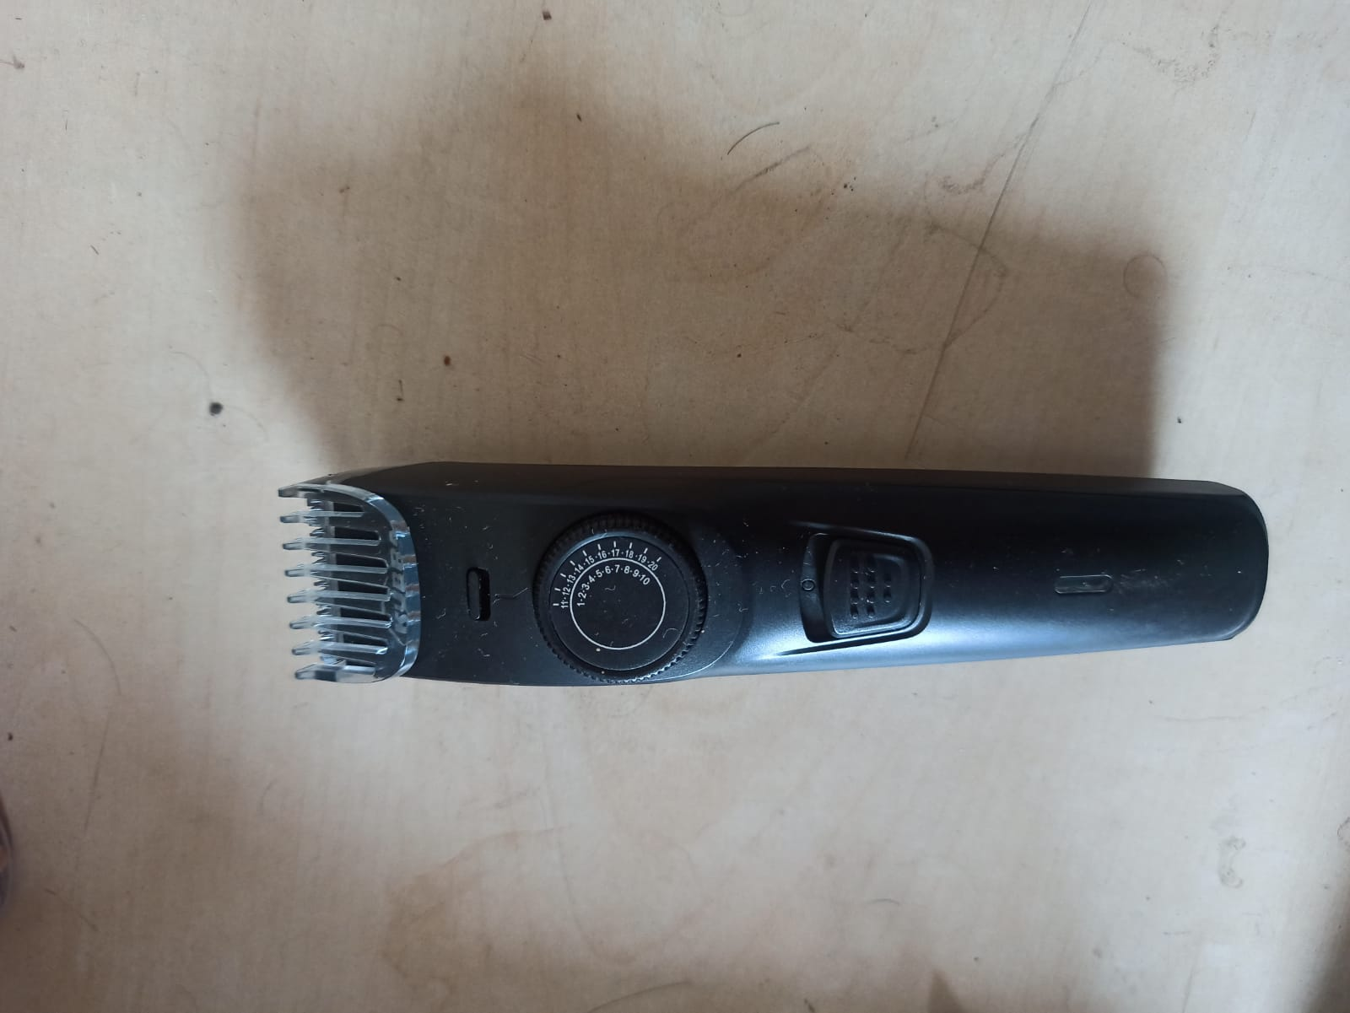
Trimmers
Trimmer 1 (Front and Back)
Trimmer 2 (Front)
Trimmer 3 (Front and Back)

Slide 6
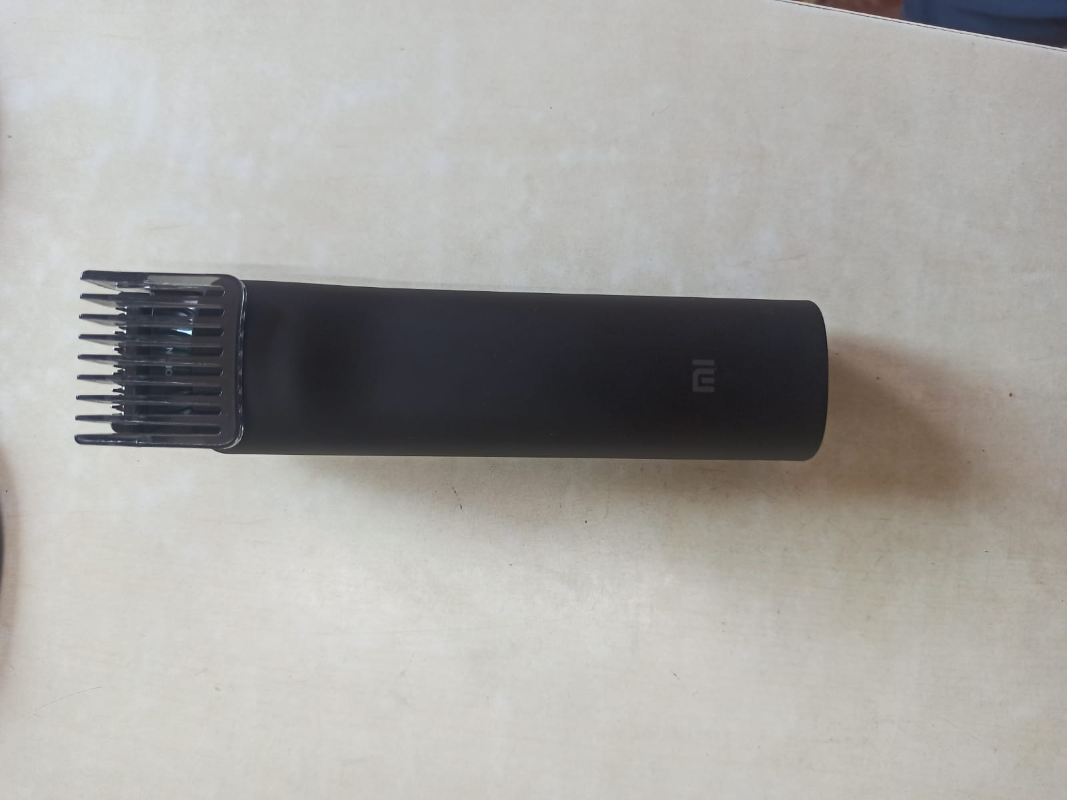
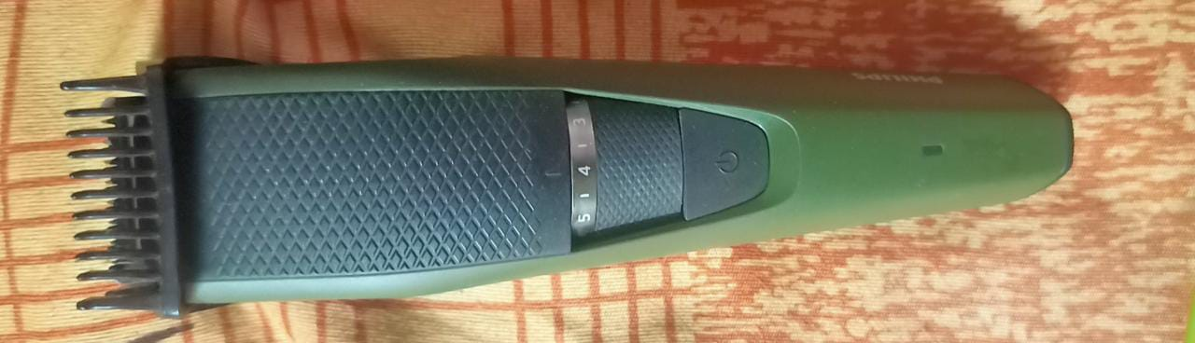
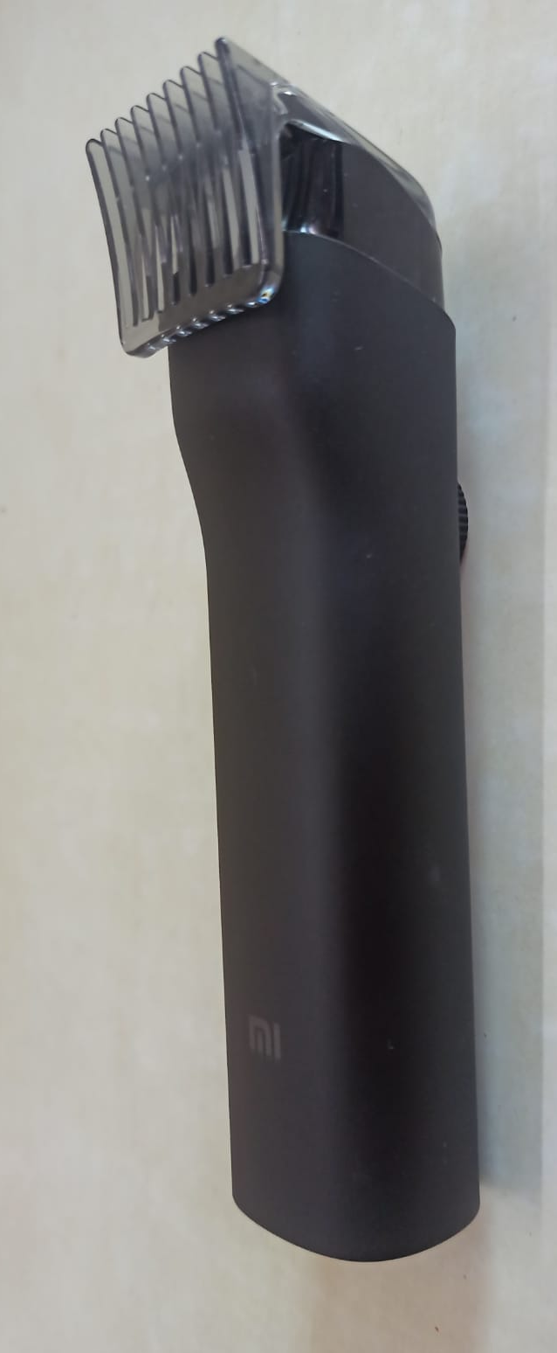
Trimmers
Trimmer 4 (Front and Iso)
Trimmer 5 (Front )

Slide 7
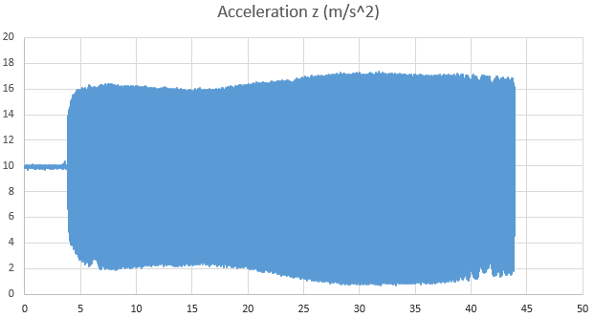
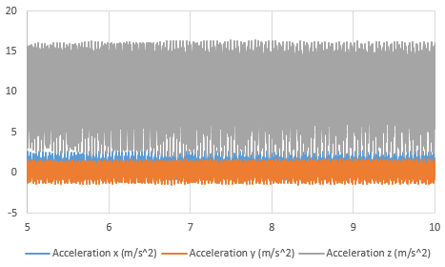
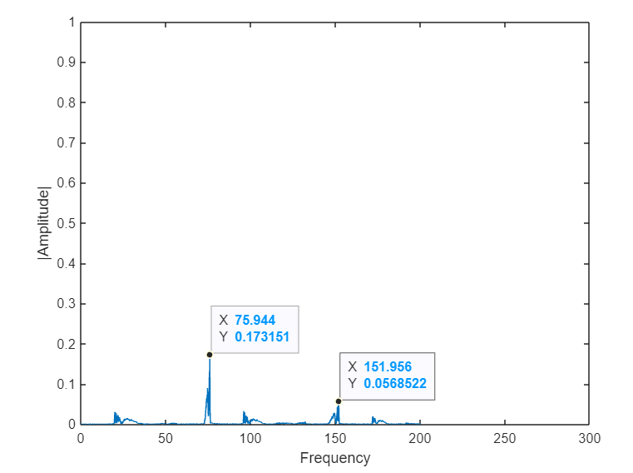
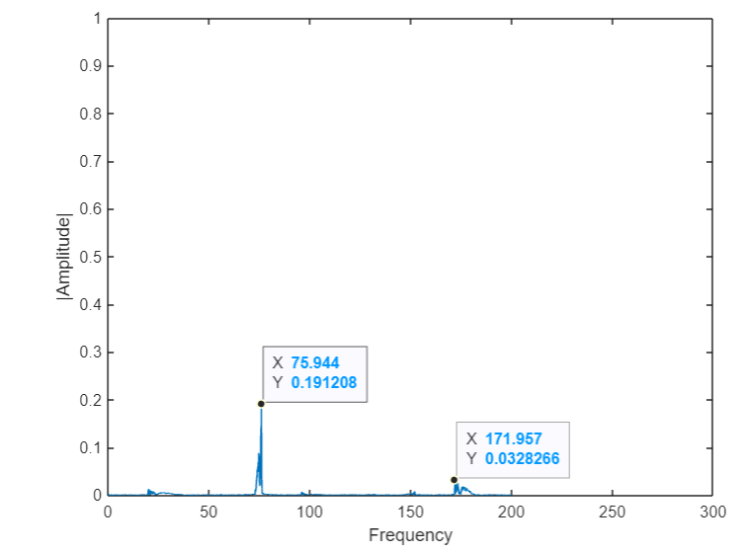
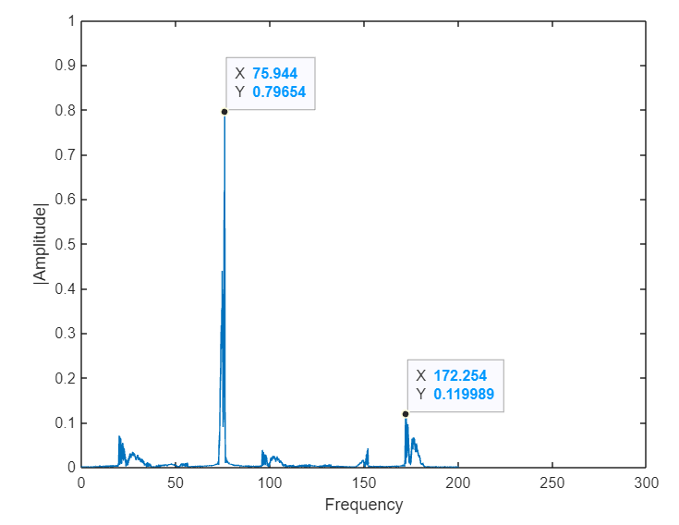
Time and Frequency domain analysis (Trimmer 1)
Zoomed view of acceleration in x, y and z axis

Slide 8
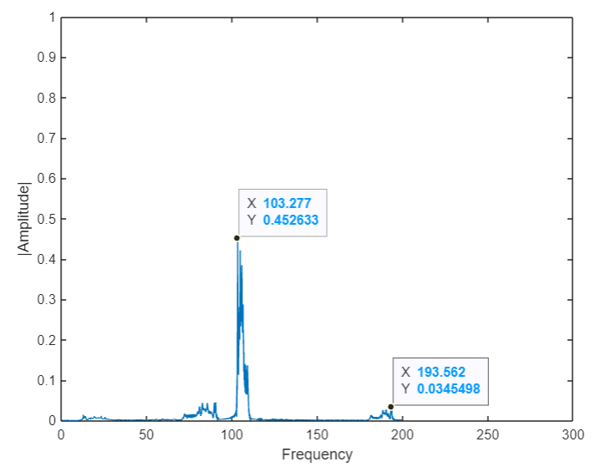
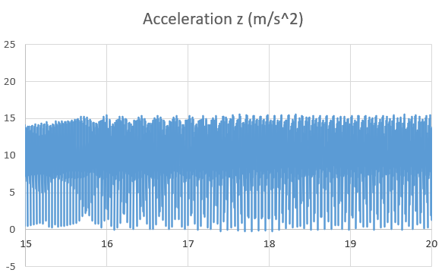
Time and Frequency domain analysis (Trimmer 2)

Slide 9
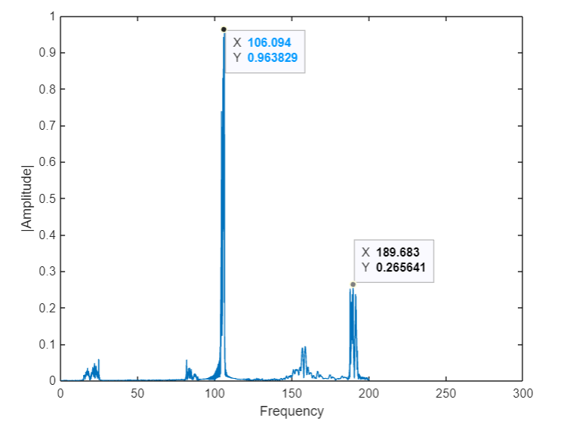
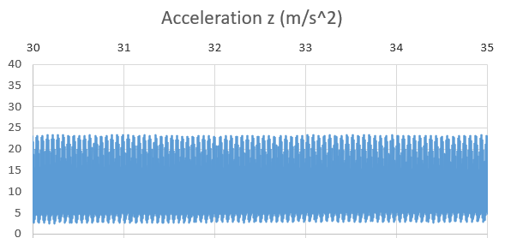
Time and Frequency domain analysis (Trimmer 3)

Slide 10
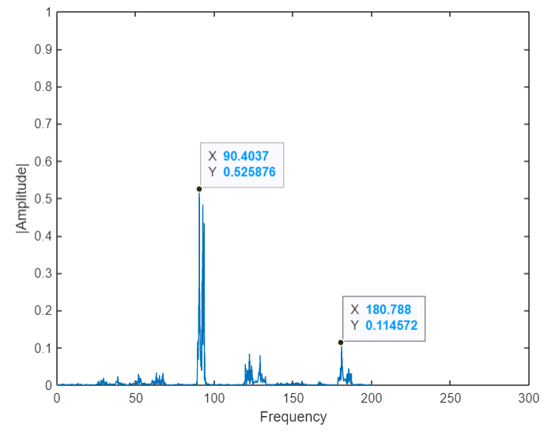
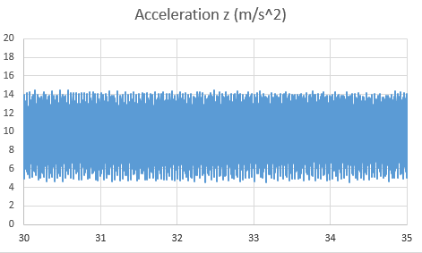
Time and Frequency domain analysis (Trimmer 4)

Slide 11
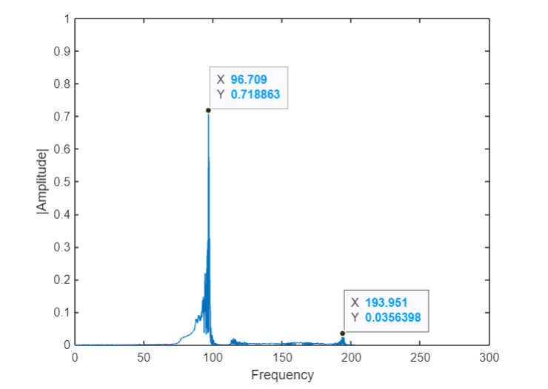
Time and Frequency domain analysis (Trimmer 5)

Slide 12
Observations
Trimmer no. | Age (days) | Obtained frequency (Approx) | RPM (approx) | RPM range from company
Trimmer 1 | 189 | 75.9 | 4554 | 5000 series
Trimmer 2 | 399 | 103.3 | 6200 | 7000 series (1)
Trimmer 3 | 211 | 106.1 | 6366 | 7000 series (2)
Trimmer 4 | 466 | 90.4 | 5424 | 6000 series
Trimmer 5 | 1313 | 96.7 | 5802 | 7000 series (1)

Slide 13
Insights and conclusion
Peak amplitude of trimmer 3 is significantly higher in spite of lower age among all the trimmers. It may be because of poor built quality.
Trimmer 1 and 4 belong to the same company under different series which can be seen in the observation table.
Trimmer 2 and 5 have same specifications and belong to the same company under same rpm series.
Age difference between the two is large.
It is found that trimmer 5 has significant drop in rpm count compare to trimmer 2
Also, peak amplitude of trimmer 5 is large compare to trimmer 2. This may be because the age of trimmer 5 is much larger than trimmer 2.

Slide 14
Thank you
Please find us at:
213101001@iitb.ac.in 213100061@iitb.ac.in
Reference:
[1] https://www.youtube.com/watch?v=bNX8gk52k24&t=148s

