Slide 1
ME735 CGPM GROUP PROJECT ON – Graphical representation of shortest travel path in the given layout between two locations UNDER GUIDANCE OF PROF. DR. SANJAY S. Pande
Galla Rama Srinivas (213104014)
Deepak Kumar Thakur (213101001)
Thirumalasetty Sravan Sai Kumar (213100053)
Yogesh Shrikant Sale (213100061)
Bijay Kumar Shah (213101002)

Slide 2
Abstract:
In this Project, we are defining a 2D layout with obstacles and defined pathways and we are working on finding an optimized path to cover the distance between the user defined starting and final destination points in a path where distance travelled is the minimum of all the possible paths between the two said points. The shortest (optimized) path is generated using Dijkstra’s Algorithm with Python as the coding software.

Slide 3
Objective, Deliverables and Software used:
Objective:
Generate a 2D based layout and find optimized path on the layout to move from one location to other in the shortest path and interpret the same graphically.
Deliverable:
Graphical work to replicate the layout (in 2D)/2D simulator-based layout generation.
Optimization algorithm to move from one point to other in shortest or best path.
Merging Graphical part with Optimization.
Programming Languages used:
Python (libraries used: NumPy, matplotlib)

Slide 4
ALGORITHM/METHODOLOGY:
Generate a fixed 2D layout image of size 20X20 pixels. Layout can be modified as needed to a size of N X N pixels.
Allocate a value of “0” to the obstacles and “1” to the pathways.
Identify nodes in the image of the layout.
Note: Nodes are the intersections of the pathways present in the layout.
Rearrange the nodes in ascending order and record the distances between the nodes in a L X L matrix (L=Number of nodes) as an adjacency list.
Convert adjacency list to Dictionary list for the implementation of Dijkstra’s algorithm.
Adjust the dictionary list to provide input to Dijkstra’s algorithm as a graph with vertices defined.

Slide 5


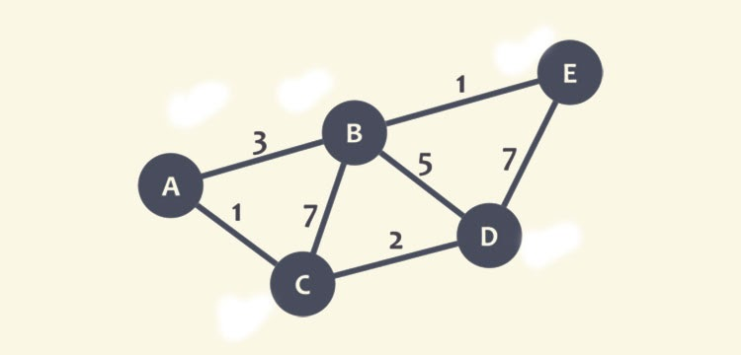

Slide 6
7. Dijkstra’s Algorithm – taken from Stack overflow.
Input start and end vertices for starting and ending points of the path respectively. We can also randomize the input for starting and end vertices.
Call Dijkstra’s algorithm to compute the optimized path and print out the node vertices along the optimized path.
10. Invert the Y-axis of the layout for plotting the optimized path using Matplotlib, as the layout has inverted Y axis and we would like to locate origin on bottom-left part of the layout.
Covert nodes to points on the layout for Graphical representation.
Plot an animated path from starting to end point on the layout.
Algorithm/
Methodology

Slide 7
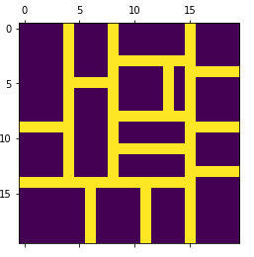
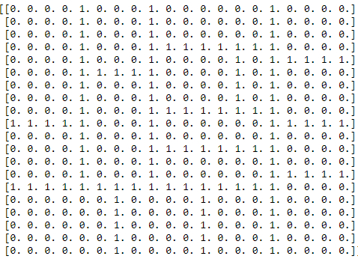
Layout Generation and mapping:
Layout Generated
Layout Mapped 1-Pathways & 0-Obstacles

Slide 8
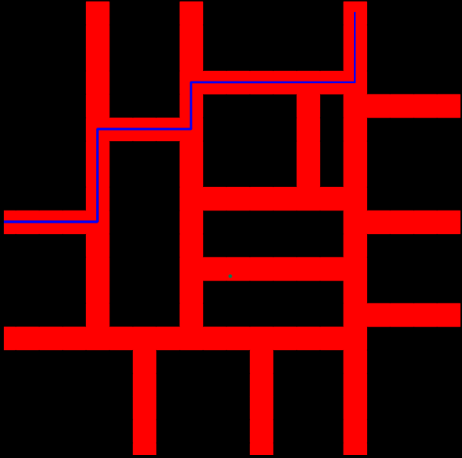
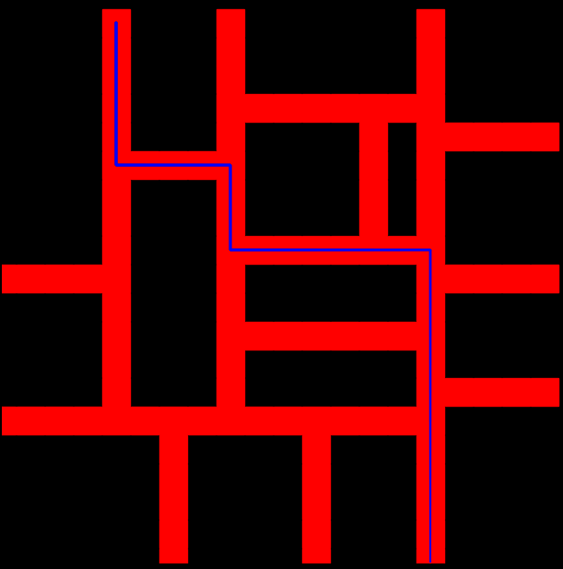
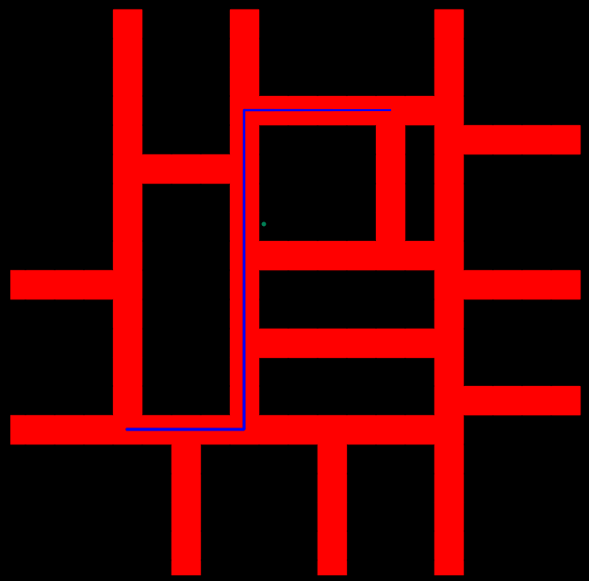
Plot of the optimized path:
Starting node: 13
End node: 2
Starting node: 0
End node: 29
Starting node: 22
End node: 4

Slide 9
Other options explored:
Interactive Design of Using pygame,
Library used:
pygame, math, queue
Main points:
1. Get a start point with left mouse button click
2. Get a end point with left mouse button click
3. Create blockage by using mouse
4. Process starts on pressing ‘S’ key from keyboard
5. Restarts the process with ‘N’ key from keyboard

Slide 10
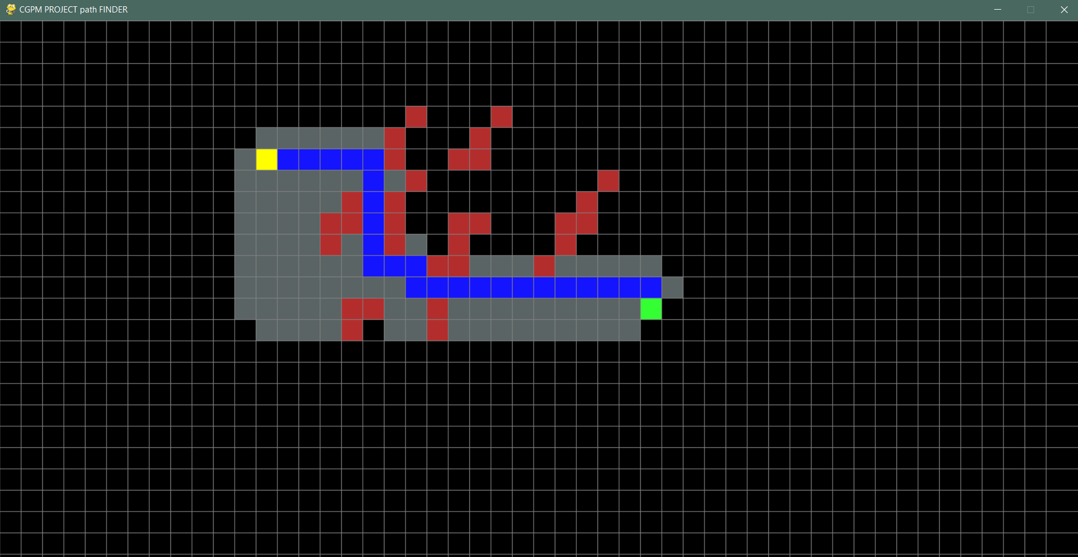

Slide 11
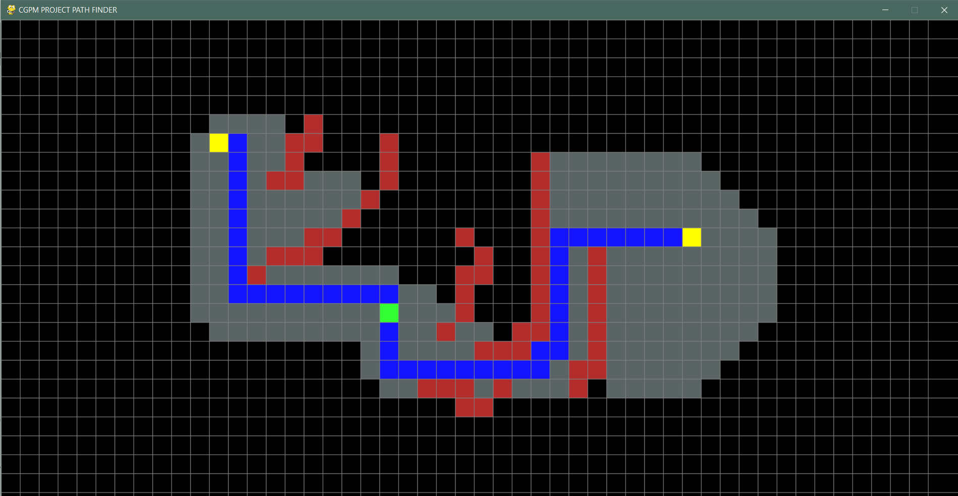
Future Work:

Slide 12
Results and Conclusion:
Successfully generated a layout and the shortest path between 2 nodes in the layout using Dijkstra’s algorithm.
Plotted the layout and optimized path graphically as the output of the Algorithm.
As declared in the objective, we were successfully able to Generate a 2D based layout and find optimized path on the layout to move from one location to other in the shortest path and interpret the same graphically.

Slide 13
References:
Dijkstra’s Algorithm: https://stackoverflow.com/questions/22897209/dijkstras-algorithm-in-python/61078380#61078380
Dijkstra’s Algorithm - Wikipedia: https://en.wikipedia.org/wiki/Dijkstra%27s_algorithm

