Slide 1
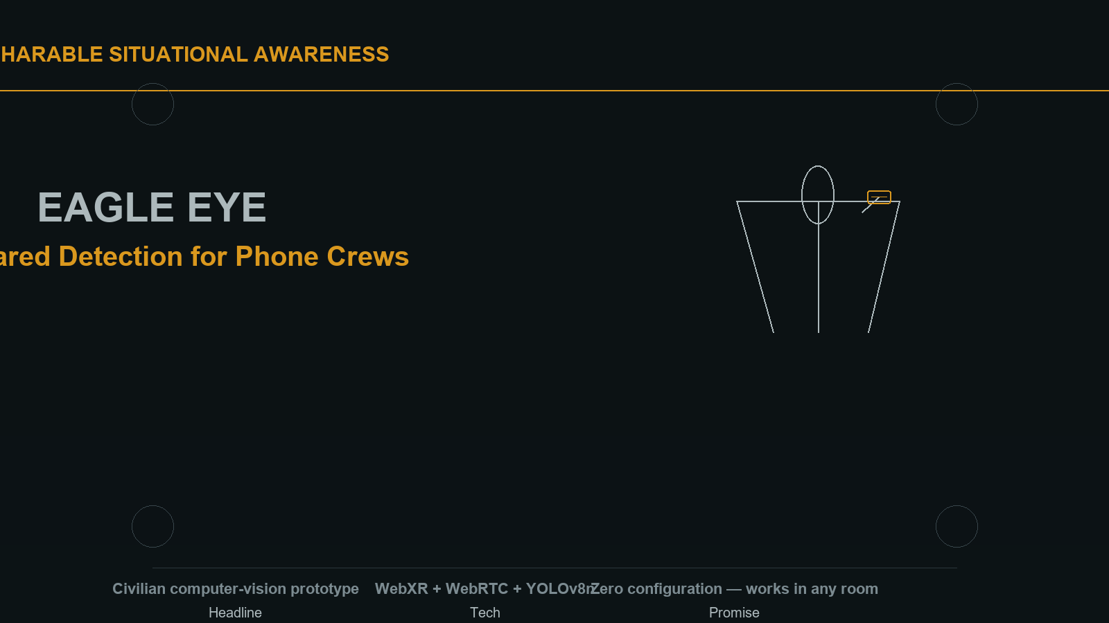
CREW-SHARABLE SITUATIONAL AWARENESS · CIVILIAN COMPUTER VISION
EAGLE EYE
Live Shared Detection for Phone Crews
WebXR + WebRTC + YOLOv8n · Zero configuration — works in any room
01 / 08

Slide 2
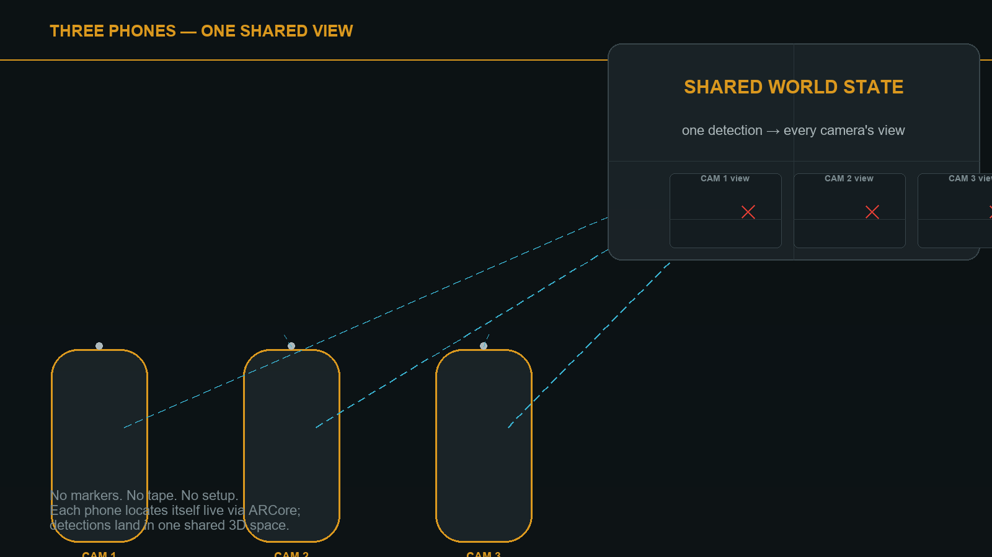
THE IDEA
THREE PHONES — ONE SHARED VIEW
Each phone streams its view and its live ARCore location to one server. When a person is spotted, every other screen shows a red X at their real 3D position — even through a wall.
02 / 08

Slide 3
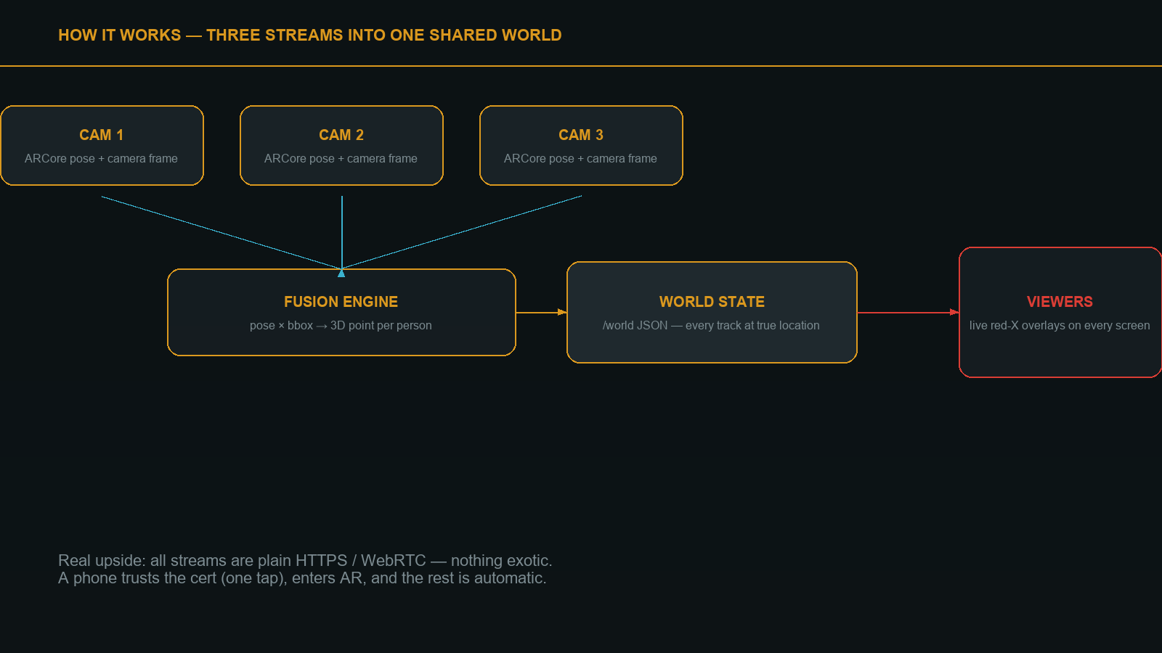
PROCESS
HOW IT WORKS
Three plain streams — ARCore pose, camera frame, video — converge in a fusion engine that turns each detection into one real 3D point, then broadcasts it to every viewer. Nothing exotic: HTTPS, WebRTC, a WebSocket. A phone trusts the cert (one tap), enters AR, and it just works.
03 / 08

Slide 4
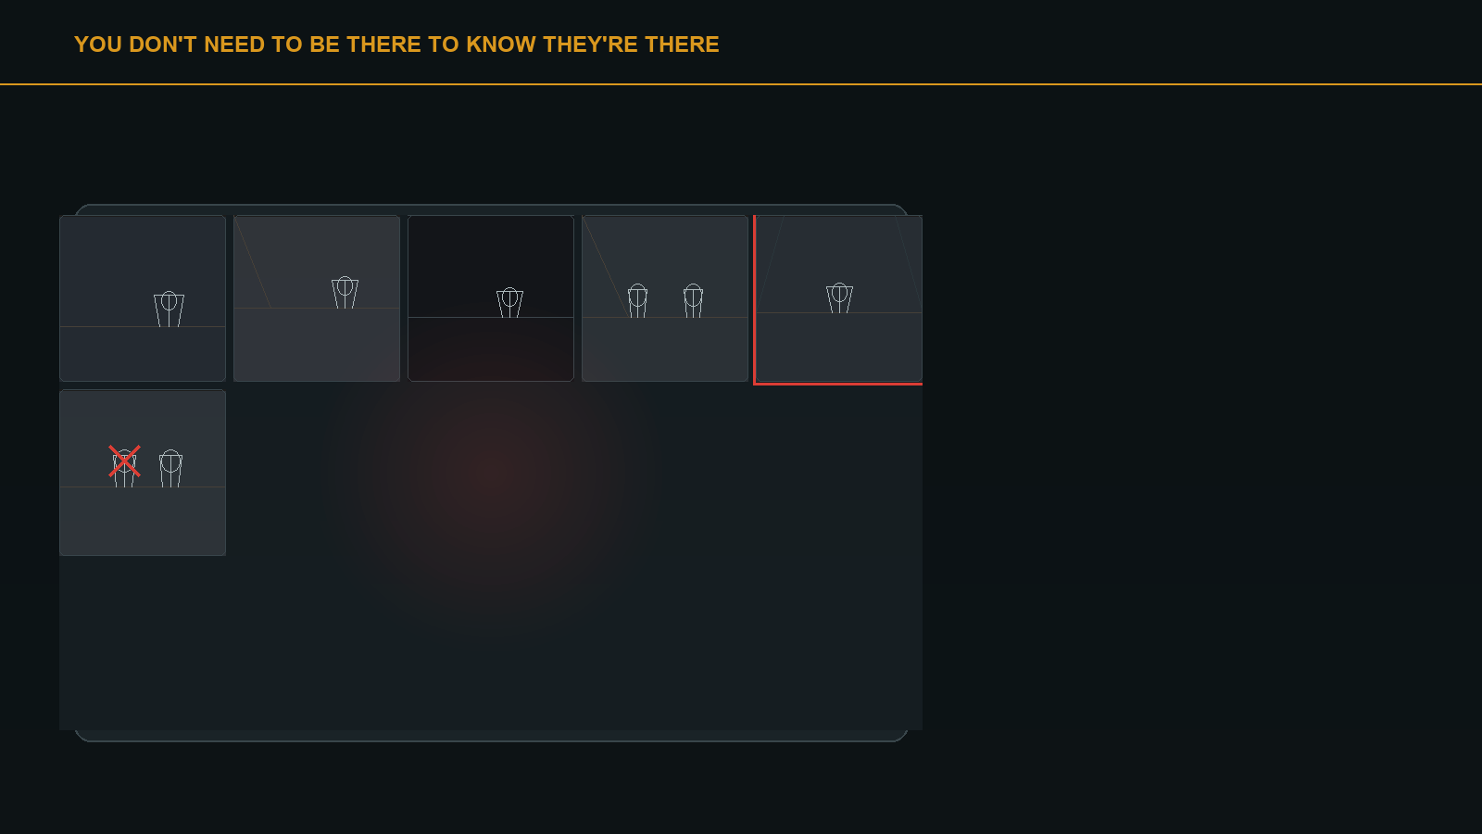
THE MOMENT
YOU DON'T NEED TO BE THERE
Detections appear on every screen, in every camera's view, within about a second — including on a wall that blocks the line of sight.
04 / 08

Slide 5
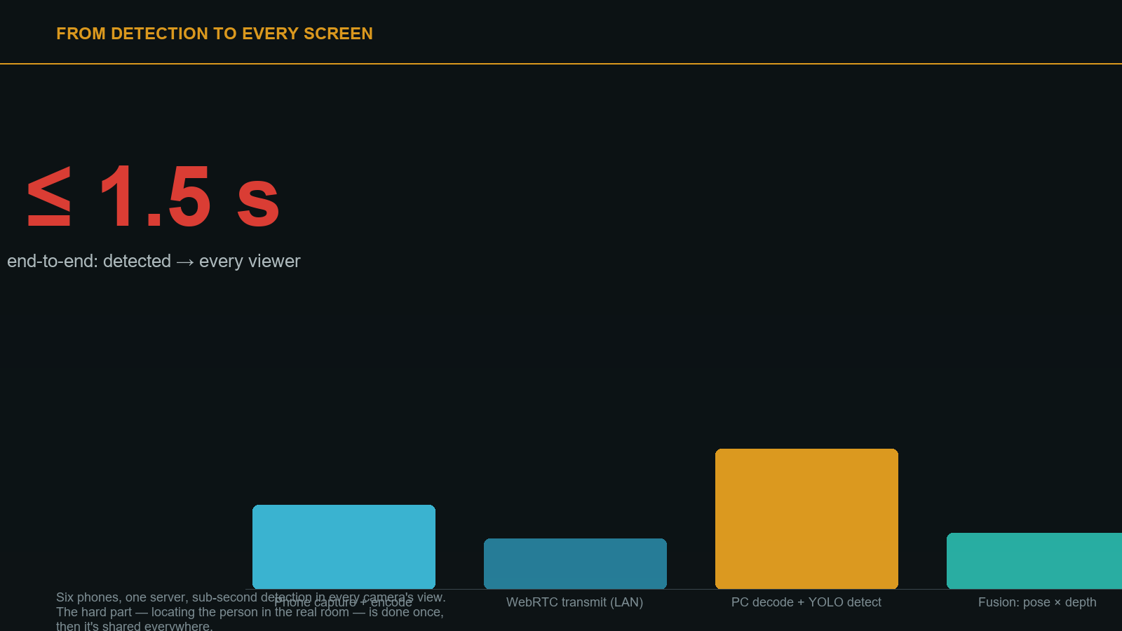
TIMING
FROM DETECTION TO EVERY SCREEN
≤ 1.5 seconds, end to end — captured, decoded, detected, fused, and broadcast to every viewer. The hard part — locating the person in the real room — is done once, then shared everywhere.
05 / 08

Slide 6
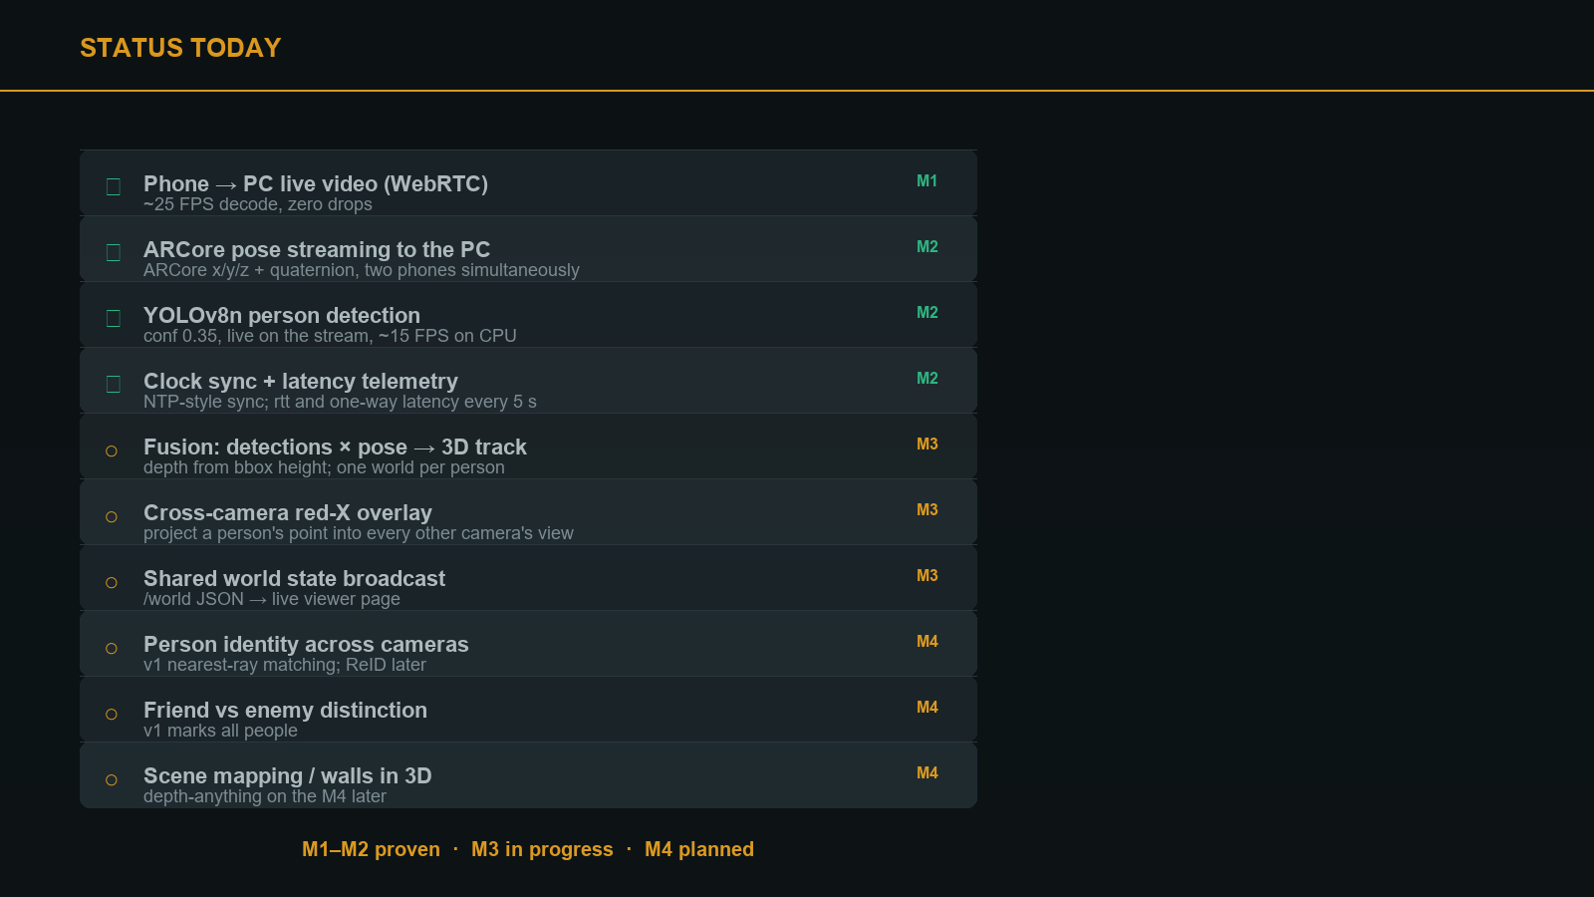
M1–M2 proven · M3 in progress · M4 planned
06 / 08

Slide 7
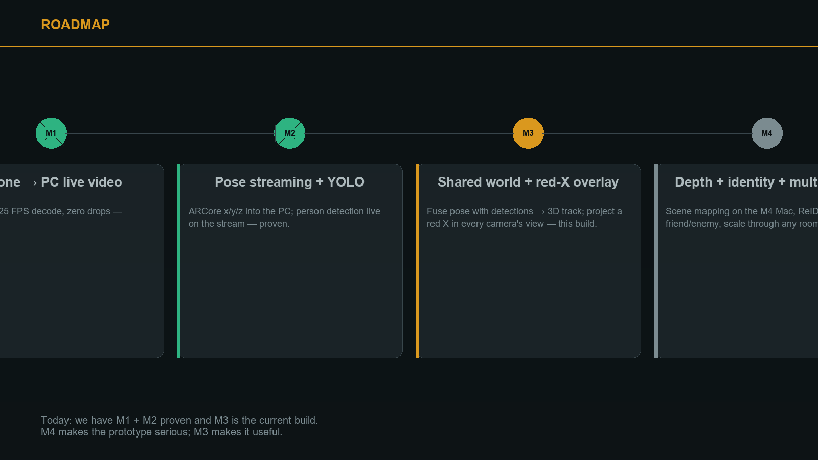
WHAT'S NEXT
ROADMAP
Today: M1 and M2 are proven, M3 is the current build. M4 makes the prototype serious — scene mapping, identity across cameras, friend vs enemy. But M3 is what makes it useful right now.
07 / 08

Slide 8
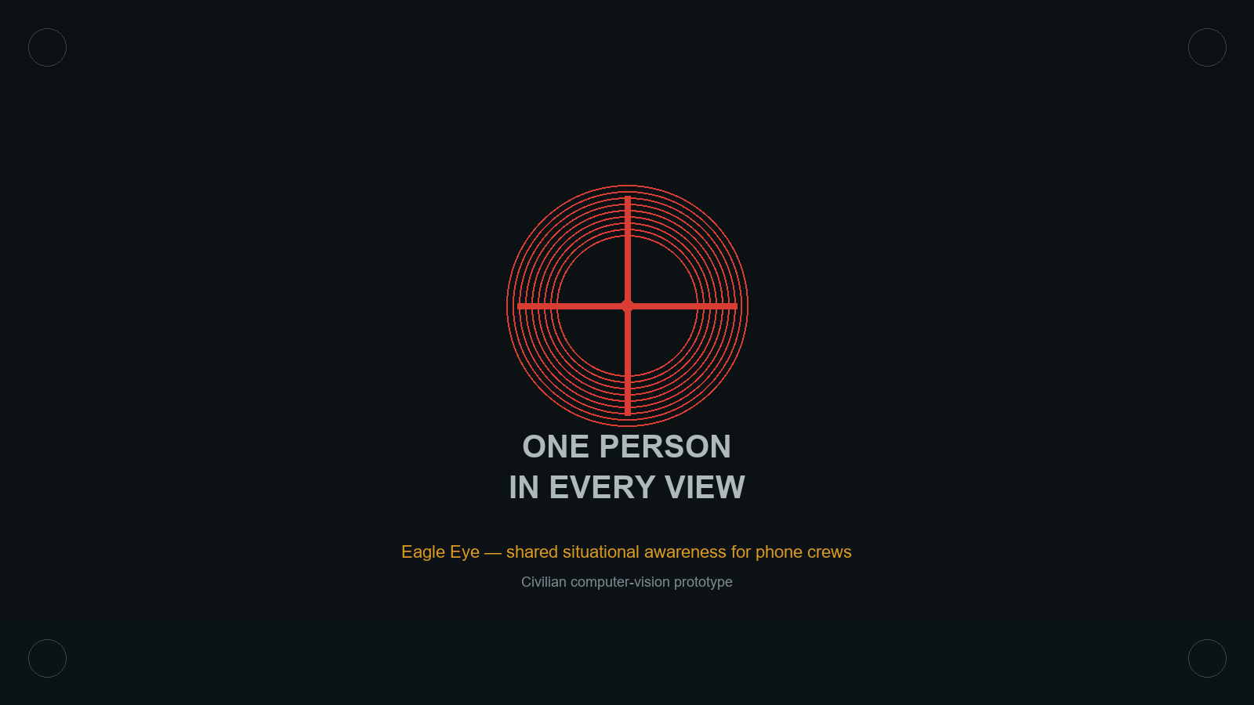
EAGLE EYE · CIVILIAN COMPUTER-VISION PROTOTYPE
Put three phones in three rooms, point them, and one person in any of those rooms
shows up for every other screen — at their real location, through walls, in seconds.
08 / 08

