Slide 1

CS549 :Performance Analysis of Computer Network
Group member | Roll number
Vinay Kumar | B17068
Deepak Kumar | B17039
Mini Project - Topic number 4
Faculty - T.A. Gonsalves & Sreelakshmi P.M.

Slide 2
Problem Statement:
Create N+1 nodes on your Laptop where one node acts as a server and remaining as clients.
Write Client-Server code using UDP sockets. Vary the rate,loss and delay on the client MACVLANs and measure the performance.

Slide 3
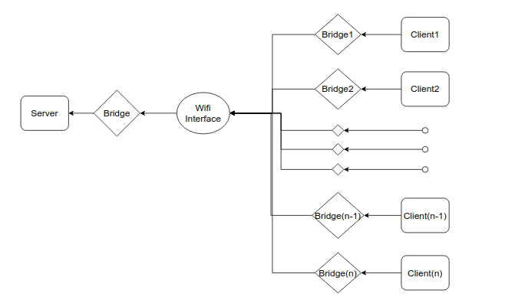
Experiment Setup: Block Diagram

Slide 4
Experiment Setup : Measurements
Send large file(100MB) from client to server.
Throughput(MB/s) = total byte received / total time taken.
For measuring total byte -> added all data received.
For measuring total time -> python module time used.

Slide 5
Experiment Setup : Factors
Primary factors | Levels
Delay | 1,5,10,20,30,40,50,60,70,80
Rate | 1,4,9,15,30,40,50,60,70,85
Loss | 1,2,5,10,15,20,25,30,40,50
Secondary Factors | RAM, Operating System

Slide 6
Experiment Setup : Script for Automation
./run.sh 1ms 20mbit 2% 5;
while [ $(ps -aef | grep server.py | wc -l) -ne 1 ]
do
sleep 1;
done
So on ...

Slide 7
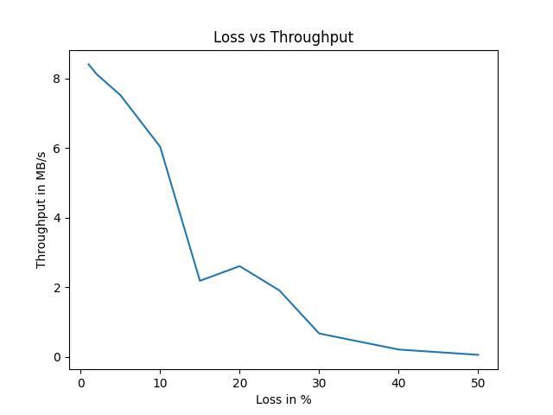
Result:
Graph: Loss vs Throughput

Slide 8
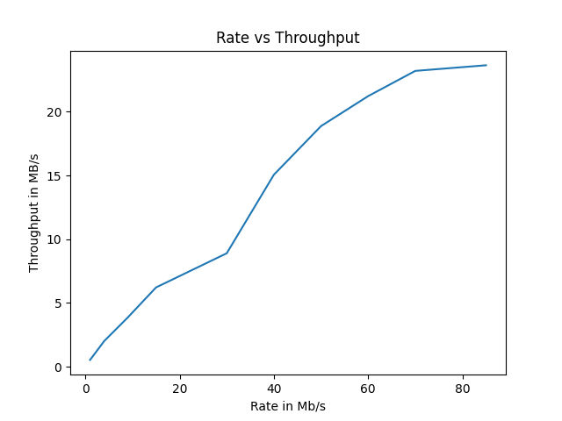
Graph: Rate vs Throughput

Slide 9
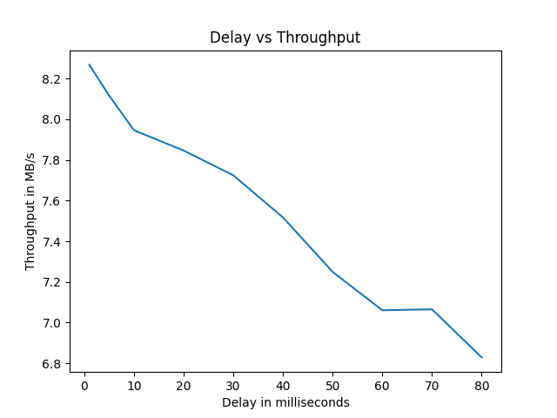
Graph: Delay vs Throughput

Slide 10
Data Table:Varying the Delay
Delay(ms) | Rate(Mb/s) | Loss(%) | No. of Client | Throughput(MB/s)
1 | 20 | 2 | 5 | 8.2679
5 | 20 | 2 | 5 | 8.1166
10 | 20 | 2 | 5 | 7.9460
20 | 20 | 2 | 5 | 7.8461
30 | 20 | 2 | 5 | 7.7242
40 | 20 | 2 | 5 | 7.5172
50 | 20 | 2 | 5 | 7.2492
60 | 20 | 2 | 5 | 7.0606
70 | 20 | 2 | 5 | 7.0650
80 | 20 | 2 | 5 | 6.8286

Slide 11
Data Table:Varying the Loss
Delay(ms) | Rate(Mb/s) | Loss(%) | No. of Client | Throughput(MB/s)
5 | 20 | 1 | 5 | 8.4064
5 | 20 | 2 | 5 | 8.1254
5 | 20 | 5 | 5 | 7.5209
5 | 20 | 10 | 5 | 6.0357
5 | 20 | 15 | 5 | 2.1821
5 | 20 | 20 | 5 | 2.6040
5 | 20 | 25 | 5 | 1.9038
5 | 20 | 30 | 5 | 0.6674
5 | 20 | 40 | 5 | 0.2064
5 | 20 | 50 | 5 | 0.0542

Slide 12
Data Table:Varying the Rate
Delay(ms) | Rate(Mb/s) | Loss(%) | No. of Client | Throughput(MB/s)
5 | 1 | 2 | 5 | 0.5344
5 | 4 | 2 | 5 | 2.0156
5 | 9 | 2 | 5 | 3.8639
5 | 20 | 2 | 5 | 6.2213
5 | 30 | 2 | 5 | 8.8993
5 | 40 | 2 | 5 | 15.0587
5 | 50 | 2 | 5 | 18.8710
5 | 60 | 2 | 5 | 21.2220
5 | 70 | 2 | 5 | 23.1999
5 | 85 | 2 | 5 | 23.6423

Slide 13
Inference:
We infer following things by doing experiments :
Increase in the loss, decreases the throughput.
Increase in the rate, increases the throughput.
Increase in the delay, decreases the throughput.

Slide 14
Conclusion
We have successfully conducted the experiments and concluded that increase in loss decrease throughput and increase in delay decrease throughput and increase in rate at client interface increase throughput.

Slide 15
Contribution
Vinay kumar - B17068
Configuration, Client script, Plotting script, Slide preparation.
Deepak kumar - B17039
Automation , Varying factor, Server script, File generator script.

Slide 16
References
https://www.cs.unm.edu/~crandall/netsfall13/TCtutorial.pdf
Quick Guide to Virtual Networking.
https://students.iitmandi.ac.in/moodle/mod/resource/view.php?id=21921
https://www.chuanjin.me/2016/08/03/transfer-file/

