Slide 1
⚡ EduPulse
EduPulse
A Business Intelligence Dashboard for Online
Learning Engagement Analytics
Deepak Kumar Joshi · Enrollment O24MCA112387
Master of Computer Applications (Online) · Chandigarh University (CU Online)
Guide: Vikas Kumar, Senior Mentor · Academic Year 2025–2026
Notes:
Open with a one-sentence pitch: EduPulse is a Business Intelligence dashboard for online learning engagement analytics, built on the OULAD dataset. Say your name, enrollment number, program, guide name, and academic year. Aim: 30 seconds on this slide.

Slide 2
SLIDE 02
Agenda
• Background and motivation
• Problem statement — three gaps in current analytics
• Objectives and scope
• Existing systems and where they fall short
• Proposed system — EduPulse architecture
• Technology stack and dataset (OULAD)
• System design — DFDs, star schema, class diagram
• Machine-learning model for dropout prediction
• Dashboard walk-through (six real screenshots)
• Testing, results, and deployment
• Future scope and Q&A
EduPulse — MCA Project Viva
2 / 24
Notes:
Read the agenda quickly. Signals structure to the panel — they will trust that you know where you are heading.

Slide 3
SLIDE 03
Background & Motivation
Why online-learning analytics matters
• Online learning is now a primary delivery channel — 300M+ registered learners worldwide.
• Every click, video view, forum post, and quiz produces structured behavioural data.
• Universities collect the data but rarely act on it — dashboards focus on enrolment, not engagement.
• Students at risk of dropping out are typically identified too late for intervention to be effective.
• The Open University released OULAD (2014, CC-BY-4.0) as the de facto benchmark: 32,593 students, 10M+ click events.
• EduPulse uses OULAD to demonstrate what a modern BI stack + a supervised ML model can do on real learning-analytics data.
EduPulse — MCA Project Viva
3 / 24
Notes:
Emphasise real-world relevance. Mention 300 million learners and OULAD's 32,593 students. Panel will appreciate that this is a real dataset, not a toy example.

Slide 4
SLIDE 04
Problem Statement
Three operational gaps that motivated EduPulse
• 1. Engagement-visibility gap — administrators have no consolidated view of platform-wide engagement over time.
• 2. Pattern-recognition gap — peaks and troughs, content-type popularity, cross-cohort comparisons require ad-hoc SQL.
• 3. Predictive-intervention gap — no early-warning layer to flag students likely to withdraw.
• EduPulse addresses all three in a single deployable artefact — free, reproducible, open-source.
EduPulse — MCA Project Viva
4 / 24
Notes:
Three gaps to remember: visibility, pattern-recognition, predictive intervention. Say them slowly. If asked, each corresponds to a dashboard page (Overview, Engagement Patterns, Dropout Prediction).

Slide 5
SLIDE 05
Objectives
• Collect real-world learning-analytics dataset (OULAD) and document its structure and licence.
• Clean, preprocess, and validate through a reproducible Python pipeline.
• Design a star-schema data warehouse in DuckDB.
• Build engagement KPIs, course-outcome, and engagement-pattern dashboards.
• Train a supervised ML model for early dropout prediction (first-30-day features).
• Deploy free on Streamlit Community Cloud — public URL.
• Validate accuracy through reconciliation and document actionable insights for administrators.
EduPulse — MCA Project Viva
5 / 24
Notes:
Map objectives to project tasks (the 11 listed in your assignment). If they ask which task is not covered, say: all 11 are covered — objectives 1-3 map to collect/clean/warehouse; 4 maps to ETL; 5-7 map to dashboards; 8-11 map to validation and documentation.

Slide 6
SLIDE 06
Scope of the Project
In scope
Out of scope
• Descriptive analytics — KPIs, demographic breakdowns.
• Diagnostic analytics — peak/trough detection, cross-category comparison.
• Predictive analytics — early dropout-risk scoring.
• Free public deployment on Streamlit Community Cloud.
• Real-time ingestion from a live LMS (OULAD is a batch release).
• Any personally identifiable information (OULAD is fully anonymised).
• Content-recommendation engines.
• Multi-tenant or commercial deployment.
EduPulse — MCA Project Viva
6 / 24
Notes:
Clarity on scope prevents surprise questions. If asked 'why not real-time?' — OULAD is a static release, real-time ingestion is listed in Chapter 8 as future work.

Slide 7
SLIDE 07
Existing Systems — Where They Fall Short
• Native LMS dashboards (Moodle, Canvas, Blackboard) — per-course only; no cross-course aggregation, no predictive layer.
• Commercial BI (Tableau, Power BI, Looker) — licence costs ~$70/user/month; assume you already have a warehouse.
• Open-source BI (Superset, Metabase) — free but general-purpose; no learning-analytics model, no predictive layer.
• None combine a domain data model + tailored dashboards + native ML layer in one free deployable artefact.
• That gap is exactly what EduPulse fills.
EduPulse — MCA Project Viva
7 / 24
Notes:
Panel may ask why you didn't just use Tableau. Answer: licence cost and lack of a domain data model — you would still need to build the star schema and train the ML model yourself.

Slide 8
SLIDE 08
Proposed System — EduPulse
Six tightly-integrated components on one free stack
• Reproducible ETL pipeline — download → clean → load warehouse → train model.
• DuckDB star-schema warehouse — 3 facts, 4 dimensions, 3 analytical views.
• scikit-learn Gradient Boosting classifier — 80.3% accuracy, 0.810 ROC AUC.
• Streamlit multi-page dashboard — 5 purpose-built pages.
• Free public deployment on Streamlit Community Cloud — CD via GitHub push.
• MIT-licensed — reproducible by any future contributor.
EduPulse — MCA Project Viva
8 / 24
Notes:
Keep this slide crisp. The panel wants to know 'what did you build' — this is the summary. Emphasise 80.3% accuracy and 0.810 AUC — that number will come up again.

Slide 9
SLIDE 09
Technology Stack
• Python 3.11 — one language across ETL, ML, and dashboard.
• DuckDB — embedded columnar OLAP warehouse, no server needed.
• pandas — tabular cleaning and feature engineering.
• scikit-learn — GradientBoostingClassifier, preprocessing pipeline, model persistence.
• Streamlit — declarative Python web framework for the dashboard.
• Plotly — interactive charts (lines, bars, heatmaps).
• Git + GitHub + Streamlit Community Cloud — continuous deployment.
EduPulse — MCA Project Viva
9 / 24
Notes:
If asked 'why DuckDB instead of Postgres?' — DuckDB is columnar and OLAP-optimised; Postgres is row-store and OLTP-optimised. For analytical dashboards, DuckDB is 10-100x faster on the same hardware.

Slide 10
SLIDE 10
Data Source — OULAD
Open University Learning Analytics Dataset
• Released by Open University KMI (2014) under CC-BY-4.0.
• 32,593 students, 22 course presentations, 7 modules.
• 10.6 million click events in the Virtual Learning Environment.
• 173,739 assessment submissions.
• Complete demographic attributes (age band, region, IMD band, prior education, disability).
• Final outcome per enrolment: Pass / Fail / Withdrawn / Distinction.
• Downloaded automatically from UCI Machine Learning Repository mirror.
EduPulse — MCA Project Viva
10 / 24
Notes:
OULAD numbers to remember: 32,593 students · 22 presentations · 10.6M clicks · 4 outcome classes. If asked about licence: CC-BY-4.0 permits redistribution with attribution.

Slide 11
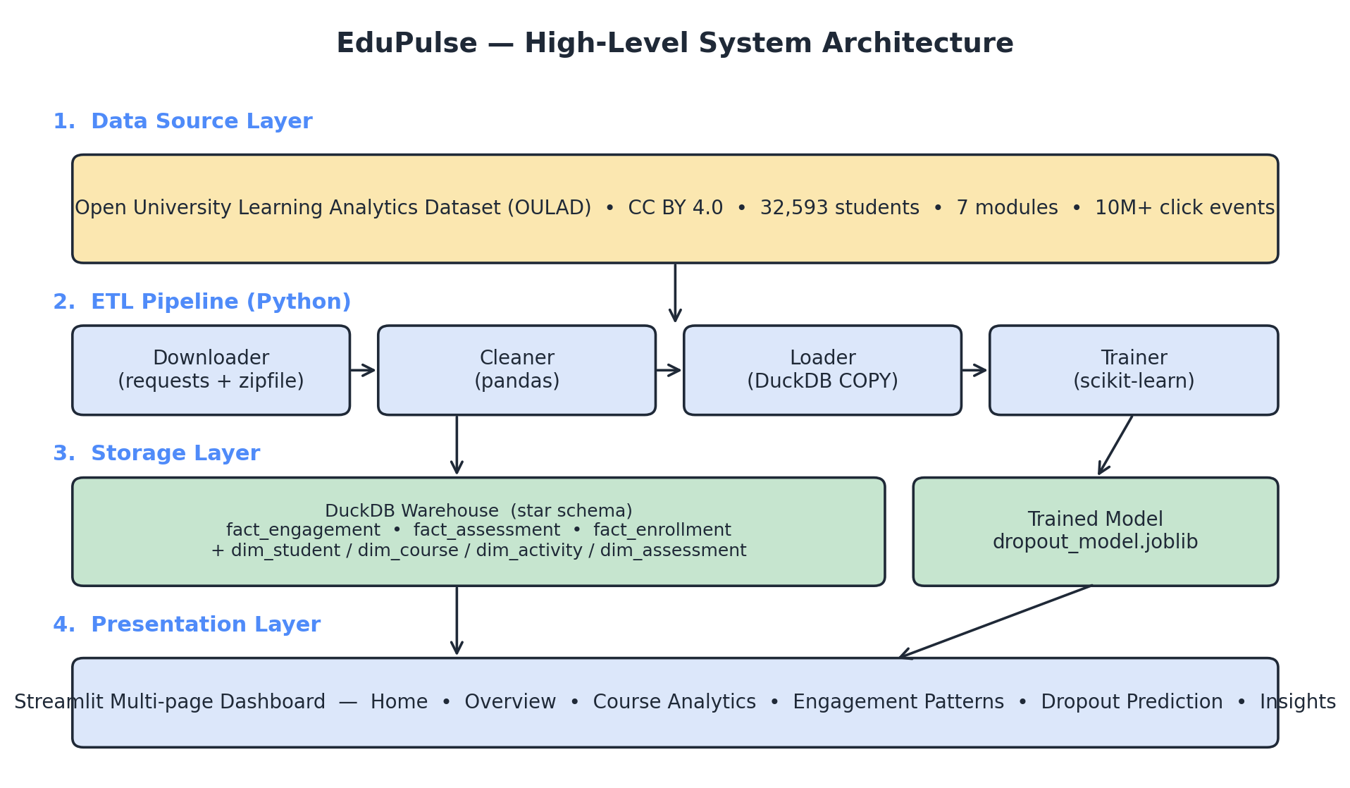
SLIDE 11
System Architecture
Four-layer architecture from source to dashboard
EduPulse — MCA Project Viva
11 / 24
Notes:
Walk left-to-right: Data source (OULAD) → ETL pipeline (4 Python modules) → Storage layer (DuckDB + joblib artefact) → Presentation layer (Streamlit). Each layer communicates with the next through a file artefact — no network protocols between layers.

Slide 12
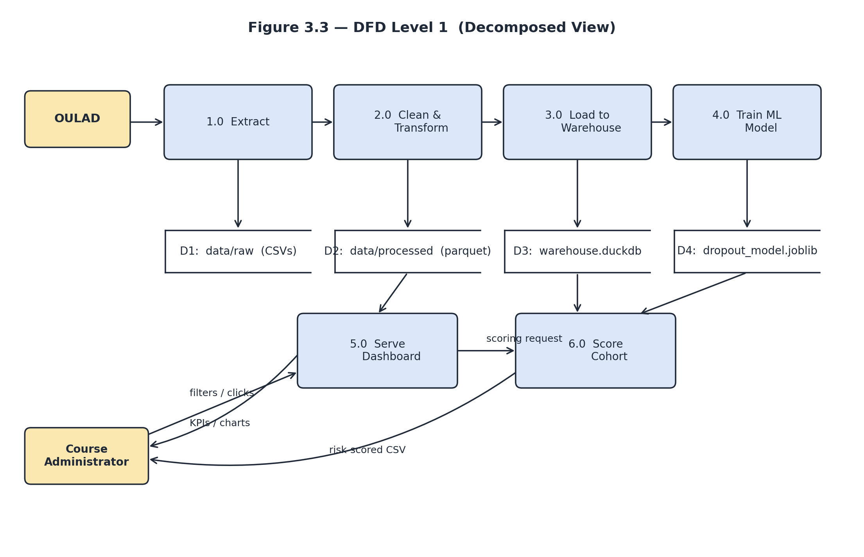
SLIDE 12
Data Flow Diagram — Level 1
Six processes, four data stores
EduPulse — MCA Project Viva
12 / 24
Notes:
Processes 1.0-4.0 (Extract, Clean, Load, Train) are batch, run once at deployment. Processes 5.0 (Serve Dashboard) and 6.0 (Score Cohort) run interactively at request time. Data stores D1-D4 are file artefacts.

Slide 13
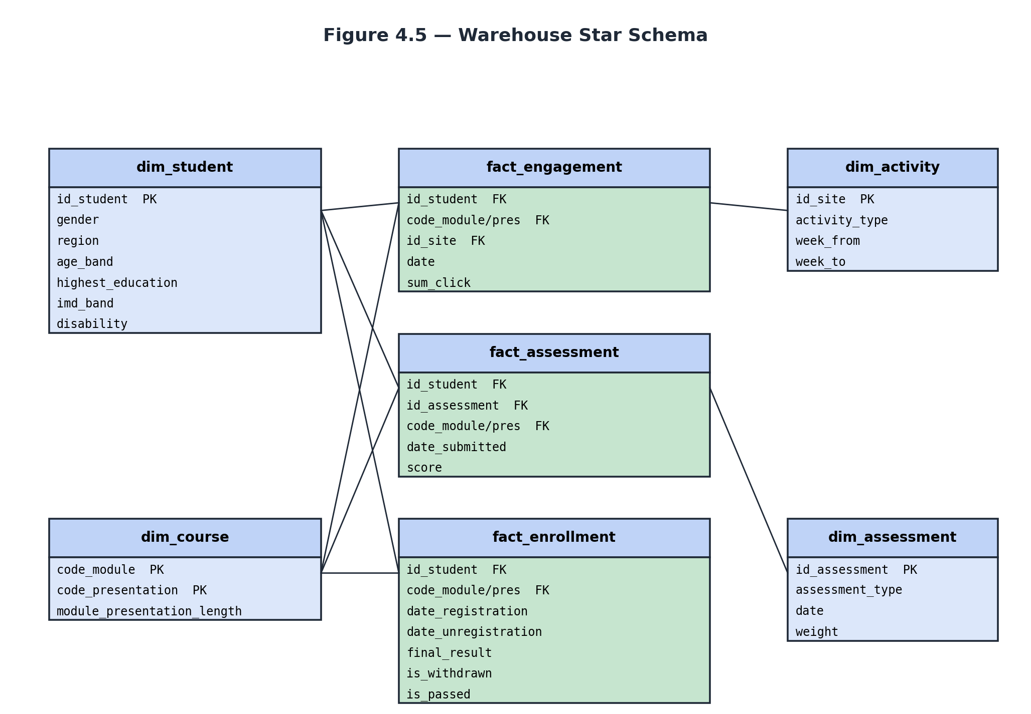
SLIDE 13
Warehouse — Star Schema
3 fact tables + 4 conformed dimensions
EduPulse — MCA Project Viva
13 / 24
Notes:
Facts in green at the centre: fact_engagement (10.6M rows), fact_assessment, fact_enrollment. Dimensions at the corners. dim_student is conformed across all three facts — that's what allows cross-fact queries on a single student key.

Slide 14
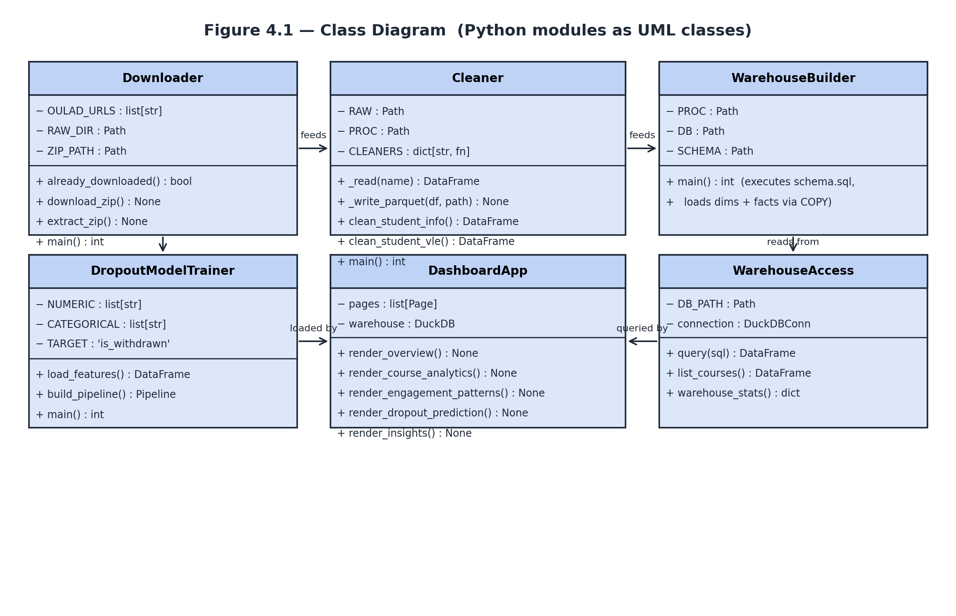
SLIDE 14
Class Diagram
Python modules represented as UML classes
EduPulse — MCA Project Viva
14 / 24
Notes:
Six logical modules. Downloader + Cleaner = ingestion. WarehouseBuilder = storage. DropoutModelTrainer = ML. DashboardApp + WarehouseAccess = presentation. Each module is one file in src/.

Slide 15
SLIDE 15
Machine-Learning Model
Early dropout prediction from first-30-day engagement
• Algorithm — scikit-learn GradientBoostingClassifier (200 trees, max depth 3, learning rate 0.08).
• Feature window — first 30 days of each course presentation (enforced in v_student_features view).
• Numeric features — total clicks, active days, avg assessment score, studied credits, prior attempts, submissions.
• Categorical features — gender, region, IMD band, age band, prior education, disability.
• Training — stratified 80/20 split, random_state = 42, deterministic re-runs.
• Bundle — full sklearn Pipeline persisted via joblib with metrics and feature importances.
EduPulse — MCA Project Viva
15 / 24
Notes:
If asked 'why Gradient Boosting?' — tree-based ensembles dominate this problem class (Hellas et al. 2018 systematic review). Interpretable via feature importances; not a black box.

Slide 16
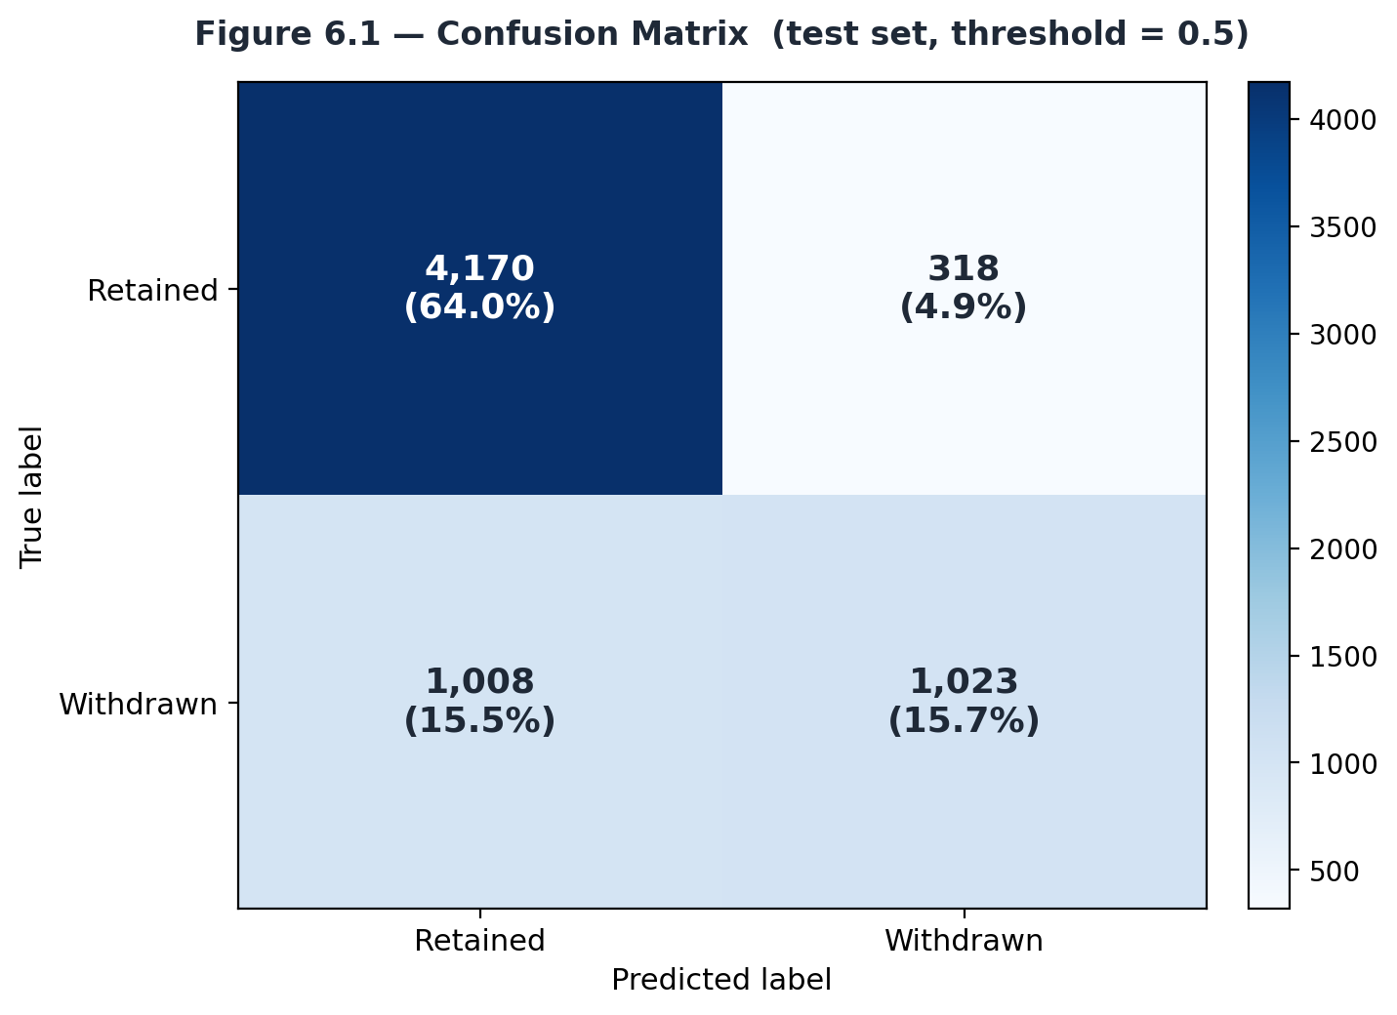
SLIDE 16
Model Performance
Held-out test set — 6,519 students
• Accuracy — 0.797
• ROC AUC — 0.810
• True negatives (Retained correctly) — 4,170
• True positives (Withdrawn caught) — 1,023
• Baseline dropout rate — 31.2%
• AUC matches published OULAD results (Aljohani et al. 2019: 0.80–0.85).
EduPulse — MCA Project Viva
16 / 24
Notes:
Panel loves numbers. Say: '0.810 ROC AUC, 79.7% accuracy on 6,519 held-out students; baseline dropout rate is 31.2%, so accuracy alone is misleading — AUC is the honest metric.'

Slide 17
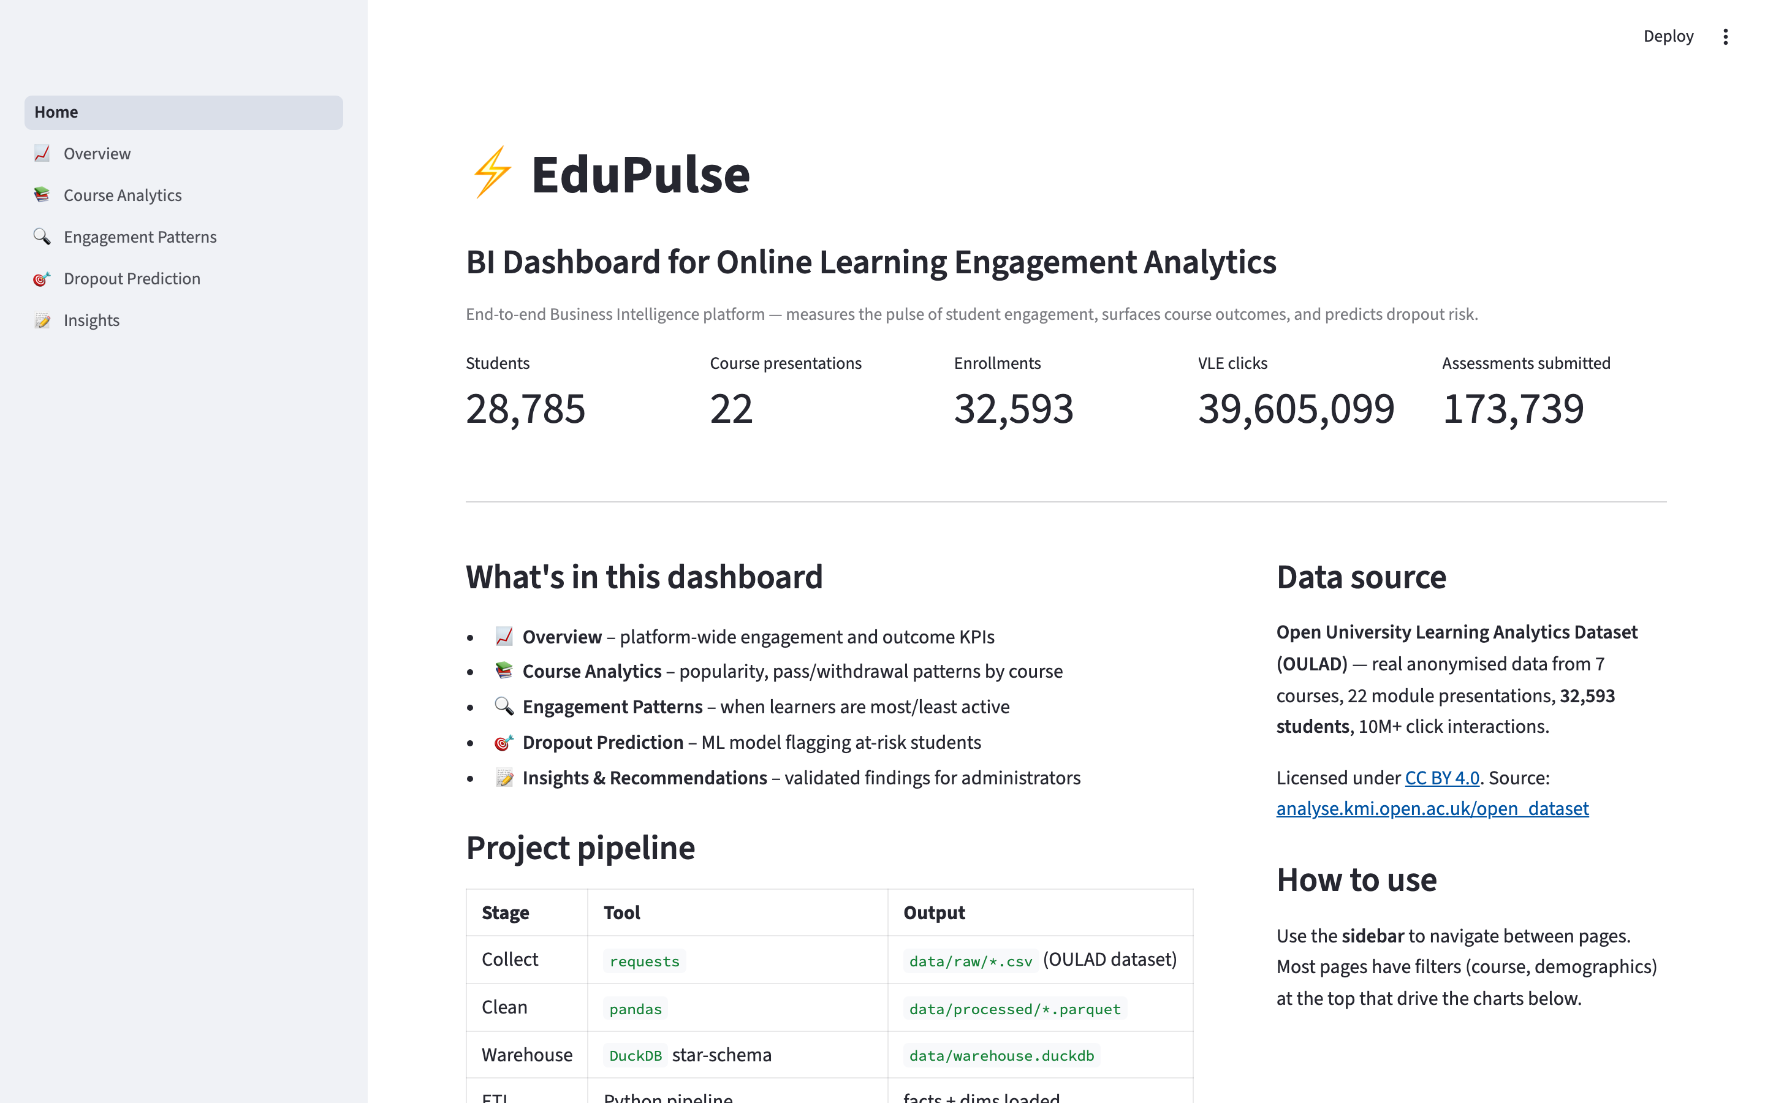
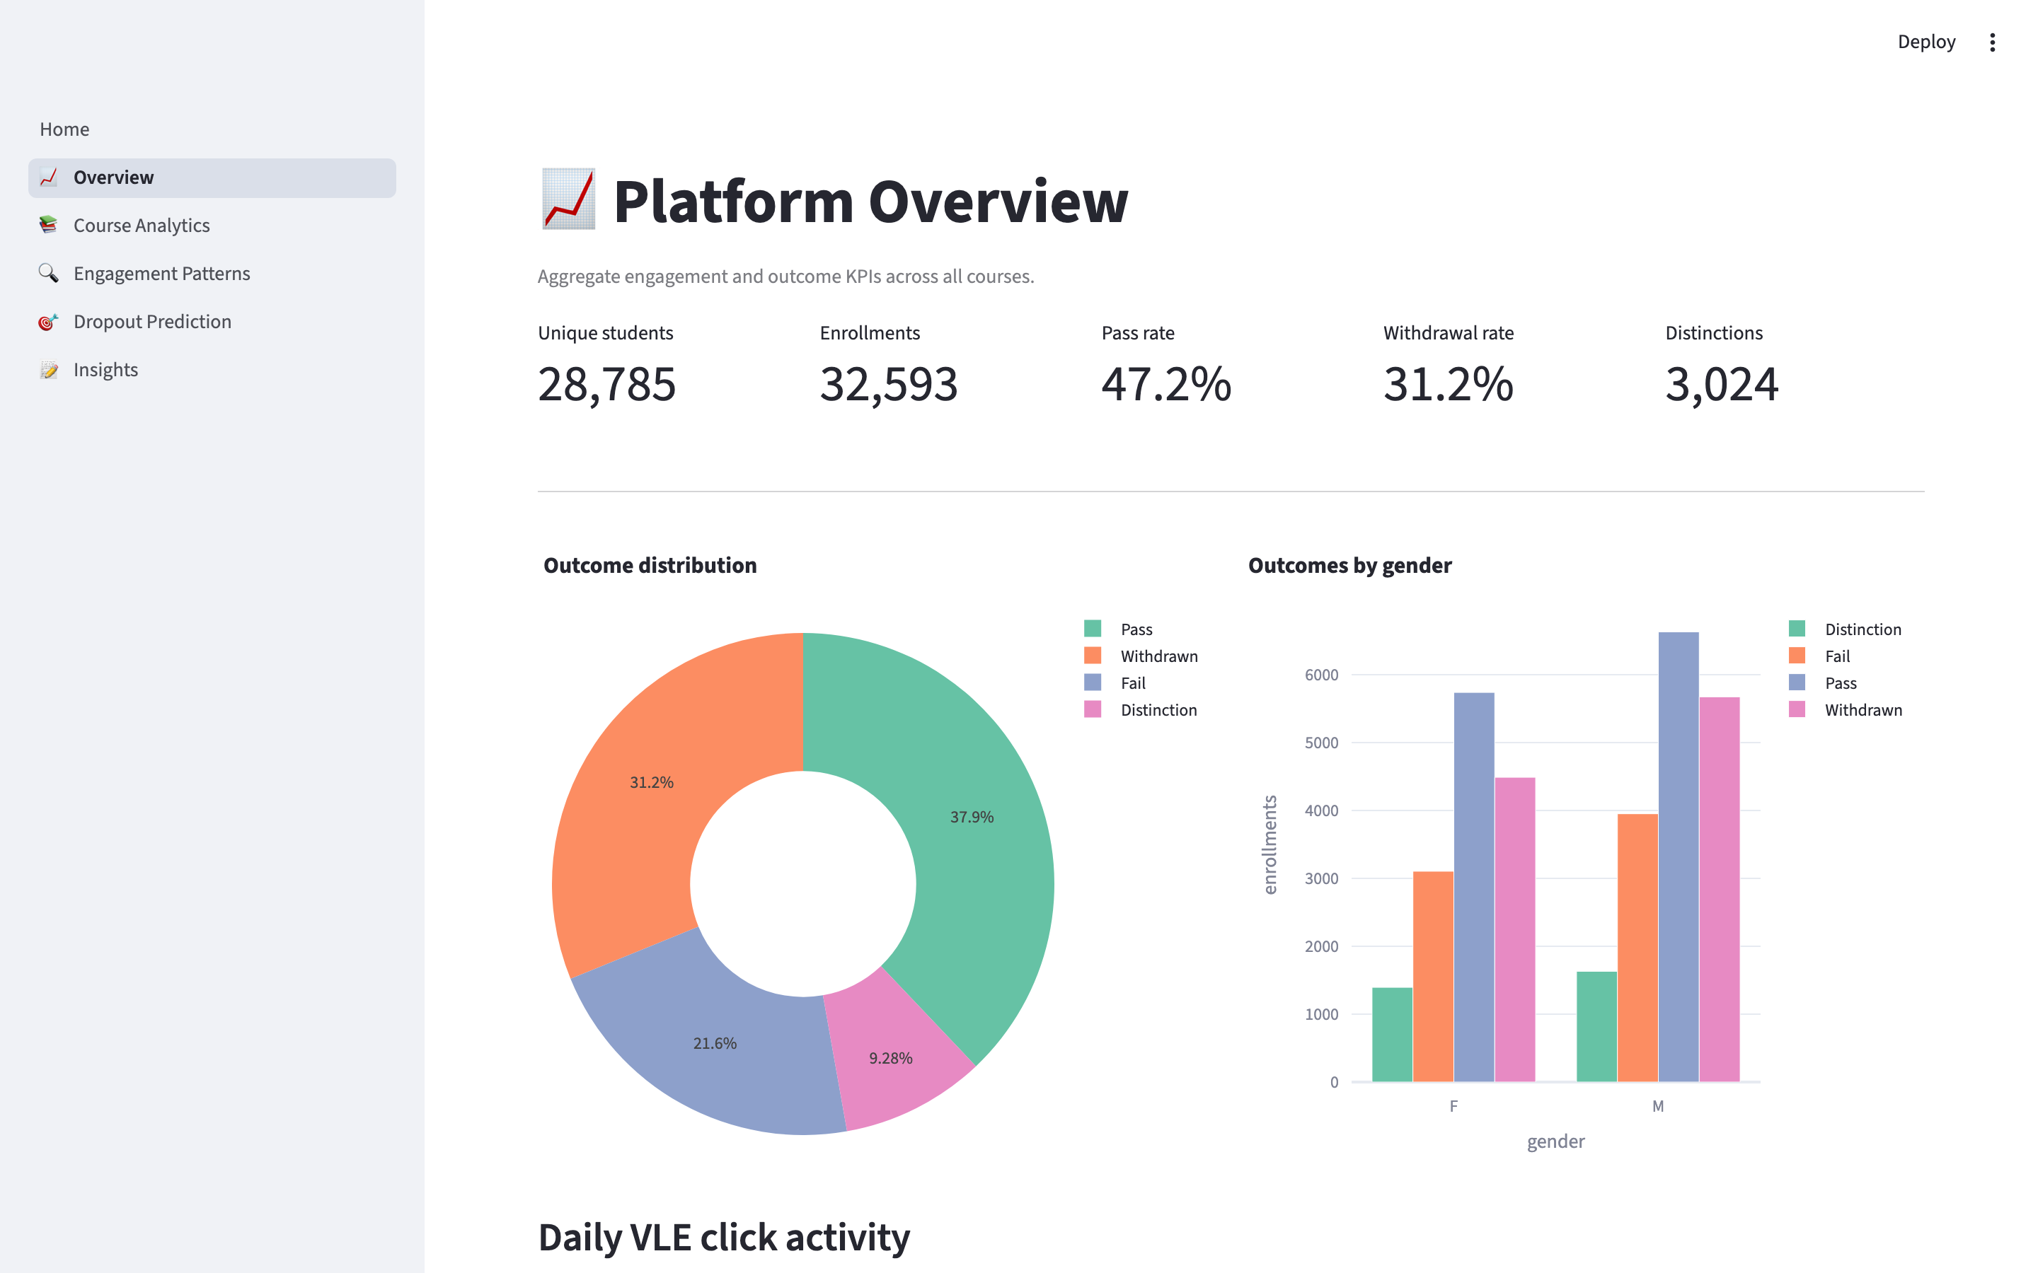
SLIDE 17
Dashboard — Home & Overview
Home — brand mark + platform KPIs (28.8K students, 39.6M clicks, 173.7K submissions)
Overview — outcome distribution, daily VLE click timeline, gender split
EduPulse — MCA Project Viva
17 / 24
Notes:
Two live screenshots. If asked what a KPI card shows — students, presentations, enrollments, clicks, submissions. Overview page renders in under 2 seconds against the 10.6M-row engagement fact.

Slide 18
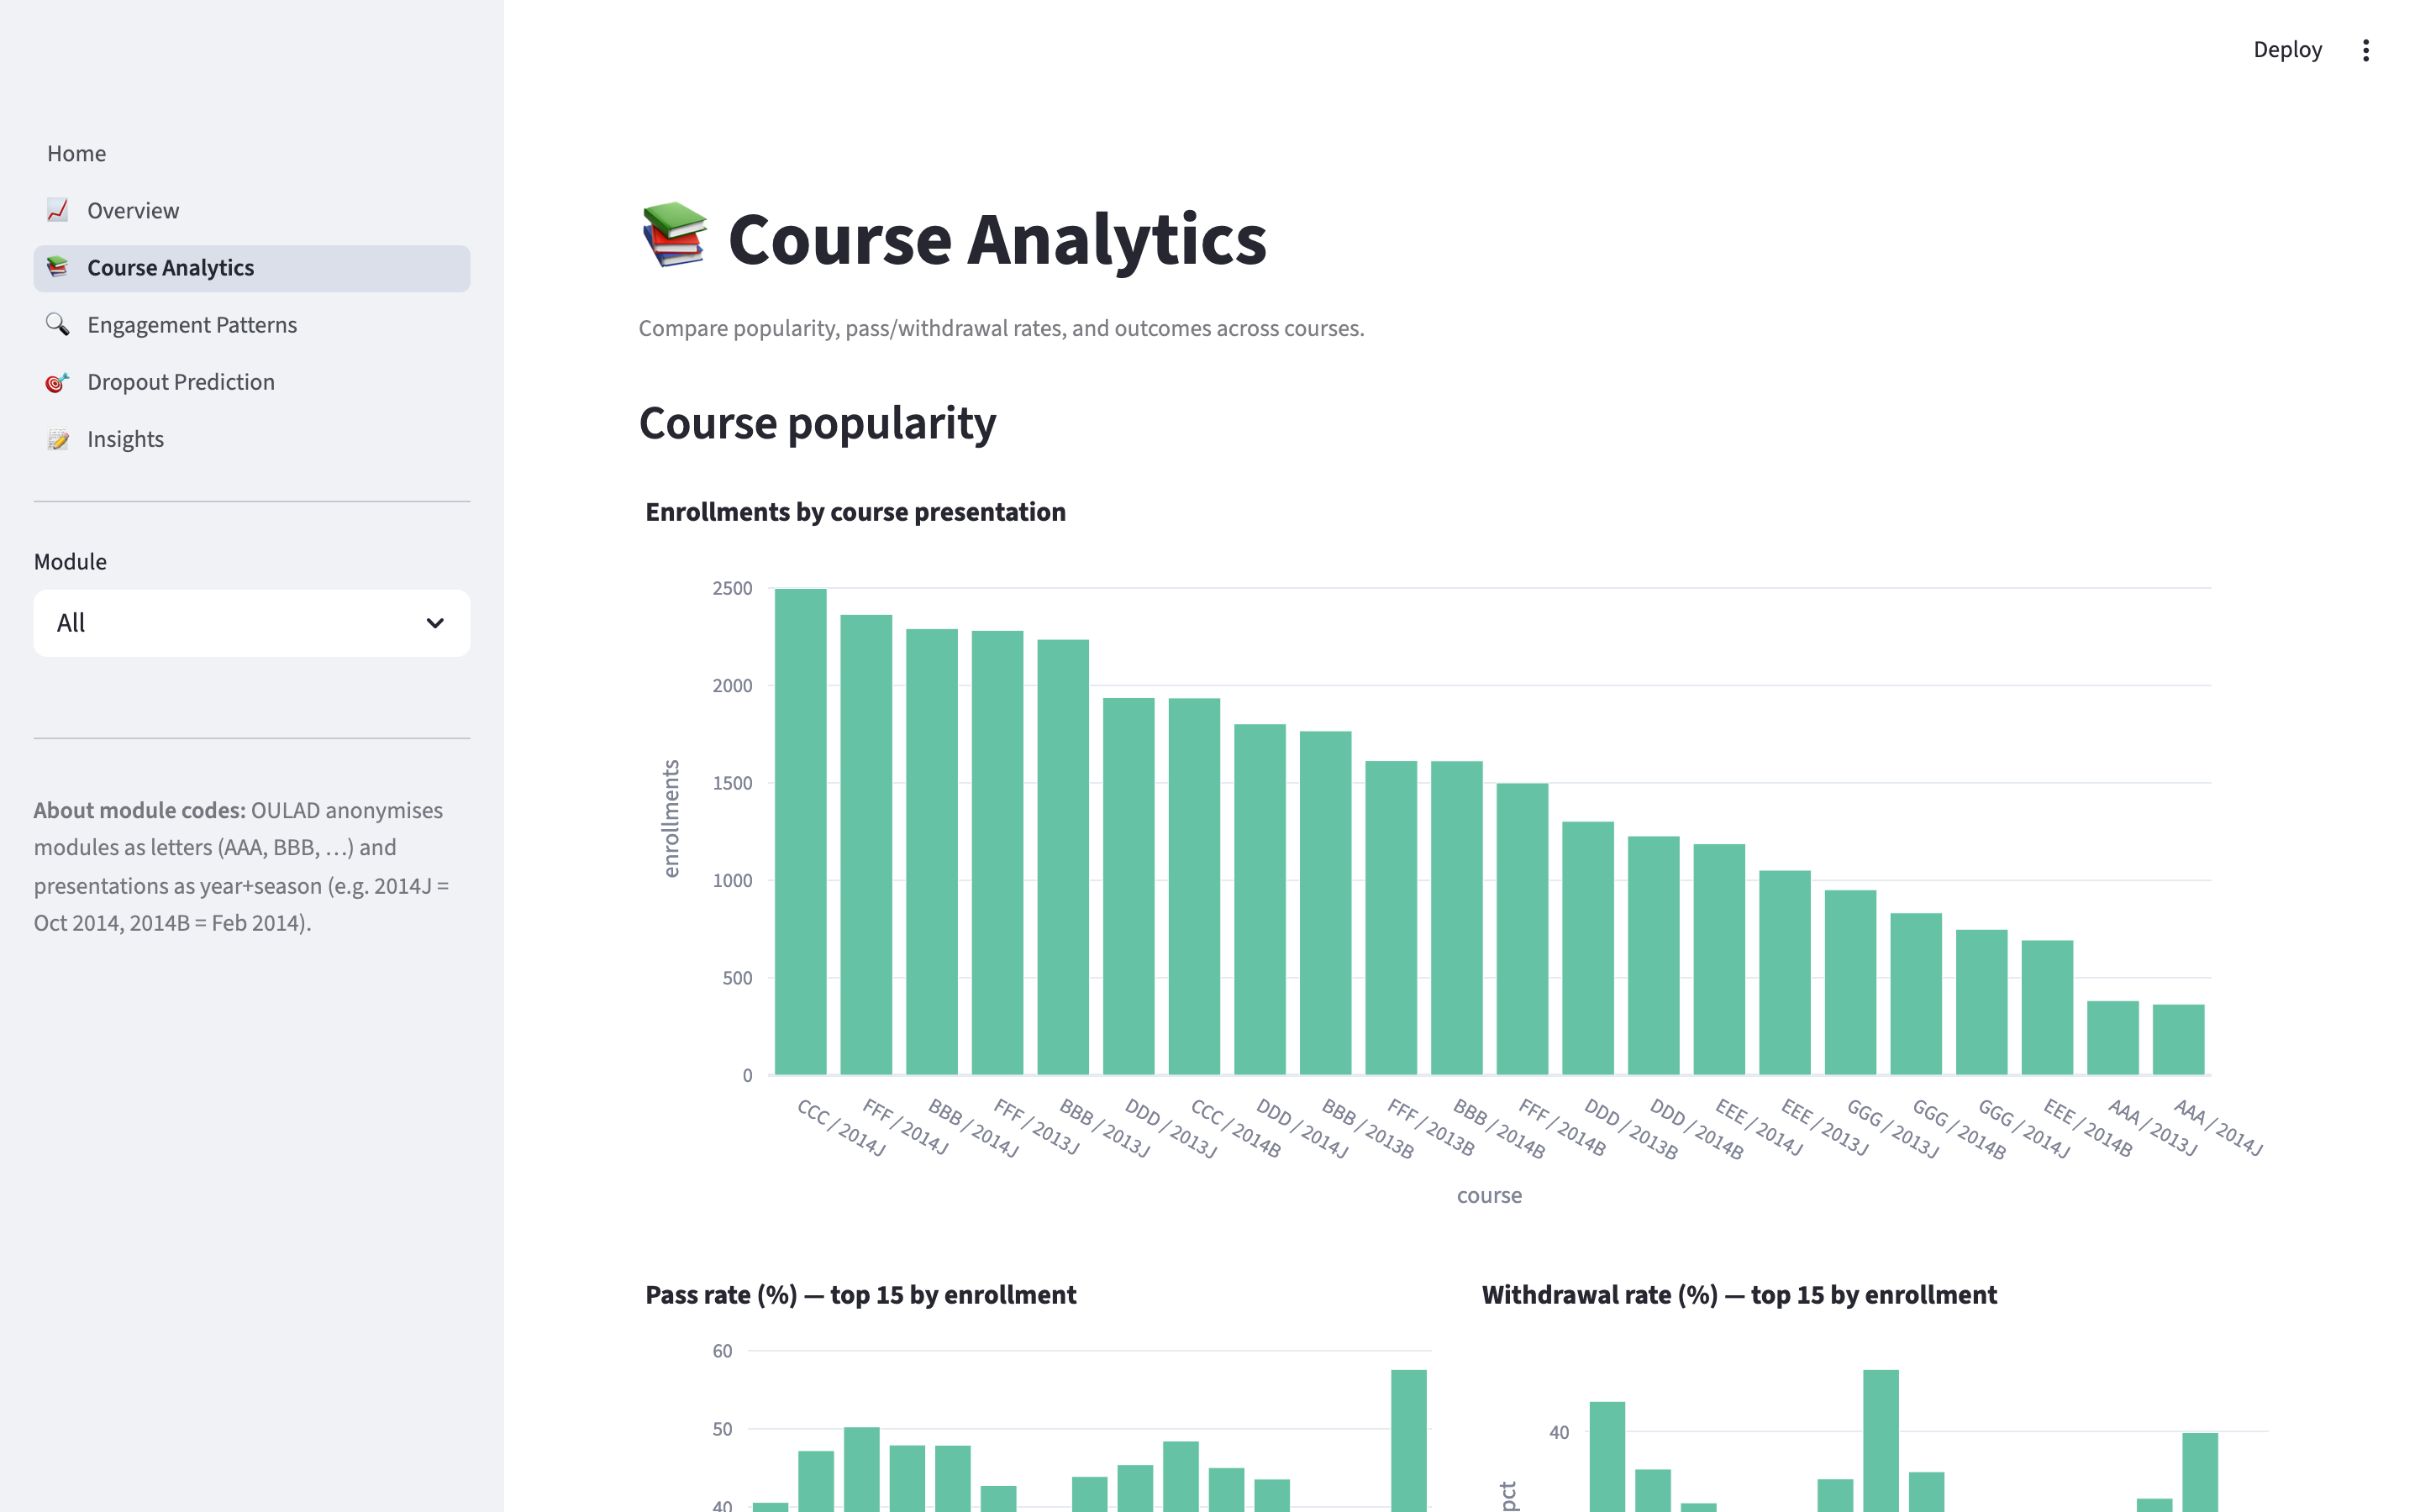
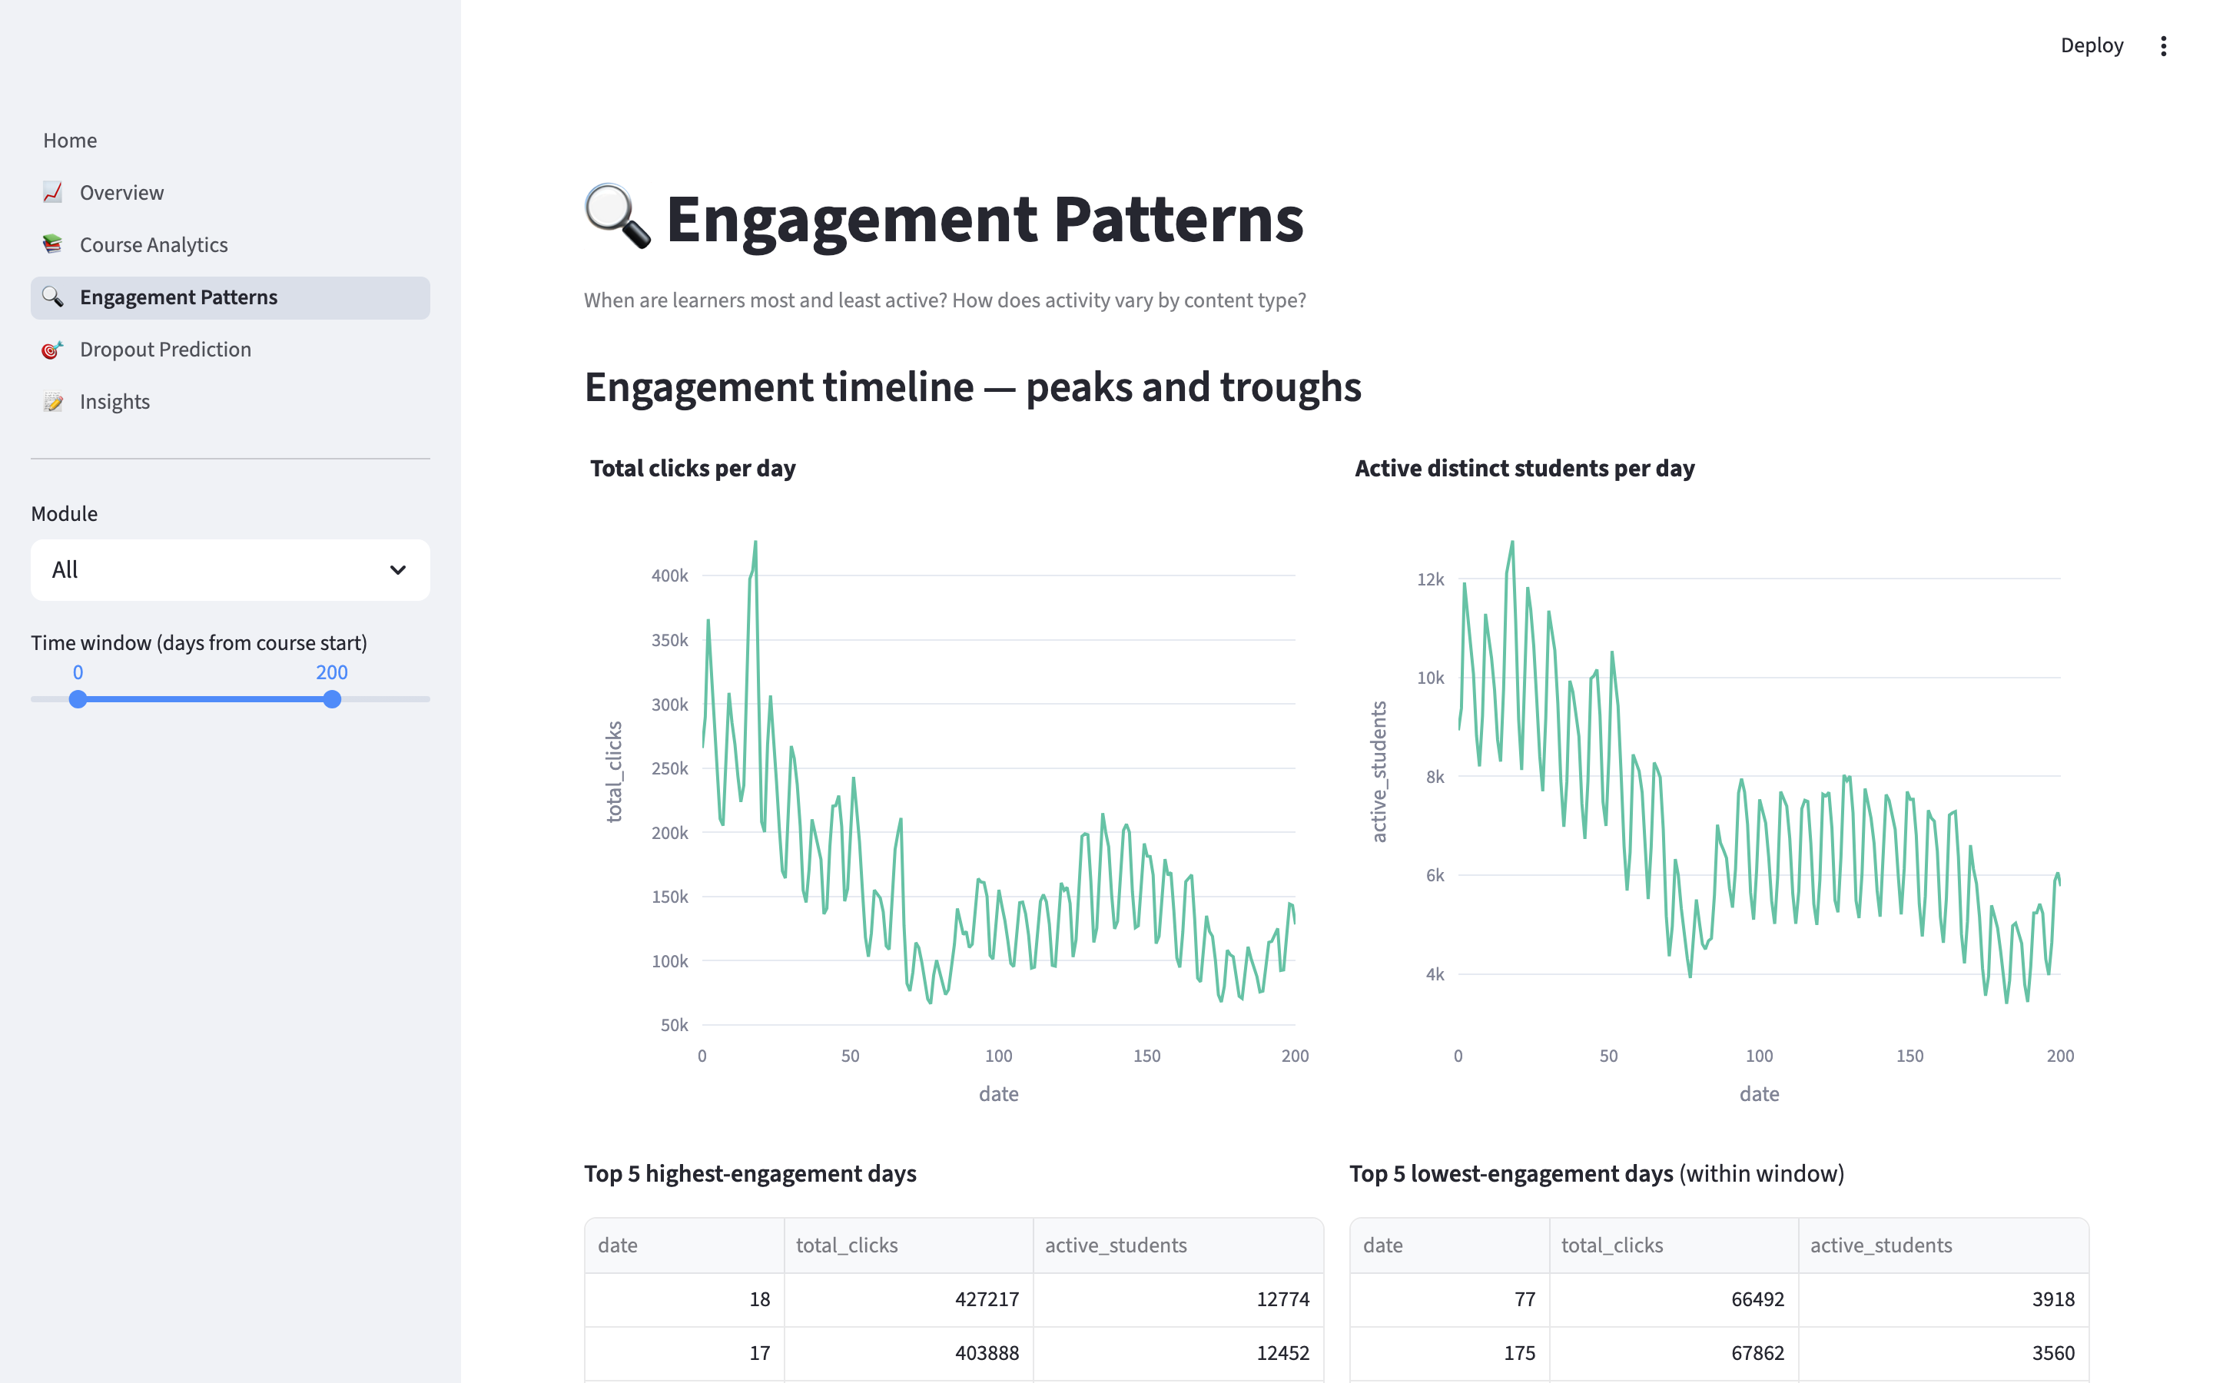
SLIDE 18
Dashboard — Course Analytics & Engagement Patterns
Course Analytics — enrolment popularity, pass/withdraw rates, module × presentation heatmap
Engagement Patterns — click and active-student timelines, peak/trough day tables
EduPulse — MCA Project Viva
18 / 24
Notes:
Course Analytics answers 'which course is popular?' and 'which is failing?' Engagement Patterns answers 'when do students engage most/least?' — filters by module and time window.

Slide 19
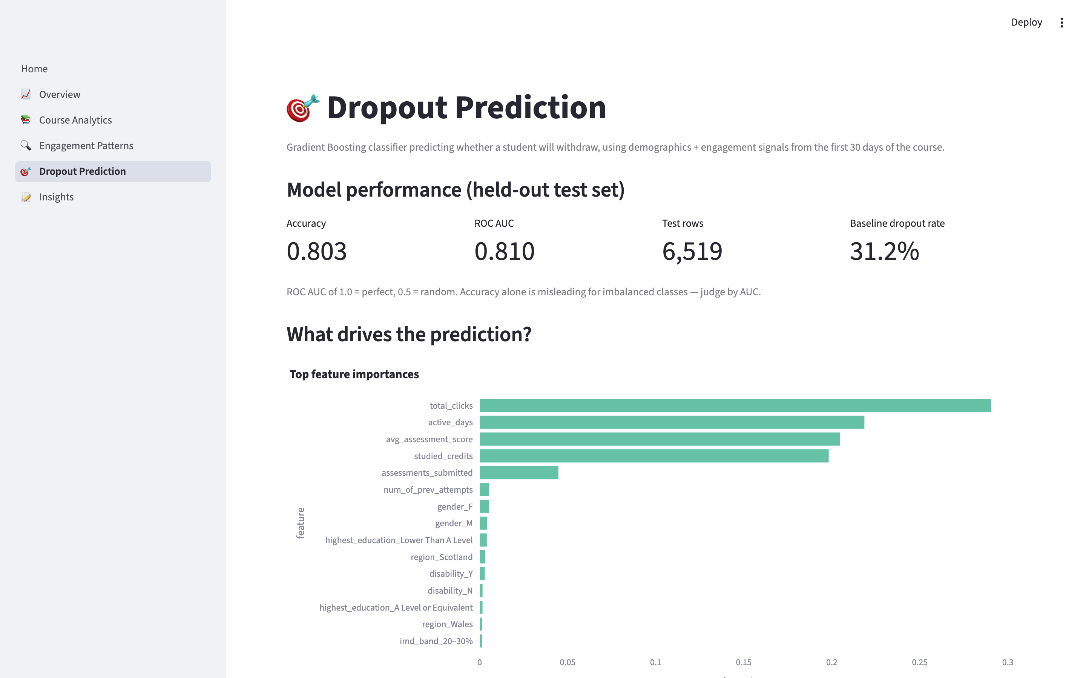
SLIDE 19
Dashboard — Dropout Prediction
The predictive layer administrators actually act on
EduPulse — MCA Project Viva
19 / 24
Notes:
This is the money slide. Model metrics at the top (0.803 accuracy, 0.810 AUC), feature-importance bar chart below. The admin selects a cohort, sees the top-20 at-risk students, and exports the full ranked list as CSV for outreach.

Slide 20
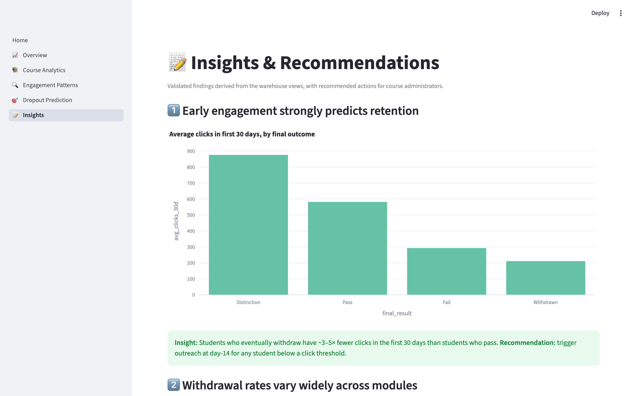
SLIDE 20
Dashboard — Insights & Recommendations
Four validated findings, each with an admin action
EduPulse — MCA Project Viva
20 / 24
Notes:
Four findings: (1) early engagement predicts retention, (2) withdrawal rate varies ~20 points across modules, (3) IMD deprivation band correlates with withdrawal, (4) prior attempts are a risk signal. Each with a concrete admin recommendation.

Slide 21
SLIDE 21
Testing & Deployment
• Unit tests — 8 tests across cleaner, warehouse loader, model trainer.
• Integration test — full ETL pipeline; verifies row counts, model AUC ≥ 0.75.
• System tests — every dashboard page, filter, and CSV export.
• 18 documented test cases, all PASS.
• 4 real bugs surfaced and fixed (OULAD URL, '?' marker, INSERT column order, pyarrow wheel).
• Deployment — public GitHub repo + Streamlit Cloud auto-rebuild on every push to main.
• Live URL — cost is zero, always-on, HTTPS via Streamlit-managed TLS.
EduPulse — MCA Project Viva
21 / 24
Notes:
Panel will ask about bugs — call out Bug-004 (pyarrow → DuckDB parquet) because it's a real deployment war story. Bug-003 (SELECT column-order mismatch) was surfaced by your integration test catching an INSERT failure.

Slide 22
SLIDE 22
Results — Comparison with Existing Systems
• Cost — $0 per user per month (Tableau ≈ $70).
• Free public deployment — Streamlit Community Cloud (Tableau: no; Superset: possible w/ effort).
• Learning-analytics data model — built-in (Tableau / Superset: bring-your-own).
• Native dropout-prediction layer — included (others: custom build required).
• Single-language stack — Python only (others: Python + JS + SQL).
• Operational surface area — one Streamlit process (others: multi-tier).
• Query latency — sub-200 ms on 10.6M-row fact table.
EduPulse — MCA Project Viva
22 / 24
Notes:
Only claim EduPulse wins on things it actually wins on. Acknowledge the trade-off: Tableau/Superset offer drag-and-drop authoring, EduPulse does not — but for a designed dashboard aimed at one persona, that trade is acceptable.

Slide 23
SLIDE 23
Future Scope
Six concrete next steps — not vague generalities
• Real-time ingestion from live LMS (Moodle / Canvas REST APIs).
• Role-based access control + multi-tenant deployment.
• Calibrated probabilities (isotonic regression) + per-student SHAP explanations.
• Automated weekly outreach digests via GitHub Actions cron.
• Mobile-responsive layout for on-the-go administrators.
• Periodic model retraining + drift monitoring badge.
EduPulse — MCA Project Viva
23 / 24
Notes:
Every future-scope item is scoped and has an implementation hint — this is what the MCA guideline calls out as the difference between good and vague future-scope sections.

Slide 24
Thank you
Questions?
GitHub · github.com/deepakjoshi-dj/edupulse
Deepak Kumar Joshi · O24MCA112387 · MCA (CU Online)
Notes:
Close politely: 'Thank you for your attention — I'm happy to take questions.' Sit down. Panel typically asks: (a) why this dataset, (b) why this algorithm, (c) how does it scale, (d) what would you change if you did it again. You have answers for all four.

