Slide 1
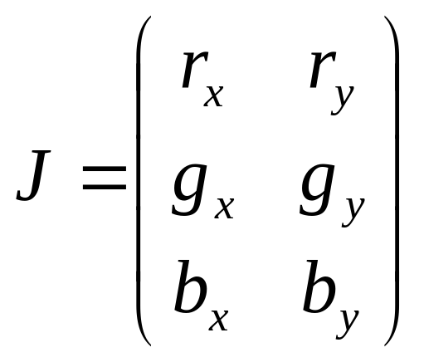
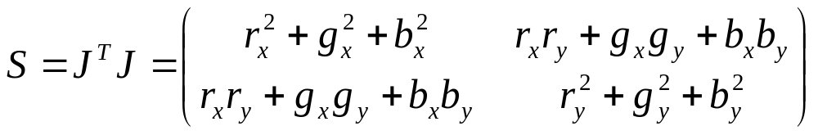
Color Edge Detection
Jacobian J
Structure matrix S

Slide 2
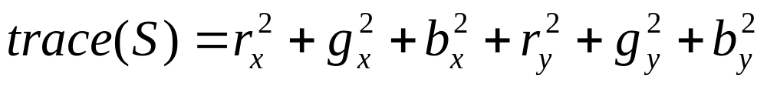
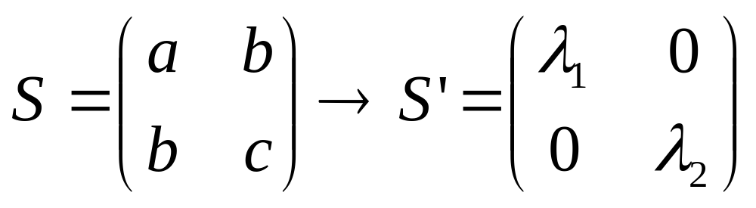
Edge strength
Edge strength at (x,y) is given by
Edge strength does not depend on the coordinate system; it is possible to rotate the coordinate system to make the elements that are not on the main diagonal zero

Slide 3
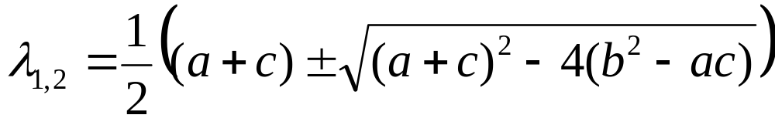
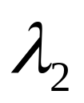
Eigenvalues of S
Solve
  Sx = λx, λ scalar is an eigenvalue of S,
  x=(x₁ x₂)^{T}
For nontrivial solution (x=0)
  det(S–λI)=0 ⇔ (a – λ)*(c – λ) – c²=0
should be 0

Slide 4
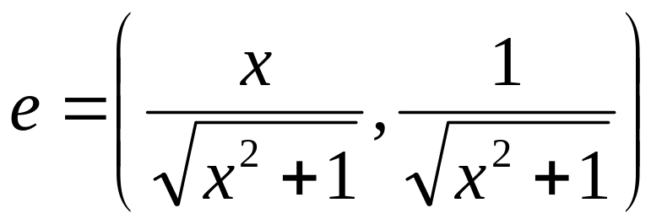
Eigenvectors of S
(a – λ₁)x + by = 0
bx + (c – λ₁) = 0
Set y = 1, (a – λ₁)x = – by = – b
If (a – λ₁) ≠ 0 (edge not horizontal or vertical, x=1 otherwise)
x = – b/(a – λ₁)
Normalize to get edge direction:

Slide 5
Edge strength and direction
Edge strength
(λ₁)^{1/2} the larger eigenvalue of S
Edge gradient direction, the corresponding eigenvector e
Can apply non-maxima suppression now
(λ₁)^{1/2}
e

Slide 6
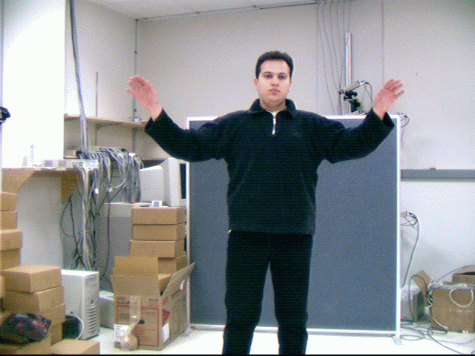
Example

Slide 7
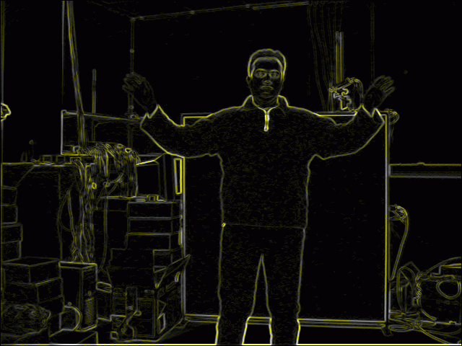
Color edges

Slide 8
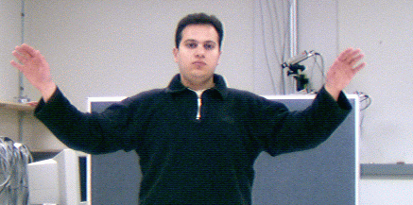
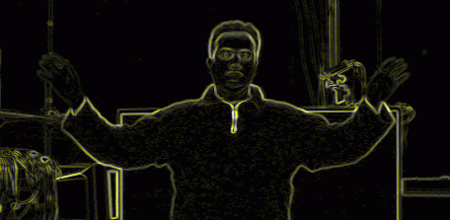
Non-maximum suppression results
Yellow middle:
maximum
gradient edges

Slide 9
Application: Edge-based background subtraction
“Learn” background edges (mean values and standard deviations of horizontal and vertical edges/derivatives)
Subtract the background image from a new image
Mark a point as a foreground if the difference is significant (should be as large as the larger of the background and the new image values)

Slide 10
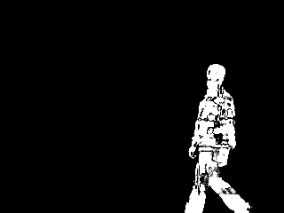
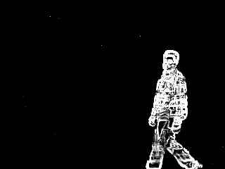
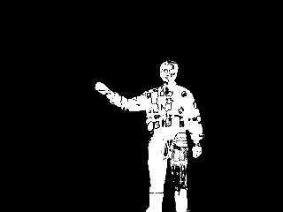
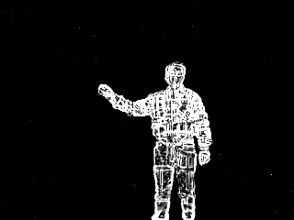
Edge-based moving object detection
color
edge

Slide 11
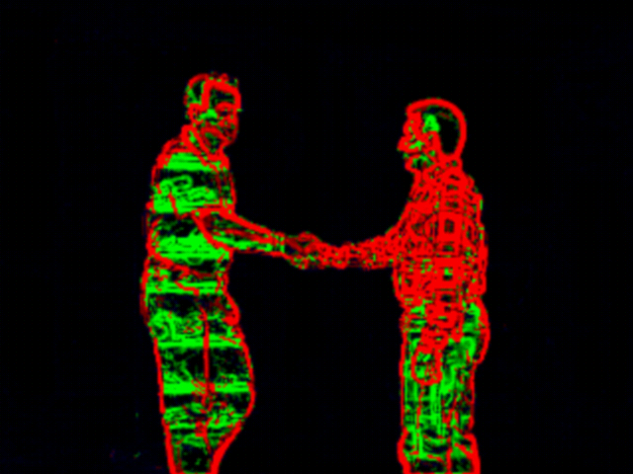
Background Subtraction: Edge Classification
Occluding edges:
edges of objects that have entered the scene
Occluded edges: background edges that have been occluded by objects
Background edges: (not shown): edges that have not changed

