Slide 1


SAPTHAGIRI COLLEGE OF ENGINEERING Department of Information Science and Engineering Final Year Project 2020-21
On “Real Time Face Mask Detection
using Deep Learning”
Phase 2
Under the guidance of:
Dr Asha P N
Associate Professor
Department of ISE
Presented by:
1SG17IS003-Aditya N
1SG17IS008-Akshay P
1SG17IS012-Arpita Prakash Paramaj
1SG17IS027-Deepak K

Slide 2
INDEX
1.Introduction
2.Objectives
3.Requirements
i)Functional requirements
ii)Non functional requirements
iii) Software requirements
iv) Hardware requirements
4. Design
i) System design
ii) Detailed design

Slide 3
1. INTRODUCTION
1.1 Overview
A composite model using deep machine learning for face mask detection will be proposed.
Our Intention is to design it using computer vision techniques.

Slide 4
2. OBJECTIVES
To build a ML model to detect whether a person is
wearing mask or not.
Using Streamlit module for the front end framework and
providing the results for the face mask detection.
Alert system, popups, voice system are integrated.

Slide 5
3. REQUIREMENTS
Functional Requirements
Non Functional Requirements
Open the Streamlit using the anaconda prompt.
We can view couple of Options:
1. Browsing Photo
2. Live Video Streaming
3. Voice Alert System
4. Covid-19 Status around the
World
.
Accuracy
Performance
Efficiency
Responsive
Maintainability

Slide 6
Hardware Requirements
Software Requirements
Device | PC, Laptop
Wi-Fi Connectivity | 2.4 and 5 GHz
Camera | Required a good camera of minimum 5 megapixel.
Operating system | Windows
Programming Language | Python 3.x
Python Libraries Included Python packages: | Opencv, numpy, os, Tensorflow, keras, imutils, argparse
User Interface | StreamLit
IDE | Jupyter notebook, Anaconda prompt, Visual code studio, Google colab

Slide 7
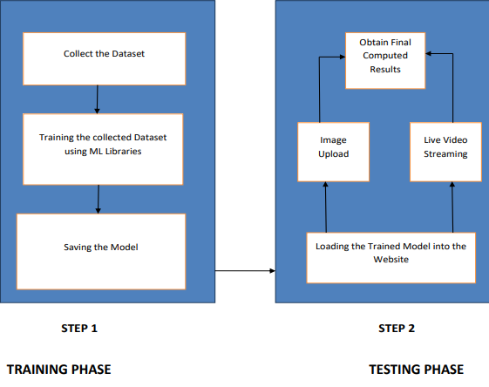
4. DESIGN
4.1 System Design
Fig 4.1

Slide 8
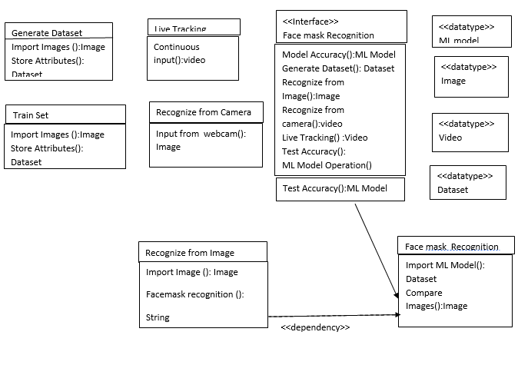
4.2 Class Diagram
Fig 4.2

Slide 9
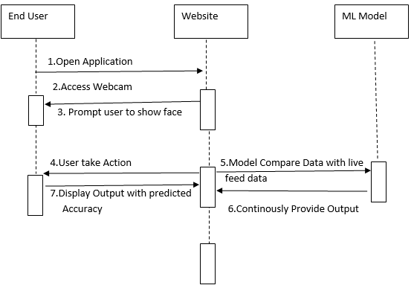
4.3 Sequence Diagram
Fig 4.3

Slide 10
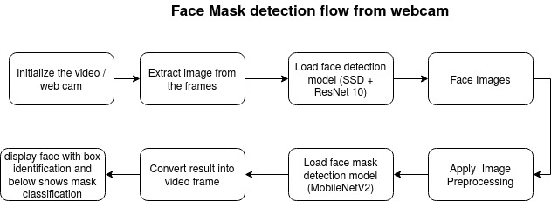
4.4 Activity Diagram
Fig 4.4

Slide 11
THANKYOU

