Slide 1

TECHNICAL SEMINAR ON “Automation Pipeline and Build Infrastructure using DevOps”
SAPTHAGIRI COLLEGE OF ENGINEERING
(Affiliated to Visvesvaraya Technological University, Belagavi & Approved by AICTE, New Delhi.)
Department of Information Science & Engineering
Under the Guidance of : Prof Dr. Asha P N Dept of ISE
Presented By: Deepak K 1SG17IS027

Slide 2
ABSTRACT
A complex project involves complex development effort and it involves more manual work and more time. It is very difficult to reduce the time involved. In the development cycle the use of the concurrent engineering concept only increases the problem by increasing the number of people and department involved at any point in the development effort. DevOps techniques can be used in these projects to control the use of project elements. Using DevOps Technique many companies involved in complex projects are able to reduce both development time and manual work involved in projects. The usual way of building a project in which code are distributed among team members leads to many issues like integration and compatible problems. This project builds an automation system that handles all the integration and deployment phrases automatically.

Slide 3
INTRODUCTION
The rapid growth of data and system configuration has brought about an unprecedented rise in building applications for real world use case.
The existing version control system gives us integration but that need to be tuned for more effective way of using that tool.
DevOps is a combination of the terms development and operations, meant to represent a collaborative or shared approach to the tasks performed by a company's application development and IT operations teams.

Slide 4
INTRODUCTION (Cont’d)
The main purpose of this project is to automate the development process of a project that includes the phrases of building the code, testing and deployment of the project which need more time when doing these tasks manually. Eight builds are involved which would take a huge time if done manually.
The existing version control system does the three phrases separately which takes more time and work. It is a lengthy process that needs more space and time.
This project uses DevOps which helps in Continuous Integration and Continuous Deployment of the distributed code that are required at the single phrase for building, testing and deploying the project.

Slide 5
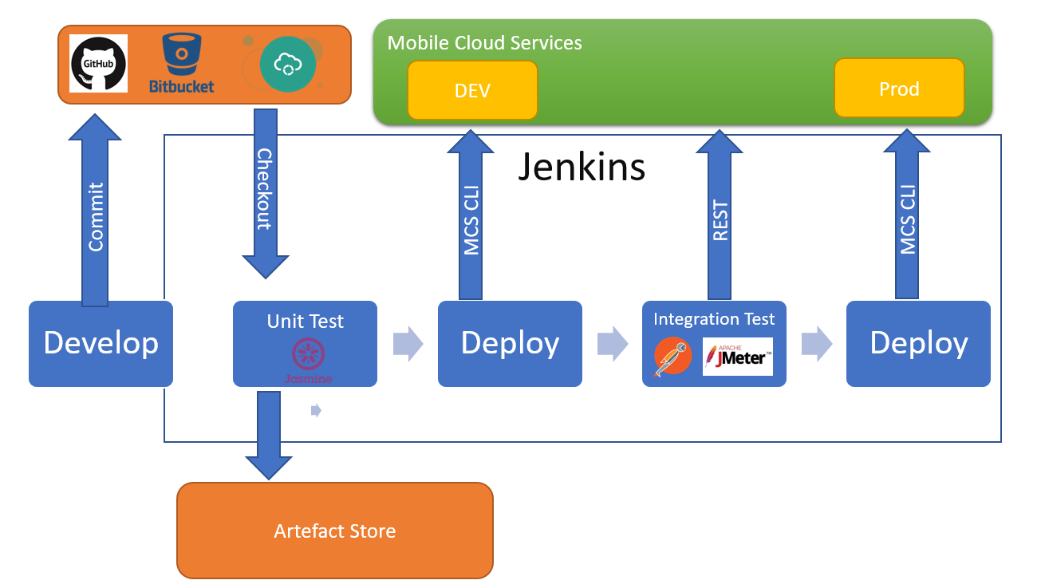
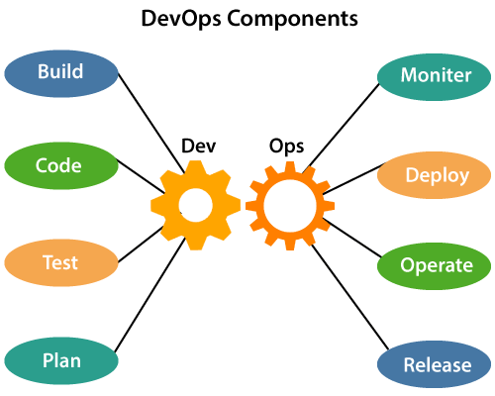
Technical Details
Fig 1: System Architecture

Slide 6
Technical Details(Cont’d)
Steps involved in system architecture for automation:
Configure the yml in GitLab according to developers need.
Make the GitLab for storing code and make it a centralized repository.
Construct the CICD pipeline for building, testing and deployment of the code across the developers.
Push the modified code to the pipeline.
Build the test suite for regression testing.
Initiate the system to do different phrases.
As per the report do the improvement process

Slide 7
Merit
Complete process from start build to end deploy in production is automatic
Understanding the flow of data through the pipeline and understating the resource life cycle for the virtualized resources, the resources are not limited by hardware but the network as well as data resources.

Slide 8
Demerit
Since the codes are build and deployed automatically, We should be careful while writing script to run the complete pipeline. Any semantic error may lead to build of invalid product or may conflict in production

Slide 9
APPLICATIONS
Deployment, testing and rapid designing became ten times faster. It became effortless for the telco service provider to add patches of security every day, which used to be done only every three months.
Pipeline definition defined and jobs of the pipeline limited only to the action of context required.
Mindful resource management by the pipeline, this means that resource be destroyed as soon as their scope of use is closed.

Slide 10
Future Enhancements
This System architecture can be implemented for machine learning domain. Where a lot of machine learning process needs manual intervention which can be automated. Using CI/CD pipeline helps time and energy invested manually on developing machine learning Model. This also reduces bugs and errors in ML model.

Slide 11
CONCLUSIONS
In the existing system, the developer need to manually do the process of building, testing and deployment which consumes more time and even if user use scripts to do these process user can’t stop while execution but if user use these automation system, the developer do these process in a pipeline manner and get the report periodically even if any phase got error the system don’t move to next phase. It helps the developer to track the issues and fix it easier. In future this work can be further improved with the help of different phrases to be added to the existing system that can further improve the time and space issues.

Slide 12
Thank You

