Slide 1

GyanDaan
Place where you can share your knowledge
Submitted by:
Arun Janghiniya
Submitted to:
Mrs.Sushila Vishnoi

Slide 2
Contents
Introduction
Benefits
Features
Requirements
Implementation
Snapshot
Scope
Notes:
Lesson descriptions should be brief.

Slide 3
Introduction
Aim is to develop an online Knowledge management system which will be helpful to college students and faculty.
Students/faculty will be able to upload any type of information/article.
Students/faculty logging in may also access/search any information put up by others.
Students can view all the articles/information related to their interest on top.
Notes:
Example objectives
At the end of this lesson, you will be able to:
Save files to the team Web server.
Move files to different locations on the team Web server.
Share files on the team Web server.

Slide 4
Benefits
For College:
Easy to manage all articles (Computer Science, Database etc.).
All information/articles can be synchronized in one place.
KMS is beneficial for both students/faculty.
It is helpful to maintain the students record (admission no, roll no, dob etc.)
Easy to create any kind of article.
Easy to query all related details of student.
Easy to read and publish article uploaded by students.

Slide 5
Benefits
For Students:
Students will be aware to their interested fields
Students can get knowledge
Don’t have to search other places
Can manage their articles easily
Can get review about their article by likes/dislikes of other students
Comments can help understanding other students requirements

Slide 6
Features
Registration and login system
Sharing point of knowledge article of all fields
Providing knowledge among other students
Notification after signup
Searching by various ways like date of post, field, likes, author name, etc
Simple to use interface
Flexibility in features

Slide 7
Requirements
Functional
User registration
Content management (articles, news.)
Non-functional
Performance requirements
Safety requirements
Security requirements
Software quality attributes

Slide 8
Implementation
Login section for users
Sign-up facility for new users
Can upload articles
Filter articles by date, author, article rank and interest
Put query if facing any problem

Slide 9
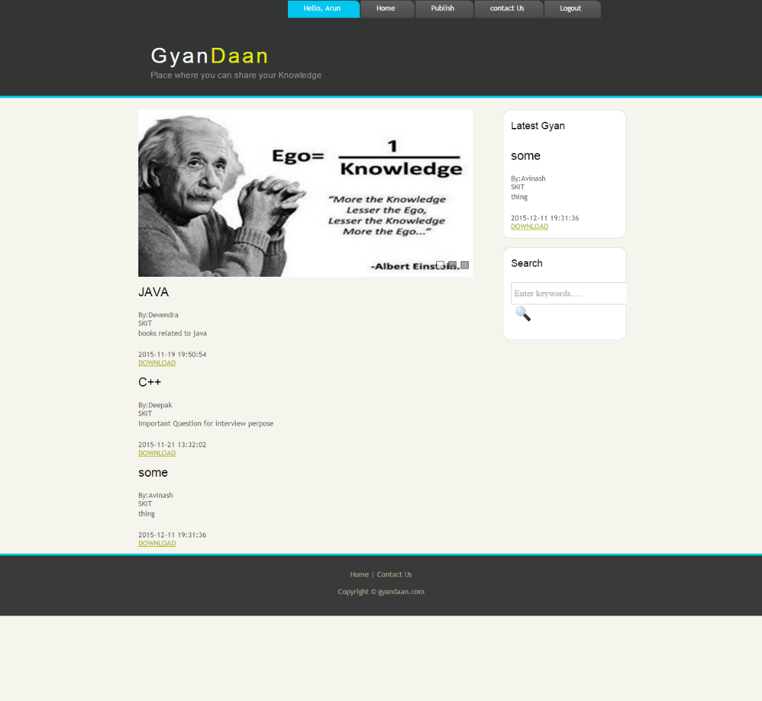
Home Page

Slide 10
Scope
Easy to use if all information is at one place.
Helpful for students and faculty.
Solutions for student queries will be there.

Slide 11


