Slide 1
Race
Races in cyber security

Slide 2
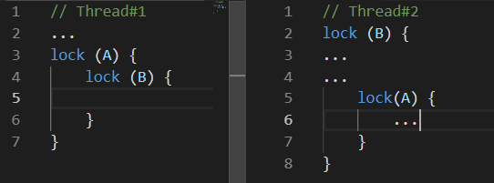
What is deadlock?
A simple example
Consider this example where Thread 1 and thread 2 is executed at a time
Simultaneously A will be locked by thread 1 and B will be locked by Thread 2
Now Thread 1 will wait till B is released and Thread 2 will wait till A is released
Hence both thread will wait indefinitely

Slide 3
So now what is race condition?
A short note
A race condition attack happens when a computing system that’s designed to handle tasks in a specific sequence is forced to perform two or more operations simultaneously
Other names used to refer to this vulnerability include Time of Check/Time of Use or TOC/TOU attacks
As per the OWASP testing guide, “A race condition is a flaw that produces an unexpected result when the timing of actions impact other actions. An example may be seen on a multithreaded application where actions are being performed on the same data. Race conditions, by their very nature, are difficult to test for.”

Slide 4
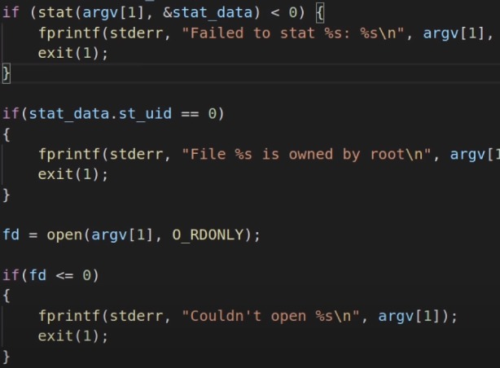
Race in file permissions
Consider an example where I am a normal user and want to access a file secret.txt which can be only read by root
I create a script to open secret.txt and check the permission, we cannot read it
What happens is , the file is opened first and now the opened file is verifies if the permission is user level
Now we can use syscall
For this we create a user created file name test.exe
  While(1){
  Syscall(SYS_remaneat2, AT_FDCWD, secret.txt, AT_FDCWD, test,txt, RENAME_EXCHANGE)
  }
  This code will exchange the names infinite times
  If we write a script to read the file now we will be able to read the file somehow

Slide 5
Race in web application
API level
Whenever there is creation, deletion and changes , We can test the race condition
For this we can use turbo intruder (burp suite extension) and zgrab
The success of the race condition exploit depends on how fast and how many requests are being sent
Web app client level
We can bypass the captcha using the race condition
POC for the captcha bypassing is below
https://portswigger.net/research/cracking-recaptcha-turbo-intruder-style
Bank transaction can be tested for race condition as they are very common due to the consistency and atomicity
Meltdown is famous attack due to race condition
https://github.com/TheHackerDev/race-the-web - race the web can be used for testing

Slide 6
Remediations
Remove dependencies as much as possible
Use mutex(mutual exclusions)
Implement ATOM(atomicity, consistency, isolation , durability) in DBMS
Don’t create predictable file since the user may target the particular file, eg. Web.config
Sysnchrounous process is recommended while using critical resourse

Slide 7
References:
https://www.youtube.com/watch?v=5g137gsB9Wk
https://lab.wallarm.com/race-condition-in-web-applications/
https://medium.com/@ciph3r7r0ll/race-condition-bug-in-web-app-a-use-case-21fd4df71f0e
https://www.mcafee.com/blogs/enterprise/testing-race-conditions-web-applications/

