Slide 1
Centralized Criminal Data Extraction using Face Recognition

Slide 2
Contents
Abstract
Introduction
Literature Survey
Problem Statement & Hypothesis
Implementation
Result Analysis
Future Work
Conclusion
References

Slide 3
Abstract
Identifying a person with an image has been popularized through the mass media. However, it is less robust to fingerprint or retina scanning. This presentation describes the face detection and recognition minor-project. It reports the technologies available in the Open-Computer-Vision (OpenCV) library and methodology to implement them using Python. For face detection, Haar-Cascades were used and for face recognition Local binary pattern histograms were used. The methodology is described including flow charts for each stage of the system. Next, the results are shown including plots and screen-shots followed by a discussion of encountered challenges. The presentation is concluded with the opinion on the project and possible applications.
KEYWORDS :-
Face Recognition, numpy, python , haarcascade, openCV, LBHP.

Slide 4
Introduction
Objective -
To identify a human face in the camera footage and recognize the person’s identity and hence utilize this information in a real world application.
Technology Used-
Open computer Vision
Python Libraries
Haarcascade
LBHP Face Recognizer

Slide 5
Literature Survey
As one of the most successful applications of image analysis and understanding, face recognition has recently received significant attention, especially during the past several years. At least two reasons account for this trend: the first is the wide range of commercial and law enforcement applications, and the second is the availability of feasible technologies after 30 years of research. Even though current machine recognition systems have reached a certain level of maturity, their success is limited by the conditions imposed by many real applications. For example, recognition of face images acquired in an outdoor environment with changes in illumination and/or pose remains a largely unsolved problem. In other words, current systems are still far away from the capability of the human perception system. This presentation provides an up-to-date critical survey of still- and video-based face recognition research..

Slide 6
Problem Statement & Hypothesis
In identification problems, the input to the system is an unknown face, and the system reports back the decided identity from a database of known individuals, whereas in verification problems, the system needs to confirm or reject the claimed identity of the input face.
The system needs to tackle the problem of images taken in low lighting condition with increased dataset and hence improving the efficiency of the facial recognition system.
It is assumed that the Centralized Dataset is available to access to all the authorities using this system.

Slide 7
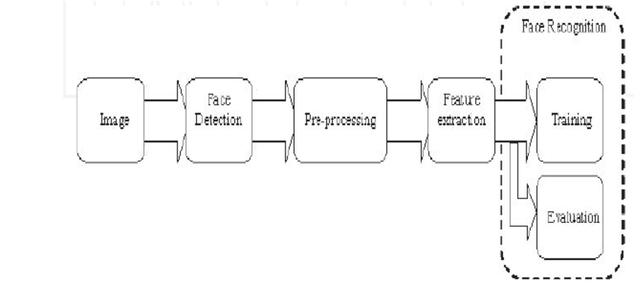
Implementation
Architecture Model –

Slide 8
Algorithm Analysis
The Algorithm of Face Recognition system consists of Three major steps.
Acquisition of Face Data
Extracting the features of the faces
Recognition of face

Slide 9
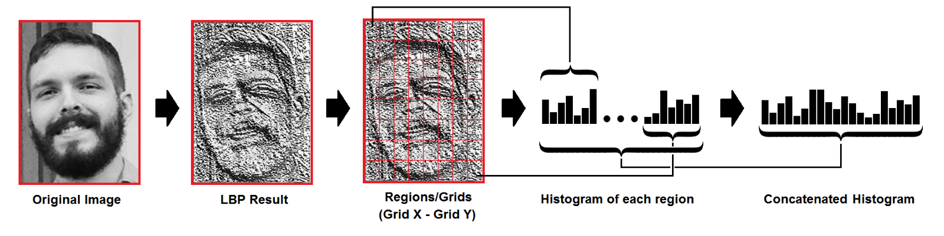

Acquisition Of Face Data
Let face image $I(x,y)$ be a two-dimensional $N$ by $N$ array of (8-bit) intensity values
Can consider image an $N^{2}$ vector of dimensions
Image of 256 by 256 becomes a 65,536 vector of dimension
Or a point in 65,536-dimensional space

Slide 10
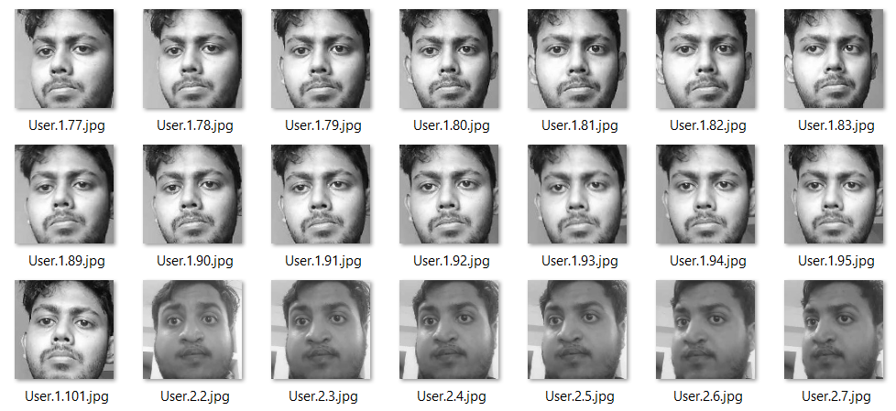
Dataset Creation
Camera is used to capture images
A face is detected using Face Detection algorithm.
It captures face image in BGR then it is converted to Greyscale.
Images are then cropped and resized so that it only contains faces.
Around 100 images are stored in a Dataset file.

Slide 11
Extracting Face Features
Four possibilities for an input image
Near face space, near face class
Known face
Near face space, not near face class
Unknown face
Not near face space, near face class
Not a face, but may look like one (false positive)
Not near face space, not near face class
Not a face

Slide 12

Training the Dataset
Model was trained using greyscale images from the dataset file.
Creates training file that holds the $M$-dimensional face space
recognizer=cv2.face.LBPHFaceRecognizer_create();
recognizer.train(faces , IDs)
recognizer.save("recognizer/ trainingData.yml"));

Slide 13
Face Recognition
Steps to recognizing face
Capture image
Detect face
Crop and resize around face
Project across all eigenvectors
Find face class that minimizes Euclidian distance
Return label from face class, and Euclidian distance
Euclidian distance also called Confidence level
Id , conf= rec.predict(gray[ y:y+h, x:x+w])

Slide 14
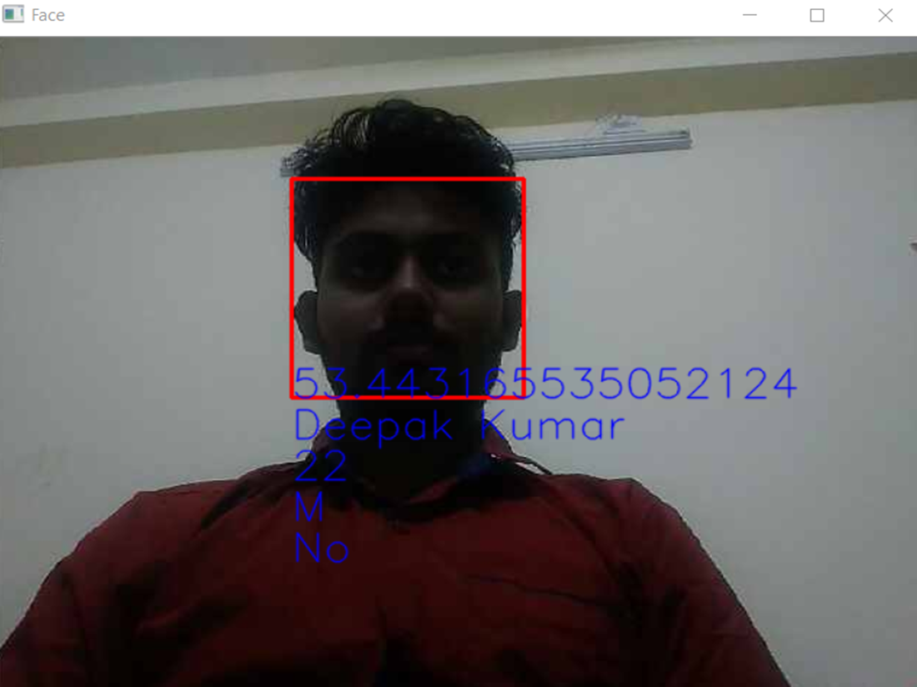
Simulation Scenario

Slide 15
Result Analysis
The Accuracy of the Facial recognition with Open Computer Vision technology using LBHP Face Recognizer is around 60-70 % with optimal lighting conditions.
This result is found to be of the maximum accuracy as compared to other Facial Recognizer of OpenCV like EigenFaces, FisherFaces face recognizer.
The Confidence was set at less than 65 to attain the maximum accuracy.
If a captured face data does not matches with the data present in the dataset, then it displays a message , “No record found”

Slide 16
Future Work
Currently, the available face recognition approaches that use the 2D information of face images, suffer from low reliability because of their sensitivity to illumination conditions, facial expressions and changes in pose. The inadequate performance of these approaches should come as no surprise as these 2D-based algorithms ignore the fact that the human face is naturally a complex 3D object characterised by distinguishing features such as eyes, mouth and nose and by skin pigmentation; consequently, it needs to be described by a 3D model taking into account geometrical information of the 3D face.

Slide 17
Conclusion
To improve the recognition performance, there are MANY things that can be improved here, some of them being fairly easy to implement. For example, you could add color processing, edge detection, etc. You can usually improve the face recognition accuracy by using more input images, at least 50 per person, by taking more photos of each person, particularly from different angles and lighting conditions. If you can’t take more photos, there are several simple techniques you could use to obtain more. Face recognition is a challenging problem in the ﬁeld of computer vision, which has received a great deal of attention over the past years because of its several applications in various domains . Although research efforts have been conducted vigorously in this area, achieving mature face recognition systems for operating under constrained conditions, they are far from achieving the ideal of being able to perform adequately in all various situations that are commonly encountered by applications in the real world.

Slide 18
References
[1]Ahonen, Timo, Abdenour Hadid, and Matti Pietikainen. “Face description with local binary patterns: Application to face recognition.” IEEE transactions on pattern analysis and machine intelligence 28.12 (2006): 2037–2041.
[2]Ojala, Timo, Matti Pietikainen, and Topi Maenpaa. “Multiresolution gray-scale and rotation invariant texture classification with local binary patterns.” IEEE Transactions on pattern analysis and machine intelligence24.7 (2002): 971–987.
[3] Y. Adini, Y. Moses, and S. Ullma. Face recognition: the problem ofcompensating for changes in illumination direction. IEEE Transactions on Pattern Analysis and Machine Intelligence, 19:721–732, 1997.
[4] N. Ahmed, T. Natarajan, and K. R. Rao. Discrete cosine transform.IEEE Transactions on Computers, 23:90–93, 1974.
[5] F. Bach and M. Jordan. Kernel independent component analysis. Journal of Machine Learning Research, 3:1–48, 2002.
[6] M. Ballantyne, R. S. Boyer, and L. Hines. Woody bledsoe: His life and legacy. AI Magazine, 17(1):7–20, 1996.
[5] M. Bartlett, J. Movellan, and T. Sejnowski. Face recognition by independent component analysis. IEEE Trans. on Neural Networks, 13(6):1450–1464, November 2002.
[7] P. Belhumeur, J. Hespanha, and D. Kriegman. Eigenfaces vs. fisherfaces: Recognition using class specific linear projection. IEEE Transactions on Pattern Analysis and Machine Intelligence, 19(7):711–720, July 1997.
https://docs.opencv.org/2.4/modules/contrib/doc/facerec/facerec_tutorial.html#local-binary-patterns-histograms
http://www.scholarpedia.org/article/Local_Binary_Patterns

