Slide 1
Face Recognition using OpenCV
By- Deepak kumar mandal
akshit mittal
david Johnson ekka

Slide 2
Idea
Facial recognition for Automated data retrieval
Gain a better understanding of the subject
Can be used in Automatic Attendance , Criminal verification

Slide 3
Focus
Basic understand of OpenCV face recognition software and algorithms
Methods and Theory behind the LBHPFaceRecogniton method for facial recognition
Implementation using Python

Slide 4
openCV
OpenCV (Open Source Computer Vision Library) is released under a BSD license and hence it’s free for both academic and commercial use. It has C++, Python and Java interfaces and supports Windows, Linux, Mac OS, iOS and Android. OpenCV was designed for computational efficiency and with a strong focus on real-time applications. Written in optimized C/C++, the library can take advantage of multi-core processing. Enabled with OpenCL, it can take advantage of the hardware acceleration of the underlying heterogeneous compute platform.
Adopted all around the world, OpenCV has more than 47 thousand people of user community and estimated number of downloads exceeding 14 million. Usage ranges from interactive art, to mines inspection, stitching maps on the web or through advanced robotics.

Slide 5
LBHP Face Recognizer
Local Binary Pattern (LBP) is a simple yet very efficient texture operator which labels the pixels of an image by thresholding the neighborhood of each pixel and considers the result as a binary number.
LBP is combined with histograms of oriented gradients (HOG) descriptor, it improves the detection performance considerably on some datasets.
Using the LBP combined with histograms we can represent the face images with a simple data vector.
As LBP is a visual descriptor it can also be used for face recognition tasks, as can be seen in the following step-by-step explanation.

Slide 6
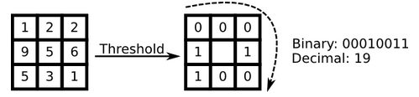
Local Binary Patterns
Describes local features of an object
Comparison of each pixel to its neighbors
Histogram of image contains information about the destruction of the local micro patterns

Slide 7
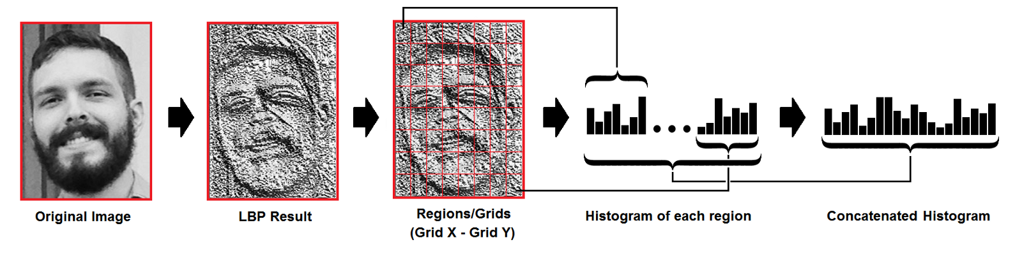

Basic Idea
Let face image $I(x,y)$ be a two-dimensional $N$ by $N$ array of (8-bit) intensity values
Can consider image an $N^{2}$ vector of dimensions
Image of 256 by 256 becomes a 65,536 vector of dimension
  Or a point in 65,536-dimensional space

Slide 8
Classifying
Four possibilities for an input image
Near face space, near face class
  Known face
Near face space, not near face class
  Unknown face
Not near face space, near face class
  Not a face, but may look like one (false positive)
Not near face space, not near face class
  Not a face

Slide 9
OpenCV and Theory
Beauty about OpenCV is a lot of this process is completely automated
Need:
  Training images
  Specify type of training
  Number of eigenfaces
  Threshold
  Input Image

Slide 10
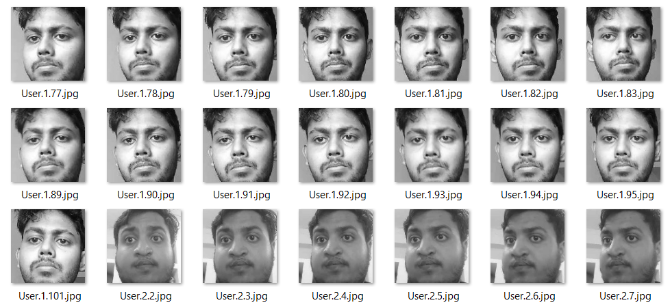








Dataset Creation
Dataset of negatives
Database of faces developed

Slide 11






Dataset Creation
Captured Positives
Used the camera to capture images
Images were then cropped and resized

Slide 12

Training
Model was trained using positive and negative images
Creates training file that holds the $M$-dimensional face space
Now have a base to recognize from
recognizer=cv2.face.LBPHFaceRecognizer_create();

Slide 13
Recognition
Steps to recognizing face
  Capture image
  Detect face
  Crop and resize around face
  Project across all eigenvectors
  Find face class that minimizes Euclidian distance
  Return label from face class, and Euclidian distance
    Euclidian distance also called Confidence level
recognizer.train(faces,IDs)
recognizer.save("recognizer/trainingData.yml")

Slide 14
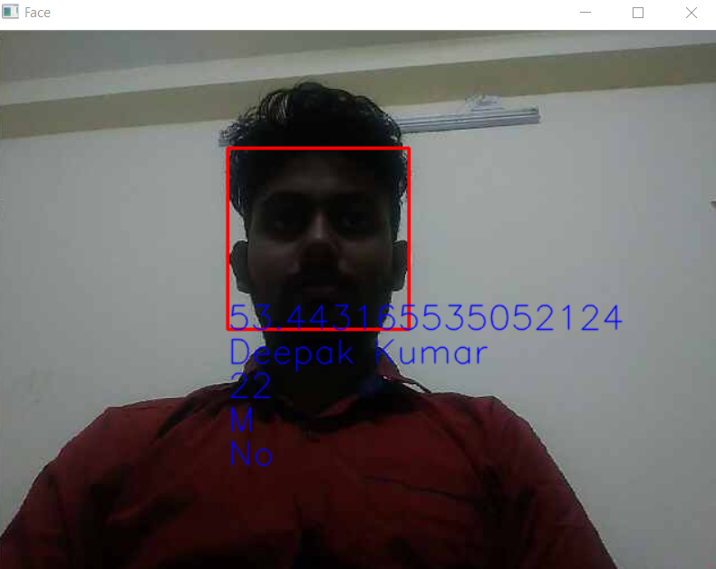
Detector

Slide 15
Conclusion
Face detection and recognition using openCV works well and the project was successfully completed. This project can be used in any field of interest where facial recognition is required. Automated attendance, criminal records etc. It can be concluded that the LBHPFaceRecognition method is quite efficient in recognizing the faces.

Slide 16
REFERENCES
Ahonen, Timo, Abdenour Hadid, and Matti Pietikainen. “Face description with local binary patterns: Application to face recognition.” IEEE transactions on pattern analysis and machine intelligence 28.12 (2006): 2037–2041.
Ojala, Timo, Matti Pietikainen, and Topi Maenpaa. “Multiresolution gray-scale and rotation invariant texture classification with local binary patterns.” IEEE Transactions on pattern analysis and machine intelligence24.7 (2002): 971–987.
LBPH OpenCV: https://docs.opencv.org/2.4/modules/contrib/doc/facerec/facerec_tutorial.html#local-binary-patterns-histograms
Local Binary Patterns: http://www.scholarpedia.org/article/Local_Binary_Patterns

