Slide 1
AI-Based Electronic Component
Remaining Useful Life Estimation
Machine-learning capstone project
Time-series feature engineering + regression
Dataset included is synthetic and for educational demonstration only

Slide 2
Problem Statement & Objectives
Estimate remaining useful life (RUL) from component operating measurements.
Study aging indicators such as temperature, load, ripple, ESR, capacitance and efficiency.
Compare Random Forest and Gradient Boosting regression.
Evaluate with MAE, RMSE and R² on unseen component IDs.

Slide 3
Dataset & Target
180 simulated components; observations sampled across component life.
Inputs: age cycle, ambient/case temperature, load, voltage, ripple, vibration, ESR, capacitance and efficiency.
Target: rul_cycles — simulated cycles remaining until end-of-life.
Provenance: synthetic simulation, not real laboratory or field measurements.

Slide 4
System Workflow
1. Generate / load time-series data
2. Validate and sort by component and cycle
3. Engineer stress, rolling-average and trend features
4. Split by component ID to reduce data leakage
5. Train two regressors and compare error metrics
6. Save model, prediction files, graphs and dashboard

Slide 5
Feature Engineering
Thermal stress above 40°C and squared normalized load.
Ripple stress, normalized age and ESR-to-capacitance ratio.
Efficiency loss relative to 100%.
Three-observation rolling means and first-difference trends for selected signals.

Slide 6
Models & Evaluation
Random Forest Regressor: ensemble of trees; models nonlinear interactions.
Gradient Boosting Regressor: sequential shallow trees; Huber loss.
MAE: average absolute error; RMSE penalizes larger errors.
R²: comparison against a mean-target baseline.

Slide 7
Results on Synthetic Holdout
Random Forest — MAE 11.99 cycles; RMSE 39.36 cycles; R² 0.9865.
Gradient Boosting — MAE 53.25 cycles; RMSE 84.03 cycles; R² 0.9386.
Random Forest selected by lowest MAE for this generated-data run.
Scores demonstrate the pipeline only; they do not establish real-world accuracy.

Slide 8
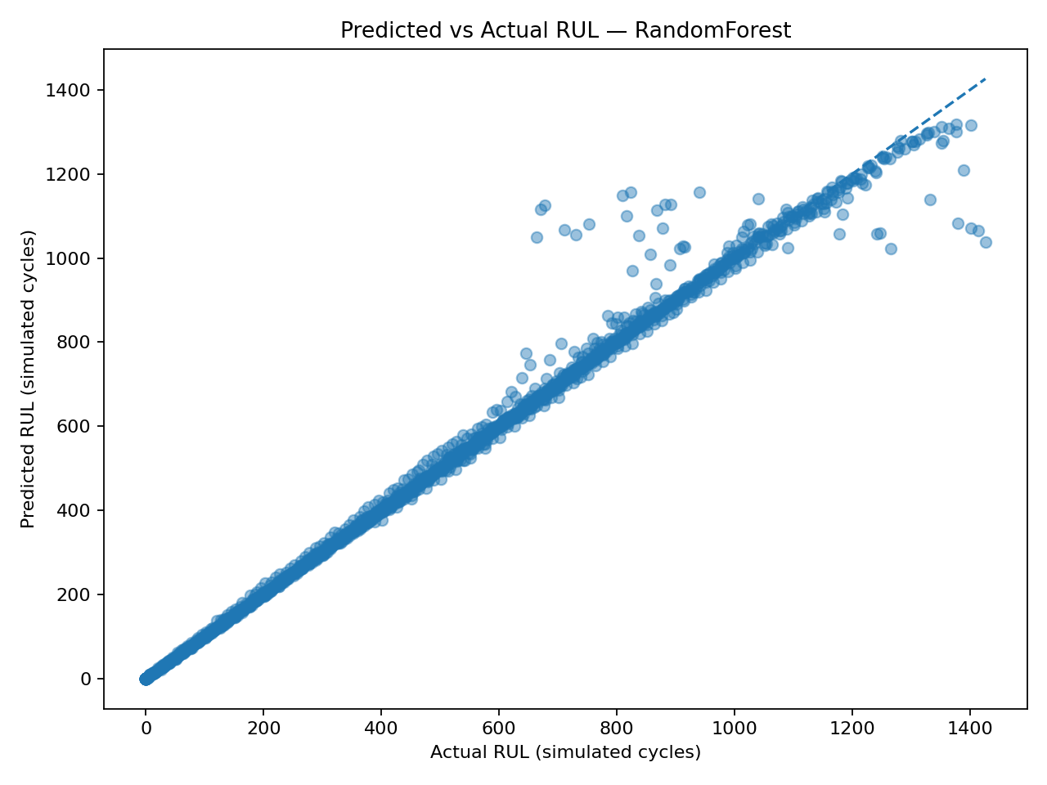
Predicted vs Actual RUL
Points closer to the diagonal indicate better predictions.

Slide 9
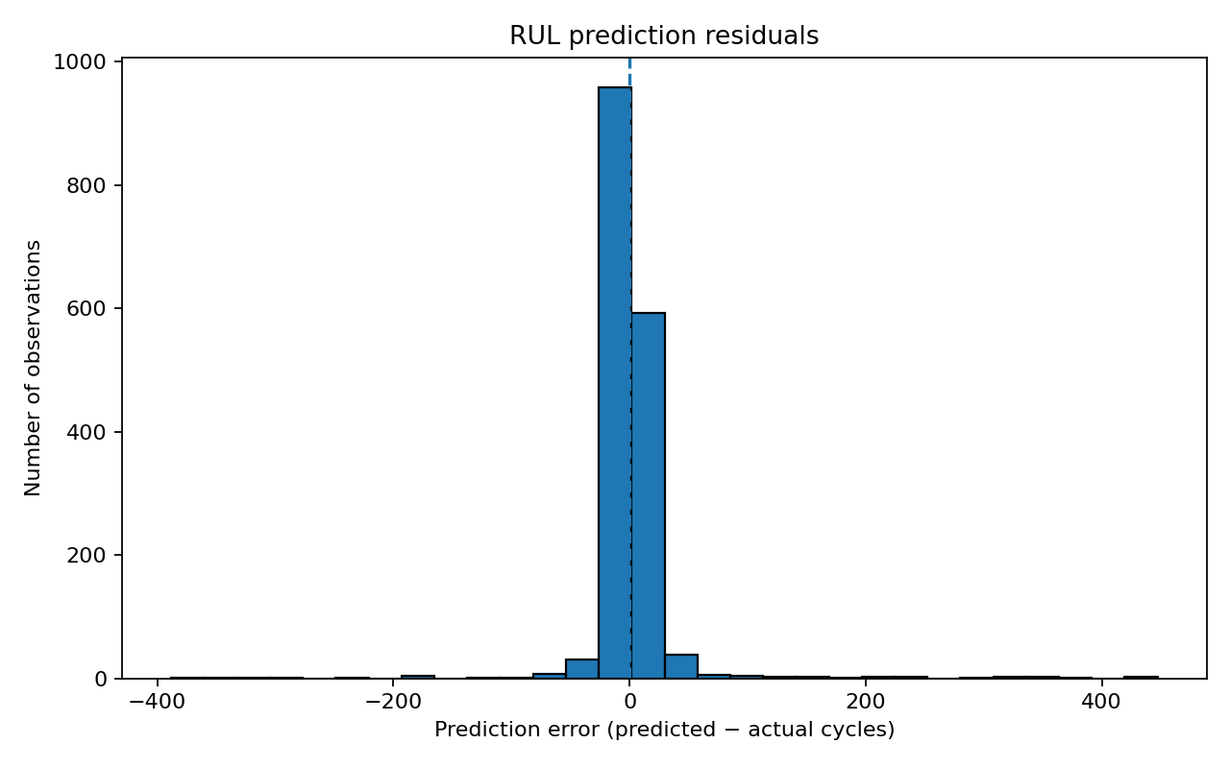
Residual Error Analysis
Residual = predicted RUL minus actual RUL.

Slide 10
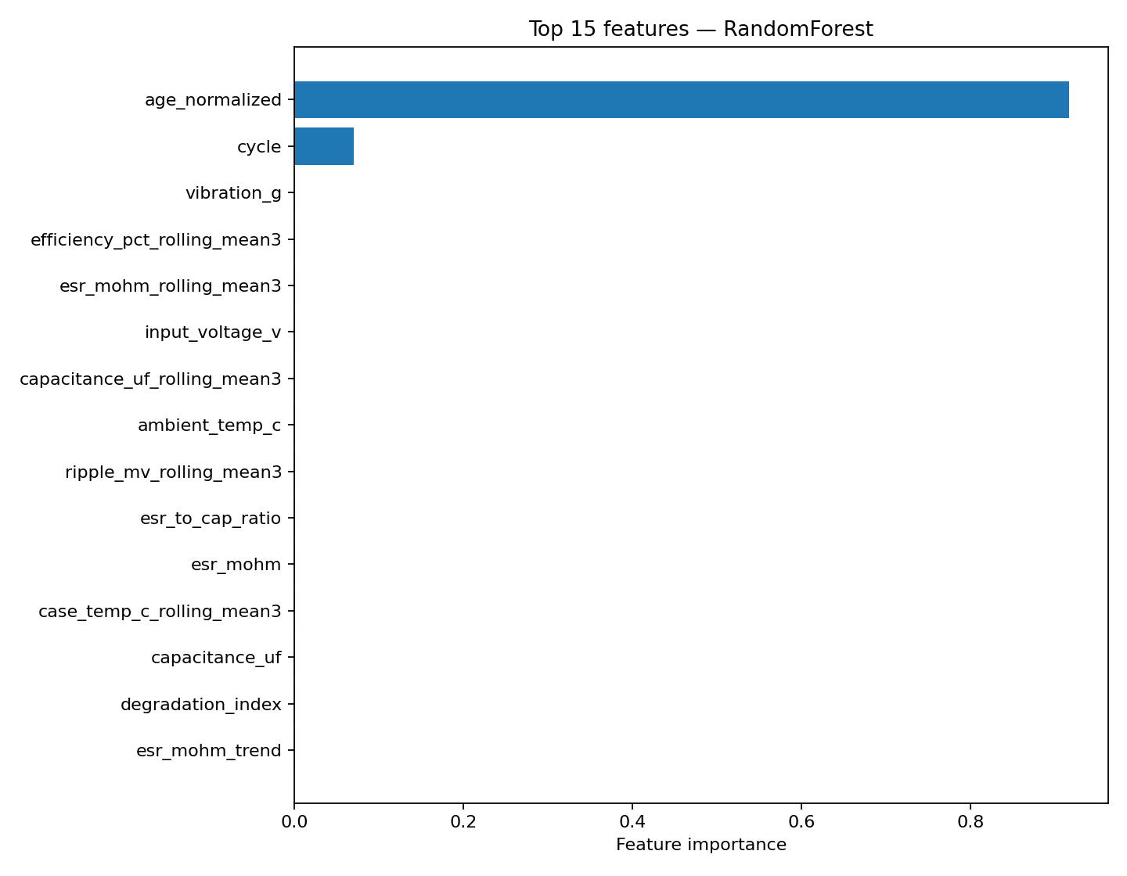
Feature Importance
Model importance indicates predictive association, not causation.

Slide 11
Dashboard & Demonstration
Optional Streamlit dashboard: explore dataset and enter operating measurements.
Run: streamlit run run_dashboard.py
The model estimates RUL in simulated cycles.
For one-row inputs, rolling/trend history is limited; real time-series inputs are preferable.

Slide 12
Limitations & Future Work
Synthetic data and simplified end-of-life assumptions.
No uncertainty intervals; feature importance is not causal evidence.
Replace with measured component-aging data and validate independently.
Add time-series cross-validation, confidence intervals and drift monitoring.
Do not use this prototype for safety-critical maintenance decisions.

Slide 13
Conclusion
Implemented a reproducible end-to-end RUL regression workflow.
Includes dataset generator, feature engineering, two models, metrics, plots and saved model.
Report, source code, viva questions and this presentation are included in the ZIP.

