Slide 1
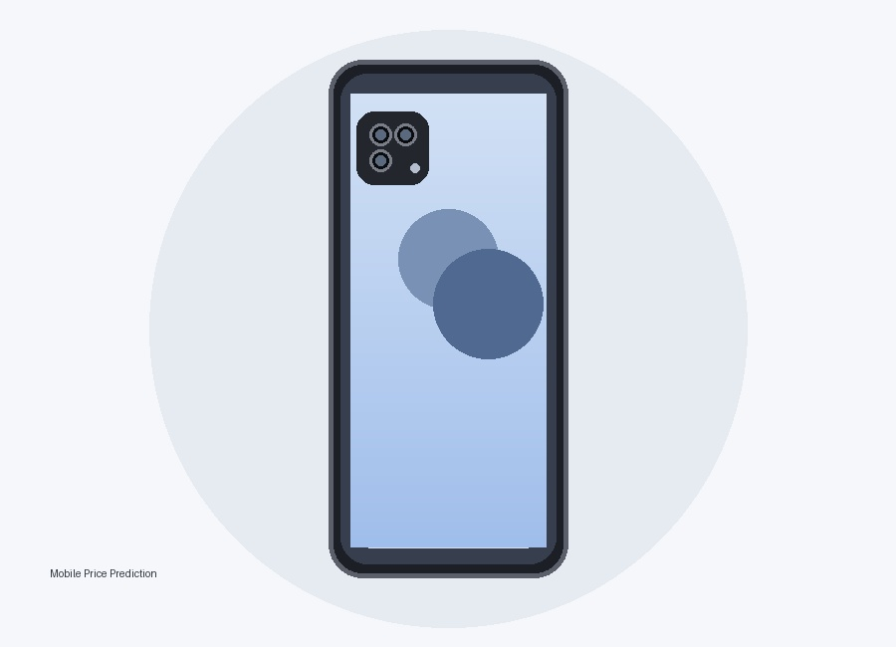
Feature Extraction and Price Prediction for Mobile Phones
Machine Learning Project Presentation
~ Deepak Rajput
What I did
Built an end-to-end workflow: loaded the mobile dataset, cleaned it, engineered useful features, explored relationships, trained regression models, compared performance, and selected the best model.

Slide 2
1. Project Objective
What problem am I solving?
• Goal: predict the price of a mobile phone from its specifications.
• Understand which hardware characteristics are associated with higher prices.
• Prepare raw mobile-phone data for machine learning.
• Compare multiple regression algorithms and select the best-performing model.
• Use the model results to explain price drivers in a business-friendly way.
What I say
My project combines EDA, feature engineering and regression modeling to estimate smartphone prices from product specifications.

Slide 3
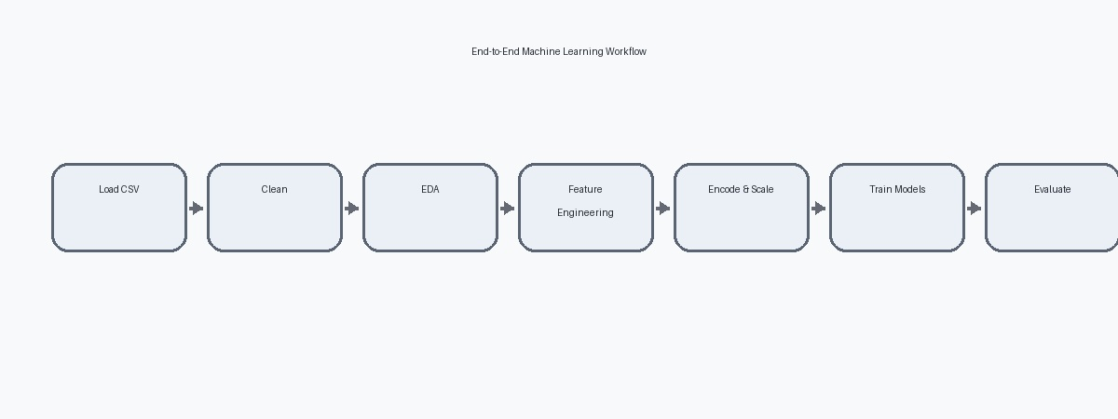
2. Dataset Overview
First step: understand the raw data
• Dataset size: 541 mobile-phone records and 12 original columns.
• Important fields: Model, Colour, Memory, RAM, Battery, cameras, AI Lens, Mobile Height, Processor and Price.
• Example records include Infinix SMART 7, MOTOROLA G32 and POCO C50.
• The target variable is Prize (price).
Key number
541 rows | 12 original columns

Slide 4
3. Data Cleaning
Make the dataset analysis-ready
• Removed the unnecessary Unnamed: 0 index field from the analytical columns.
• Renamed Battery_ → Battery_Level and Processor_ → Processor_Type.
• Converted Front Camera and Rear Camera from text such as “50MP” into numeric megapixels.
• Converted Prize from text containing commas/currency formatting into numeric values.
• Checked missing values: every column had 0 null values.
Result
541 rows × 11 cleaned columns
Why this matters
Models need consistent numeric inputs; cleaning also prevents incorrect calculations.

Slide 5
4. Outlier Detection
I used the IQR method
• I calculated Q1, Q3 and IQR = Q3 − Q1.
• Outlier limits were Q1 − 1.5×IQR and Q3 + 1.5×IQR.
• Battery_Level had the highest number of detected outliers (152).
• Price had 25 detected outliers.
• Instead of deleting records, the notebook later applies IQR capping/winsorization to preserve all 541 rows.

Slide 6
5. Distribution Analysis
Skewness and kurtosis
• Most numerical features are not normally distributed.
• RAM is approximately symmetric (skewness ≈ 0.07).
• Battery_Level is highly left-skewed (−3.30).
• Price is highly right-skewed (2.43).
• Mobile Height has very high kurtosis (48.22), indicating heavy tails/extreme observations.
• These findings support careful outlier handling before modeling.
Simple explanation
Skewness tells me whether values lean to one side. Kurtosis tells me how heavy the tails/extreme values are.

Slide 7
6. Feature Engineering
Create features that carry more business meaning
• Total_Camera_MP = Rear Camera + Front Camera.
• Brand extracted from the Model name.
• Processor Brand extracted from Processor_Type.
• Battery_per_GB = Battery_Level ÷ RAM.
• Memory_per_GB = Memory ÷ RAM.
• Created phone flags: Gaming Phone, Camera Phone, Performance Phone and Budget Phone.
• Created Price Segment: Budget ≤ ₹10,000; Mid-Range ₹10,000–₹20,000; Premium > ₹20,000.
Impact
Feature engineering expanded the dataset from 11 to 21 analytical columns.

Slide 8
7. Market Segmentation
Turn specifications into meaningful phone categories
💰 Budget
Price up to ₹10,000
📱 Mid-Range
₹10,000 to ₹20,000
⭐ Premium
Above ₹20,000
• Gaming Phone: RAM ≥ 8 GB, battery ≥ 5000 mAh and qualifying gaming chipset.
• Camera Phone: rear camera ≥ 64 MP and front camera ≥ 16 MP.
• Performance Phone: RAM ≥ 8 GB.
• Budget Phone: price ≤ ₹10,000.

Slide 9
8. Exploratory Data Analysis
What relationships did I discover?
• RAM vs Memory: higher RAM configurations generally come with higher storage.
• RAM vs Price: price rises visibly as RAM increases from lower to higher tiers.
• Memory vs Price: higher storage is associated with higher retail prices.
• Total Camera MP vs Price: higher overall camera resolution generally corresponds to higher price.
• Gaming, camera and performance-oriented phones show price premiums compared with standard devices.
Important correlation
Total Camera MP vs Rear Camera ≈ +0.98; Performance Phone vs RAM ≈ +0.84.

Slide 10
9. Feature Importance & Price Drivers
Which inputs help explain price?
• The notebook identifies Processor Brand, Total Camera MP and ratio features such as Memory per GB among the important price drivers.
• Tree-based models can capture non-linear interactions between specifications.
• Low-importance flag variables can potentially be removed for a simpler model.
• Feature importance helps convert a prediction model into a business explanation.
Business meaning
A phone's price is not determined by one specification; combinations of processor, memory and camera capability matter.

Slide 11
10. Prepare Data for Machine Learning
Select X and y, split, then scale
• Predictors (X): Brand, Memory, RAM, Battery_Level, Rear Camera, Front Camera, AI Lens, Mobile Height and Processor Brand.
• Target (y): Prize.
• X shape = 541 rows × 9 selected predictors.
• Used an 80/20 train-test split to evaluate generalization on unseen data.
• Standardized continuous numerical features with StandardScaler.
• Scaler was fitted only on X_train and then applied to X_test to avoid data leakage.
Workflow
Raw data → X/y → 80/20 split → Standardization → Model training

Slide 12
11. Models Tested
I compared four regression algorithms

Slide 13
12. Model Evaluation Result
Random Forest performed best
• Random Forest: MAE ≈ 0.08, RMSE ≈ 0.19, R² ≈ 0.87 on the first feature set.
• Linear Regression: R² ≈ 0.72.
• KNN Regressor: R² ≈ 0.81.
• Decision Tree: R² ≈ 0.80.
• Random Forest had the lowest error and highest R², so it was selected as the primary model.
Final selection
Random Forest
Interpretation
R² ≈ 0.87 means the model explains about 87% of the observed price variance in that evaluation.

Slide 14
13. Engineered-Feature Model
I also tested a second feature set
• Second feature set used Brand, Processor Brand, Mobile Height, Total Camera MP, Gaming Phone, Camera Phone, Performance Phone, Battery per GB and Memory per GB.
• Same 80/20 train-test strategy was used.
• Results: Linear Regression R² 0.68; KNN 0.67; Decision Tree 0.84; Random Forest 0.89.
• Random Forest again performed best, improving R² to about 0.89 and RMSE to about 0.17.
What this shows
Useful feature engineering can improve the model's ability to capture price patterns.

Slide 15
14. Final Conclusion & What I Learned
How to present the project confidently
• Started with 541 mobile records and cleaned the raw columns.
• Checked nulls, outliers, skewness and kurtosis.
• Created meaningful features and price/phone segments.
• Used EDA to identify relationships between specifications and price.
• Prepared the data with train-test splitting and standardization.
• Compared four regression models.
• Random Forest was the strongest model; the engineered-feature version reached about 0.89 R².
• Main learning: good preprocessing + meaningful feature engineering + model comparison produces a stronger ML solution.
Closing line to say
“My project shows how smartphone specifications can be transformed into useful features and used to build a model that estimates mobile prices with strong predictive performance.”

Slide 16
Thank You

