Slide 1
Problem Statement:
Predicting the Broadband outage duration
If outage_duration = 0
If outage_duration = 1
If outage_duration = 2
No Outage
Short Outage
Long Outage
Outage duration being the target variable, given only 3 values can occur (0/1/2)
It is a 3 class classification problem.

Slide 2
Project Objective:
When outage_duration = 1/2, broadband company is losing a existing customer.
A customer churn implies a major potential revenue loss for the company.
If outage_duration = 1 or 2
Look for the patterns in the dataset why the outage occurs
With an underlying pattern from the previous/historical set predict if outage will occur or not

Slide 3
Approaching the problem

Slide 4
Given dataset:
Train
Broadband
Outage
1. Id
2. Area_code
3. Outage_duration
1. Id
2. Broadband_type
1. Id
2. Outage_type
Report
Server
Test
1. Id
2. Log_report
3. Volume
1. Id
2. Transit_server_type
1. Id
2. Area_code

Slide 5
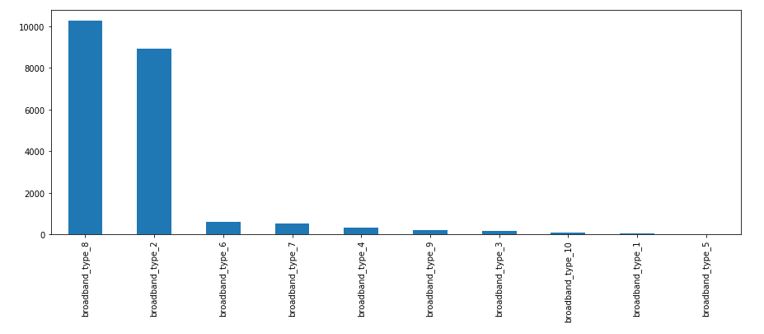
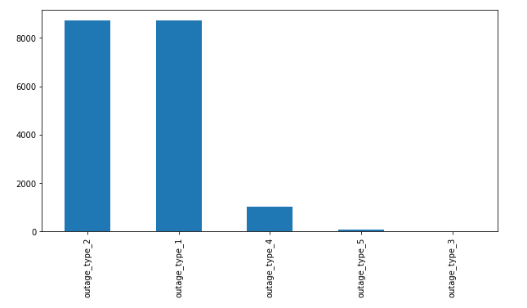
Exploratory data analysis
Broadband Data Distribution
Outage Data Distribution

Slide 6
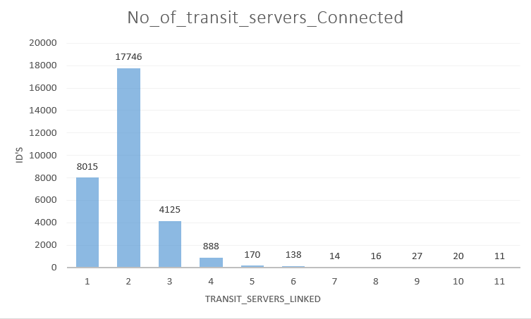
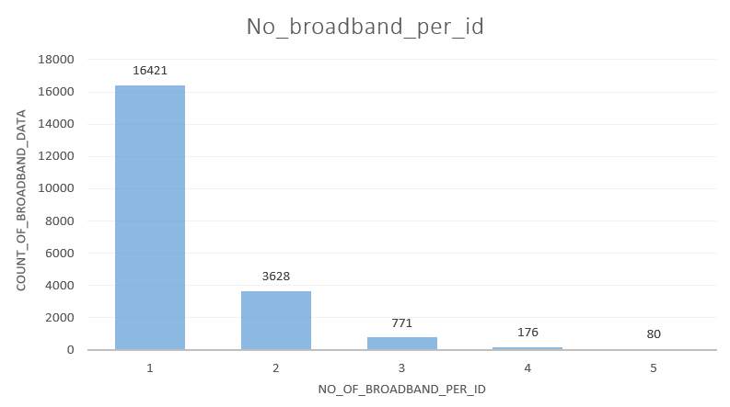
Exploratory data analysis
Transit_server Data Distribution
No_of_broadban_per_ID Data Distribution

Slide 7
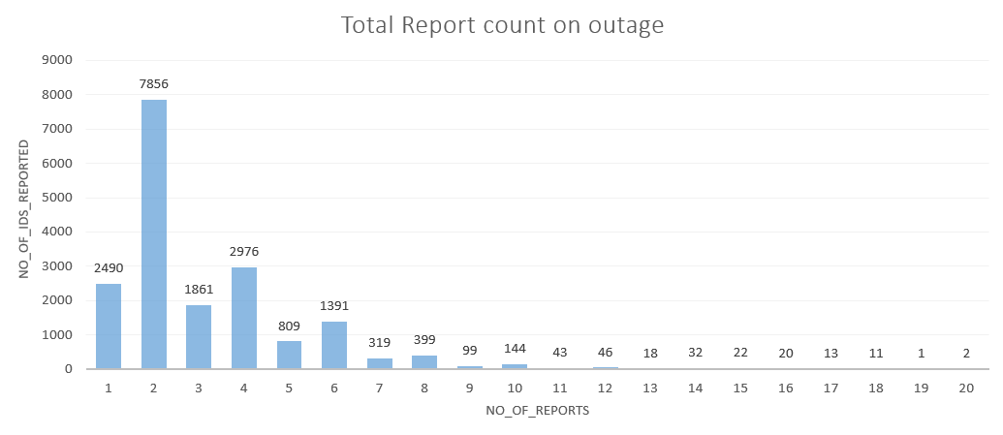
Exploratory data analysis
Total Reports per ID

Slide 8
Feature Engineering
S.No | Column Name | Column Description
1. | Area_code | Mapped with ID from Train and Test dataset given
2. | Int_area | Integer converted values for Area_code
3. | Count_of_area | Count of Area_codes repeated per ID
4. | Count of broadband_type | Count of broadband_type repeated per ID
5. | broadband_type | Collated based on the ID, if more than one broadband type in same ID then collated with a underscore(_) Eg: ID 20 = _8_2_3 means ID 20 have broadband type 8, broadband type 2, broadband type 3
6. | bb_type | Field added after observing the pattern in the broadband_type and outage_duration.
7. | outage_type | Mapped with the ID from Outage dataset given
8. | Count of transit_server_type | Count of transit_server_type repeated per ID from Server dataset
9. | server_type | Collated based on the ID, if more than one transit_server type in same ID then collated with a underscore(_) Eg: ID 20 = _54_11_10 means ID 20 have transit_server 54, transit_server 11, transit_server 10
10. | Transit_type | Field added after observing the pattern in the transit_server_type and outage_duration.
11. | log_report | Collated based on the ID, if more than one log_report type in same ID then collated with a underscore(_) Eg: ID 20 = _55_39 means ID 20 have log_report 55, log_report 39

Slide 9
Feature Engineering
S.No | Column Name | Column Description
12. | Count of log_report_type | Count of log_report_type repeated per ID
13. | count_of_log | Count of log_report_type repeated
14. | sum_of_logs | Sum of Logs added up in interger
15. | sum_area_vol | Sum_aread_vol = Sum of Volume in all ID’s /count of area per ID
16. | Average_of_Volume_frm_area | Average_of_Volume_frm_area = Avg on ID level (Sum of Volume in all ID’s /count of area per ID)
17. | StdDev_of_Volume_frm_area | StdDev_of_Volume_frm_area = StdDev on ID level (Sum of Volume in all ID’s /count of area per ID)
18. | Min_of_Volume_frm_area | Min_of_Volume_frm_area = Min value on ID level (Sum of Volume in all ID’s /count of area per ID)
19. | Max_of_Volume_frm_area | Max_of_Volume_frm_area = Max value on ID level (Sum of Volume in all ID’s /count of area per ID)
20. | Median_of_Volume_frm_area | Median_of_Volume_frm_area = Median value on ID level (Sum of Volume in all ID’s /count of area per ID)
21. | Sum of volume | Sum of Volume in per ID
22. | Average_of_volume | Average of Volume in per ID

Slide 10
Feature Engineering
S.No | Column Name | Column Description
23. | StdDev_of_volume | StdDev of Volume in per ID
24. | Min_of_volume | Minimum value of Volume in per ID
25. | Max_of_volume | Maximum value of Volume in per ID
26. | Median_of_volume | Median value of Volume in per ID
27. | outage_duration | Target Variable from train Dataset

Slide 11
Dividing the numerical columns and categorical columns
Numerical Attributes
Categorical Attributes
int_area
Count_of_area
Sum_of_volume
area_code
Count_of_broadband_type
outage_type
bb_type
Count_of_transit_server_type
count_of_log
broadband_type
Count_of_log_report_type
sum_of_logs
Transit_type
sum_area_vol
Average_of_Volume_frm_area
log_report
StdDev_of_Volume_frm_area
Average_of_volume
Min_of_Volume_frm_area
server_type
StdDev_of_volume
Max_of_Volume_frm_area
Min_of_volume
outage_duration
Median_of_Volume_frm_area
Max_of_volume
Median_of_volume
Target Attribute

Slide 12
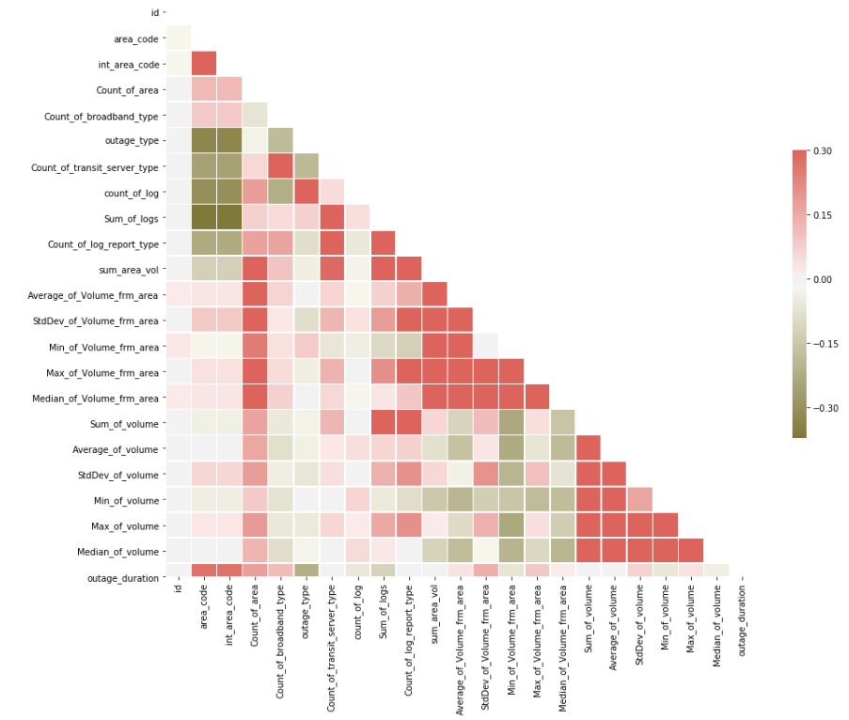
Correlation Plot for Numerical attributes

Slide 13
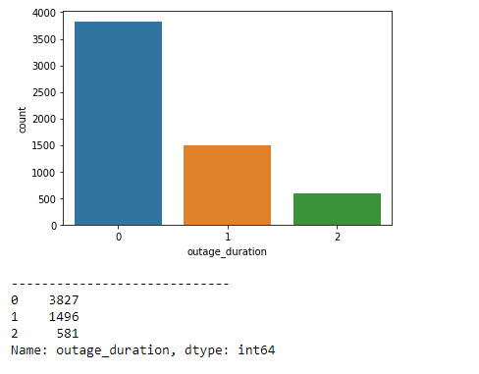
Checking for class Imbalance Problem
Target Column Distribution
Class Imbalance Problem Identified
We have a class Imbalance Problem
Data must be balanced before creating any model

Slide 14
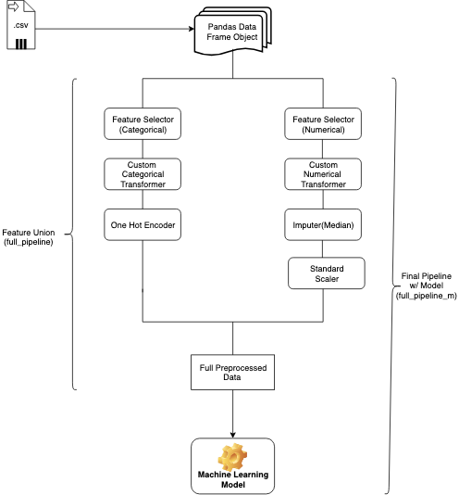
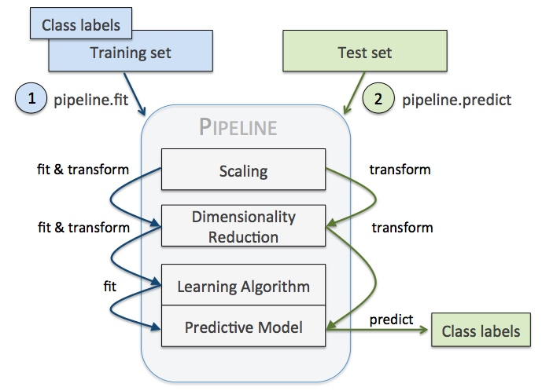
Pipeline Initialization

Slide 15
Pipeline Initialization
Train/ Test Data Frame
Preprocesser
Column Transformer
numeric_transformer
categorical_transformer
StandardScaler()
OneHotEncoder()
Fully Processed data

Slide 16
Train and Test Split (70% and 30%) (5904 x 26 )
70 % of the data
30 % of the data
x_train
y_train
x_test
y_test
int_area
Count_of_area
Sum_of_volume
outage_duration
int_area
Count_of_area
Sum_of_volume
outage_duration
Count_of_broadband_type
outage_type
Count_of_broadband_type
outage_type
count_of_log
count_of_log
Count_of_transit_server_type
Count_of_transit_server_type
Count_of_log_report_type
sum_of_logs
Count_of_log_report_type
sum_of_logs
sum_area_vol
Average_of_Volume_frm_area
sum_area_vol
Average_of_Volume_frm_area
StdDev_of_Volume_frm_area
Average_of_volume
StdDev_of_Volume_frm_area
Average_of_volume
Min_of_Volume_frm_area
StdDev_of_volume
Min_of_Volume_frm_area
StdDev_of_volume
Max_of_Volume_frm_area
Min_of_volume
Max_of_Volume_frm_area
Min_of_volume
Median_of_Volume_frm_area
Max_of_volume
Median_of_Volume_frm_area
Max_of_volume
area_code
bb_type
Median_of_volume
area_code
bb_type
Median_of_volume
broadband_type
Transit_type
log_report
broadband_type
Transit_type
log_report
server_type
server_type
(4132 x 26)
(4132 x 1)
(1772 x 26)
(1772 x 1)

Slide 17
Fixing the Imbalance Problem using SMOTE
Step 1 Pre-process both train and test data using the pipeline
x_train
x_test
Pipeline
Fit & Transform
Transform
Fully Processed data
Fully Processed data
x_train_pp
x_test_pp

Slide 18
Fixing the Imbalance Problem using SMOTE
Step 2 Use SMOTE to solve the Imbalance problem
x_train_pp (imbalanced)
y_train (imbalanced)
SMOTE.fit_sample()
os_train_x (Balanced)
os_train_y (Balanced)

Slide 19
Fixing the Imbalance Problem using SMOTE
Step 2 Use SMOTE to solve the Imbalance problem
x_train_pp (imbalanced)
y_train (imbalanced)
SMOTE.fit_sample()
os_train_x (Balanced)
os_train_y (Balanced)
Use this balanced train data to train any model in future

Slide 20
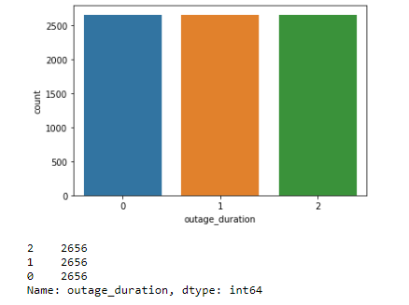
Fixing the Imbalance Problem using SMOTE
Balanced problem now

Slide 21
Model Building

Slide 22
Overall approach used in model Building
Step 1. Fitting the model
Pipeline
Create a Pipeline object for the model
Pipeline object.fit()
os_train_x
os_train_y

Slide 23
Overall approach used in model Building
Step 1. Fitting the model
Pipeline
Create a Pipeline object for the model
Pipeline object.fit()
os_train_x
os_train_y
Feature input for the model
Actual o/p data (target column)

Slide 24
Overall approach used in model Building
Step 2. Predicting the model
Pipeline object.predict()
os_train_x
x_test_pp

Slide 25
Overall approach used in model Building
Step 2. Predicting the model
Pipeline object.predict()
os_train_x
x_test_pp
Train Predictions
(train_pred)
Test Predictions
(test_pred)

Slide 26
Overall approach used in model Building
Step 3. Checking the Train and test Scores
Train_Scores
Confusuion_matrix()
os_train_y
train_pred
Test_Scores
Confusuion_matrix()
Y_test
test_pred

Slide 27
Overall approach used in model Building
Step 3. Checking the Train and test Scores
Train_Scores
Confusuion_matrix()
os_train_y
train_pred
Test_Scores
Train Predicted data
Train Actual data
Confusuion_matrix()
Y_test
test_pred
Test Actual data
Test Predicted data

Slide 28
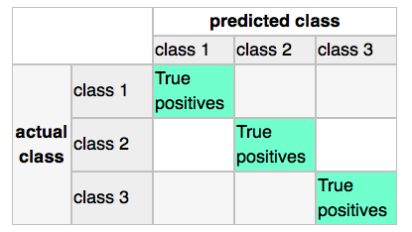
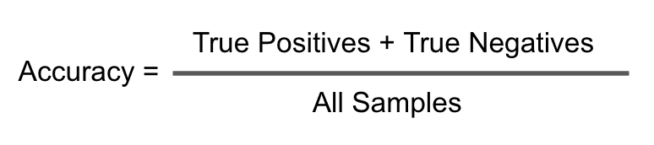
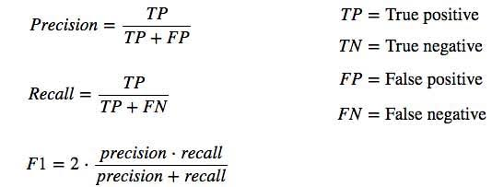
Confusion Matrix

Slide 29
Model 1 Logistic regression
Pipeline object for the model (clf_logreg)
clf_logreg.fit()
clf_logreg.predict()
os_train_x
os_train_y
os_train_x
x_test_pp
Checking the Train and test Scores:
Train_Score = confusion Matrix(os_train_y, train_pred)
Test_Score = confusion Matrix(y_test, test_pred)
S.no | Model Type | Test F1 Macro Score
1 | Logistic regression | 62.7%

Slide 30
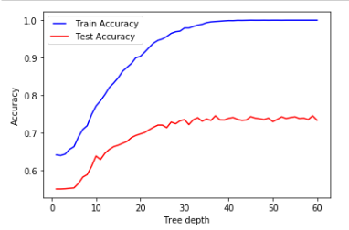
Tried Growing the tree completely to get the optimal max depth to use
Model 2 Random Forest

Slide 31
Model 2 Random Forest
Pipeline object for the model (clf_rf2)
clf_rf2.fit()
clf_rf2.predict()
os_train_x
os_train_y
os_train_x
x_test_pp
Checking the Train and test Scores:
Train_Score = confusion Matrix(os_train_y, train_pred)
Test_Score = confusion Matrix(y_test, test_pred)
S.no | Model Type | Test F1 Macro Score
1 | Random Forest | 67.3%

Slide 32
Model 3 KNN
Pipeline object for the model (clf_knn)
clf_knn.fit()
clf_knn.predict()
os_train_x
os_train_y
os_train_x
x_test_pp
Checking the Train and test Scores:
Train_Score = confusion Matrix(os_train_y, train_pred)
Test_Score = confusion Matrix(y_test, test_pred)
S.no | Model Type | Test F1 Macro Score
1 | KNN Classifier | 59.1%

Slide 33
Model 4 SVC
Pipeline object for the model (clf_svc3)
clf_svc3.fit()
clf_svc3.predict()
os_train_x
os_train_y
os_train_x
x_test_pp
Checking the Train and test Scores:
Train_Score = confusion Matrix(os_train_y, train_pred)
Test_Score = confusion Matrix(y_test, test_pred)
S.no | Model Type | Test F1 Macro Score
1 | SVC | 61.5%

Slide 34
Model 5 ADA Boosting
Pipeline object for the model (clf_ada1)
clf_ada1.fit()
clf_ada1.predict()
os_train_x
os_train_y
os_train_x
x_test_pp
Checking the Train and test Scores:
Train_Score = confusion Matrix(os_train_y, train_pred)
Test_Score = confusion Matrix(y_test, test_pred)
S.no | Model Type | Test F1 Macro Score
1 | ADA Boosting | 65.2%

Slide 35
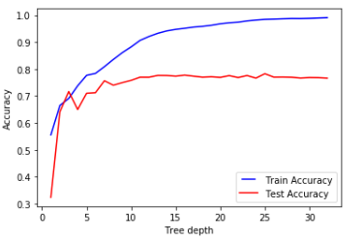
Tried Growing the tree completely to get the optimal max depth to use
Model 6 Decision Tree

Slide 36
Model 6 Decision Tree
Pipeline object for the model (clf_dt3)
clf_dt3.fit()
clf_dt3.predict()
os_train_x
os_train_y
os_train_x
x_test_pp
Checking the Train and test Scores:
Train_Score = confusion Matrix(os_train_y, train_pred)
Test_Score = confusion Matrix(y_test, test_pred)
S.no | Model Type | Test F1 Macro Score
1 | Decision Tree | 63.6%

Slide 37
Model 7 XG Boosting
Pipeline object for the model (clf_xg)
clf_xg.fit()
clf_xg.predict()
os_train_x
os_train_y
os_train_x
x_test_pp
Checking the Train and test Scores:
Train_Score = confusion Matrix(os_train_y, train_pred)
Test_Score = confusion Matrix(y_test, test_pred)
S.no | Model Type | Test F1 Macro Score
1 | XG Boosting | 68.6%

Slide 38
Model Scores Summary
S.no | Model Type | Test F1 Macro Score
1 | Logistic regression | 62.7 %
2 | Random Forest | 67.3 %
3 | KNN Classifier | 59.1 %
4 | SVC | 61.5 %
5 | ADA Boosting | 65.2 %
6 | Decision Tree | 63.6 %
7 | XG Boosting | 68.6 %

