Slide 1
Problem Statement:
Predicting the customer churn in a bank
If Churn = 1
If Churn = 0
Customer will churn out/ Leave the bank
Customer will not churn out/ staying in the bank
Churn being the target variable, given only 2 values can occur (0/1)
It is a Binary classification problem.

Slide 2
Project Objective:
When churn = 1, bank is losing a existing customer.
A customer churn implies a major potential revenue loss for the bank.
As customer acquisition cost for a bringing in a new customer is very high, it is advisable that bank should look for patterns in the current customer who are deciding to leave(Churn out =1 ) the bank and address them specially with various offers etc., to keep them as customers.
If Churn = 1
Look for the patterns in the dataset why the customer is leaving
With an underlying pattern from the previous/historical set predict if customer is going to stay/leave the bank

Slide 3
Approaching the problem

Slide 4
Given Train dataset:
Train Dataset Columns
1. Customer ID
2. Customer Name
3. Year of Birth
4. Month of Birth
5. Day of Birth
6. Year of Entry
7. Month of Entry
8. Day of Entry
9. Gender
10. Location
11. Education
12. Marital Status
13. Occupation
14. Own house
15. Credit Score
16. Account Balance
17. Number Of
Products
18. Is Credit Card Customer
19. Active Member
20. Salary
21. Churn

Slide 5
Given Train dataset: (Dropping the unnecessary columns )
Train Dataset Columns
1. Customer ID
2. Customer Name
3. Year of Birth
4. Month of Birth
5. Day of Birth
6. Year of Entry
7. Month of Entry
8. Day of Entry
9. Gender
10. Location
11. Education
12. Marital Status
13. Occupation
14. Own house
15. Credit Score
16. Account Balance
17. Number Of
Products
18. Is Credit Card Customer
19. Active Member
20. Salary
21. Churn

Slide 6
Given Train dataset: (Data Types as given in the Train Data)
Train Dataset Columns
1. Year of Birth
2. Month of Birth
3. Day of Birth
4. Year of Entry
5. Month of Entry
6. Day of Entry
7. Gender
8. Location
9. Education
10. Marital Status
11. Occupation
12. Own house
13. Credit Score
14. Account Balance
15. Number Of
Products
16. Is Credit Card Customer
17. Active Member
18. Salary
19. Churn
- Integer/ Float
- Object

Slide 7
Converting the train data into appropriate data Type (Using astype)
Train Dataset Columns
1. Year of Birth
2. Month of Birth
3. Day of Birth
4. Year of Entry
5. Month of Entry
6. Day of Entry
7. Gender
8. Location
9. Education
10. Marital Status
11. Occupation
12. Own house
13. Credit Score
14. Account Balance
15. Number Of
Products
16. Is Credit Card Customer
17. Active Member
18. Salary
19. Churn
- Integer/ Float
- Category

Slide 8
Converting the train data into appropriate data Type (Using astype)
Train Dataset Columns
1. Year of Birth
2. Month of Birth
3. Day of Birth
4. Year of Entry
5. Month of Entry
6. Day of Entry
7. Gender
8. Location
9. Education
10. Marital Status
11. Occupation
12. Own house
13. Credit Score
14. Account Balance
15. Number Of
Products
16. Is Credit Card Customer
17. Active Member
18. Salary
19. Churn
Target Variable

Slide 9
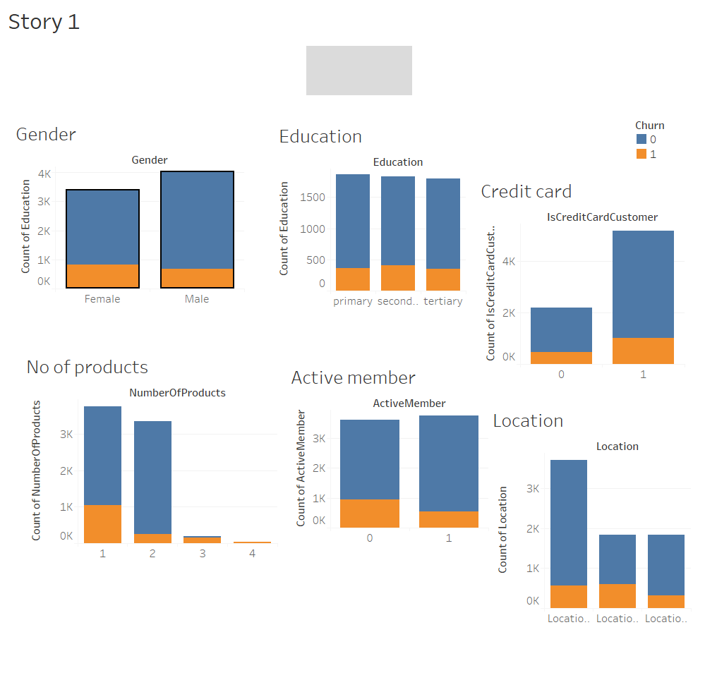
Distribution of all categorical columns on target variable

Slide 10
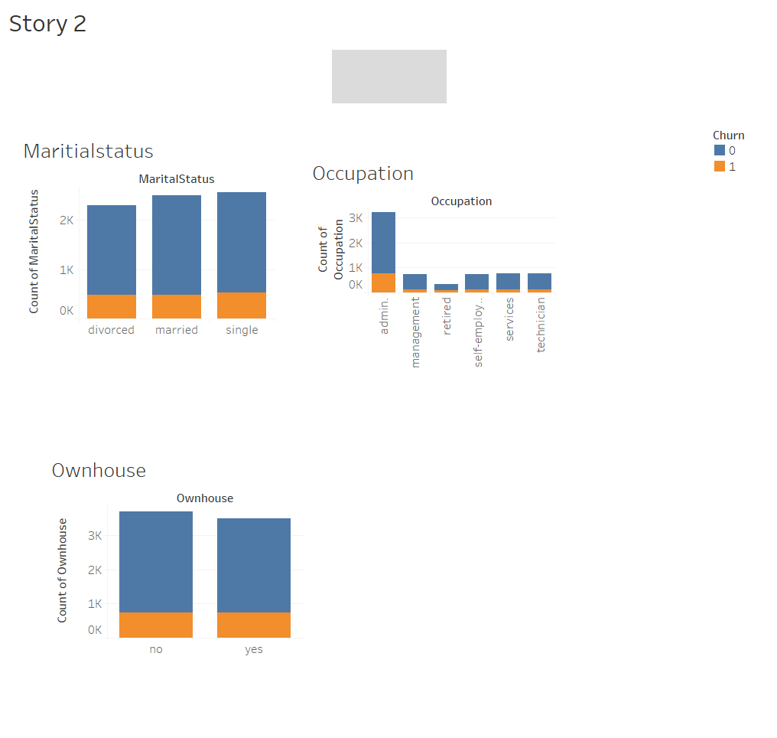
Distribution of all categorical columns on target variable

Slide 11
Distribution of all categorical columns when Churn = 1 (Normalized)

Slide 12
Distribution of all categorical columns when Churn = 1 (Normalized)

Slide 13
Distribution of all categorical columns when Churn = 1 (Normalized)

Slide 14
Conclusion from the above graphs
Females have more churn rate than male
Location 12 has more churn rate than others
Customer’s with secondary education have more churn rate
Customer’s whose marital status single have more churn rate
Customer’s with occupation “Admin” have more churn rate
Customer’s with no own house have more churn rate
Customer’s with “1-Product” have more churn rate
Customer’s having credit card have more churn rate
Non active members have more churn rate

Slide 15
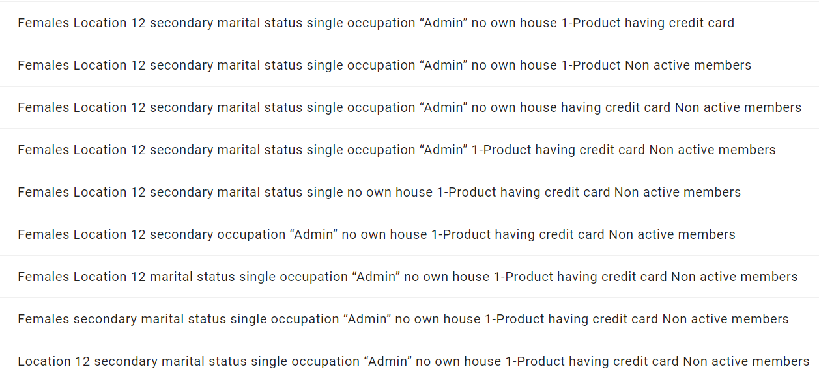
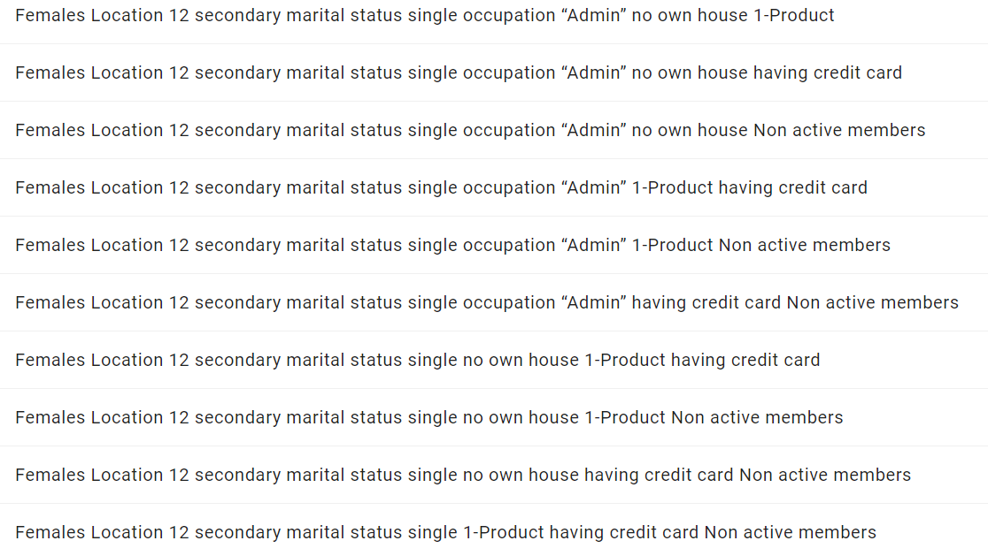
Priority 1
Females Location 12 secondary marital status single occupation “Admin” no own house 1-Product having credit card Non active members
Priority 2
Priority 3
Etc…

Slide 16
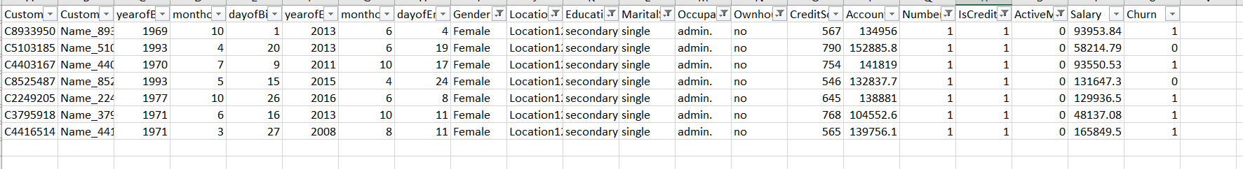
Note:
Any combination of the above conditions, results in a increase in chance that the customer will leave the company.
E.g., Females having a secondary education in location12 whose marital status is single and working as a admin with no own house possession and have 1product and having a credit card and not active member have more than 71% chance that they will churn out. (All 9 Conditions)
As seen from the above snap from train data with all the conditions we have 5 out of 7 customer’s churn out

Slide 17
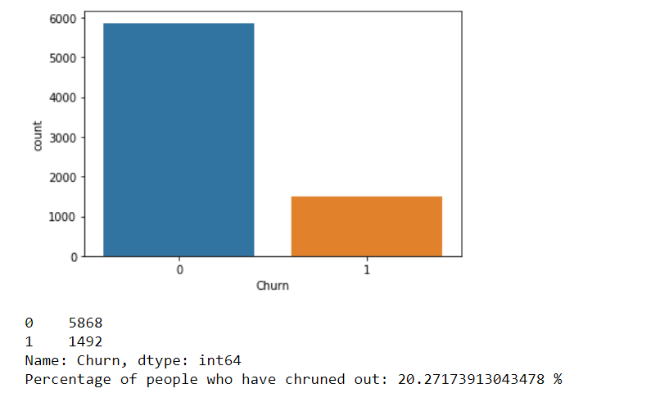
Checking for class Imbalance Problem
We have a class Imbalance Problem
Data must be balanced before creating any model

Slide 18
Dividing the numerical columns and categorical columns
num_attr
cat_attr
1. Year of Birth
2. Month of Birth
7. Gender
8. Location
3. Day of Birth
4. Year of Entry
9. Education
10. Marital Status
5. Month of Entry
6. Day of Entry
11. Occupation
12. Own house
13. Credit Score
14. Account Balance
15. Number Of
Products
16. Is Credit Card Customer
18. Salary
17. Active Member

Slide 19
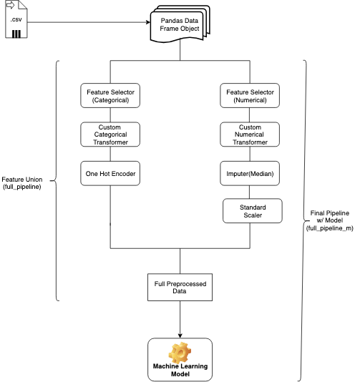
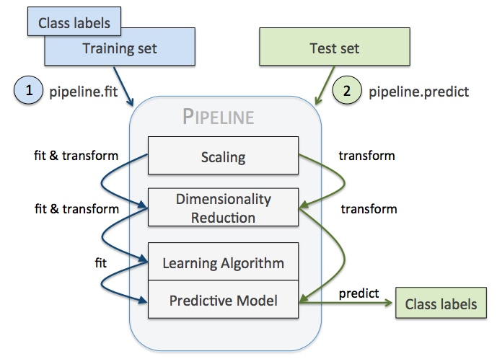
Pipeline Initialization

Slide 20
Pipeline Initialization
Train/ Test Data Frame
Preprocesser
Column Transformer
numeric_transformer
categorical_transformer
StandardScaler()
StandardSimpleImputer(strategy='most_frequent’)
OneHotEncoder()
Fully Processed data

Slide 21
Train and Test Split (70% and 30%)
x_train
y_train
x_test
y_test
1. Year of Birth
2. Month of Birth
19. Churn
1. Year of Birth
2. Month of Birth
19. Churn
3. Day of Birth
4. Year of Entry
3. Day of Birth
4. Year of Entry
5. Month of Entry
6. Day of Entry
5. Month of Entry
6. Day of Entry
13. Credit Score
14. Account Balance
14. Account Balance
13. Credit Score
18. Salary
7. Gender
18. Salary
7. Gender
8. Location
9. Education
8. Location
9. Education
10. Marital Status
11. Occupation
10. Marital Status
11. Occupation
12. Own house
15. Number Of
Products
12. Own house
15. Number Of
Products
16. Is Credit Card Customer
17. Active Member
16. Is Credit Card Customer
17. Active Member

Slide 22
Train and Test Split (70% and 30%)
70 % of the data
30 % of the data
x_train
y_train
x_test
y_test
1. Year of Birth
2. Month of Birth
19. Churn
1. Year of Birth
2. Month of Birth
19. Churn
3. Day of Birth
4. Year of Entry
3. Day of Birth
4. Year of Entry
5. Month of Entry
6. Day of Entry
5. Month of Entry
6. Day of Entry
13. Credit Score
14. Account Balance
14. Account Balance
13. Credit Score
18. Salary
7. Gender
18. Salary
7. Gender
8. Location
9. Education
8. Location
9. Education
10. Marital Status
11. Occupation
10. Marital Status
11. Occupation
12. Own house
15. Number Of
Products
12. Own house
15. Number Of
Products
16. Is Credit Card Customer
17. Active Member
16. Is Credit Card Customer
17. Active Member

Slide 23
Fixing the Imbalance Problem using SMOTE
Step 1 Pre-process both train and test data using the pipeline
x_train
x_test
Pipeline
Fit & Transform
Transform
Fully Processed data
Fully Processed data
x_train_pp
x_test_pp

Slide 24
Fixing the Imbalance Problem using SMOTE
Step 2 Use SMOTE to solve the Imbalance problem
x_train_pp (imbalanced)
y_train (imbalanced)
SMOTE.fit_sample()
os_train_x (Balanced)
os_train_y (Balanced)

Slide 25
Fixing the Imbalance Problem using SMOTE
Step 2 Use SMOTE to solve the Imbalance problem
x_train_pp (imbalanced)
y_train (imbalanced)
SMOTE.fit_sample()
os_train_x (Balanced)
os_train_y (Balanced)
Use this balanced train data to train any model in future

Slide 26
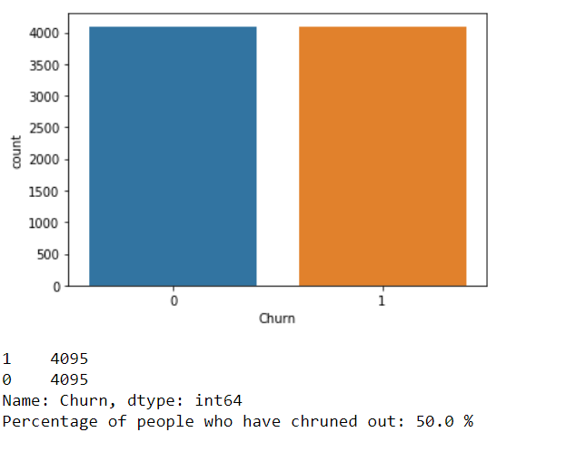
Fixing the Imbalance Problem using SMOTE
Balanced problem now

Slide 27
Model Building

Slide 28
Overall approach used in model Building
Step 1. Fitting the model
Pipeline
Create a Pipeline object for the model
Pipeline object.fit()
os_train_x
os_train_y

Slide 29
Overall approach used in model Building
Step 1. Fitting the model
Pipeline
Create a Pipeline object for the model
Pipeline object.fit()
os_train_x
os_train_y
Feature input for the model
Actual o/p data (target column)

Slide 30
Overall approach used in model Building
Step 2. Predicting the model
Pipeline object.predict()
os_train_x
x_test_pp

Slide 31
Overall approach used in model Building
Step 2. Predicting the model
Pipeline object.predict()
os_train_x
x_test_pp
Train Predictions
(train_pred)
Test Predictions
(test_pred)

Slide 32
Overall approach used in model Building
Step 3. Checking the Train and test Scores
Train_Scores
Confusuion_matrix()
os_train_y
train_pred
Test_Scores
Confusuion_matrix()
Y_test
test_pred

Slide 33
Overall approach used in model Building
Step 3. Checking the Train and test Scores
Train_Scores
Confusuion_matrix()
os_train_y
train_pred
Test_Scores
Train Predicted data
Train Actual data
Confusuion_matrix()
Y_test
test_pred
Test Actual data
Test Predicted data

Slide 34
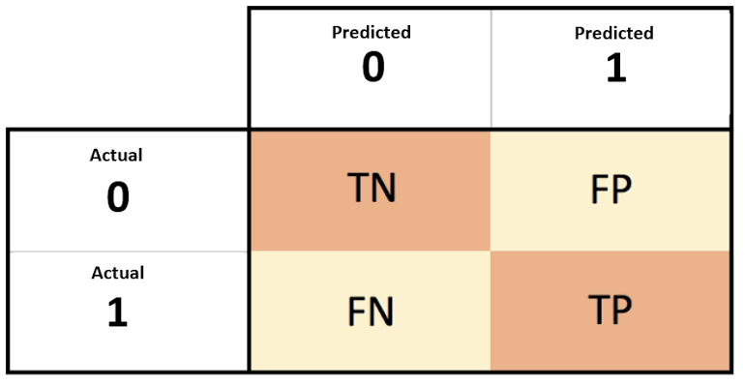
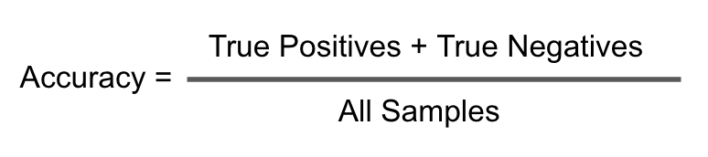
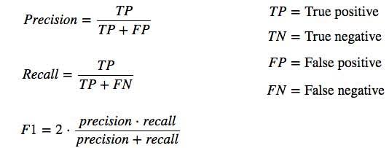
Confusion Matrix

Slide 35
Model 1 Logistic regression
Pipeline object for the model (clf_logreg)
clf_logreg.fit()
clf_logreg.predict()
os_train_x
os_train_y
os_train_x
x_test_pp
Checking the Train and test Scores:
Train_Score = confusion Matrix(os_train_y, train_pred)
Test_Score = confusion Matrix(y_test, test_pred)
S.no | Model Type | Train F1 Score | Train F1 Score % Equivalent | Validation F1 Score | Validation F1 Score % Equivalent
1 | Logistic regression | 1.210636397 | 60.53% | 1.144045449 | 57.20%

Slide 36
Model 2 SVM Model Type 1
Pipeline object for the model (clf_svc)
Parameters | Value
kernel | Linear
C | 1
clf_svc.fit()
clf_svc.predict()
os_train_x
os_train_y
os_train_x
x_test_pp
Checking the Train and test Scores:
Train_Score = confusion Matrix(os_train_y, train_pred)
Test_Score = confusion Matrix(y_test, test_pred)
S.no | Model Type | Train F1 Score | Train F1 Score % Equivalent | Validation F1 Score | Validation F1 Score % Equivalent
2 | SVM Model Type 1 | 1.215200526 | 60.76% | 1.157997093 | 57.90%

Slide 37
Model 3 KNN
Pipeline object for the model (clf_knn)
Parameters | Value
n_neighbors | 5
clf_knn.fit()
clf_knn.predict()
os_train_x
os_train_y
os_train_x
x_test_pp
Checking the Train and test Scores:
Train_Score = confusion Matrix(os_train_y, train_pred)
Test_Score = confusion Matrix(y_test, test_pred)
S.no | Model Type | Train F1 Score | Train F1 Score % Equivalent | Validation F1 Score | Validation F1 Score % Equivalent
3 | KNN | 1.974683799 | 98.73% | 0.901191703 | 45.06%

Slide 38
Model 4 Decision Tree Type 1
Pipeline object for the model (clf_dt1)
clf_dt1.fit()
clf_dt1.predict()
os_train_x
os_train_y
os_train_x
x_test_pp
Checking the Train and test Scores:
Train_Score = confusion Matrix(os_train_y, train_pred)
Test_Score = confusion Matrix(y_test, test_pred)
S.no | Model Type | Train F1 Score | Train F1 Score % Equivalent | Validation F1 Score | Validation F1 Score % Equivalent
4 | Decision Tress Type 1 | 2 | 100.00% | 0.559122737 | 27.96%

Slide 39
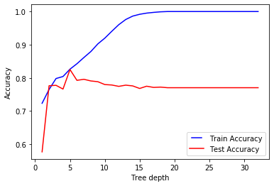
Tried Growing the tree completely to get the optimal max depth to use

Slide 40
Model 5 Decision Tree Type 2
Pipeline object for the model (clf_dt2)
Parameters | Value
criterion | entropy
max_depth | 5
clf_dt2.fit()
clf_dt2.predict()
os_train_x
os_train_y
os_train_x
x_test_pp
Checking the Train and test Scores:
Train_Score = confusion Matrix(os_train_y, train_pred)
Test_Score = confusion Matrix(y_test, test_pred)
S.no | Model Type | Train F1 Score | Train F1 Score % Equivalent | Validation F1 Score | Validation F1 Score % Equivalent
5 | Decision Tress Type 2 | 1.106577872 | 55.33% | 0.603736293 | 30.19%

Slide 41
Model 6 Decision Tree Using Random Search and CV=5
Pipeline object for the model (clf_dt3)
Random Search
Parameters | Value
criterion | entropy, gini
max_depth | 3,4,5,6,7
CV | 5
clf_dt3.fit()
clf_dt3.predict()
os_train_x
os_train_y
os_train_x
x_test_pp
Checking the Train and test Scores:
Train_Score = confusion Matrix(os_train_y, train_pred)
Test_Score = confusion Matrix(y_test, test_pred)
S.no | Model Type | Train F1 Score | Train F1 Score % Equivalent | Validation F1 Score | Validation F1 Score % Equivalent
6 | Decision Tree Using Random Search and CV=5 | 1.434433308 | 71.72% | 0.840523187 | 42.03%

Slide 42
Model 7 Random Forest
Pipeline object for the model (clf_ rf1)
clf_ rf1.fit()
clf_ rf1.predict()
os_train_x
os_train_y
os_train_x
x_test_pp
Checking the Train and test Scores:
Train_Score = confusion Matrix(os_train_y, train_pred)
Test_Score = confusion Matrix(y_test, test_pred)
S.no | Model Type | Train F1 Score | Train F1 Score % Equivalent | Validation F1 Score | Validation F1 Score % Equivalent
7 | Random Forest | 2 | 100.00% | 0.488571806 | 24.43%

Slide 43
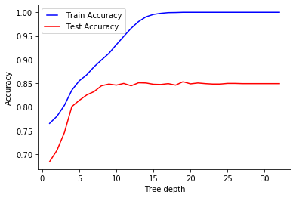
Tried Growing the tree completely to get the optimal max depth to use

Slide 44
Model 8 Random Forest type 2
Pipeline object for the model (clf_rf2)
Random Search
Parameters | Value
criterion | entropy, gini
max_depth | 15,16,17,18
clf_rf2.fit()
clf_rf2.predict()
os_train_x
os_train_y
os_train_x
x_test_pp
Checking the Train and test Scores:
Train_Score = confusion Matrix(os_train_y, train_pred)
Test_Score = confusion Matrix(y_test, test_pred)
S.no | Model Type | Train F1 Score | Train F1 Score % Equivalent | Validation F1 Score | Validation F1 Score % Equivalent
8 | Random Forest type 2 | 2 | 100.00% | 0.502301493 | 25.12%

Slide 45
Model 9 Ada Boosting (Boosting Model 5 Decision Tree)
Pipeline object for the model (clf_ada)
Parameters | Value
n_estimators | 600
learning_rate | 1
max_depth | 6
criterion | entropy
clf_ada.fit()
clf_ada.predict()
os_train_x
os_train_y
os_train_x
x_test_pp
Checking the Train and test Scores:
Train_Score = confusion Matrix(os_train_y, train_pred)
Test_Score = confusion Matrix(y_test, test_pred)
S.no | Model Type | Train F1 Score | Train F1 Score % Equivalent | Validation F1 Score | Validation F1 Score % Equivalent
9 | Ada Boosting (Boosting Model 5 Decision Tree) | 2 | 100.00% | 0.312685956 | 15.63%

Slide 46
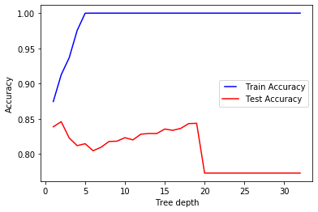
Tried Growing the tree completely to get the optimal max depth to use

Slide 47
Model 10 Ada Boosting Type 2 (Boosting Model 5 Decision Tree)
Pipeline object for the model (clf_ada1)
Parameters | Value
n_estimators | 600
learning_rate | 1
max_depth | 2
criterion | entropy
clf_ada1.fit()
clf_ada1.predict()
os_train_x
os_train_y
os_train_x
x_test_pp
Checking the Train and test Scores:
Train_Score = confusion Matrix(os_train_y, train_pred)
Test_Score = confusion Matrix(y_test, test_pred)
S.no | Model Type | Train F1 Score | Train F1 Score % Equivalent | Validation F1 Score | Validation F1 Score % Equivalent
10 | Ada Boosting Type 2 (Boosting Model 5 Decision Tree) | 1.97371332 | 98.69% | 0.357838552 | 17.89%

Slide 48
Model 11 Stacking( Logistic, SVM(linear), KNN, DT, Random forest, ADA)
Logistic Regression
SVM(linear)
KNN
Logistic regression
Output Values
Output Value
DT
Random Forest
ADA

Slide 49
Model 11 Stacking (Logistic, SVM(linear), KNN, DT, Random forest, ADA)
stack.fit()
stack.predict()
stack_train
os_train_y
stack_train
stack_test
Checking the Train and test Scores:
Train_Score = confusion Matrix(os_train_y,stacked_pred_train)
Test_Score = confusion Matrix(y_test,stacked_pred_test)
S.no | Model Type | Train F1 Score | Train F1 Score % Equivalent | Validation F1 Score | Validation F1 Score % Equivalent
11 | Stacking (Logistic, SVM(linear), KNN, DT, Random forest, ADA) | 2 | 100.00% | 0.502301493 | 25.12%

Slide 50
Model 12 SVM Model Type 2
Pipeline object for the model (clf_svc2 )
Parameters | Value
C | 1
gamma | 0.001
kernel | rbf
clf_svc2 .fit()
clf_svc2 .predict()
os_train_x
os_train_y
os_train_x
x_test_pp
Checking the Train and test Scores:
Train_Score = confusion Matrix(os_train_y, train_pred)
Test_Score = confusion Matrix(y_test, test_pred)
S.no | Model Type | Train F1 Score | Train F1 Score % Equivalent | Validation F1 Score | Validation F1 Score % Equivalent
12 | SVM Model Type 2 | 1.260538523 | 63.03% | 1.236242568 | 61.81%

Slide 51
Model 13 SVM Type 3 With Random Search and CV = 5
Pipeline object for the model (clf_svc3 )
Random Search
Parameters | Value
C | 0.01, 0.1, 1
gamma | 0, 0.0001, 0.001, 0.01
kernel | rbf
CV | 5
clf_svc3 .fit()
clf_svc3.predict()
os_train_x
os_train_y
os_train_x
x_test_pp
Checking the Train and test Scores:
Train_Score = confusion Matrix(os_train_y, train_pred)
Test_Score = confusion Matrix(y_test, test_pred)
S.no | Model Type | Train F1 Score | Train F1 Score % Equivalent | Validation F1 Score | Validation F1 Score % Equivalent
13 | SVM Type 3 With Random Search and CV = 5 | 1.291748447 | 64.59% | 1.172033294 | 58.60%

Slide 52
Model 14 Stacking( Logistic, SVM(linear), KNN, DT, Random forest, ADA, svm2, svm3)
Logistic Regression
SVM(linear)
KNN
Logistic regression
Output Value
Output Values
DT
Random Forest
ADA
SVM 2
SVM 3

Slide 53
Model 14 Stacking (Logistic, SVM(linear), KNN, DT, Random forest, ADA, svm2, svm3)
stack.fit()
stack.predict()
stack_train
os_train_y
stack_train
stack_test
Checking the Train and test Scores:
Train_Score = confusion Matrix(os_train_y,stacked_pred_train)
Test_Score = confusion Matrix(y_test,stacked_pred_test)
S.no | Model Type | Train F1 Score | Train F1 Score % Equivalent | Validation F1 Score | Validation F1 Score % Equivalent
14 | Stacking (Logistic, SVM(linear), KNN, DT, Random forest, ADA, svm 2, svm3) | 2 | 100.00% | 0.502301493 | 25.12%

Slide 54
Model 15 SVM Type 4 (Grid Search and CV = 10)
Pipeline object for the model (clf_svc4 )
Grid Search
Parameters | Value
C | 0.01, 0.1, 1
gamma | 0, 0.0001, 0.001, 0.01
kernel | rbf
CV | 10
clf_svc4 .fit()
clf_svc4.predict()
os_train_x
os_train_y
os_train_x
x_test_pp
Checking the Train and test Scores:
Train_Score = confusion Matrix(os_train_y, train_pred)
Test_Score = confusion Matrix(y_test, test_pred)
S.no | Model Type | Train F1 Score | Train F1 Score % Equivalent | Validation F1 Score | Validation F1 Score % Equivalent
15 | SVM Type 4 (Grid Search and CV = 10) | 1.358531578 | 67.93% | 1.137101334 | 56.86%

Slide 55
Reducing the noise in the data
Dropping columns to improve score:
AccountBalance
yearofBirth
monthofBirth
dayofBirth
Salary
CreditScore
dayofEntry

Slide 56
Model 16 Logistic Regression (11 Variables)
Pipeline object for the model (clf_logreg )
clf_logreg .fit()
clf_logreg.predict()
os_train_x
os_train_y
os_train_x
x_test_pp
Checking the Train and test Scores:
Train_Score = confusion Matrix(os_train_y, train_pred)
Test_Score = confusion Matrix(y_test, test_pred)
S.no | Model Type | Train F1 Score | Train F1 Score % Equivalent | Validation F1 Score
16 | Logistic Regerssion (11 Variables) | 1.133806229 | 56.69% | 1.024156216

Slide 57
Model 17 SVM With Random Search and CV = 5 (11 Variables)
Pipeline object for the model (clf_svc3 )
Random Search
Parameters | Value
C | 0.01, 0.1, 1
gamma | 0, 0.0001, 0.001, 0.01
kernel | rbf
CV | 5
clf_svc3.fit()
clf_svc3.predict()
os_train_x
os_train_y
os_train_x
x_test_pp
Checking the Train and test Scores:
Train_Score = confusion Matrix(os_train_y, train_pred)
Test_Score = confusion Matrix(y_test, test_pred)
S.no | Model Type | Train F1 Score | Train F1 Score % Equivalent | Validation F1 Score | Validation F1 Score % Equivalent
17 | SVM With Random Search and CV = 5 (11 Variables) | 1.433732986 | 71.69% | 1.37110723 | 68.56%

Slide 58
Tried to add Credit score back to the data to check if it increases the score

Slide 59
Model 18 Logistic Regression (12 Variables)
Pipeline object for the model (clf_logreg )
clf_logreg .fit()
clf_logreg.predict()
os_train_x
os_train_y
os_train_x
x_test_pp
Checking the Train and test Scores:
Train_Score = confusion Matrix(os_train_y, train_pred)
Test_Score = confusion Matrix(y_test, test_pred)
S.no | Model Type | Train F1 Score | Train F1 Score % Equivalent | Validation F1 Score
18 | Logistic Regerssion (12 Variables) | 1.12664815 | 56.33% | 0.993501563

Slide 60
Model 19 SVM With Random Search and CV = 5 (12 Variables)
Pipeline object for the model (clf_svc3 )
Random Search
Parameters | Value
C | 0.01, 0.1, 1
gamma | 0, 0.0001, 0.001, 0.01
kernel | rbf
CV | 5
clf_svc3 .fit()
clf_svc3.predict()
os_train_x
os_train_y
os_train_x
x_test_pp
Checking the Train and test Scores:
Train_Score = confusion Matrix(os_train_y, train_pred)
Test_Score = confusion Matrix(y_test, test_pred)
S.no | Model Type | Train F1 Score | Train F1 Score % Equivalent | Validation F1 Score | Validation F1 Score % Equivalent
19 | SVM With Random Search and CV = 5 (12 Variables) | 1.440480718 | 72.02% | 1.410584964 | 70.53%

Slide 61
After adding credit score the accuracy did not go up, trying now with dropping few more columns
Dropping columns to improve score:
AccountBalance
yearofBirth
monthofBirth
dayofBirth
Salary
CreditScore
dayofEntry
yearofEntry
monthofEntry

Slide 62
Model 20 Logistic Regression (9 Variables)
Pipeline object for the model (clf_logreg )
clf_logreg .fit()
clf_logreg.predict()
os_train_x
os_train_y
os_train_x
x_test_pp
Checking the Train and test Scores:
Train_Score = confusion Matrix(os_train_y, train_pred)
Test_Score = confusion Matrix(y_test, test_pred)
S.no | Model Type | Train F1 Score | Train F1 Score % Equivalent | Validation F1 Score | Validation F1 Score % Equivalent
20 | Logistic Regerssion (9 Variables) | 1.071622434 | 53.58% | 0.896584861 | 44.83%

Slide 63
Model 21 SVM With Random Search and CV = 5 (9 Variables)
Pipeline object for the model (clf_svc3 )
Random Search
Parameters | Value
C | 0.01, 0.1, 1
gamma | 0, 0.0001, 0.001, 0.01
kernel | rbf
CV | 5
clf_svc3 .fit()
clf_svc3.predict()
os_train_x
os_train_y
os_train_x
x_test_pp
Checking the Train and test Scores:
Train_Score = confusion Matrix(os_train_y, train_pred)
Test_Score = confusion Matrix(y_test, test_pred)
S.no | Model Type | Train F1 Score | Train F1 Score % Equivalent | Validation F1 Score | Validation F1 Score % Equivalent
21 | SVM With Random Search and CV = 5 (9 Variables) | 1.443722087 | 72.19% | 1.354309625 | 67.72%

Slide 64
Model Scores Summary

Slide 65
S.no | Model Type | Train F1 Score | Train F1 Score % Equivalent | Validation F1 Score | Validation F1 Score % Equivalent
1 | Logistic regression | 1.210636397 | 60.53% | 1.144045449 | 57.20%
2 | SVM Model Type 1 | 1.215200526 | 60.76% | 1.157997093 | 57.90%
3 | KNN | 1.974683799 | 98.73% | 0.901191703 | 45.06%
4 | Decision Tress Type 1 | 2 | 100.00% | 0.559122737 | 27.96%
5 | Decision Tress Type 2 | 1.106577872 | 55.33% | 0.603736293 | 30.19%
6 | Decision Tree Using Random Search and CV=5 | 1.434433308 | 71.72% | 0.840523187 | 42.03%
7 | Random Forest | 2 | 100.00% | 0.488571806 | 24.43%
8 | Random Forest type 2 | 2 | 100.00% | 0.502301493 | 25.12%
9 | Ada Boosting (Boosting Model 5 Decision Tree) | 2 | 100.00% | 0.312685956 | 15.63%
10 | Ada Boosting Type 2 (Boosting Model 5 Decision Tree) | 1.97371332 | 98.69% | 0.357838552 | 17.89%

Slide 66
S.no | Model Type | Train F1 Score | Train F1 Score % Equivalent | Validation F1 Score | Validation F1 Score % Equivalent
11 | Stacking (Logistic, SVM(linear), KNN, DT, Random forest, ADA) | 2 | 100.00% | 0.502301493 | 25.12%
12 | SVM Model Type 2 | 1.260538523 | 63.03% | 1.236242568 | 61.81%
13 | SVM Type 3 With Random Search and CV = 5 | 1.291748447 | 64.59% | 1.172033294 | 58.60%
14 | Stacking (Logistic, SVM(linear), KNN, DT, Random forest, ADA, svm 2, svm3) | 2 | 100.00% | 0.502301493 | 25.12%
15 | SVM Type 4 (Grid Search and CV = 10) | 1.358531578 | 67.93% | 1.137101334 | 56.86%
16 | Logistic Regerssion (11 Variables) | 1.133806229 | 56.69% | 1.024156216 | 51.21%
17 | SVM With Random Search and CV = 5 (11 Variables) | 1.433732986 | 71.69% | 1.37110723 | 68.56%
18 | Logistic Regerssion (12 Variables) | 1.12664815 | 56.33% | 0.993501563 | 49.68%
19 | SVM With Random Search and CV = 5 (12 Variables) | 1.440480718 | 72.02% | 1.410584964 | 70.53%
20 | Logistic Regerssion (9 Variables) | 1.071622434 | 53.58% | 0.896584861 | 44.83%
21 | SVM With Random Search and CV = 5 (9 Variables) | 1.443722087 | 72.19% | 1.354309625 | 67.72%

Slide 67
Thank You

