Slide 1
Name of the Topic : SQL Commands
Student Name : Deepak M Raigonda
SRN No : R23EF069
Subject : Database Management Systems
Date : 28-03-2025

Slide 2
LIST OF CONTENTS
1. Introduction
2. Types of SQL Commands
3. DDL Commands
4. DML Commands
5. DQL Commands
6. DCL Commands
7. TCL Commands
8. Conclusion

Slide 3
Types of SQL Commands
1. DDL - Data Definition Language
2. DML - Data Manipulation Language
3. DQL - Data Query Language
4. DCL - Data Control Language
5. TCL - Transaction Control Language

Slide 4
DdL Commands
1. CREATE
The CREATE command is used to create a new database or table.
Syntax:
CREATE TABLE table_name (
column1 datatype, column2 datatype );
Example:
CREATE TABLE students (id INT, name VARCHAR(50));

Slide 5

DdL Commands
2. ALTER
The ALTER command modifies an existing database structure.
Syntax:
ALTER TABLE table_name ADD column_name datatype;
Example:
ALTER TABLE students ADD age INT;

Slide 6
DDL COMMANDS
3. DROP
The DROP command permanently deletes a database or table.
Syntax:
DROP TABLE table_name;
Example:
DROP TABLE students;

Slide 7

DDL COMMANDS
4. TRUNCATE
The TRUNCATE command removes all records from a table but retains the structure.
Syntax:
TRUNCATE TABLE table_name;
Example:
TRUNCATE TABLE students;

Slide 8
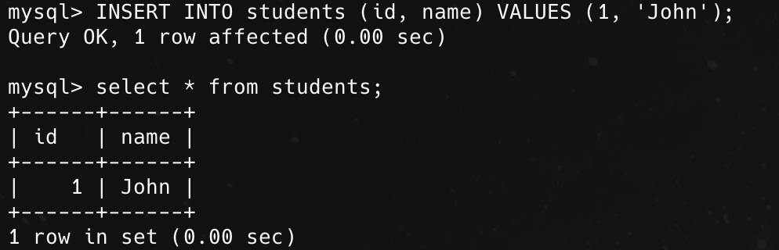
DML COMMANDS
1. INSERT
The INSERT command adds new records into a table.
Syntax:
INSERT INTO table_name (column1, column2) VALUES (value1, value2);
Example:
INSERT INTO students (id, name) VALUES (1, 'John');

Slide 9
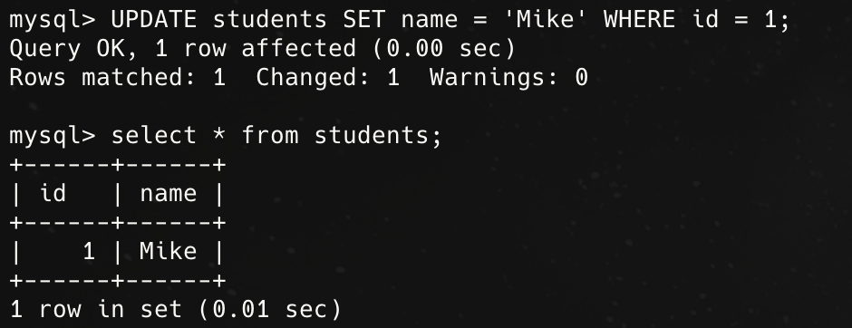
DML COMMANDS
2. UPDATE
The UPDATE command modifies existing records in a table.
Syntax:
UPDATE table_name SET column1 = value1 WHERE condition;
Example:
UPDATE students SET name = 'Mike' WHERE id = 1;

Slide 10
DML COMMANDS
3. DELETE
The DELETE command removes specific records from a table.
Syntax:
DELETE FROM table_name WHERE condition;
Example:
DELETE FROM students WHERE id = 1;

Slide 11
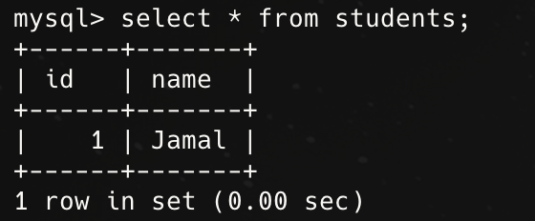
DQL COMMANDS
1. SELECT
The SELECT command retrieves data from a table.
Syntax:
SELECT column1, column2 FROM table_name;
Example:
SELECT * FROM students;

Slide 12
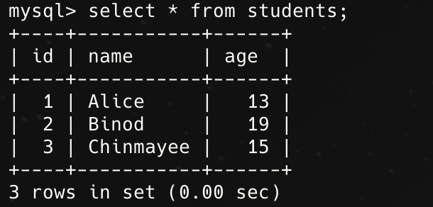
DQL COMMANDS
2. FROM
The FROM command is used to specify the tables or views from which to retrieve data.
Syntax:
SELECT column1, column2 ... FROM table_name;
Example:
SELECT * FROM customers;

Slide 13
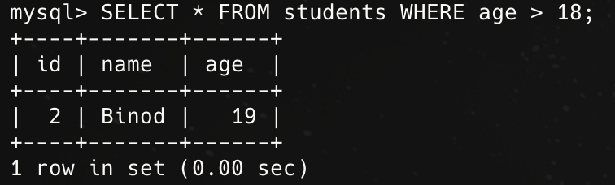
DQL COMMANDS
3. WHERE
The WHERE command is used to filter data based on conditions.
Syntax:
SELECT column1, column2 FROM table_name WHERE condition;
Example:
SELECT * FROM students WHERE age > 18;

Slide 14
DcL COMMANDS
1. GRANT
The GRANT command gives specific privileges to a user.
Syntax:
GRANT privilege_name ON object_name TO user;
Example:
GRANT SELECT ON students TO user1;

Slide 15
DcL COMMANDS
2. REVOKE
The REVOKE command removes privileges from a user.
Syntax:
REVOKE privilege_name ON object_name FROM user;
Example:
REVOKE SELECT ON students FROM user1;

Slide 16

DCL COMMANDS
3. COMMIT
The COMMIT command saves all changes made during the transaction.
Syntax:
COMMIT;
Example:
COMMIT;

Slide 17

TCL COMMANDS
1. ROLLBACK
The ROLLBACK command reverts changes made during the transaction.
Syntax:
ROLLBACK;
Example:
ROLLBACK;

Slide 18
TCL COMMANDS
2. SAVEPOINT
The SAVEPOINT command creates a point within a transaction to which a rollback can be made.
Syntax:
SAVEPOINT savepoint_name;
Example:
SAVEPOINT sp1;

Slide 19
Conclusion
SQL commands are categorized into DDL, DML, DQL, DCL, and TCL, each serving a specific purpose in database management.

Slide 20
REFERENCES
google.com

Slide 21
THANK YOU

