Slide 1
Cervical Cancer Prediction Using Machine Learning
s. Deepak naga sai
MCA 2nd year
24471f0096

Slide 2
OUTLINE
1. Abstract
2. Introduction
3. Problem Statement
4. Dataset Description
5. Data Preprocessing
6. Methodology
7. Machine Learning Models
8. Implementation
9. Result
10. Performance Metrics
11. Conclusion
12. Future Scope
13. References

Slide 3
Abstract
Cervical cancer is one of the leading causes of death among women.
Early detection can significantly reduce mortality.
This project uses machine learning to predict cervical cancer.
UCI Cervical Cancer Risk Factors dataset is used.
Models help in early and accurate diagnosis.

Slide 4
Introduction
Cervical cancer affects the cervix and is mainly caused by HPV.
Traditional diagnosis is time-consuming and error-prone.
Machine learning helps in automated and fast prediction.
This system supports medical decision-making.

Slide 5
Problem Statement
Early detection of cervical cancer is difficult.
Manual diagnosis may lead to delays and errors.
An automated prediction system is required.
Machine learning can provide accurate results.

Slide 6
Dataset Description
Dataset: Cervical Cancer Risk Factors (UCI Repository).
Total Records: 858.
Total Attributes: 36.
Target Variable: Cancer (Yes / No).
Medical and lifestyle related data.

Slide 7
Data Preprocessing
Handling missing values.
Removing irrelevant data.
Encoding categorical variables.
Feature selection.
Train-test data split.

Slide 8
Methodology
The methodology explains the steps used to develop the cervical cancer prediction system.
Data Collection.
Data Preprocessing.
Feature Selection.
Model Training.
Testing and Evaluation.
Final Prediction.

Slide 9
Machine Learning Models Used
Different machine learning algorithms are used to analyze patient data and improve the accuracy of cervical cancer prediction.
Logistic Regression.
Random Forest.
Support Vector Machine (SVM).
XG Boost.

Slide 10
Implementation
Implemented using Google Colab.
Programming Language: Python.
Libraries: Pandas, NumPy, Scikit-learn.
Model training and testing performed.
Results analyzed using metrics.

Slide 11
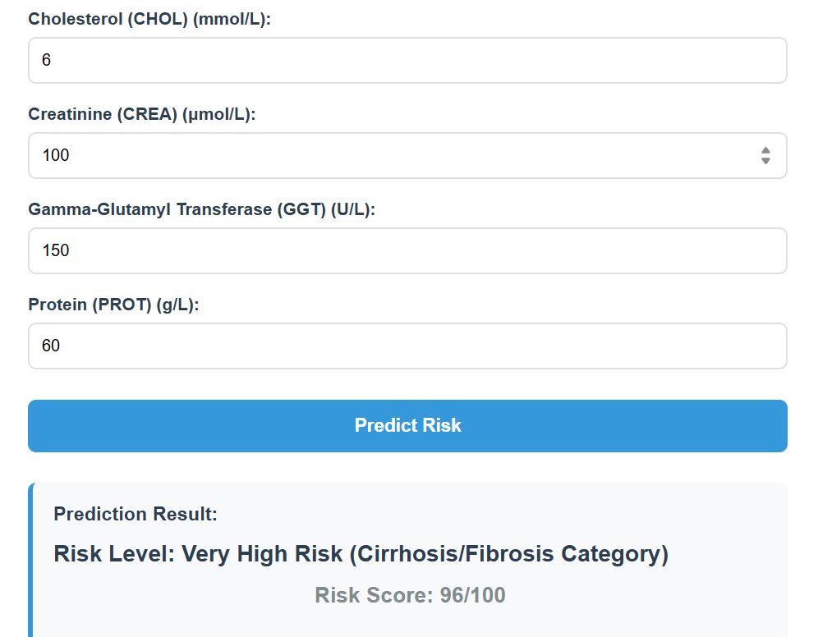
Results
Models trained and tested successfully.
Accuracy calculated for each model.
Best model selected based on performance.
Confusion matrix used for evaluation.

Slide 12
Performance Metrics
Accuracy, Precision, Recall, and F1-Score help measure the model’s prediction quality and overall performance.
Accuracy.
Precision.
Recall.
F1-Score.

Slide 13
Conclusion
Machine learning effectively predicts cervical cancer.
Early detection improves survival rates.
System provides reliable and accurate results.
Useful for healthcare support systems.

Slide 14
Future Scope
The future scope focuses on improving the system accuracy, scalability, and real-time healthcare integration using advanced technologies.
Use deep learning techniques.
Increase dataset size.
Develop web or mobile application.
Integrate real-time hospital data.

Slide 15
References
UCI Machine Learning Repository.
Research papers on cervical cancer prediction.
Scikit-learn Documentation.

