Slide 1

HEART DISEASE PREDICTION
Under the Guidance Of
Dr. DINESHA L
Associate Professor
Department of CSE
DEEKSHA PRABHU 4MT20CS047
DEEPIKA 4MT20CS050
VAIBHAV R JADHAV 4MT20CS175
MOHAMMED SHIHABUL FAIEZ 4MT21CS402
1

Slide 2
INTRODUCTION
ML models for heart disease prediction can be used to identify individuals who are at high risk of developing heart disease, even if they are not showing any symptoms.
This information can be used to encourage these individuals to adopt healthier lifestyles and seek early medical intervention, which can improve their chances of survival and reduce the risk of complications.
In our exploration of heart health, we're diving into a project that involves using machine learning, specifically Logistic Regression. This innovative approach aims to create a smart tool capable of predicting the likelihood of heart disease that considers various factors like age, blood pressure, and lifestyle choices to make predictions.
This tool, powered by Logistic Regression’s ,becomes a valuable ally for healthcare professionals, assisting them in identifying potential heart risks early on and taking proactive measures. The goal is to revolutionize how we approach heart health, making timely interventions and personalized care the cornerstone of our strategy for a healthier future.
2

Slide 3
LITERATURE SURVEY
[1]Heart Disease Prediction Using Machine Learning-Published by IEEE, 2023
[2]A Clinical Decision Support System for Heart Disease Prediction Using Deep Learning-Published by IEEE, 2023
[3]Effective Feature Engineering Technique for Heart Disease Prediction With Machine Learning-Published by IEEE, 2023
The earlier model for predicting heart disease primarily relied on the Random Forest and XGBoost classification algorithms.
However, it was observed that the accuracy of this model in predicting heart disease was not as high as desired.
Limitations :
Random Forest and XGBoost, while powerful algorithms, may not be as accurate for heart disease prediction due to the complexity and nuances of cardiovascular health.
3

Slide 4
Improvements with Logistic Regression:
In response to the limitations, the model was upgraded to utilize Logistic Regression, a well-established and interpretable classification algorithm.
Logistic Regression is known for its effectiveness in binary classification tasks, making it suitable for predicting heart disease.
Incorporation of Additional Parameters:
To enhance the predictive accuracy, the updated model now includes additional input parameters:
Age: Age is a crucial factor in heart disease risk assessment, as the likelihood of heart-related issues increases with age.
Gender: Gender can also play a significant role in heart disease risk, as men and women may exhibit different symptoms and risk factors.
ST Depression: ST depression on an electrocardiogram (ECG) is a critical indicator of cardiac ischemia or reduced blood flow to the heart muscle. This parameter provides valuable diagnostic information.
Enhanced Accuracy and Early Prediction:
The incorporation of age, gender, and ST depression as input features allows the model to consider more relevant factors in heart disease prediction.
This enhanced model is expected to provide more accurate predictions, potentially assisting doctors in the early detection and diagnosis of heart disease.
4

Slide 5
PROBLEM STATEMENT
We aim to develop a machine learning model that predicts the probability of heart disease in individuals. By utilizing a dataset containing various health-related features such as cholesterol levels, blood pressure, and age, our goal is to create an accurate regression model. This model will assist healthcare professionals in assessing the risk of heart disease in patients, facilitating early intervention and personalized healthcare strategies.
5

Slide 6
OBJECTIVES
The objectives for predicting heart disease using machine learning with Logistic Regression are
To create a smart tool that can accurately tell if someone is at risk
Help doctors make decisions about patients' heart health and
Make sure the tool is easy for doctors to understand and trust, so they can take action early and keep people healthier.
6

Slide 7
METHODOLOGY PROPOSED
This study employs Logistic Regression for heart disease prediction, utilizing a dataset enriched with essential factors. Factors include age, gender, cholesterol levels, blood pressure, BMI, and lifestyle elements. Preprocessing involves handling missing values and normalizing features. The dataset is split into training and testing sets.
Logistic Regression is selected for its aptitude in binary classification. Training the model optimizes for heart disease presence or absence. Evaluation metrics such as accuracy, precision, recall, F1 score, and ROC-AUC assess model performance. Logistic Regression coefficients offer insights into the relative importance of predictive factors.
Ensuring interpretability, the model is deployed, continuously monitored, and updated for real-world accuracy. Explanation mechanisms accompany predictions to foster trust, especially in healthcare contexts. This methodology strives to deliver a robust and understandable heart disease prediction model, contributing to proactive healthcare interventions.
7

Slide 8
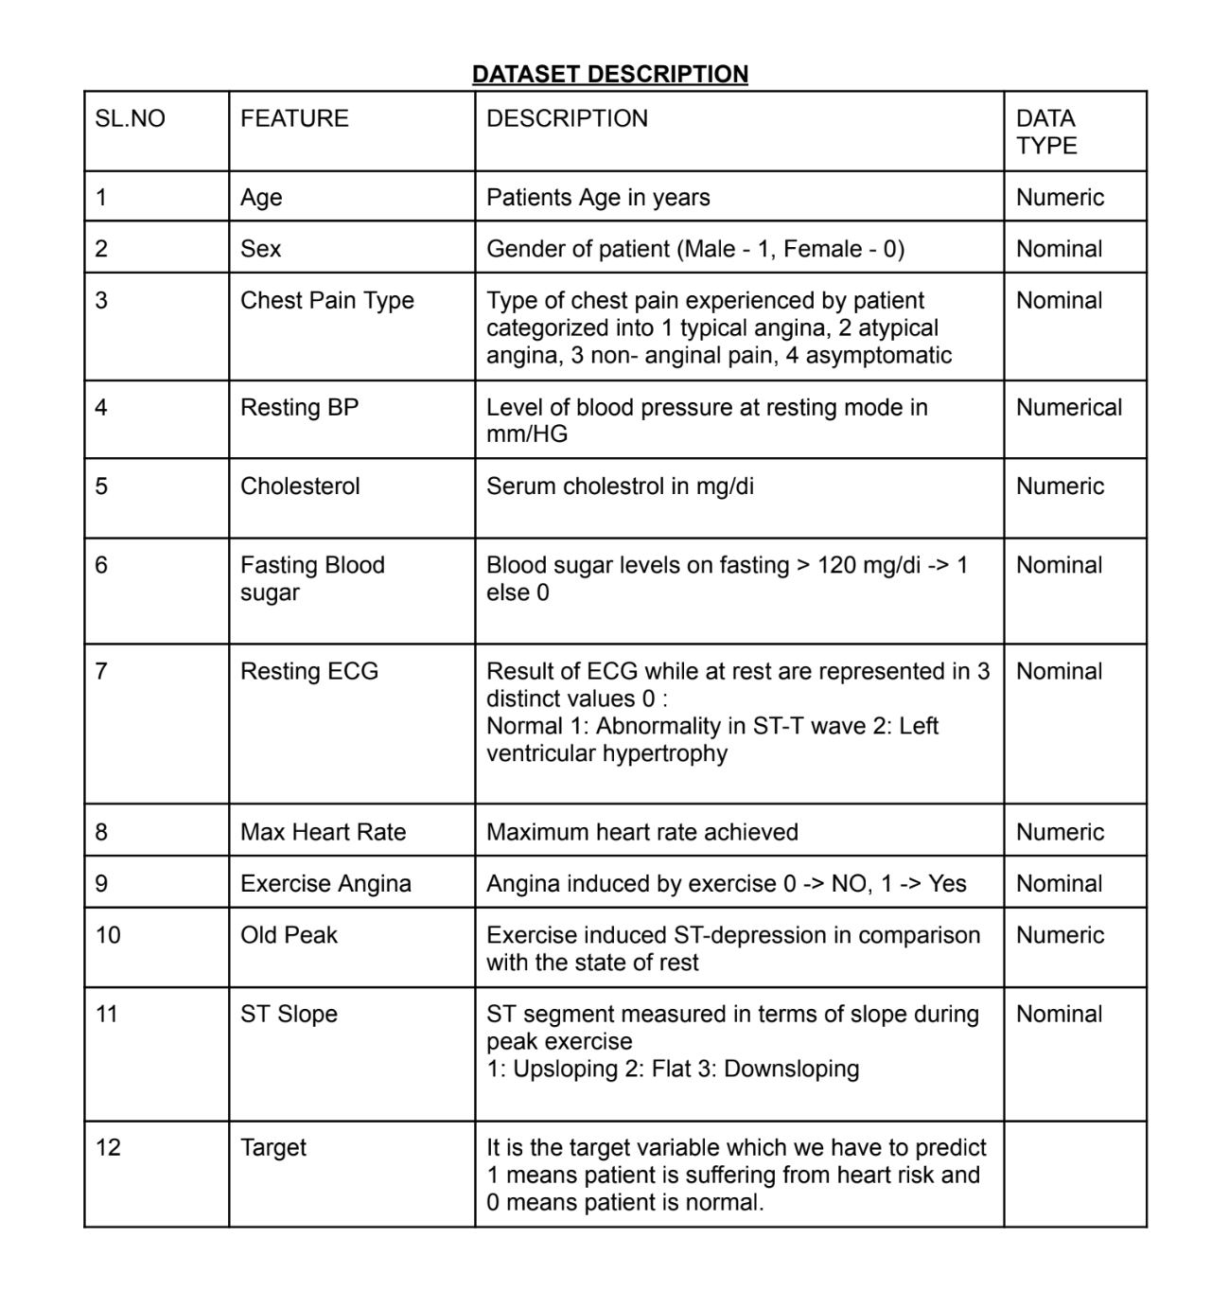
8

Slide 9
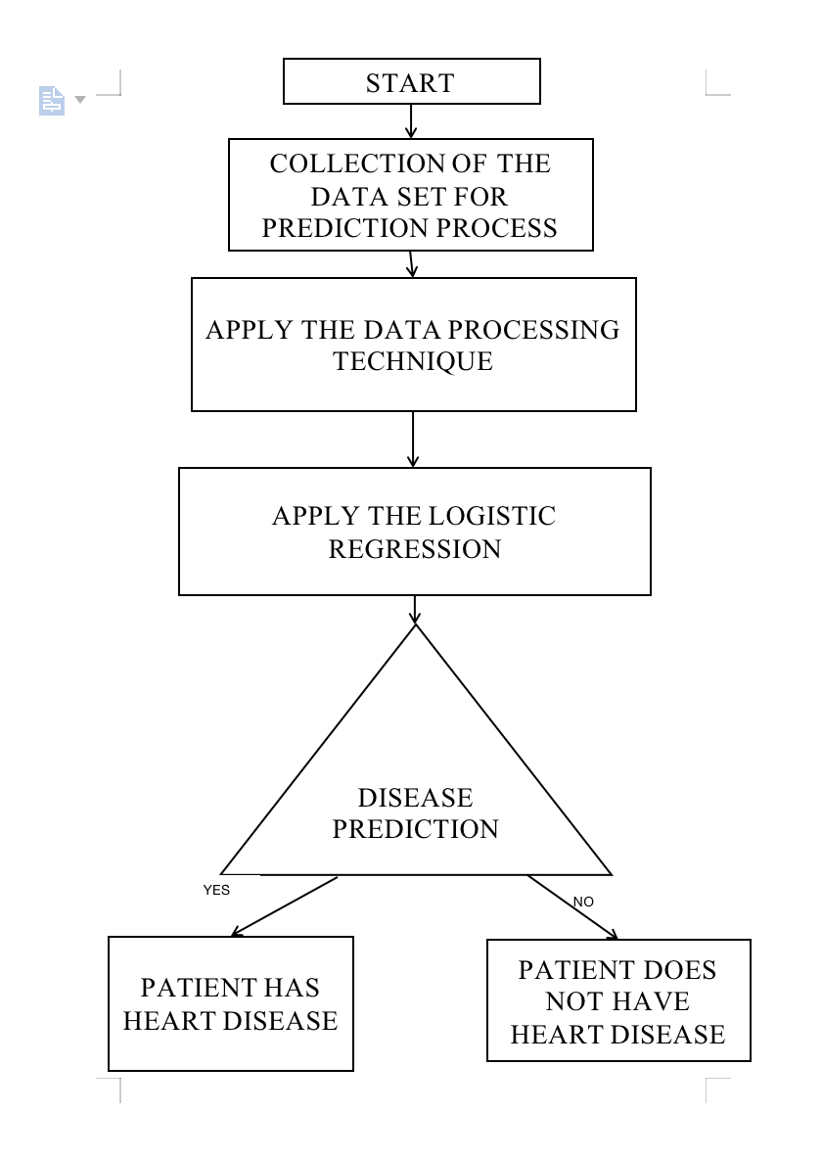
9

Slide 10
MEDICAL TEST RESULTS
WEB INTERFACE
ML MODEL
OUTPUT
DOCTOR’S DIAGNOSIS
10

Slide 11
EXPECTED OUTCOME
The expected outcome for heart disease prediction using machine learning with Logistic Regression is :
Highly accurate and interpretable model capable of classifying individuals into appropriate risk categories.
Empowering healthcare professionals with a reliable tool for early identification of individuals at risk and facilitating timely interventions .
Ultimately leading to improved patient outcomes and a proactive approach to heart health.
11

Slide 12
THANK YOU!...😊
12

