Slide 1
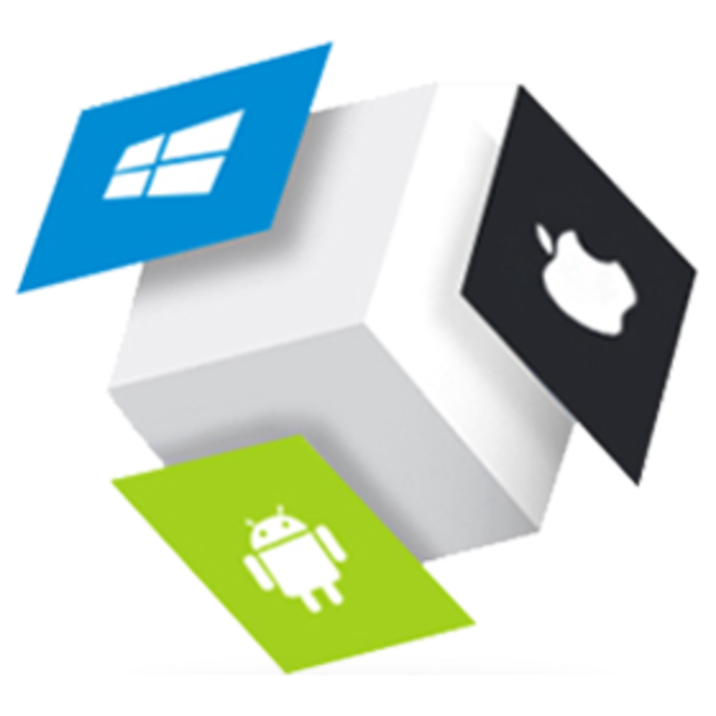
Mini Project- Flutter “FOODIE!”
Submitted by:
Deepak Parihar(201500206)
Suchita Khare(201500712)
Akash Rathour(201500060)
Devesh Sharma(2015000216)
Submitted to:
Mr. Akash Kumar Choudhary

Slide 2

FLUTTER
Google's free and open-source UI framework

Slide 3
Flutter is a UI toolkit for building fast, beautiful, natively
compiled applications for mobile, web, and desktop with
one programing language and single codebase
It is free and open-source
Flutter is different from other frameworks because it neither
uses Web View nor the OEM widgets that shipped with the
device.

Slide 4
Instead, it uses its own high-performance rendering engine to draw widgets
It also comes with a rich set of customizable widgets, all build from a modern reactive framework
Stateful Hot Reload widget allows you to change your code and see it come to life in less than a second, without loosing the state of the app

Slide 5

Highlights of Flutter
Advanced Image Formatting Capabilities
Advanced Image Formatting Capabilities
Advanced Image Formatting Capabilities
Layered Architecture
Wide range of IDEs
Multiplatform UI toolkits
Wide range of IDEs
Wide range of IDEs
Flutter doctor for dependencies
Customizable Widgets
Flutter doctor for dependencies
Flutter doctor for dependencies

Slide 6

DART PROGRAMMING LANGUAGE
Client-optimized language for developing
fast applications

Slide 7
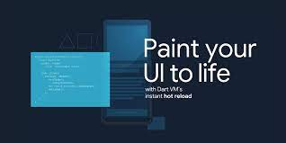
It is an open-source, general-purpose, object-oriented programming language with C-style syntax developed by Google in 2011.
The purpose of Dart programming is to create frontend user interfaces for the web and mobile apps.
It supports most of the common concepts of programming languages like classes, interfaces, functions, unlike other programming languages.

Slide 8

SWOT ANALYSIS
STRENGTHS
Creates a frontend user interface for the web and mobile apps.
WEAKNESSES
It does not support arrays directly.
S
W
It supports collection . It is used to replicate data structures such as arrays, generics , and optional typing.
OPPORTUNITIES
IT is mainly used to develop applications like Gmail, Google maps , and Google Instant Search etc.
APPLICATIONS
O
T

Slide 9


Optimal Hires..
As students we all have different kinds of doubts when it comes to placements.
What were the last year asked questions by the companies?
Which major corporate companies visit your college to hire students? • •
What were the packages offered?
Optimal Hires is an android application which will provide the user the information about the campus drives. It will provide information like company names, skills required, last year offered packages etc. So that the user(student) can target his/her dream company and prepare himself/herself according to company requirements.

Slide 10
ROADMAP
Sign up Screen
Quiz section
Home Screen
1
3
5
2
4
6
Sign-In Screen
Drive info.
Previous year questions/
Other important information
Logout screen

Slide 11
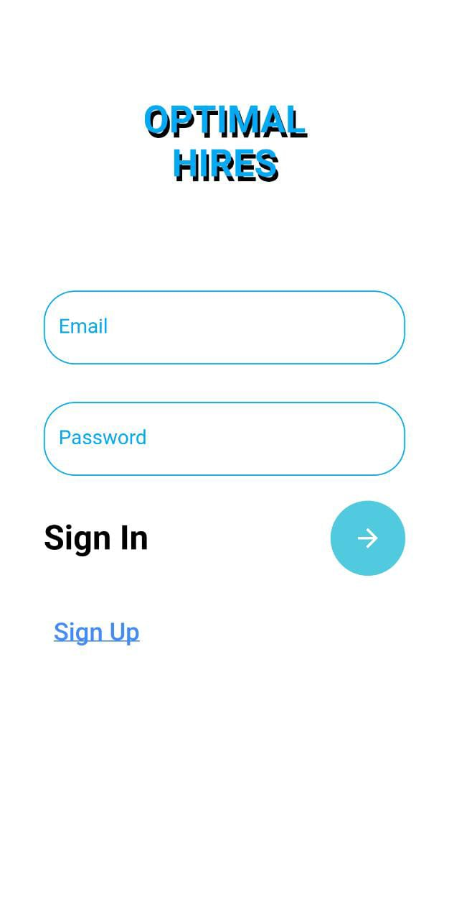
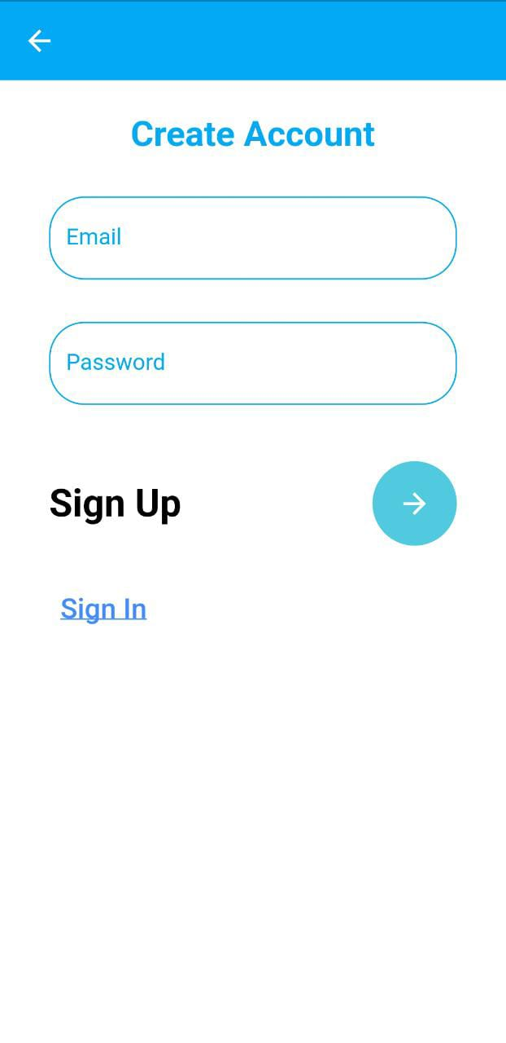
Screens for Sign-up
and Sign-in

Slide 12
Sign- up Page
Sign-In Page
Here you can login by using the same email and password
The user can Sign-up to the app
using email and
password.

Slide 13
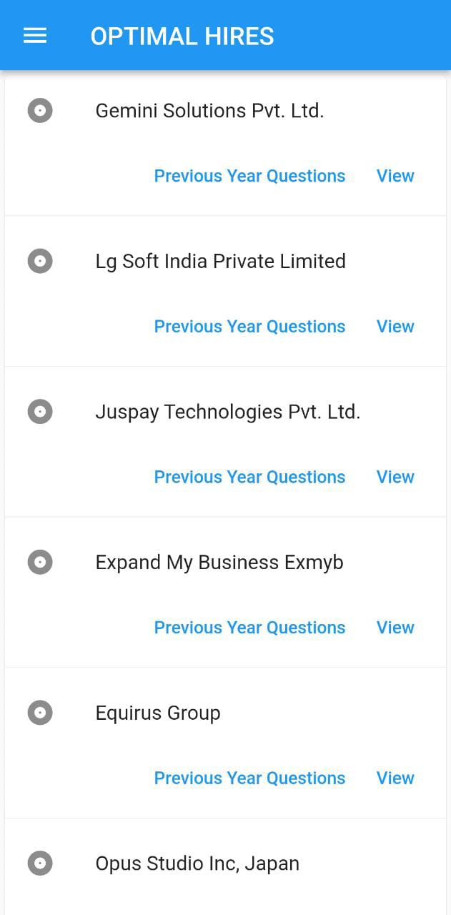
Home Screen
A clean,organized user-friendly UI
Multiple items that redirect to different screens for Company details.
Where you can see the previous years question button as well as the view buttont.
On top left corner you can find the pop up icon where you can find Quiz ,Help,contact us and about section.

Slide 14
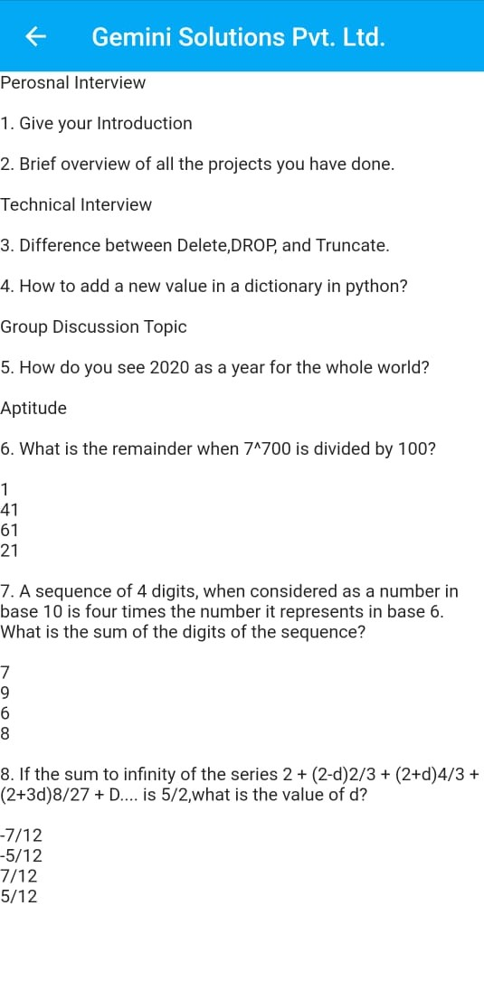
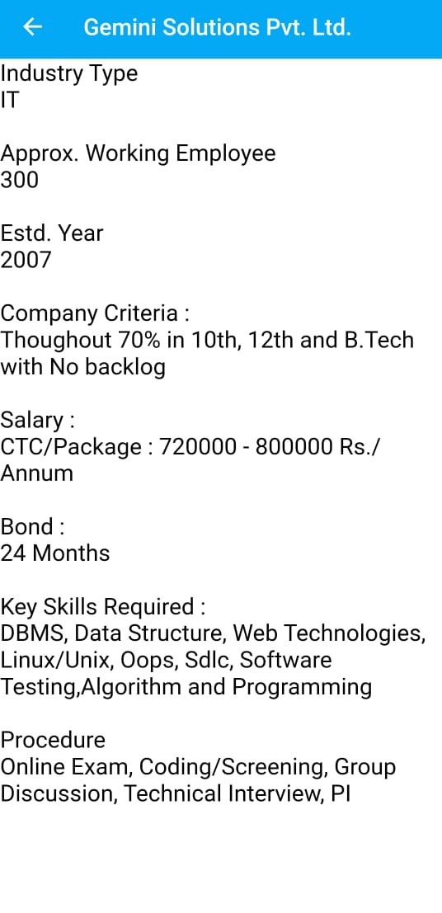
Company Description
Pages:-
Previous year questions
View information

Slide 15
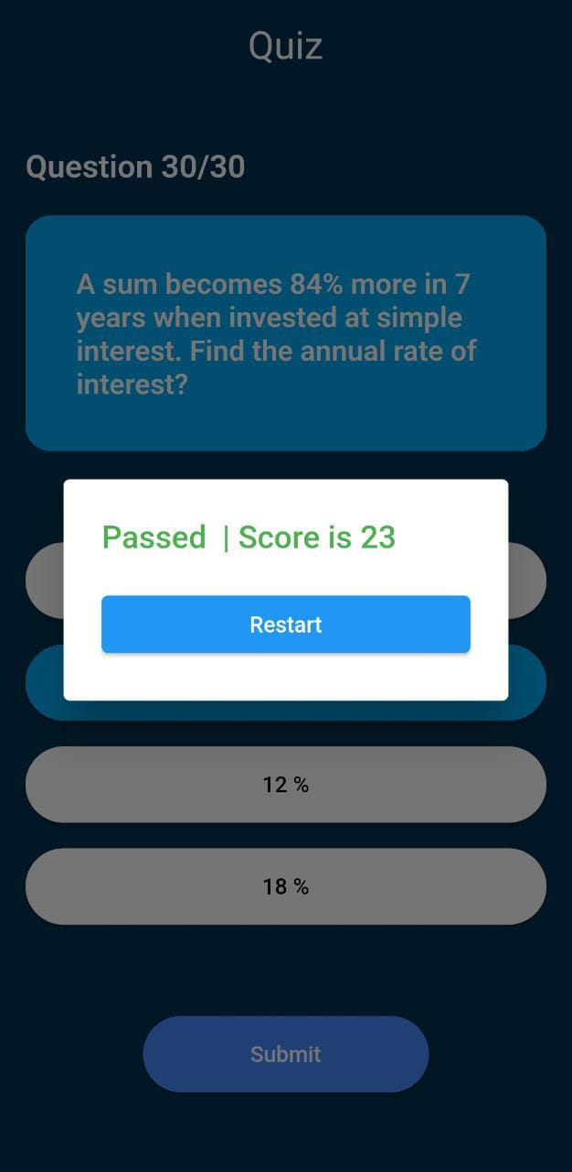
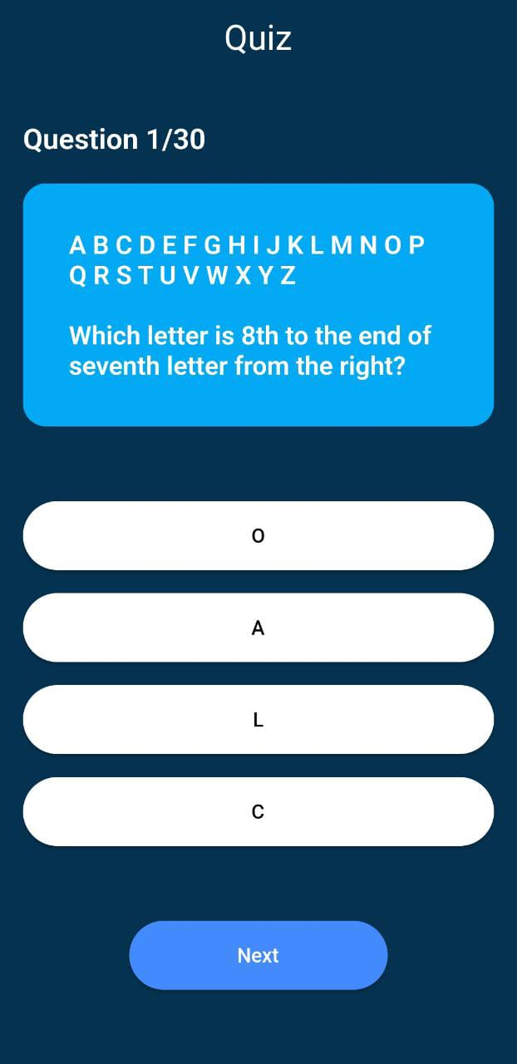
Company Description
Pages:-
Quiz
Passed or failed status

Slide 16
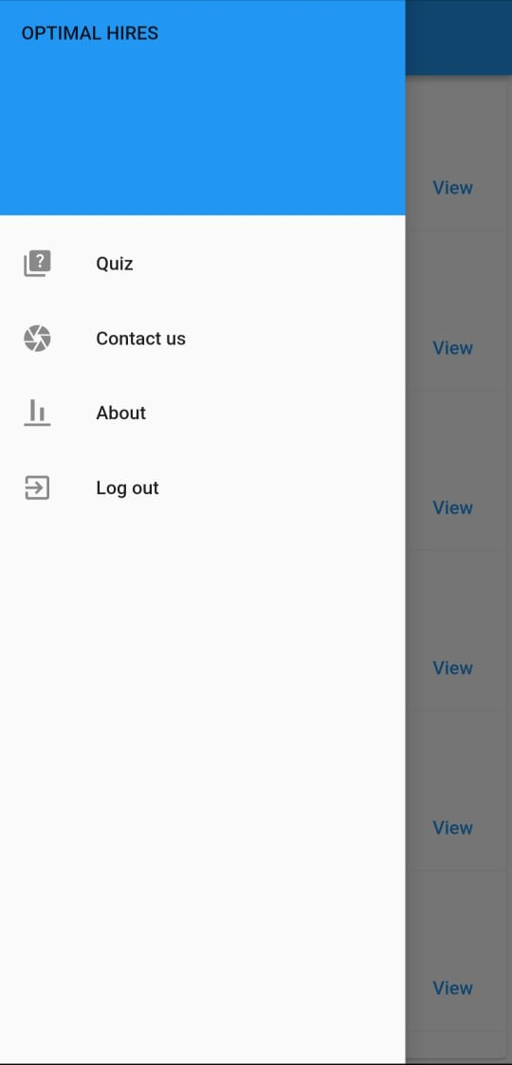
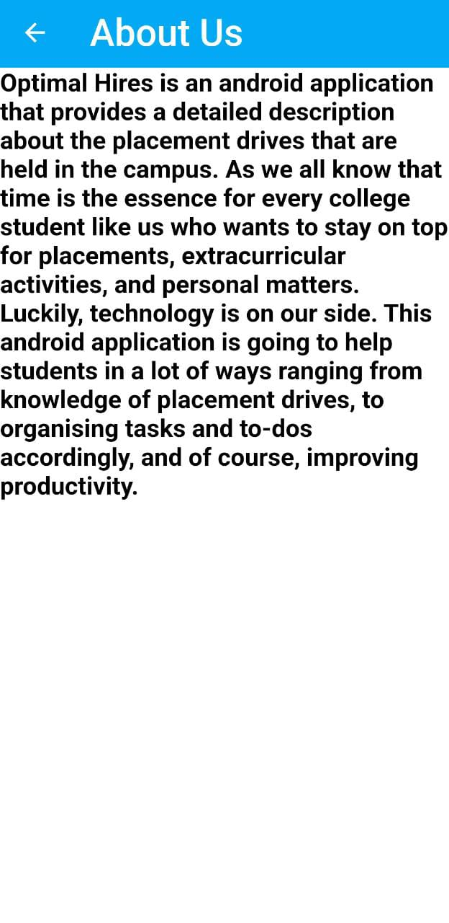
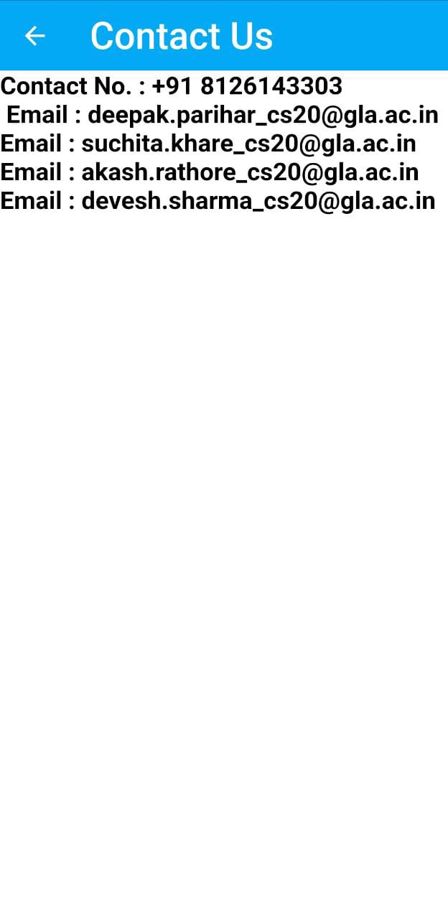
POP UP SCREENS

Slide 17
Course of action of our application-
Welcome Page
Sign-up
Sign In
Sign In/Sign up
Select time
See peevious year questions
Select Quantity
Quiz
Login Success
Details Entry Page
View desciption
Home Page
Home Page
Order confirmed
Home
Passed/failed
Home

Slide 18
THANK YOU

