Slide 1
RetinoAI: Advanced Diabetic Retinopathy Staging DEEP LEARNING APPROACH FOR PREDICTION OF DIABETIC RETINOPATHY
Alokam Gnaneswara Sai - 319106410005
Balaram Mahanthi Deepak Patnaik-319106410006
Betha Madhuri-319106410007

Slide 2
CONTENTS: 1.Introduction 2. Aim(objectives) 3. Motivation 5. Representatives of Diabetic Retinopathy 6. Problem Statement 7. Methodology 7.1 Existing System 7.2 Proposed System 8. Architecture 9. Conceptual Terms 10. Model Building 11. Conclusion

Slide 3
1.INTRODUCTION
Diabetic retinopathy is an eye condition that can cause vision loss and blindness in people who have diabetes. It affects blood vessels in the retina (the light-sensitive layer of tissue in the back of your eye).
Diabetic retinopathy may not have any symptoms at first but finding it early can help you take steps to protect your vision.
One of the essential challenges is early detection, which is very important for treatment success. Unfortunately, the exact identification of the diabetic retinopathy stage is notoriously tricky and requires expert human interpretation of fundus images.
Simplification of the detection step is crucial and can help millions of people. However, the high cost of big labeled datasets, as well as inconsistency between different doctors, impede the performance of these methods.
Convolutional neural networks (CNN) have been successfully applied in many adjacent subjects, and for diagnosis of diabetic retinopathy itself.
In this thesis, we propose a deep-learning-based method and multistage approach to transfer learning for automatic stage detection of diabetic retinopathy by single photography of the human fundus.
The presented method can be used as a screening method for early detection of diabetic retinopathy

Slide 4
2.AIM(OBJECTIVES)
The main objective of this project is to develop a deep learning model that can accurately detect diabetic retinopathy from eye retina images.
1.To collect a large dataset of eye retina images.
2.To pre-process the images to remove noise and enhance the contrast.
3.To train a deep learning model using a convolutional neural network.
4.To evaluate the performance of the model using metrics such as accuracy, precision, and recall.
5. To deploy the model to a web application or a mobile app, users can upload their retina images and receive a prediction of whether they have diabetic retinopathy.

Slide 5
3.MOTIVATION
According to U.S Survey,at least 56% of new cases of this disease could be reduced with proper and timely treatment and monitoring of the eyes.
However, the initial stage of this ailment has no warning signs, and it becomes a real challenge to detect it on the early start.
Moreover, well-trained clinicians sometimes could not manually examine and evaluate the stage from diagnostic images of a patient’s fundus (according to Google’s research (Krause et al., 2017)).
Furthermore, existing ways of diagnosing are quite inefficient due to their duration time, and the number of ophthalmologists included in patient’s problem solution. Such sources of disagreement cause wrong diagnoses and unstable ground-truth for automatic solutions, which were provided to help in the research stage.
Thus, algorithms for DR detection began to appear.
The motivation behind this project is to develop an automated system for the detection of diabetic retinopathy, which can save time and reduce the cost of screening. The system can also be used in areas where there is a shortage of ophthalmologists.

Slide 6
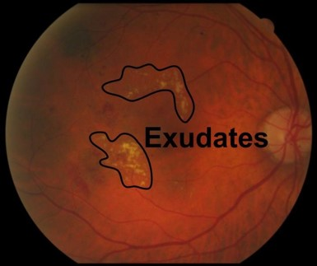
5.REPRESENTATIVES OF DIABETIC RETINOPATHY:
The features like exudates,micro aneurysms and hemorrhages are the major representatives of diabetic retinopathy.
1.Exudates
Exudates in the eye happen when there is a problem with the blood vessels in the eye. The blood vessels can leak a fluid into the surrounding tissue, which can cause a buildup of a yellowish-white substance called exudate. Exudates in the eye can be a sign of an eye infection or other serious eye problems.

Slide 7
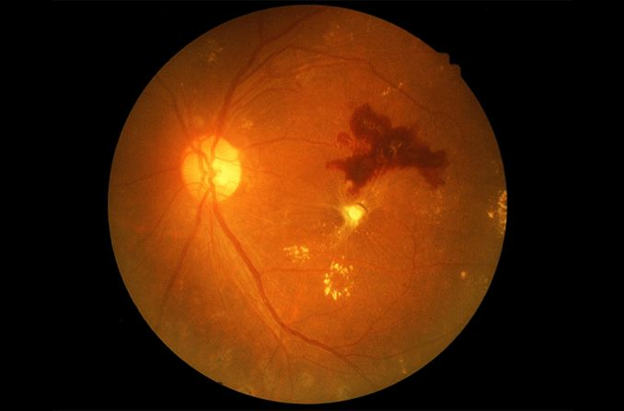
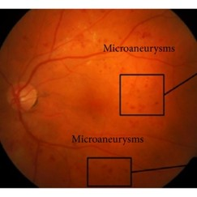
2. Hemorrhages
Hemorrhages in the eye happen when tiny blood vessels in the eye burst and blood leaks out into the surrounding tissue. This can cause a red patch to appear in the white part of the eye. Hemorrhages can be caused by many things, such as an injury, high blood pressure, or a problem with the blood vessels in the eye. Hemorrhages in the eye can be a sign of a serious medical condition, so it's important to see a doctor or eye specialist if you notice any changes in your vision or if your eye looks different than normal.
3.Micro aneurysms
Microaneurysms are tiny little balloons that can form on the small blood vessels in the eye. They are caused by a problem with the blood vessels, and are often seen in people with diabetes or high blood pressure. Microaneurysms can be a sign of a more serious eye problem, so it's important to see a doctor or eye specialist if you notice any changes in your vision or if your eye looks different than normal.

Slide 8
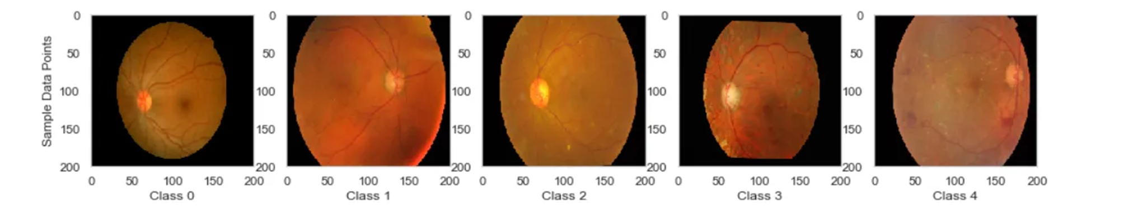
6.PROBLEM STATEMENT
This is a 5 Class Image Classification Task based on a Kaggle dataset from Eye Images (Aravind Eye hospital) - APTOS 2019 Challenge. The goal is to predict the Blindness Stage (0-4) class from the Eye retina Image using Deep Learning Models (CNN).
Why deep learning?
Deep learning is a method in artificial intelligence (AI) that teaches computers to process data in a way that is inspired by the human brain. Deep learning models can recognize complex patterns in pictures, text, sounds, and other data to produce accurate insights and predictions.
Here, we consider 5 stages of diabetic retinopathy
No diabetic retinopathy (label 0)
Mild diabetic retinopathy (label 1)
Moderate diabetic retinopathy (label 2
Severe diabetic retinopathy (label 3)
Proliferative diabetic retinopathy
(label 4)

Slide 9
7.METHODOLOGY
7.1 EXISTING SYSTEM:
Existing system for diabetic retinopathy involves a lot of human work. To diagnose DR at an early stage, manual methods such as bio-microscopy, retinal imaging of the fundus, Retinal Thickness Analyzer (RTA), Scanning Laser Ophthalmoscopy (SLO), Adaptive Optics, Retinal Oximetry, Optical Coherence Tomography (OCT), OCT Angiography, Doppler OCT, and many more can be adopted.
However, such conventional methods for manually analyzing the disease makes it cumbersome, time consuming and highly prone to error. Besides, it demands a sophisticated task force which is sometimes not feasible w.r.t (with respect to) prevailing circumstances.
Thus, it is not feasible to perform manual diagnosis for early detection of DR at any time and at any place.
The present ratio of Ophthalmologists to patient especially in India is 1:10000,and in such a situation, the need of an automated intelligent detection system for primary analysis of early signs of DR is realized.
Thus, a faster and a revolutionary method, proposing an intelligent system is necessitated.
7.2 PROPOSED SYSTEM
We propose the deep learning approach to detect diabetic retinopathy.
Deep Learning (DL) is a new advent of ML which can perform automated and complex tasks, discover unseen insights, highly scalable, better domain knowledge, reliable decision making etc and efficiently applies them upon high-dimensional data, thereby outperforming shallow ML models.
DL methods such as Convolutional Neural Network (CNN) , Deep Convolutional Neural Network (DCNN), and Deep Neural Network (DNN/DLNN) architectures such as AlexNet, Residual Network (ResNet) and its variants etc. are proposed for deep feature extraction and image classification. DR detection is highly dependent on assessment and analysis of fundus images.

Slide 10
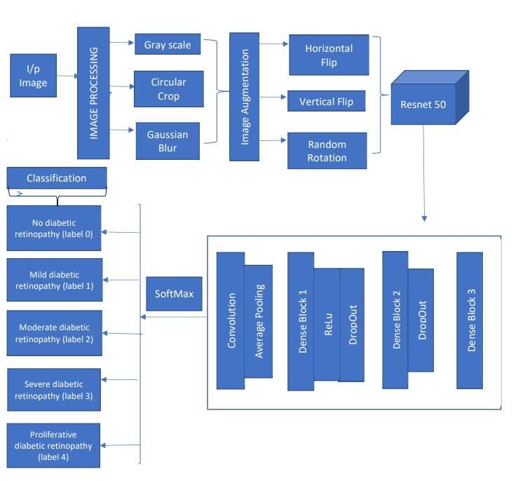
8.ARCHITECTURE

Slide 11
9.Conceptual Terms
Convolutional Neural Network(CNN):
A Convolutional Neural Network (CNN) is a deep learning model commonly used for image and video recognition,
classification. CNNs are particularly effective at identifying and classifying images because they can learn and recognize complex visual patterns and features, such as edges, textures, and shapes, by applying a series of convolutional and pooling layers. This makes them well-suited for tasks such as image recognition. The basic building blocks of a CNN are convolutional layers, pooling layers, and fully connected layers.
1.Convolutional layers: Convolutional layers apply a set of filters to the input image, which extract local features from the image. Each filter slides over the input image and performs a dot product between its weights and the
corresponding region of the input image. This operation produces a feature map that highlights the presence
of a specific feature in the input image.
2.Pooling layers: Pooling layers are used to downsample the feature maps obtained from the convolutional layers.
They reduce the spatial size of the feature maps and make the network more computationally efficient, while also
making the learned features more robust to small variations in the input image.
3.Fully Connected Layer: Finally, fully connected layers are used to classify the image based on the features learned
by the previous layers. These layers take the flattened feature maps as input and apply a set of weights to produce
the final classification.

Slide 12
9.Conceptual Terms(cont..)
2.Transfer learning:
It is a machine learning technique, that involves using a pre-trained model on a large dataset for a new,similar task.It involves taking a neural network ,that has already been trained on a large dataset ,such as IMAGENET and reusing its learned features and weights to solve a different problem.
The idea behind transfer learning is that learned features and weights of pre-Trained model can be useful for a new task ,as they have already been trained on a large dataset.
Rather than training a new model from scratch,transfer learning enables us to leverage the power of a pre-trained model and fine tune it for a specific task,to reduce the amount of training data and time required for the new model to achieve high accuracy.
3.ResNet-50:
ResNet-50 is a deep convolutional neural network architecture,that was introduced in 2015 by researchers at Microsoft Research.
It was designed to address the problem of vanishing gradients that occur in very deep neural networks.It consists of 50 layers and uses residual connections ,to enable the gradient to flow more easily through the network during training.

Slide 13
9.Conceptual Terms(cont..)
4.Deep Learning:
Deep Learning is a subfield of machine learning ,that is inspired by the structure and function of human brain. It involves training artificial neural networks that are composed of many layers of interconnected nodes or neurons, to preform many such tasks such as image recognition. Deep learning models learn by analyzing large amounts of data, and extract features from them.
5.Gaussian Blur:
Gaussian blur is a type of image filtering technique that is commonly used to reduce image noise and smooth out an image. It works by applying a Gaussian function to each pixel in the image, which results in a weighted average of the neighboring pixels.
The amount of blur applied to an image is determined by the size of the Gaussian kernel used. The kernel is a matrix that is convolved with the image to produce the blurred output, with larger kernels resulting in more blur. The standard deviation of the Gaussian function also affects the amount of blur, with higher standard deviations resulting in more smoothing.
In a Gaussian blur, the pixels nearest the centre of the kernel are given more weight than those far away from the centre. The rate at which this weight diminishes is determined by a Gaussian function, hence the name Gaussian blur.

Slide 14
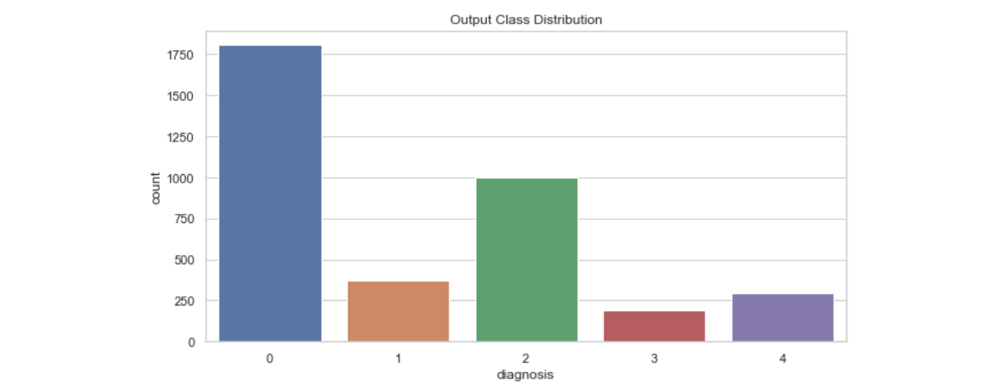
10.MODEL BUILDING
Steps in model building:
1.Load data.
2.Define model.
3.Model Compilation..
4.Model Training .
5.Making Predictions. Fig - Class Distribution
6.Model Evaluation.
Step-1:Load Data: We have collected data from open dataset from Kaggle Diabetic Retinopathy Detection Challenge APTOS 2019 dataset .The full dataset consists of 18590 fundus photographs, which are divided into 3662 training, 1928 validation, and 13000 testing images by organizers of Kaggle competition, each photography is of different resolution.
We then visualized the Class Distribution of given dataset and observed that the dataset is more skewed towards class 0(No DR).To overcome this imbalance and increase diversity of the dataset ,we introduced ‘Data Augmentation’.

Slide 15
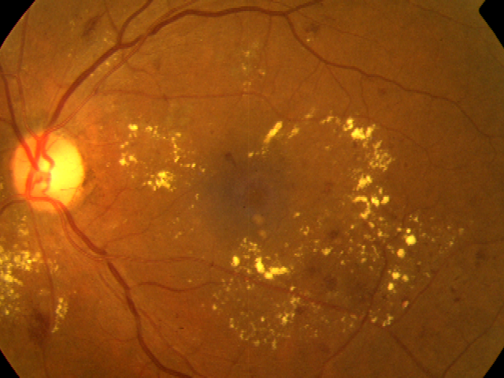
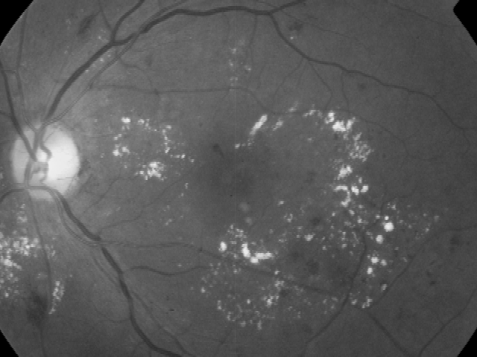
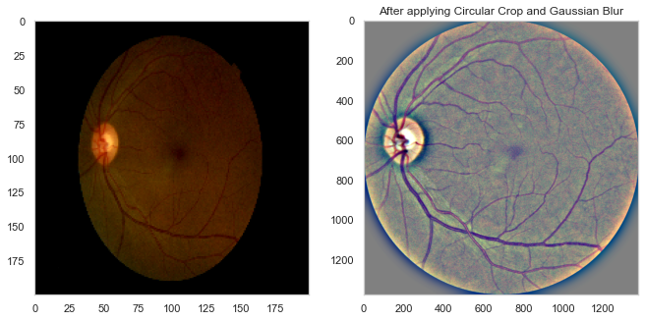
10.Model Building(cont..)
Data preprocessing: We used few image processing techniques to pre-process the image before it is fed into our model.
We then observed that -The features are more visible in case of gray-scale image, rather than colored image.
So,we converted the colored images into gray-scale image.
Fig. Colored fundus image Fig. Gray-scale image
Also,we used Gaussian Blur Concept to blur the image and extract only required essential features,rather than other
noise in the data.So,we used Gaussian blur to every given image and to focus on the central eye fundus than other
surroundings in it, we cropped given images circularly and resized it.

Slide 16
Step-2:Define Model:
We have build the model using Transfer learning approach with ResNet-50, a 50-layer convolutional neural network (48 convolutional layers, one MaxPool layer, and one average pool layer) that is pre-trained on ImageNet database which consists of more than 14 million images have been hand-annotated by the project to indicate what objects are pictured. We have developed 2 models for our project.
Model-1:Depending only on Pre-Trained Resnet-50 weights .
Model-2: Pre-Trained Resnet-50 weights + Additional custom layers(to not fully depend on pre-trained ResNet-50 model and generalize it more to our project) .
Step-3:Model Compilation:Then ,we have compiled the model using adam optimizer with categorical_crossentropy as loss function.
Step-4 Model Training(fitting): Then ,we trained the model for about 15 epochs and used the concepts of Early Stopping and Reduce Learning Rate to reduce the chances of overfitting
Step-5 Model Predictions: We have predicted labels on test dataset with our model and predicted their labels.
Step-6 Model Evaluation: After predicting the values, their performances are evaluated and accuracy scores are obtained as:
 | Train Accuracy | Test Accuracy
Model-1(with Restnet-50) | 93.8% | 78.3%
Model-2(Restnet-50+additional layers) | 89.6% | 79.7%

Slide 17
11.CONCLUSION
We proposed the multistage transfer learning approach and an automatic method for detection of the stage of diabetic retinopathy by single photography of the human fundus.
We have used an ensemble of CNN architecture and transfer learning for our final solution. The experimental results show that the proposed method achieves high and stable results even with unstable metric.
The main advantage of this method is that it increases generalization and reduces variance by using an ensemble of the networks, pretrained on a large dataset, and finetuned on the target dataset.

Slide 18
THANK YOU

