Slide 1

PANDASAI
Deepak Rayathurai

Slide 2
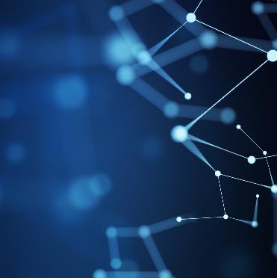
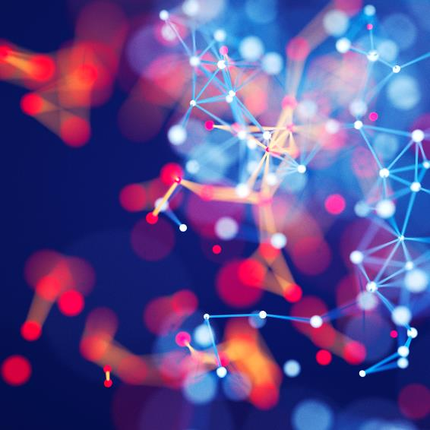

Content
Introduction
Architecture
Examples
Scope and Advantage

Slide 3
A Python Library that adds Generative Artificial Intelligence
Allowing you to ask questions about your data and get answers back.

Slide 4
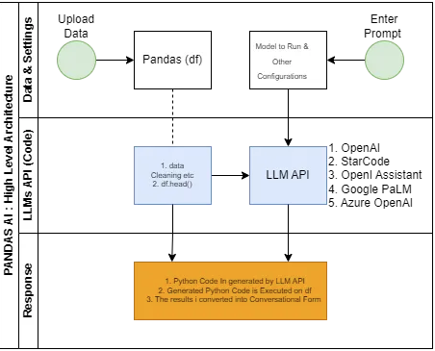
High Level Architecture

Slide 5
Insights to below
Data Upload
Submit Relevant Questions
Submit Prompts
LLMs API Response
Code Execution and Evaluation

Slide 6
How to
Data Upload
Submit Relevant Questions
Submit Prompts
LLMs API Response
Code Execution and Evaluation

Slide 7
Supported By
Chatgpt
Starcoder
Azure
Open AI assistant
Google Palm

Slide 8
Supported By
Chatgpt
Starcoder
Azure
Open AI assistant
Google Palm

Slide 9
How To

Slide 10
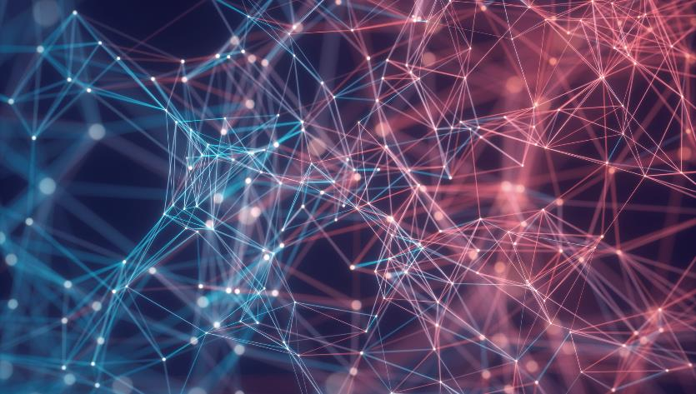

Thank You
Deepak Rayathurai
Deepakr6242@gmail.com
https://deepakrayathurai.medium.com/
https://www.quora.com/profile/Deepak-Rayathurai

