Slide 1

Python Docstring-PEP 257
Deepak Rayathurai

Slide 2



Content
Introduction
What and Why
Examples
Scope and Advantage

Slide 3
A universal convention supplies all of maintainability, clarity, consistency, and a foundation for good programming habits too. What it doesn’t do is insist that you follow it against your will. That’s Python!”—Tim Peters on comp.lang.python, 2001-06-16

Slide 4
Introduction
A docstring is a string literal that occurs as the first statement in a module, function, class, or method definition. Such a docstring becomes the __doc__ special attribute of that object.

Slide 5
Derivation
PEP 257 = PEP 256+ PEP 258
PEP 256 – Docstring Processing System Framework
PEP 258 – Docutils Design Specification

Slide 6
Type of docstring
Attribute docstring
Additional docstring

Slide 7
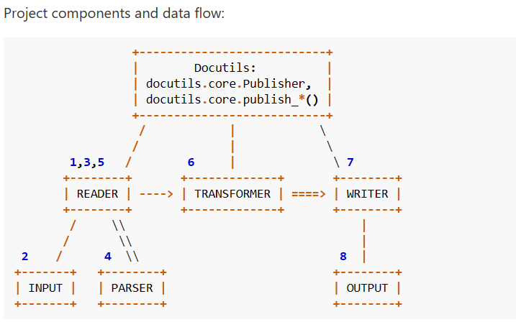
Design of Doc utils Project Model

Slide 8
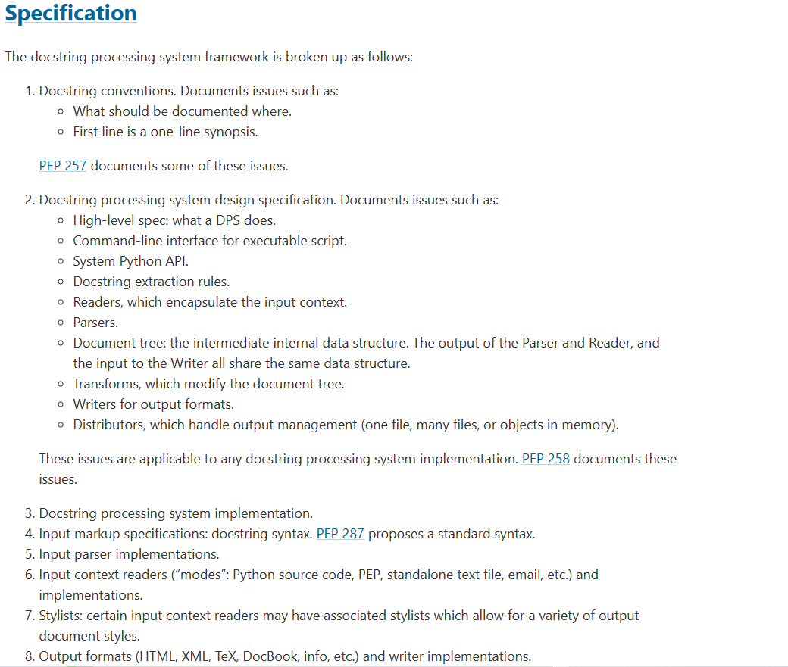
Design of Docstring Processing System Framework

Slide 9
Forms of docstring
One-liner docstrings
Multiline docstring

Slide 10
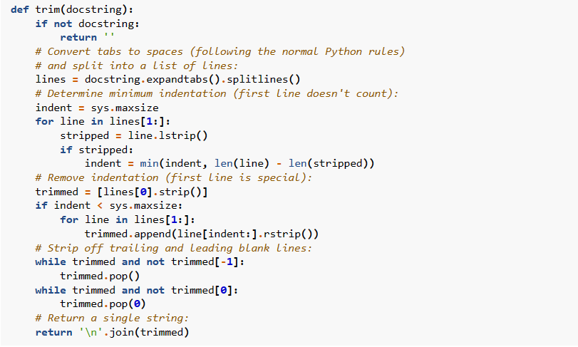
Handling Docstring Indentation

Slide 11
Fomats of docstring
One-liner docstrings
Multiline docstring

Slide 12
Forms of docstring
Epytext
Google
Numpydoc
reST

Slide 13
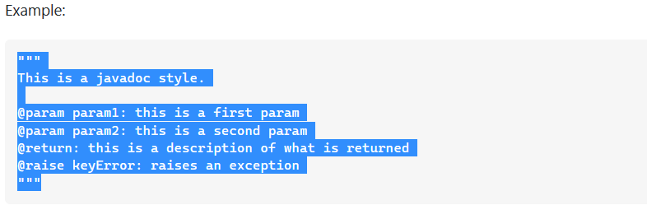
Epytext

Slide 14
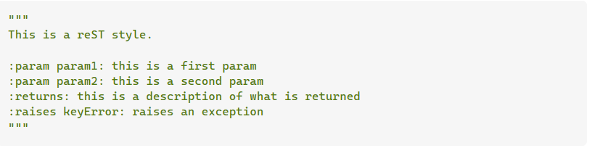
reST

Slide 15
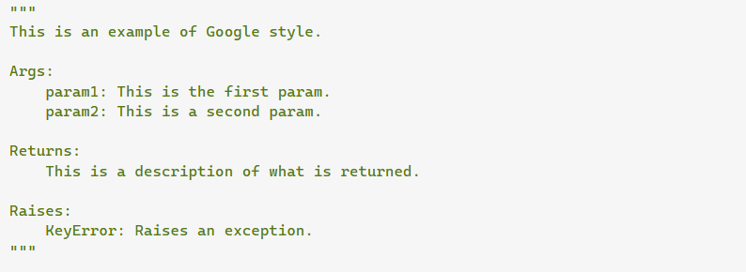
Google

Slide 16
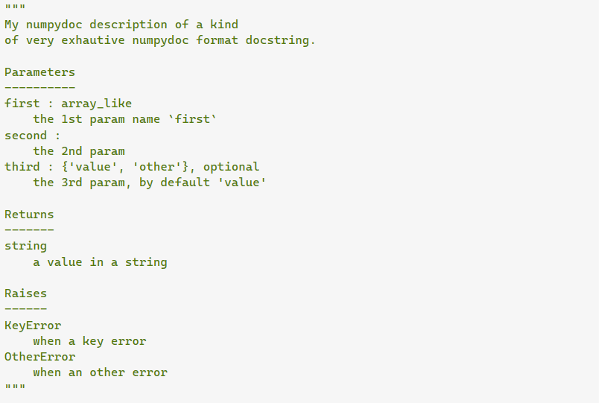
numpydoc

Slide 17
Queries and Discussion

Slide 18


Thank You
Deepak Rayathurai
Deepakr6242@gmail.com
https://deepakrayathurai.medium.com/
https://www.quora.com/profile/Deepak-Rayathurai

