Slide 1
Analytical Dynamics Project 1 Newton’s Canon Ball Dynamics Simulation
By
Deepak Raina (2019MEZ8497)
Sandeep Kumar (2019MEZ8423)

Slide 2
Outline
Problem Statement
Equation of Motion (EoM)
Conversion to reduced order EoM
Differential Equation Solver
Simulation Results
EoM in Polar form

Slide 3
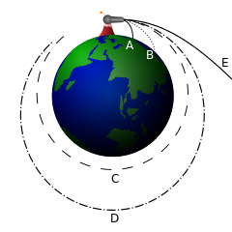
Problem Statement
To simulate dynamics of Newton’s canon ball and study the effect of velocity and height of canon on the path of canon ball.

Slide 4
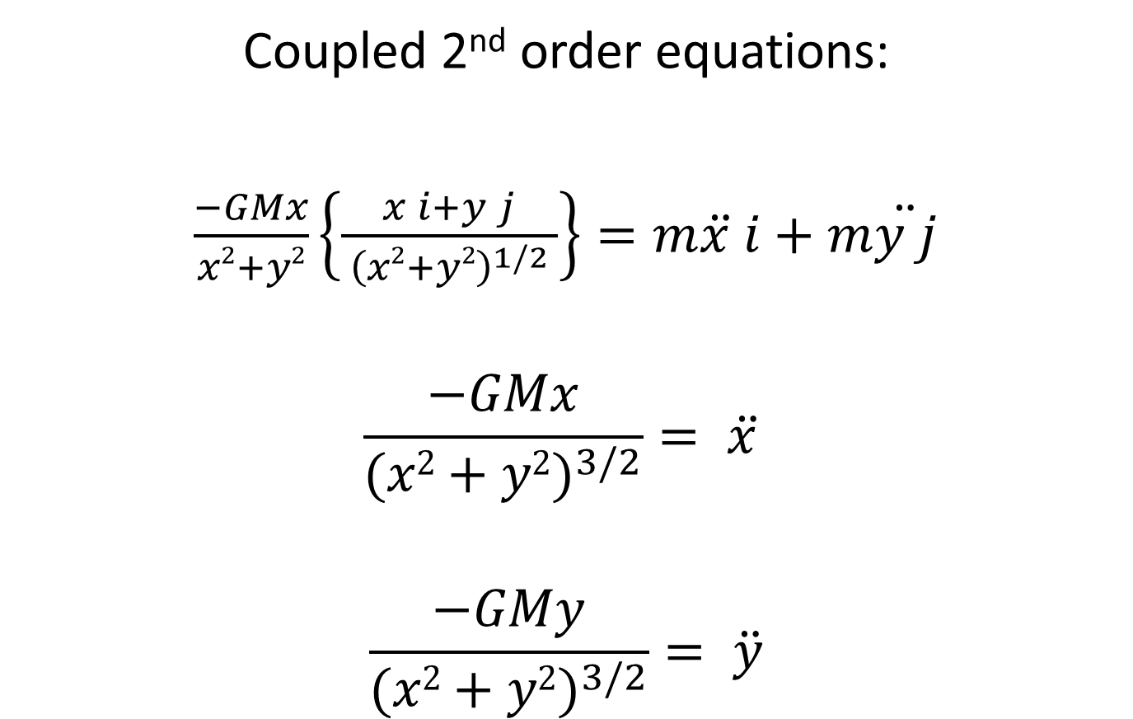
Equation of Motion (EoM)
Coupled 2nd order equations:
$\frac{−GMx}{x2+y2}\left\{\frac{x i+y j}{ {\left(x2+y2\right)}^{1/2} }\right\}=m\ddot{x }i+m\ddot{y j}$
$$\frac{−GMx}{{(x2+y2)}^{3/2}}= \ddot{x }$$
$$\frac{−GMy}{{(x2+y2)}^{3/2}}= \ddot{y}$$

Slide 5

Reduced order EoM
$$\dot{x}=x_{1 }=\int{\text{ẍ}} dt$$
$$\dot{x_{1}}= \ddot{x}=\frac{−GMx}{{\left(x2+y2\right)}^{3/2}}$$
$$\dot{y}=y_{1 }=\int{\ddot{y}}dt$$
$$\dot{y_{1}}= \ddot{y}=\frac{−GMy}{{\left(x2+y2\right)}^{3/2}}$$
$x_{1 }=f\left(x,y\right)$
$$y_{1}=f\left(x,y\right)$$

Slide 6
Differential Equation Solver
ODE45:
This function implements a Runge-Kutta method
Syntax
[t,x] = ode45(@f_name, t_span, x_init, options)
Equations
ODE45
Output
Initial conditions

Slide 7
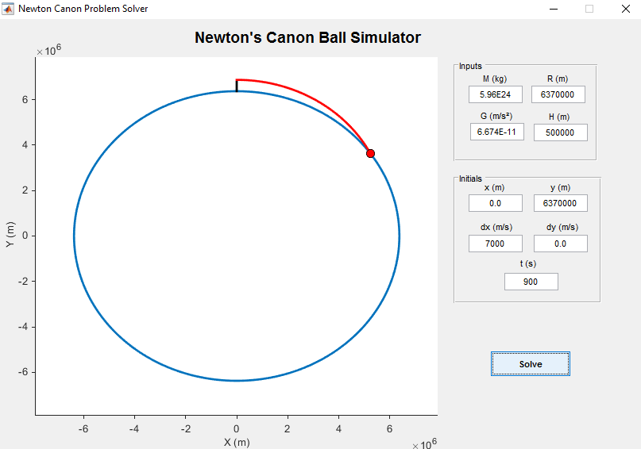
MATLAB GUI

Slide 8
Simulation Results (v = 7000 m/s)

Slide 9
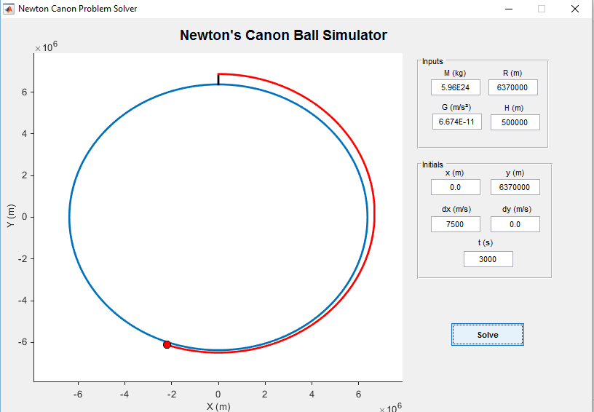
Simulation Results (v = 7500 m/s)

Slide 10
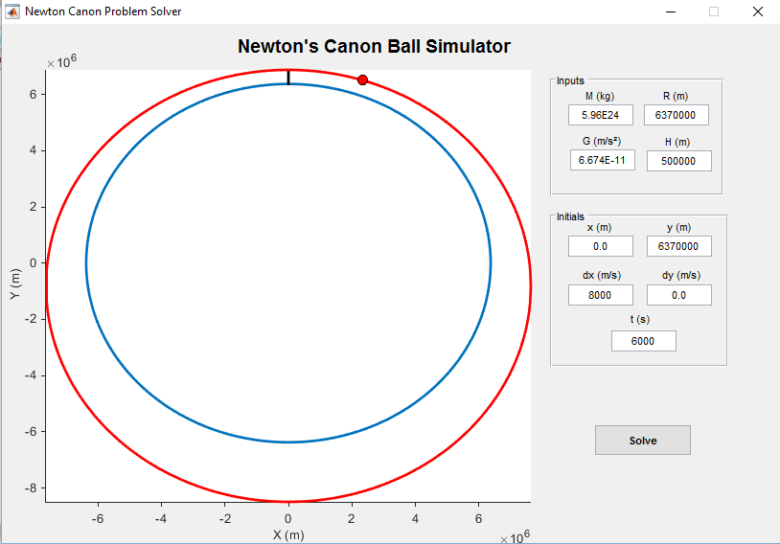
Simulation Results (v = 8000 m/s)

Slide 11
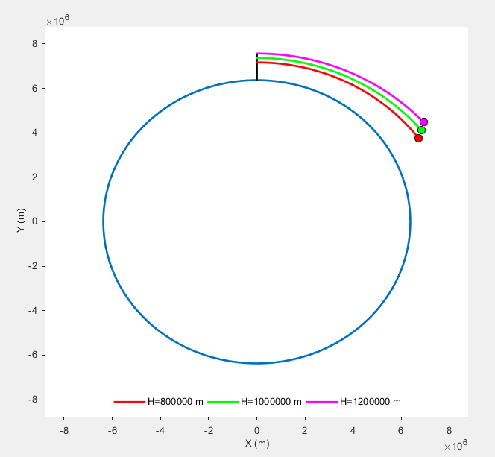
Simulation Results – Height Variation

Slide 12
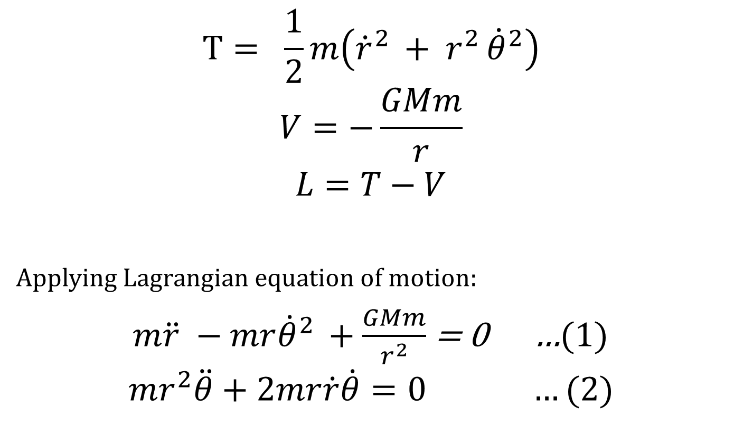
Polar Form
$$T= \frac{1}{2}m\left({\dot{r}}^{2 }+ r^{2 }{\dot{θ}}^{2}\right)$$
$$V=−\frac{GMm}{r}$$
$$L=T−V$$
Applying Lagrangian equation of motion:
$m\ddot{r} −mr{\dot{θ}}^{2 }+\frac{GMm}{r^{2}}$ = 0 …(1)
$$mr^{2}\ddot{θ}+2mr\dot{r}\dot{θ}=0 …(2)$$

Slide 13

2nd order ODE
$$\ddot{r}=r{\dot{θ}}^{2} − \frac{GM}{r^{2}}$$
$$\ddot{θ}=−\frac{2\dot{r}\dot{θ}}{r}$$

Slide 14
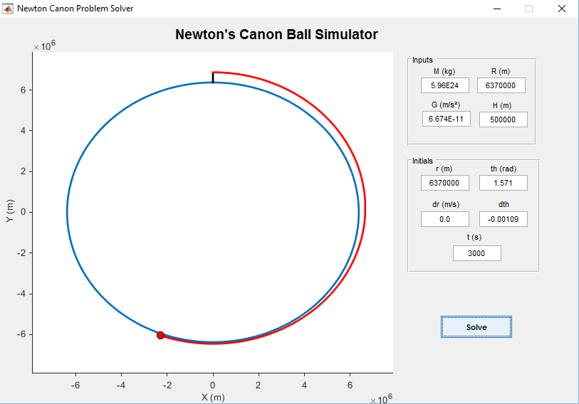
Simulation Results (v = 6900 m/s)

Slide 15
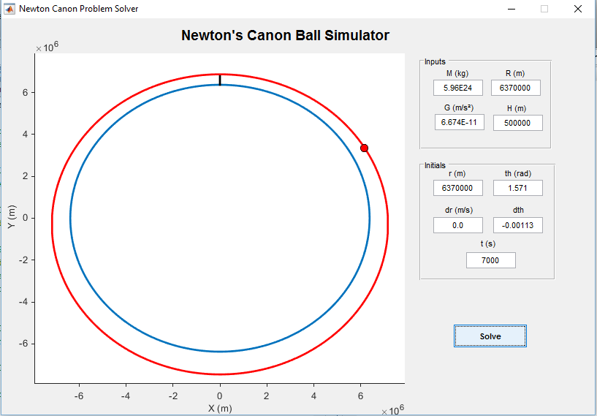
Simulation Results (v = 7200 m/s)

Slide 16
Thank You

