Slide 1

AWS CloudFront Auto Invalidation using Code pipeline

Slide 2

Agenda
01 | Architecture Diagram
02 | Workflow Steps
03 | Components
04 | Lambda Logic
05 | Deployment steps
06 | Benefits & Cost considerations

Slide 3
Project Overview
This AWS codepipeline project automates CloudFront cache invalidation when new content is uploaded to an S3 bucket.
Components:
GitHub or CodeCommit as source stage
S3 Bucket (Versioned, Private)
CloudFront Distribution
Lambda Function (Triggered on S3 upload)
IAM Role for Lambda (Allows CloudFront invalidation)

Slide 4
Architecture Overview
Developer Push Code
↓
CodePipeline (Source)
↓
Deploy to S3
↓
Invoke Lambda
↓
CloudFront Invalidation (/*)
↓
Users see new content instantly

Slide 5
Workflow Steps
User uploads/updates file in S3 bucket
S3 Event triggers the Lambda function
Lambda reads object key from event
Lambda calls CloudFront CreateInvalidation API
Specific paths (or /*) are invalidated in CloudFront
CDN cache refreshes → Users get updated content

Slide 6
Components
GitHub or CodeCommit as source stage
S3 Bucket - Hosts versioned static content
Lambda Function -Performs invalidation logic
IAM Role - Grants Lambda CloudFront access
Event Notification - S3 triggers Lambda on object creation
Outputs - Bucket name, Distribution ID, Domain name
CloudFront Distribution - Serves content globally

Slide 7
Lambda Function Logic
Write Python code to call CreateInvalidation
Add CLOUDFRONT_DISTRIBUTION_ID environment variable
Receives S3 event JSON
Extracts object keys from event
Builds CloudFront invalidation request
Handles up to 1000 paths per invalidation
If too many files → fallback to /*
Uses boto3 CloudFront client

Slide 8
def lambda_handler(event, context):
cf_client = boto3.client('cloudfront')
distribution_id = os.environ['CLOUDFRONT_DISTRIBUTION_ID']
# Create an invalidation for all files or specific changed keys
response = cf_client.create_invalidation(
DistributionId=distribution_id,
InvalidationBatch={
'Paths': {
'Quantity': 1,
'Items': ['/*'] # or list specific keys
},
'CallerReference': str(time.time())
}
)
print("Invalidation created:", response['Invalidation']['Id'])
return {"status": "success", "invalidation_id": response['Invalidation']['Id']}

Slide 9
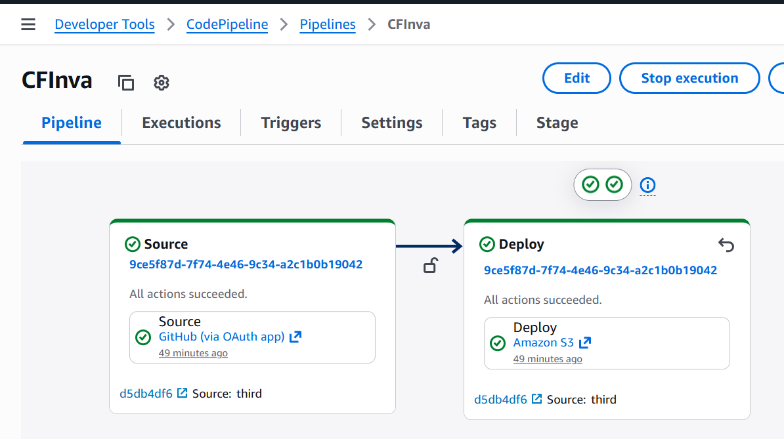
Deployment Steps
Source Stage: Pulls from GitHub/CodeCommit
Deploy Stage: Upload to S3
Invoke Lambda: Auto CloudFront invalidation

Slide 10
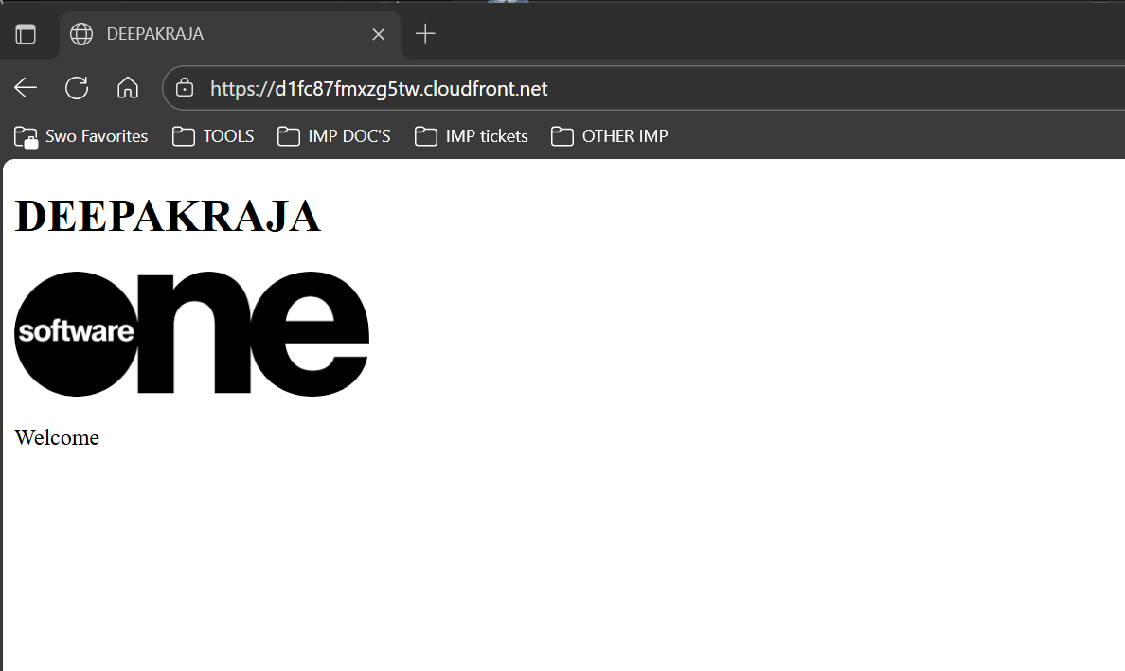
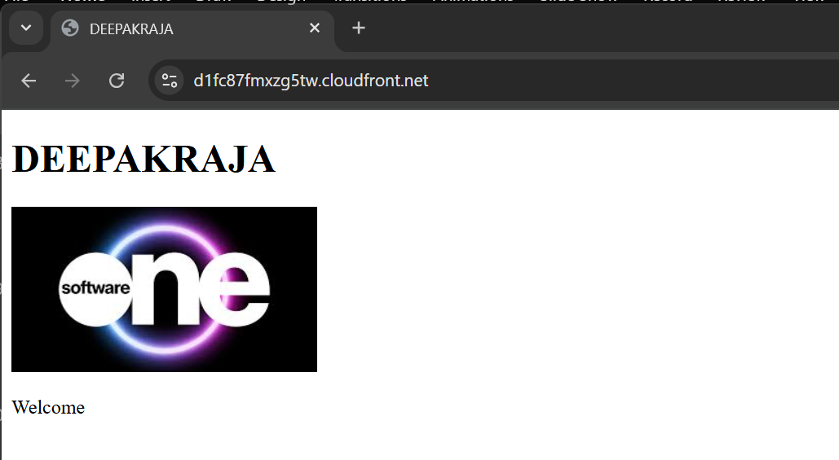
Push code → Pipeline executes
Deploys to S3 → Lambda runs
CloudFront invalidates → New content live instantly

Slide 11
Benefits & Cost Considerations
💡 Benefits:
Always serve updated content globally
Fully automated, no manual invalidation
Integrated with CI/CD pipelines
Low operational overhead
💰 Cost:
First 1000 invalidations/month free
Lambda: Charged per invocation & execution time
S3 & CloudFront standard storage/delivery costs apply

Slide 12

Thank you!!

Slide 13
Disclaimer
This publication contains proprietary information that is protected by copyright. SoftwareOne reserves all rights thereto.
SoftwareOne shall not be liable for possible errors in this document. Liability for damages directly and indirectly associated with the supply or use of this document is excluded as far as legally permissible.
The information presented herein is intended exclusively as a guide offered by SoftwareOne. The publisher's product use rights, agreement terms and conditions and other definitions prevail over the information provided herein. The content must not be copied, reproduced, passed to third parties or used for any other purposes without written permission of SoftwareOne
Copyright© by SoftwareOne. All Rights Reserved. SoftwareOne is a registered trademark of SoftwareOne. All other trademarks, service marks or trade names appearing herein are the property of their respective owners.

