Slide 1


Extract Trends from social media data
Team Name: Turing
Institute Name: IIT Kanpur

Slide 2

Team members details
Team Name | Turing
Institute Name | Indian Institute of Technology, Kanpur
Team Members > | Team Leader
Name | Deepak Raj | Rohit Kushwah | Varun Vankudre
Batch | 2021-23 | 2021-23 | 2021-23

Slide 3
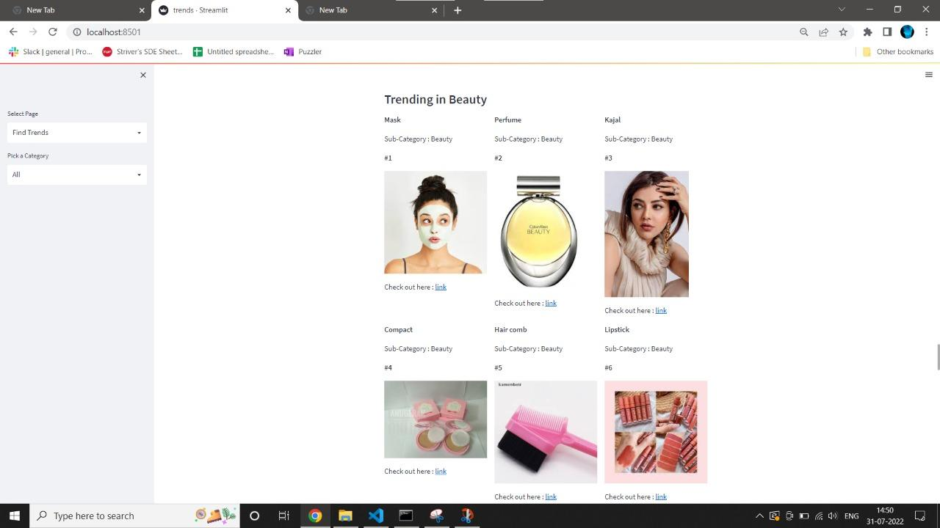
Use-cases
A user can see top trending products under any subcategory or category.

Slide 4
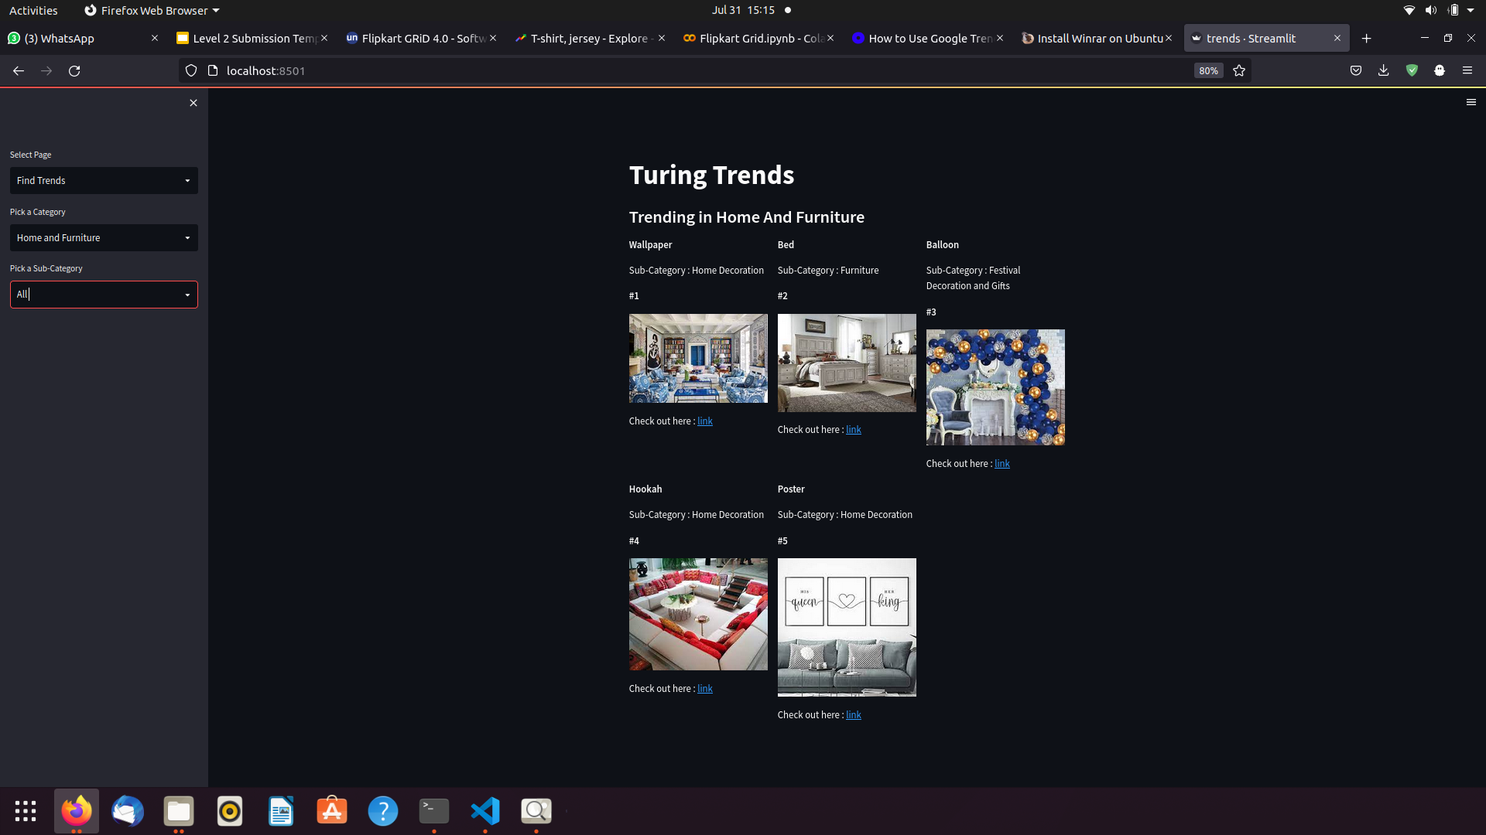
Use-cases
We can see product category and subcategory according to Flipkart.
Ex: wallpaper belongs to home and furniture category and home decoration subcategory.

Slide 5
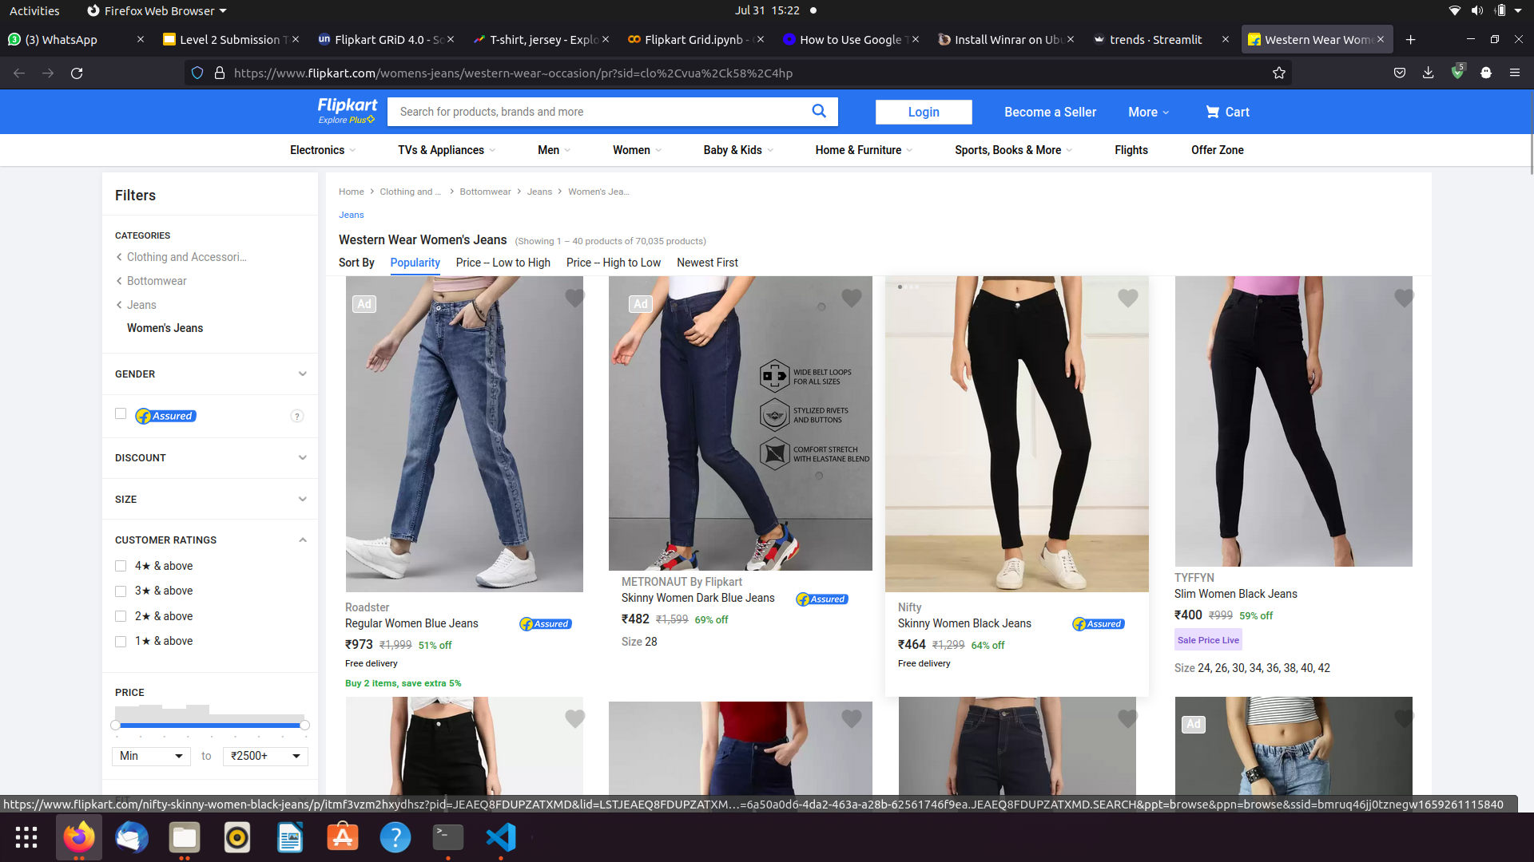
Use-cases
Interface provide link to product pages on flipkart, so user can directly visit the page and buy those products.

Slide 6
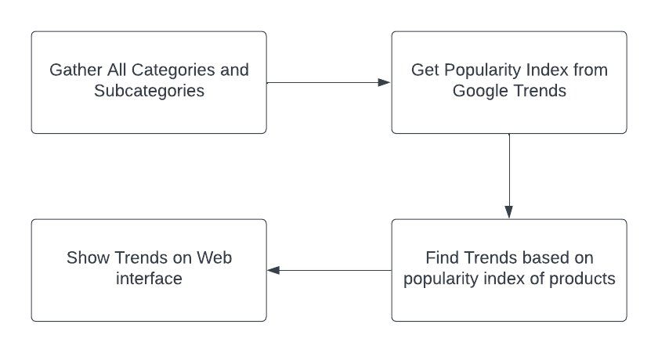
Proposed Solution
We propose a solution where user will be able to get the trends based on category or subcategory. Our solution is divided into four parts:

Slide 7
Gathering Categories
we collected the names of all the product keywords under all the categories and subcategories from the Flipkart website.
Finding trends from all the products is irrelevant(Ex- mobile popularity and dress popularity are completely independent therefore, their popularity cannot be compared), so to reduce the search space and get the relevant trend results, products are defined under categories and subcategories.
Extracting Trends
To get trends, we selected a category and subcategory and passed product keywords to google trends api as input, and we got the popularity index over a certain period.
The popularity index is calculated on a scale from 0 to 100, where 100 means product has the most popularity, a value of 50 indicates half popularity.
We found out the weighted mean of popularity index and took products with maximum score.

Slide 8
Displaying Trends
We made an interface using Streamlit to show the trends from each category and subcategories.
User can see trending product based on category and subcategory.
Interface provides the images of product and also their link on flipkart.

Slide 9
Limitations
Our solution does not consider the audio or video data from social media.
Results are generalised, the exact products are not shown as a result.
Images shown on website are generalized, they may not seem to represent exact products description.

Slide 10
Future Scope
If social media historical data is provided, this solution can be extended to get more relevant results.
The results can be refined if videos are also taken into account.
Currently, the result are more generalised, we can improve the granularity of results by showing the exact trending product.
Since google trends also provides ‘search regions wise’ feature, we can filter trend result region wise too.

