Slide 1

House price prediction
Final PYTHON PROJECT

Slide 2
INTRODUCTION
The objective of this Exploratory Data Analysis (EDA) is to uncover valuable insights and patterns within the dataset that will help predict house prices. By analyzing various features such as square footage, number of rooms, location, and other factors, we aim to identify key variables that influence the price of a property. This analysis involves visualizing the distribution of data, examining correlations between different features, and detecting any anomalies or outliers that might affect the model's accuracy. EDA plays a crucial role in understanding the underlying structure of the data, helping us make informed decisions about feature selection and preprocessing steps for building a robust predictive model. Ultimately, the goal is to build a model that accurately estimates house prices based on the input features, offering potential buyers, sellers, and real estate professionals valuable insights into property values.

Slide 3
ABSTRACT
This analysis examines the factors influencing house prices by exploring a dataset of residential properties, focusing on key variables such as status, number of bedrooms, bathrooms, lot size (in acres), city, zip code, house size (square footage), previous sale date, and prior sale price. The study involves data cleaning, summarization, and exploratory analysis to uncover patterns and correlations between these factors and the final price of a property. Key findings provide insights into how specific property features impact pricing trends and reveal regional variations in real estate values. This research aims to assist potential homebuyers in making informed decisions, while offering valuable insights to real estate professionals and investors for pricing strategies and market forecasting.

Slide 4
DATA SET DETAILS
The dataset consists of 100,000 entries, represented as a Pandas DataFrame with a range index from 0 to 99,999. It contains several columns capturing various property characteristics. Key features include :
States (categorical, non-null for all entries) and City (categorical, 99,948 non-null), which describe the location of the property.
Bed and Bath columns provide information on the number of bedrooms (75,050 non-null) and bathrooms (75,112 non-null), respectively.
The Acre_Lot column describes the lot size in acres, with 85,987 non-null entries,
while House_Size indicates the size of the property in square feet (75,082 non-null).
Additional details such as the Zip_Code (99,805 non-null) and the Prev_Sold_Date (28,745 non-null) offer insights into the property's location and sale history.
The dataset also includes the Price column (integer, non-null for all entries), which represents the property’s selling price, serving as a key target variable for analysis.

Slide 5
DATA CLEANING
The data cleaning process involved handling missing values, particularly in columns like Prev_Sold_Date, where a significant portion of data was missing. For numerical columns such as Bed, Bath, and Acre_Lot, missing values were imputed using the median, while categorical columns like City were imputed with the mode. Duplicate rows were removed to ensure data accuracy. Outliers in columns like Price and House_Size were detected and treated. Categorical variables such as States were checked for inconsistencies and corrected. Finally, numerical columns were standardized, and categorical features were encoded for use in machine learning models.

Slide 6
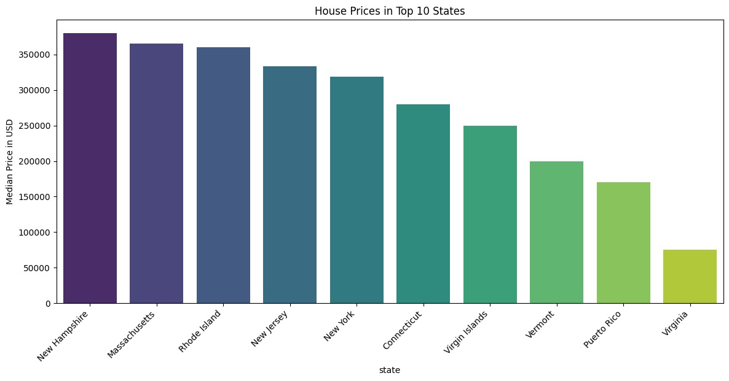
HOUSE PRICES IN TOP 10 STATES

Slide 7
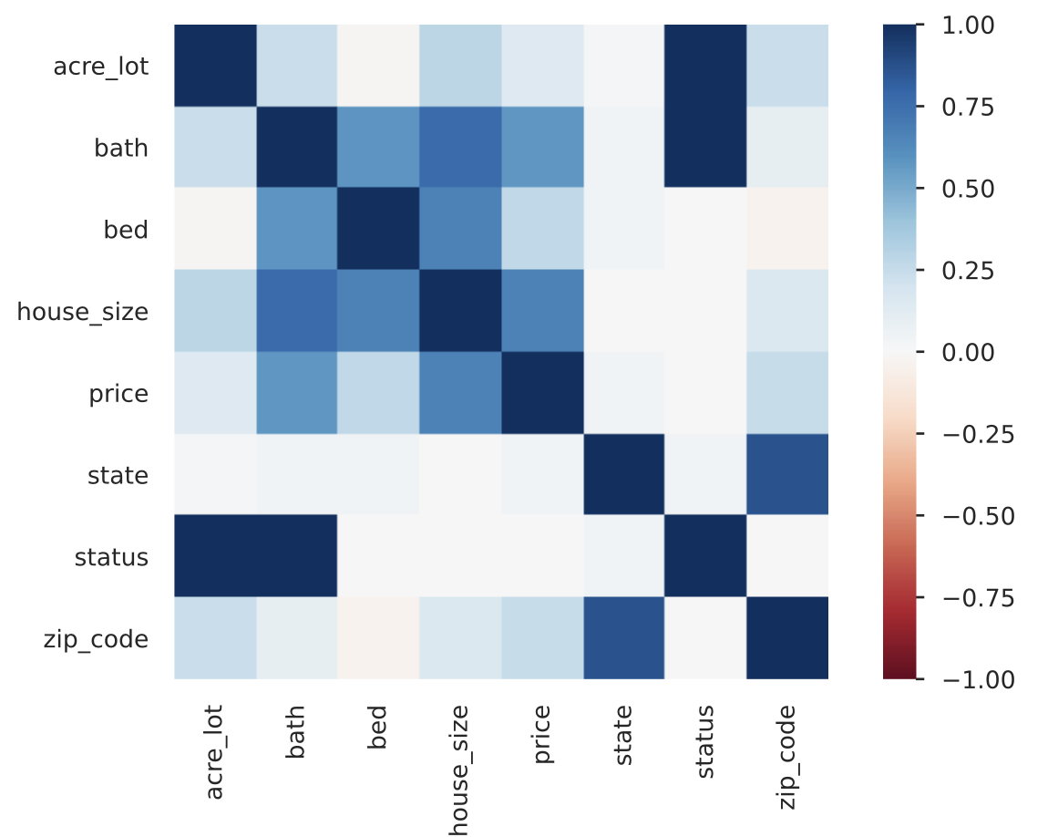
Explanation of the Correlation Heatmap

Slide 8
EXPLANATION OF THE CORRELATION HEATMAP
1. In the above Visualization, We can see the correlation between all the columns.
2. The darker the colour in the map, the stronger the correlation between the columns.
3. From the above Data Analysis, We can conclude the following things:-'bed' and 'bath' have a 0.7 correlation with each other, which means they are highly correlated.
So, the number of bathrooms in a house is correlated with number of bedrooms. Also, we can see that the correlation between bath and price is 0.4 that means, even the number of bathrooms will give the price fluctuations/predictions in the house.

Slide 9
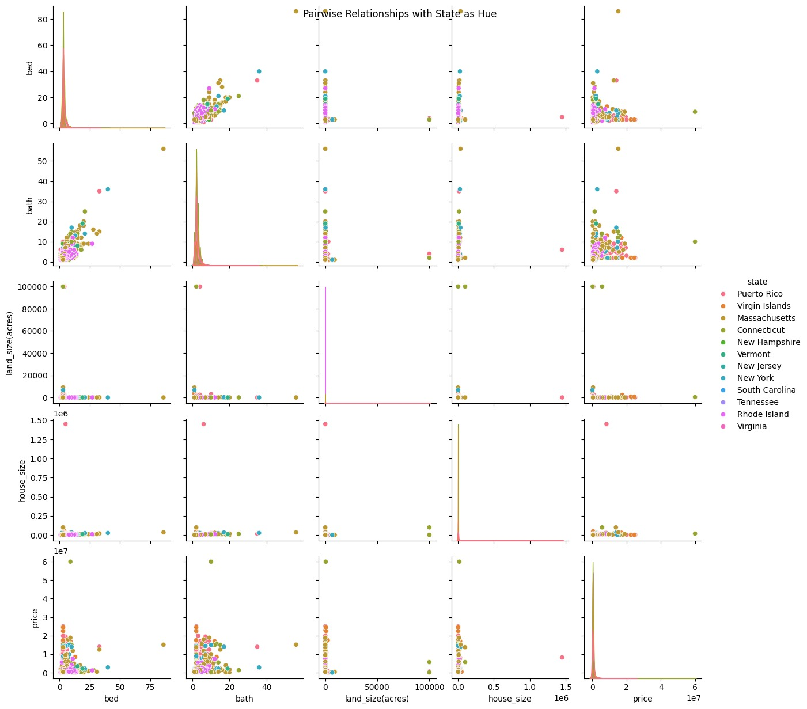
PAIRWISE RELATIONSHIP

Slide 10
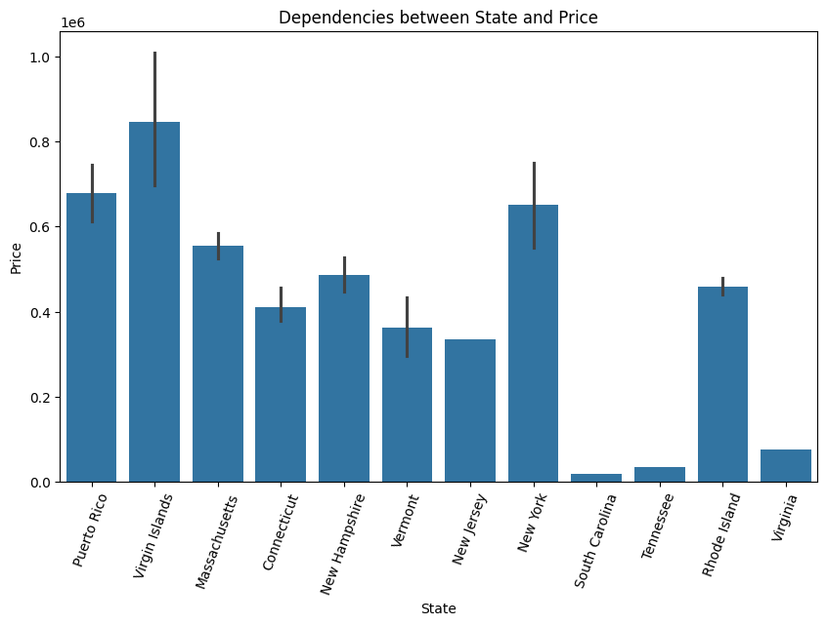
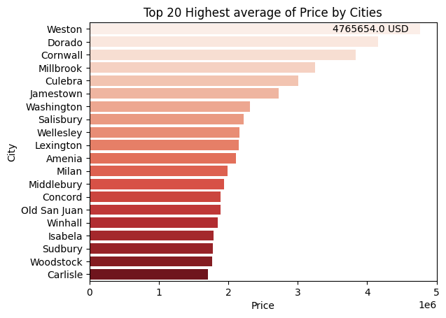
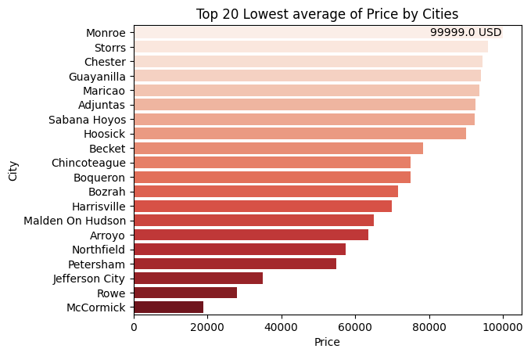
DEPENDENCIES BETWEEN STATE AND PRICE

Slide 11
LINEAR REGRESSION
Linear Regression is a foundational statistical technique used for predicting a continuous target variable based on one or more predictor variables. In this project, we use Linear Regression to model the relationship between various property features (such as bedrooms, bathrooms, house size, etc.) and the property price. The goal is to predict property prices based on these features.
The process begins with the selection of relevant features (independent variables) that are most likely to influence the target variable (dependent variable) – price in this case. The Linear Regression model estimates the coefficients (weights) for each feature that minimise the sum of squared residuals, i.e., the difference between the observed and predicted values of the target.
Key steps in applying Linear Regression include:
Data Preprocessing: Ensuring that the data is cleaned and properly encoded.
Model Training: Fitting the Linear Regression model using the training dataset.
Model Evaluation: Assessing the performance of the model using metrics like R-squared, Mean Absolute Error (MAE), and Root Mean Squared Error (RMSE).
Prediction: Using the trained model to predict the target variable (property price) for new, unseen data.
Linear Regression assumes that there is a linear relationship between the independent variables and the dependent variable. This technique is simple, interpretable, and widely used for predictive modelling in real estate and many other fields.

Slide 12
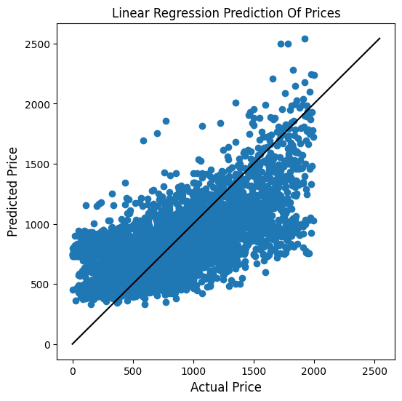
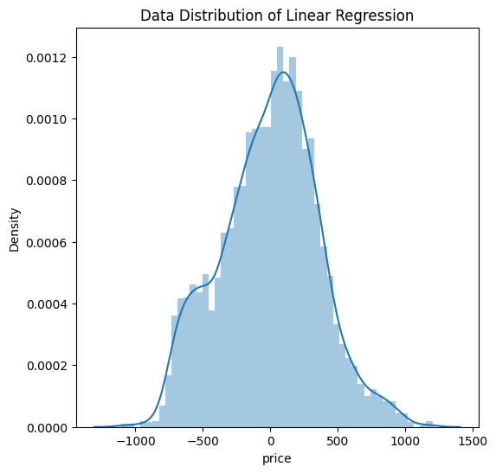
# create a Linear Regression model
lm = LinearRegression().fit(X_train, y_train)
# Get the prediction.
y_pred_linearRegression = lm.predict(X_test)
# Predicted data Distribution of Linear Regression.
plt.figure(figsize=(6, 6))
plt.title('Data Distribution of Linear Regression')
sns.distplot((y_test - y_pred_linearRegression), bins=50)

Slide 13
DECISION TREE REGRESSION
Decision Tree Regression is a powerful, non-linear model used to predict continuous target variables by recursively splitting the data based on feature values.
In the context of your dataset, we use Decision Tree Regression to predict property prices based on features such as bedrooms, bathrooms, acre_lot, house_size, and more.
The process starts by selecting relevant features and encoding categorical variables, such as city and state, into numerical values.
Missing values are handled by imputation, and the data is then split into training and test sets. The DecisionTreeRegressor from scikit-learn is used to train the model on the training data and make predictions on the test data.

Slide 14
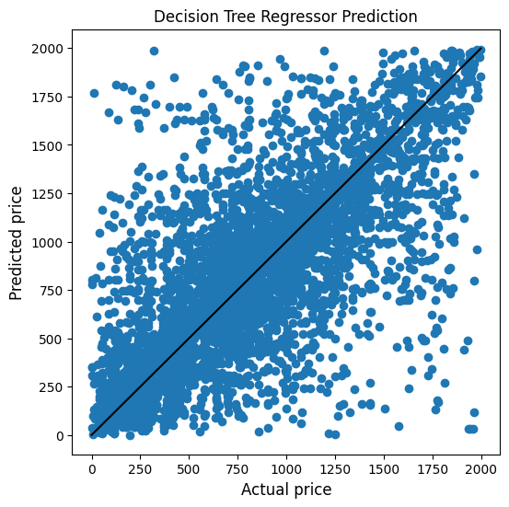
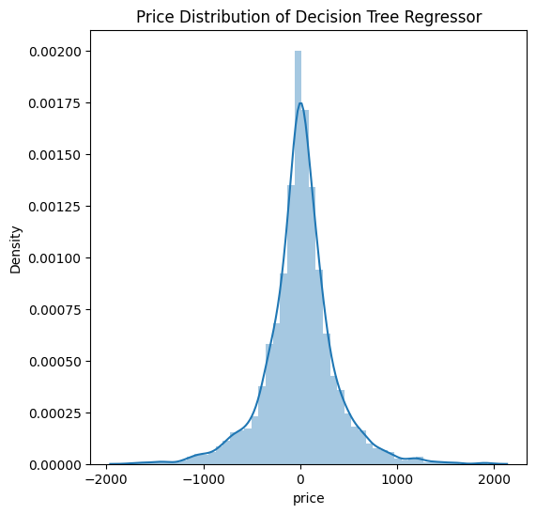
# Predicted data Distribution of Decision Tree Regressor.
plt.figure(figsize=(6, 6))
plt.title('Price Distribution of Decision Tree Regressor')
sns.distplot((y_test - y_pred_decisionTree), bins=50)
# Create the Decision Tree Regressor model and fitting data.
decisionTree_model = DecisionTreeRegressor().fit(X_train, y_train)

Slide 15
RANDOM FOREST REGRESSION
Random Forest Regression is an ensemble learning method that builds multiple decision trees and combines their predictions to provide a more accurate and robust model.
Unlike a single decision tree, which can be prone to overfitting, Random Forests mitigate this issue by averaging the predictions of numerous trees, which are trained on random subsets of the data.
This ensemble technique helps improve the accuracy and generalizability of the model, making it ideal for predicting complex and non-linear relationships, like property prices in your dataset.
In the case of predicting property prices, Random Forest Regression leverages multiple decision trees trained on random samples of the data, each using a random subset of features for splitting nodes.
This diversity among the trees reduces the variance and prevents overfitting. The model is trained on the selected features, such as bedrooms, bathrooms, house size, and others.

Slide 16
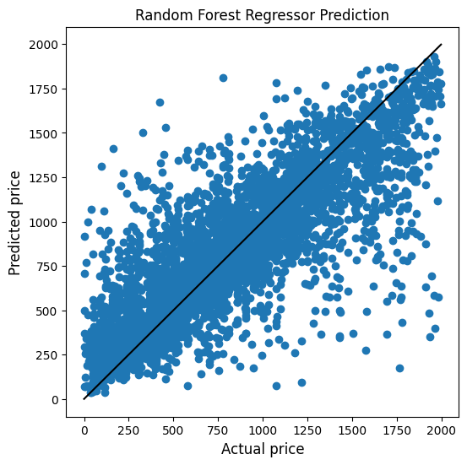
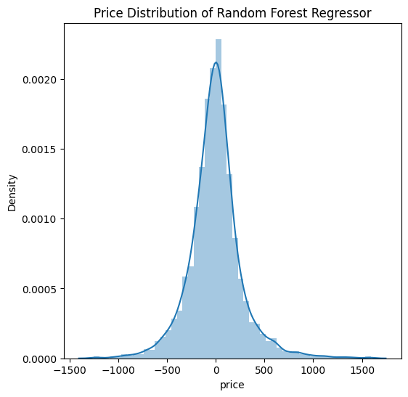
# Create the Random Forest Regressor model and fitting data.
RFR = RandomForestRegressor().fit(X_train, y_train)
# Distribution of Random Forest Regressor.
plt.figure(figsize=(6, 6))
plt.title('Price Distribution of Random Forest Regressor')
sns.distplot((y_test - y_pred_RFR), bins=50)

Slide 17
GRADIENT BOOSTING REGRESSION
Gradient Boosting Regression can be effectively used to predict property prices based on various features such as bedrooms, bathrooms, acre_lot, house_size, and more.
Unlike simpler models like Linear Regression or Decision Tree Regression, Gradient Boosting builds a series of decision trees, where each new tree corrects the errors made by the previous ones.
This makes it especially powerful for capturing complex, non-linear relationships between the features and the target variable (property price) in your dataset.
In the context of your data, the model will iteratively focus on the property features like bedrooms, bathrooms, and house-size, which may have varying levels of influence on the target price.
Gradient Boosting works by fitting trees to residuals (the differences between predicted and actual values) and continuously improving the model by reducing these residuals.

Slide 18
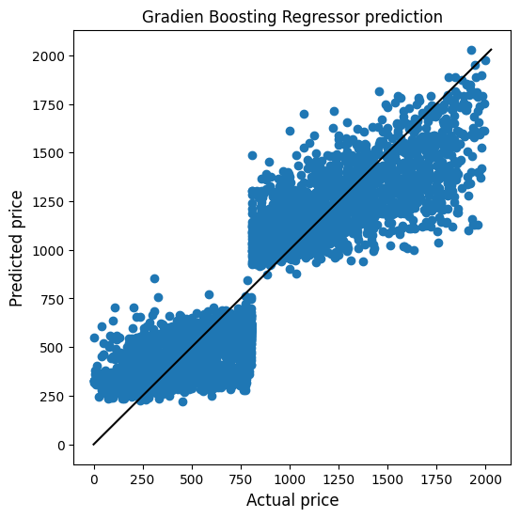
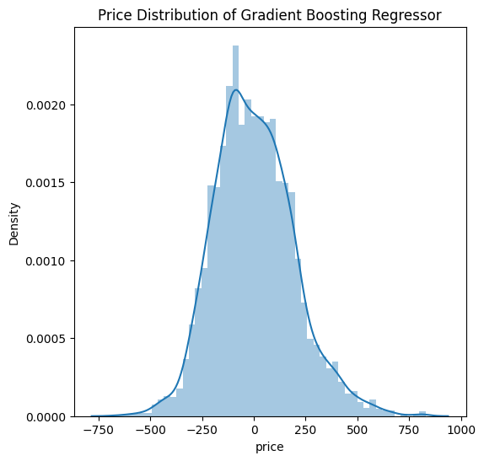
# Creating Gradient Boosting Regression and fitting data.
GBR = GradientBoostingRegressor().fit(X_train, y_train)
# Distribution of Gradient Boosting Regressor.
plt.figure(figsize=(6,6))
plt.title('Price Distribution of Gradient Boosting Regressor')
sns.distplot((y_test - y_pred_GBR), bins=50)

Slide 19
CONCLUSION
Among the regression models considered, the Random Forest Regressor and Gradient Boosting Regressor achieved the highest performance scores, suggesting that these techniques offer the most accurate predictions for house prices based on the available features. Both models demonstrated their ability to capture complex, non-linear relationships in the data, making them well-suited for predicting property prices, particularly in a diverse and dynamic market. The superior performance of these models indicates that they can provide reliable insights for understanding house prices in various regions.
Through a comprehensive analysis of house prices in the United States, it became evident that New Hampshire and Massachusetts stand out with some of the highest property prices. Several factors contribute to the elevated housing market in these states. New Hampshire's strong economy, as highlighted by sources like US News and Home Snacks, plays a significant role in its high housing demand, driving property prices upward. The state’s reputation as one of the best places to live, with high rankings for quality of life, education, healthcare, and public services, also contributes to the demand for homes, further influencing property values. As more people are drawn to live in New Hampshire, the increased demand naturally affects house prices.
Similarly, Massachusetts, which ranks second in terms of high house prices, shares many of the factors that contribute to New Hampshire’s housing market.

Slide 20
CONCLUSION
This combination of economic and cultural appeal positions Massachusetts as one of the most desirable places to live, directly influencing its housing market. This combination of economic and cultural appeal positions Massachusetts as one of the most desirable places to live, directly influencing its housing market.
At the city level, Weston and Dorado emerge as the areas with the highest property prices. While the dataset provides valuable insights into the local housing market, external factors such as proximity to major urban centers, availability of amenities, and the overall socioeconomic profile of these cities likely play a pivotal role in determining property values. These factors contribute to the desirability of these cities, making them attractive to homebuyers and influencing the price levels.
For stakeholders such as homebuyers, real estate professionals, and policymakers, it is crucial to consider the broader economic conditions, quality of life, and regional influences when making decisions in the housing market. Understanding these factors allows for more informed, data-driven choices. Policymakers can also use these insights to assess how their decisions might impact housing affordability and market dynamics, ensuring that their policies align with the economic and social needs of the region.

Slide 21
THANKYOU
BY
AASMEEN SHAIK
MOUNIKA MUSKU
DEEPAK RAJ REDDY KODUR
ANSARI MOHAMMED SAJJAD

