Slide 1



Lead Scoring Model
Submitted By:
Deepak R

Slide 2


Process Flow
Logistic regression model is deployed, as the final output indicates whether leads are Hot/Cold rather than their score.
Data Import
&
EDA
Data
Cleaning
Data
Train, Test
Split
Model
Fitting &
Re-Fitting on Train Data
Model Validation on Test Data
Model Fitting
on Test Data
Model Validation on Train Data
Compute Optimal
Cut Off

Slide 3

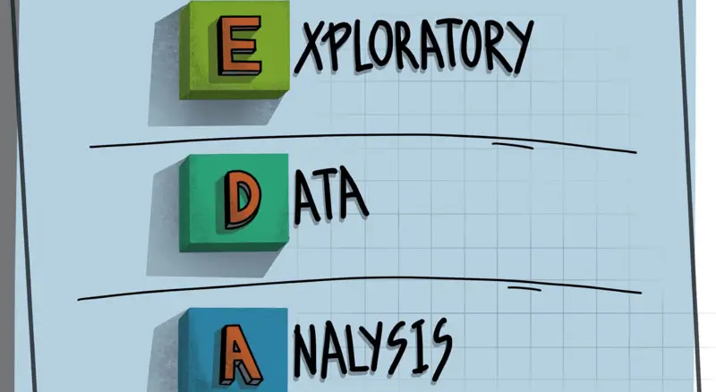
Exploratory Data Analysis
Size of data: 9240 rows * 37 columns
Quantitative parameters: 6
Parameters with null values > 30%: Tags, Lead Quality, Asymmetrique Activity Index, Asymmetrique Profile Index, Asymmetric Activity Score, Asymmetric Profile. (6 col)
Visualize parameters( Total Visits, Total Time Spent on Website, Page Views per Visit) for outlier analysis
Visualize correlation to detect correlation between multiple variables

Slide 4

Data Cleaning
Drop parameters with null values count > 30%
Parameters with null values count 5% - 30% are replaced with category(‘others’).
Parameters with null values count <5% are extrapolated on mode().
Parameters with redundant categories are combined to single category: Lead Source, Country, How did You Hear about X Education, What is your current occupation, What matters most to you in choosing a course, Lead profile, City
Drop columns with single category
Create dummy variables for categorical parameters

Slide 5

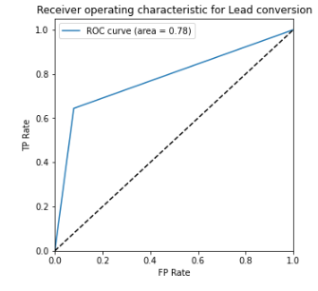
ROC Curve
Determines the Area Under the Curve(AUC)
More the curve towards upper left corner, the model has good performance since most of the area is covered.
The curve below represents presents the curve which is discovered when the probability of lead conversion is randomly chosen as 60% or 0.6
Since the AUC varies for different probability values and in-order find out optimal point where none of the parameters like accuracy, sensitivity & specificity are low, we find a point of probability where the curves of these parameters meet.

Slide 6

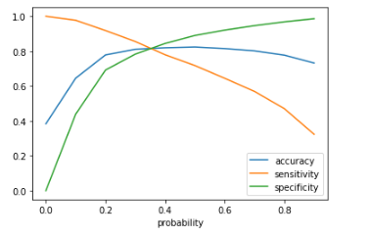
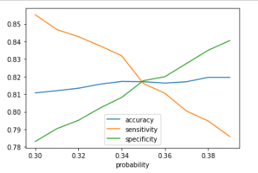
Optimal Cut Off
Optimal cut off was calculated twice in the interest of specific optimal value
1st time probability was considered between 0.0 – 0.9.
After getting to know that there might exist some point between 0.3 and 0.4, again the calculation was done between 0.3 – 0.39

Slide 7




Model Validation
With optimal cut off probability of 0.35, after fitting the model on test data, the model has following parameters
Overall Accuracy: 82.864 %
Sensitivity: 84.736 %
Specificity: 81.668 %
Since all the 3 parameters are almost same and high, model can be considered as good fit to recognizing hot and cold leads

Slide 8


