Slide 1
SMART INDIA HACKATHON 2026
GramVest
CORE INNOVATION: DUAL-ENGINE
✔ Hyper-Local 5–10km Catchment
Evaluates consumer base and distribution channels around the village.
✔ Competitor Density Radar
Identifies existing businesses to prevent sudden local market saturation.
✔ 10% / 90% Scheme Structuring
Automatically calculates Project Cost (Margin/10%) and 90% loan eligibility.
✔ Micro Finance vs. Term Loan Router
Deterministic routing: Micro Finance (6.5%) vs Term Loan (8.0%).
✔ Quarterly EMI & Moratorium Math
Computes debt schedule with 3-month or 6-month moratorium.
✔ Bank-Ready DPR Dossier
One-click generation of Detailed Project Report for bank sanction.
The Rural Decision Engine
"Know your market, your competition, and your capital — before you invest a single rupee."
Problem Statement:
AI-Driven Hyper-Local Business Advisory and Financial Structuring Assistant for Rural Micro-Entrepreneurs
Theme: Rural Entrepreneurship & Market Intelligence | MSME & Agri-Business
Problem Statement ID: 26091 (Software Edition)
Presented By: Team GramVest | Round 1 Evaluation

Slide 2
SIH 2026 · PS ID: 26091
GramVest | Team GramVest
Problem Statement
State Channelizing Agencies provide 90% concessional credit with only 10% margin, but rural micro-enterprises face high failure rates due to lack of local market visibility and financial illiteracy.
01
No Local Market Visibility
• Urban research tools ignore villages.
• Prospective entrepreneurs cannot estimate 5–10km catchment demand.
• Lack of data on purchasing power and fair local pricing.
02
Invisible Competition
• Businesses chosen based on anecdotal hearsay.
• Multiple identical copycat shops open on the same lane.
• Triggers instant market saturation, price wars, and collapse.
03
Financing is Confusing
• 10% equity / 90% debt calculations are intimidating.
• Confusion between Micro Finance (≤ ₹1.4L @ 6.5%) vs. Term Loan (≤ ₹50L @ 8%).
• Moratorium math and bank DPR filing are major hurdles.
04
High Failure, Zero Guidance
• Over 60% of rural micro-enterprises fail in Year 1.
• Private business consultancies charge ₹15,000–₹50,000+.
• Zero accessible, affordable guidance for marginalized youth.
CORE BOTTLENECK: Capital is available via SCAs and CAs, but institutional-grade feasibility intelligence has never reached the village doorstep.
GramVest: The Rural Decision Engine Slide 2 of 7

Slide 3
SIH 2026 · PS ID: 26091
GramVest | Team GramVest
Solution
GramVest turns 3 basic user inputs into a comprehensive hyper-local feasibility report and bank-ready financial roadmap in under 5 minutes.
STEP 1: User Inputs (Village, Margin Capital, Trade) ➔ STEP 2: Dual-Engine Spatial & Financial Analysis ➔ STEP 3: Bank-Ready Verdict & DPR
MODULE 1: HYPER-LOCAL FEASIBILITY REPORT
• Market Reach: Estimates 5–10km radial consumer base and primary distribution channels.
• Opportunity Analysis: Highlights unserved or underserved niches in the chosen sector.
• Evidence-Based SWOT: Objective strengths, weaknesses, opportunities & threats tailored to budget.
• Threats Identification: Pinpoints supply bottlenecks, seasonal swings, and single-buyer risk.
• Competitor Mapping: Uses demographic & OSM data to estimate density of existing similar shops.
• Product Market Value: Suggests optimal pricing strategies matching regional purchasing power.
MODULE 2: SMART SCHEME CALCULATOR & ROUTER
• Financial Structuring: Project Cost = Margin / 10%. Max Loan = 90% of Project Cost. (e.g. ₹1,00,000 margin enables ₹10,00,000 project & ₹9,00,000 loan).
• Scheme Auto-Selection: Deterministic rule-based routing to the exact concessional loan:
- Micro Finance Scheme: Project Cost ≤ ₹1.40 Lakh: 6.5% interest p.a., 3-yr tenure, 3-mo moratorium.
- Term Loan Scheme: Project Cost ₹1.40L to ₹50 Lakh: 8.0% interest p.a., 7-yr tenure, 6-mo moratorium.
• EMI & Moratorium Schedule: Generates quarterly repayment schedules, operational costs, and working capital.
• Bank-Ready DPR Dossier: One-click Detailed Project Report download for immediate bank appraisal.
GramVest: The Rural Decision Engine Slide 3 of 7

Slide 4
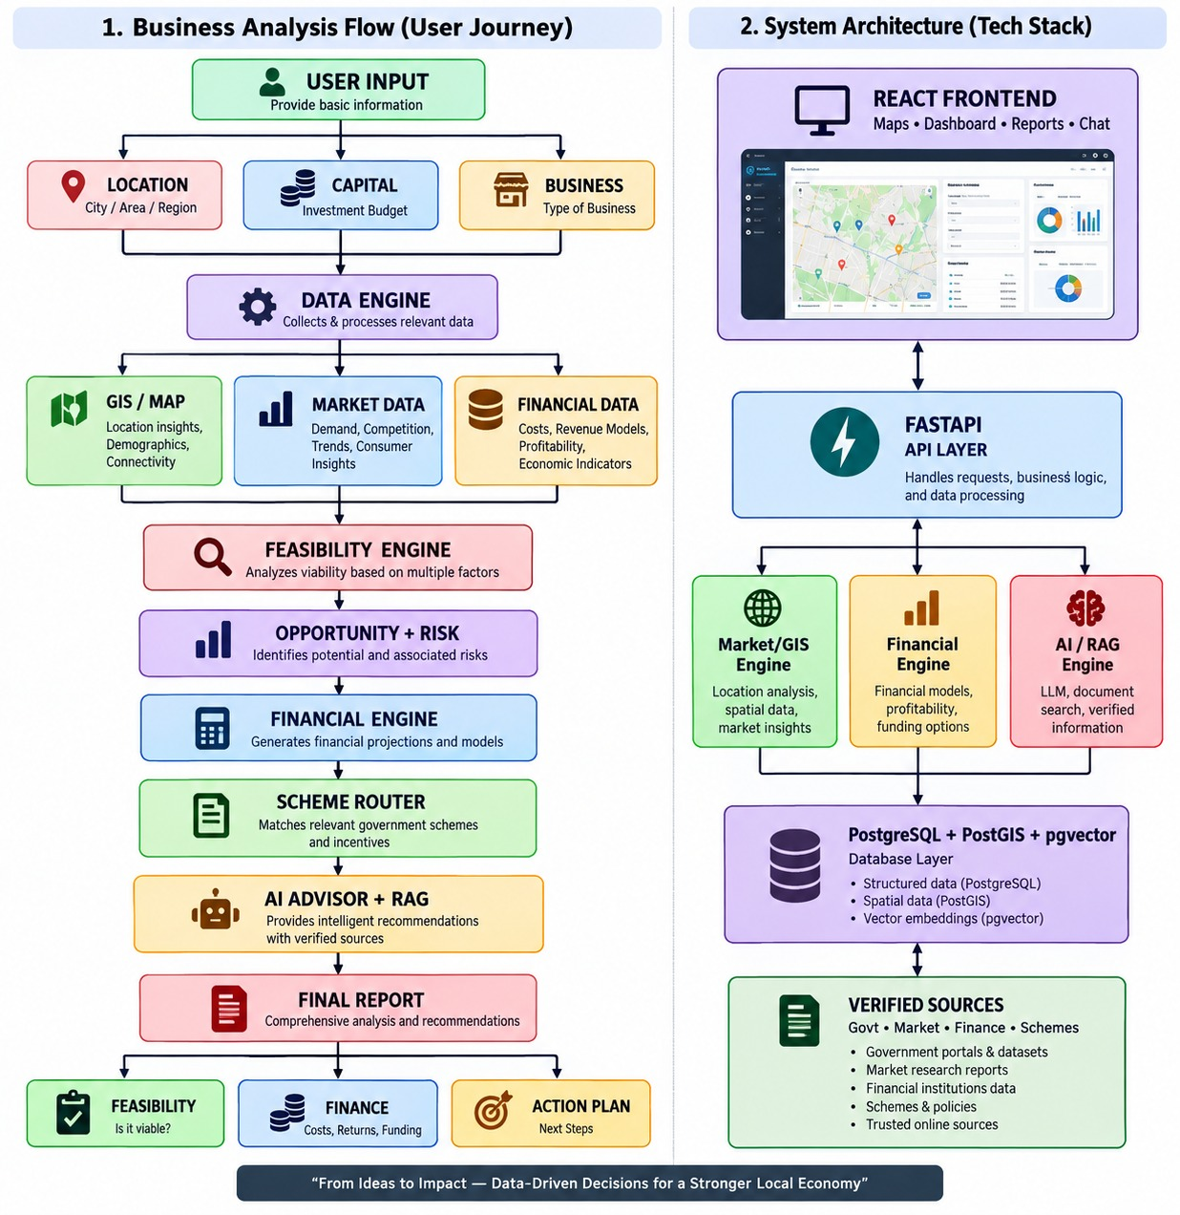
SIH 2026 · PS ID: 26091
GramVest | Team GramVest
Flow Chart
End-to-end operational decision flow from user inputs to bank-sanctionable feasibility report.
BUSINESS ANALYSIS & DECISION FLOW
✔ 1. User Input Layer
Collects village location, available margin capital, and proposed business.
✔ 2. Data Engine & GIS Ingestion
Pulls 5–10km catchment, demographics, and mandi commodity rates.
✔ 3. Feasibility & Threat Engine
Evaluates market saturation, competitor density, and evidence-based SWOT.
✔ 4. Deterministic Financial Engine
Calculates Project Cost, 90% Loan, quarterly EMI, cash flow, and DSCR.
✔ 5. Scheme Router
Matches Micro Finance (≤ ₹1.4L @ 6.5%) or Term Loan (≤ ₹50L @ 8%).
✔ 6. Grounded AI Advisor & RAG
Explains insights in local vernacular via RAG over official scheme gazettes.
✔ 7. Final DPR & Action Roadmap
Generates official bank-ready Detailed Project Report for loan sanctioning.
GramVest: The Rural Decision Engine Slide 4 of 7

Slide 5
SIH 2026 · PS ID: 26091
GramVest | Team GramVest
Tech Stack
Deterministic software core + grounded AI layer. Golden Engineering Rule: 'AI explains; software calculates.' Zero financial hallucinations.
Frontend & UI
React.js & Tailwind CSS
• Mobile-First Design:
Responsive dashboard optimized for low-bandwidth rural smartphone users.
• GIS Catchment Maps:
Leaflet & Mapbox for 5–10 km radial catchment boundary visualization.
• Guided Setup Wizard:
Simple 3-step input requiring zero prior business experience.
• Multilingual Ready:
Interface architecture built for instant vernacular translation.
Backend & Financials
FastAPI & Python Math Core
• Deterministic Finance:
Python Decimal & NumPy for 100% audit-proof loan, EMI, and DSCR math.
• Versioned Scheme Rules:
Policy-driven JSON rules for Micro Finance and Term Loan parameters.
• Asynchronous APIs:
FastAPI backend handles concurrent requests with sub-second latency.
• DPR PDF Engine:
ReportLab integration to generate official, bank-ready PDF dossiers.
AI, GIS & Data Layer
PostgreSQL, PostGIS & RAG
• Geospatial Database:
PostgreSQL + PostGIS for spatial queries and competitor clustering.
• Semantic Vector Search:
pgvector and FAISS for RAG over verified official scheme gazettes.
• Numerical Guardrails:
Strict verification layer ensures LLM never invents loan numbers or rates.
• External Feeds:
OpenStreetMap Overpass API and Agmarknet Mandi wholesale price feeds.
CORE ENGINEERING PRINCIPLE: 'AI explains; software calculates.' Generative AI never computes financial values.
GramVest: The Rural Decision Engine Slide 5 of 7

Slide 6
SIH 2026 · PS ID: 26091
GramVest | Team GramVest
Future Scope
Strategic roadmap to scale GramVest from a hackathon prototype into national digital public infrastructure.
Phase 1: Near Term
Vernacular Voice AI (Bhashini)
• Integration with GoI's Bhashini voice engine.
• Voice-in and voice-out in Hindi, Punjabi, Marathi, Tamil & Bengali.
• Removes digital & textual literacy barriers for rural artisans and women SHGs.
Phase 2: Strategic
Direct Bank & SCA API Integration
• Direct digital connectivity with State Channelizing Agencies (SCAs) & JanSamarth.
• Enables 1-click digital loan application submission.
• Real-time digital sanction and disbursement tracking.
Phase 3: Intelligence
Satellite & IoT Agro Data
• Ingesting ISRO Bhuvan & Copernicus satellite imagery.
• Real-time soil health, crop cycles, and mandi demand spikes.
• Powers precision agro-processing feasibility models.
Phase 4: Sustainability
Post-Sanction WhatsApp Bot
• Continuous lightweight WhatsApp micro-advisory.
• Quarterly repayment reminders and cash-flow health checks.
• Seasonal price warnings to actively prevent business defaults.
MISSION: Transforming rural entrepreneurship from anecdotal guesswork into data-driven conviction across 600,000+ Indian villages.
GramVest: The Rural Decision Engine Slide 6 of 7

Slide 7
SIH 2026 · PS ID: 26091
GramVest | Team GramVest
Impact & Conclusion
GramVest replaces weeks of anecdotal guesswork with minutes of institutional-grade financial clarity, empowering marginalized entrepreneurs and protecting public capital.
65%
Rural Population Reach
Designed to scale across all 6,00,000+ Indian villages at near-zero marginal cost.
Weeks ➔ 5m
Time to Feasibility
Slashes business feasibility assessment from 3 weeks of manual inquiry to under 5 minutes.
₹0
Consulting Cost
Replaces expensive ₹15,000–₹50,000 consultants with free, institutional-grade AI advisory.
90% : 10%
Scheme Clarity
Exact debt-equity structuring, eliminating surprise shortfalls and bank rejections.
"Every village has a market. GramVest helps rural India see it clearly."
Ready to empower the next 10 million rural micro-enterprises with data-backed conviction.
Team GramVest · Smart India Hackathon 2026 · Thank You!
GramVest: The Rural Decision Engine Slide 7 of 7

