Slide 1
InsightFlow - Automated Insights Report

Slide 2
Executive Summary
Total Clicks: 100
Total Impressions: 1525
Total Revenue: $121.00
CTR: 6.56%
Latest Day (2025-11-25) Clicks: 9
Recommendation: Focus on the days with highest clicks to maximize performance.

Slide 3
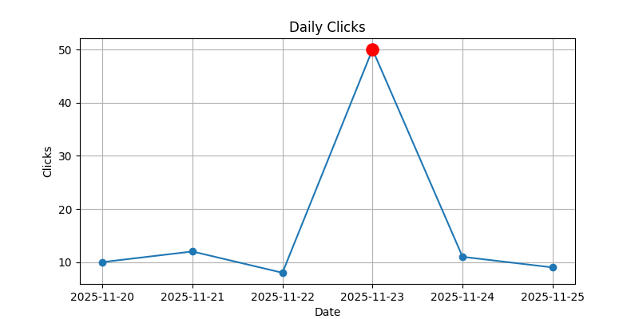
Daily Clicks Chart

Slide 4
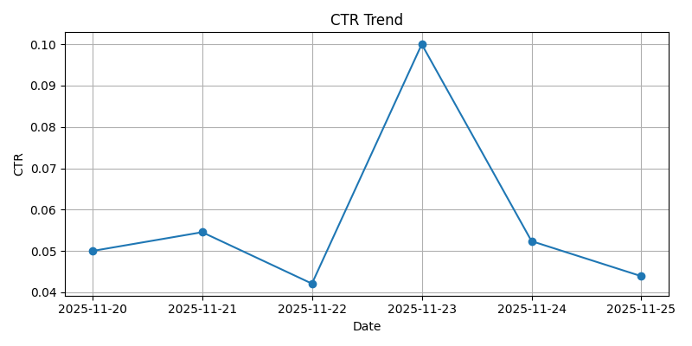
CTR Trend

Slide 5
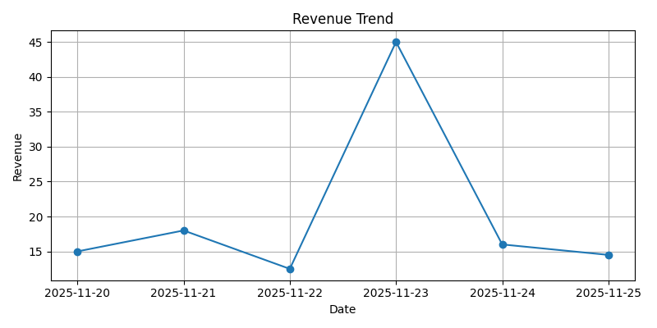
Revenue Trend

