Slide 1
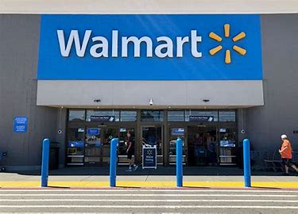
Walmart Sales Analysis/SQL Server

Slide 2
Table
-- Create table
CREATE TABLE IF NOT EXISTS WalmartSalesData(
invoice_id VARCHAR(30) NOT NULL PRIMARY KEY,
branch VARCHAR(5) NOT NULL,
city VARCHAR(30) NOT NULL,
customer_type VARCHAR(30) NOT NULL,
gender VARCHAR(30) NOT NULL,
product_line VARCHAR(100) NOT NULL,
unit_price DECIMAL(10,2) NOT NULL,
quantity INT NOT NULL,
tax_pct FLOAT(6,4) NOT NULL,
total DECIMAL(12, 4) NOT NULL,
date DATETIME NOT NULL,
time TIME NOT NULL,
payment VARCHAR(15) NOT NULL,
cogs DECIMAL(10,2) NOT NULL,
gross_margin_pct FLOAT(11,9),
gross_income DECIMAL(12, 4),
rating FLOAT(2, 1)
);

Slide 3

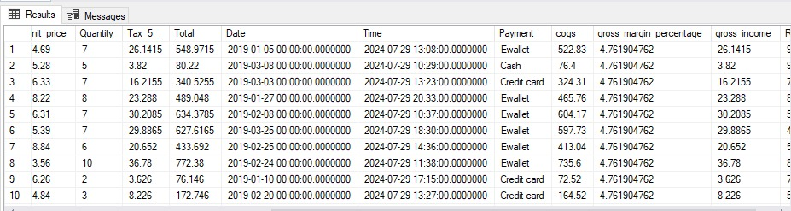
Show Table

Slide 4
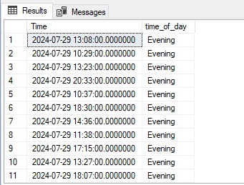
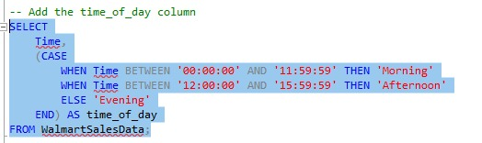
Add the Time_Of_Day column

Slide 5
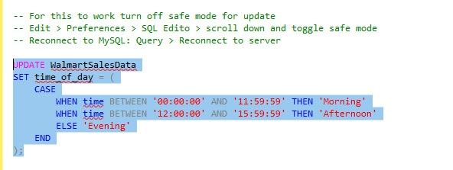
Update Table

Slide 6
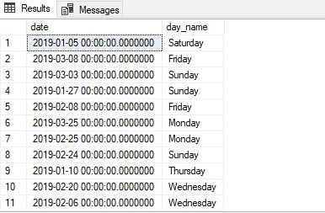

Add Day columns

Slide 7
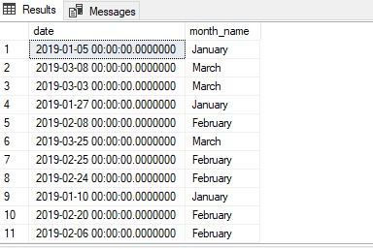

Add month name columns

Slide 8
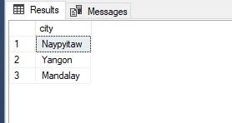
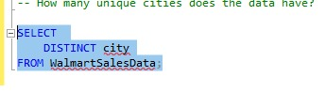
How many unique cities doses the data have

Slide 9
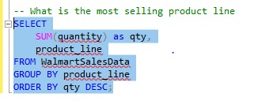
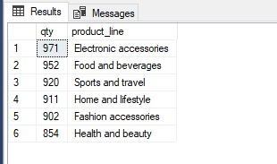
What is the most selling product

Slide 10
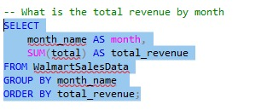
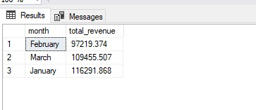
What is the total revenue by month

Slide 11
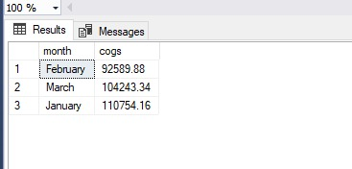
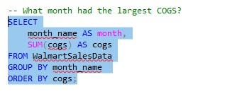
What month had the largest cogs

Slide 12
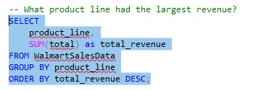
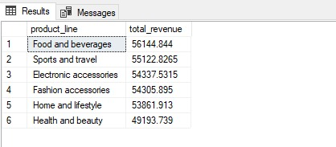
What product line had the largest revenue

Slide 13
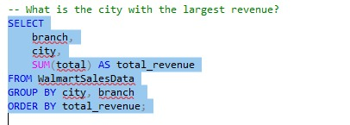
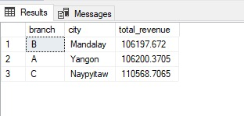
What is the city with the largest revenue

Slide 14
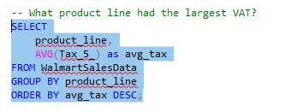
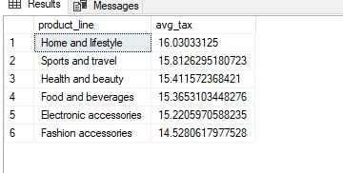
What product line had the largest vat

Slide 15
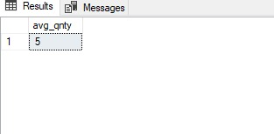
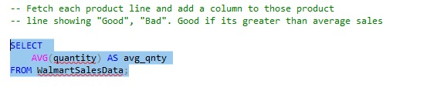
Fetch each product line and add a columns to those product

Slide 16
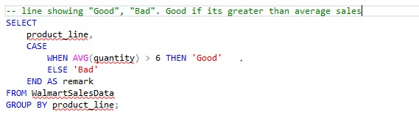
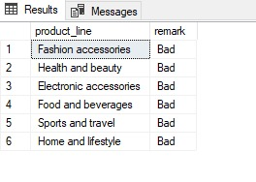
Line showing ‘GOOD’ and ‘BAD’ good if its greater than average sale

Slide 17
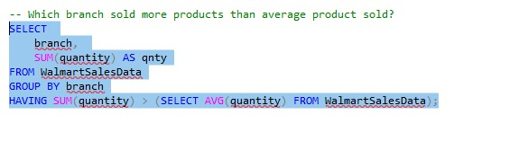
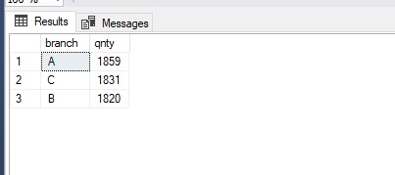
Which branch sold more product than average product sold

Slide 18
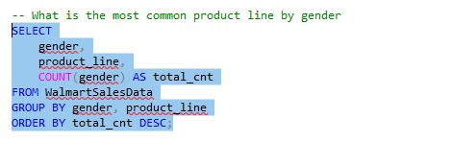
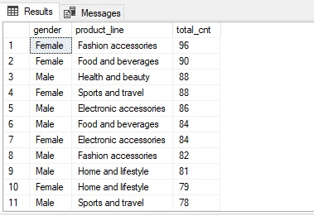
What is the most common product line by gender

Slide 19
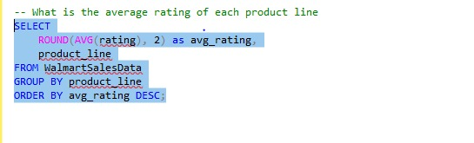
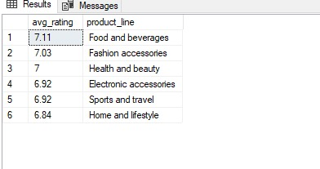
What is the average rating of each product line

Slide 20

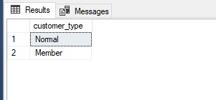
How many unique customer types does the data have

Slide 21
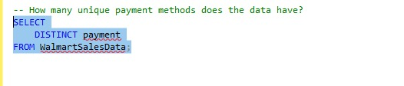
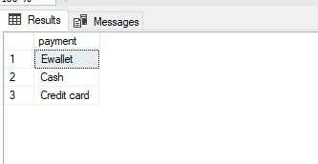
How many unique payment does the data have

Slide 22
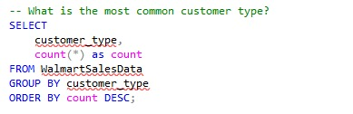
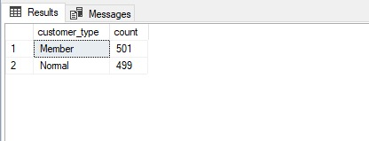
What is the most common customer types

Slide 23
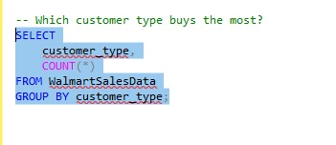
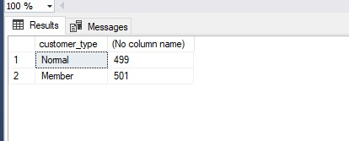
Which customer types buys the most

Slide 24
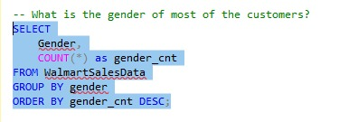
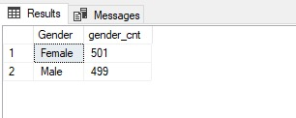
What is the gender of most of the customers

Slide 25
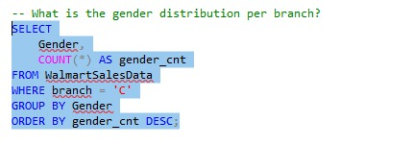
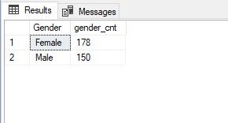
What is the gender distribution per branch

Slide 26
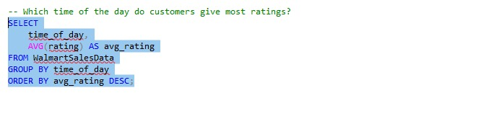
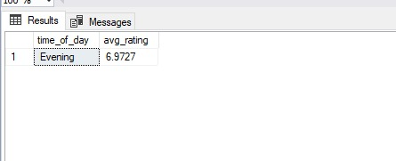
Which time of the day do customers give ratings

Slide 27
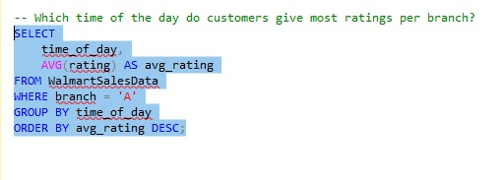
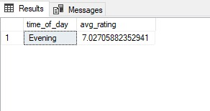
Which time of the day do customers give most rating per branch

Slide 28
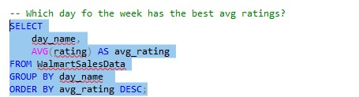
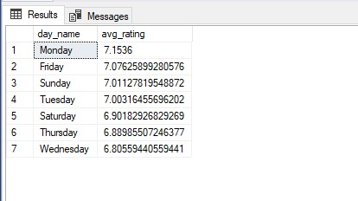
Which day for the week has the best avg rating

Slide 29
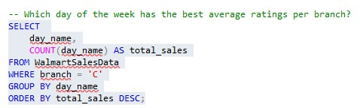
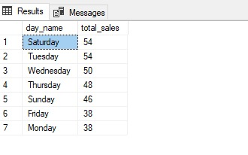
Which day of the week has the best average ratings per branch

Slide 30


Number of sales made in each time of the day per weekday

Slide 31


Which of the customer types brings the most revenue

Slide 32


Which city has the largest tax/vat

Slide 33


Which customer types pays the most in vat

Slide 34
Thanks
Created by Deepak Kumar

