Slide 1
PYTHON DATATYPES

Slide 2
Agenda
What is data type
Data Conversion
Aditional data types
Types of data types
Example with jupyter notbook

Slide 3
Data types are the classification or categorization of data items. It represents the kind of value that tells what operations can be performed on a particular data. Since everything is an object in Python programming, data types are actually classes and variables are instance (object) of these classes.

Slide 4
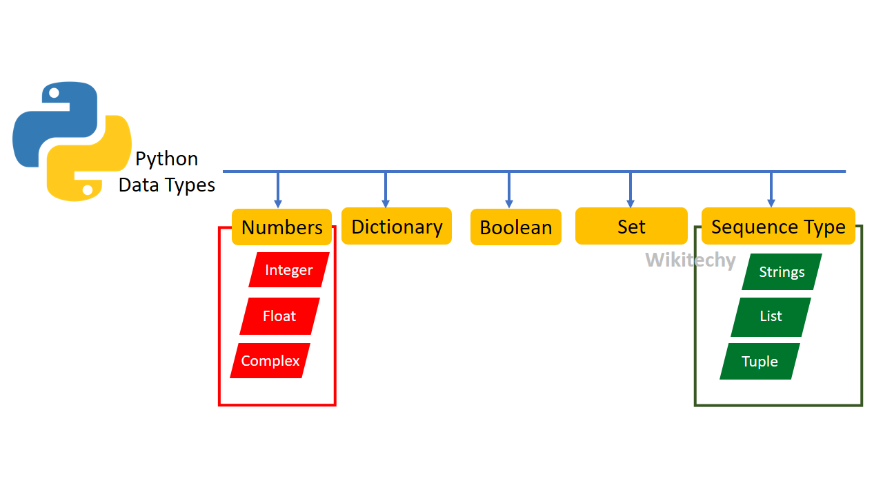
Data Types

Slide 5
Data Types conversion
Python defines type conversion functions to directly convert one data type to another which is useful in day to day and competitive programming. This article is aimed at providing information about certain conversion functions. 1. int (a,base) : This function converts any data type to integer.
there are two types of data conversion
implicit types conversion
explicit types conversion

Slide 6
implicit types convrsion automatically converts ne data types to another data types. this porcess does not need any user involement.
exampple - where pyhton promotes the conversion of the lower data types (integer) to the higher data types (float) to avoid data loss.
explicittypes conversion users convert the data types of an object to required data type. we use the predefined funciton like int,flaot,str,etc to perform explicit types conversion and it also know as the typecasting.

Slide 7
Number data types
Number data type represent the data which has numeric value. Numeric value can be integer, floating number or even complex numbers. These values are defined as int, float and complex class in Python.
Integer – integer only take the hole no of value without any decimal value but if you have decimal point value to the number it is going to became float Float -The float() method returns a floating point number from a number or a string. Complex - A Complex number consists of real and imaginary component. It is represented as x+yj. Both x and y are real numbers. Y multiplied by imaginary unit forms an imaginary part of complex number. Examples: 3+2j, 10-5.5J, 9.55+2.3j, 5.11e-6+4j. Python has a built-in complex data type.

Slide 8
Dictionary in python
Agenda of the dictionary- What is dictionary - Why use python dictionary Dictionary vs list How to implement python dictionary all method in python dictionary
nested dictionary

Slide 9
what is dicctionary- Dictionary in python is an un ordered collection of data values like a map which unlike other data types that hold only single value as an element dictionary holds key values pair key value is provided In dictionary to make it more optimized
Feature of dictionary - UNORDERED MUTABLE INDEXED NO DUPLICATE MEMBERS

Slide 10
Why use a python dictionary • un ordered and stores value like a map • Contains key value pairs unlike other data type • Similar to real life dictionary with distinct key value
Dictionary vs list
Dictionary | list
Unordered | Ordered
Accesses via keys | Accessed via index
Collection of key value pairs | Collection of elements
Preferred when you have unique key value | Preferred for ordered data
No duplicate members | Allows duplicate member

Slide 11
NOT-
A dictionary is a collection which is unordered changeable and indexed in python dictionaries are written within curly bracket and they have keys and vales means the dictionary contains two things first is the dictionary contains two thing first is the key and the second is the values. Dictionary in python is declared inside curly brackets

Slide 12
Dictionary methos
Method Description
clear() Removes all items from the dictionary.
copy() Returns a shallow copy of the dictionary.
fromkeys(seq[, v]) Returns a new dictionary with keys from seq and value equal to v (defaults to None).
get(key[,d]) Returns the value of the key. If the key does not exist, returns d (defaults to None).
items() Return a new object of the dictionary's items in (key, value) format.
keys() Returns a new object of the dictionary's keys.
pop(key[,d]) Removes the item with the key and returns its value or d if key is not found. If d is not provided and the key is not found, it raises KeyError.
popitem() Removes and returns an arbitrary item (key, value). Raises KeyError if the dictionary is empty.
setdefault(key[,d]) Returns the corresponding value if the key is in the dictionary. If not, inserts the key with a value of d and returns d (defaults to None).
update([other]) Updates the dictionary with the key/value pairs from other, overwriting existing keys.
values() Returns a new object of the dictionary's values

Slide 13
SET
AGENDA OF SET What Is set When to use sets How to create sets
Python set operators- * accessing set * finding the length * adding updating sets * removing sets * deleting sets * union set * intersection * difference

Slide 14
what is set?.
Python Set is an unordered collection of elements much like a set in mathematics.
the order of element is not maintained in the sets it means the elements may not appear in the same order as they are entered into the set.
a set does not accept duplicate elemets.
set is mutable so we can modify it.
set are unordered so we can not access its elements using index.
set are unordered so we can not access its elements using index.
set are represented using curly brackets {}

Slide 15
use
Python’s set use class represents the mathematical notion of a set. The major advantage of using a set, as opposed to a list, is that it has a highly optimized method for checking whether a specific element is contained in the set. This is based on a data structure known as a hash table

Slide 16
how to create set
a set created by placing all the items indside curly braces {} separated
by comma , a setdoes not accept duplicate elements
a = {10,20,30,”deepak”,”kumar”,5000}

Slide 17
String in python
Strings are amongst the most popular types in Python. We can create them simply by enclosing characters in quotes. Python treats single quotes the same as double quotes. Creating strings is as simple as assigning a value to a variable
string represents group of characters strings are enclosed in double quotes or single quotes. the str data type represents string.

Slide 18
creating string
variable_name
str_1 = “deepal kumar”
stirng

Slide 19
Mutable and immutable object
Mutable object – mutable object are those object whose value or content can be changed as and when required Example – list set dictionaries Immutable object- immutable object are hose object whose values or content can’t be changed

Slide 20
List
In python list is a type of container in pthon which is used to store multiple data at the same time
• A list represents a group of elements. • List are very similar to array but there is major difference an array an array can store only one types of elements whereas a list can store different types of elements. • Lists are mutable so we can modify it is elements. • A list can store different types of elements which can be modified. • List are dynamic which means size is not fixed. • List are represented using square bracket []

Slide 21
creating List
variable_name
str_1 = [“deepal”,” kumar”,”salary”,5000]
LIST

Slide 22
Basic operation in list
create list and print
print the list using for loops and while loops
indexing the list
slicing the list
mathemetical function

Slide 23
Some method preform in the list -
Append - Insert - Extend - Index - Remove - Sort - Reverse -

Slide 24
What is tuple
A tuple is an immutable sequence of python object. tuples are sequences just like lists the differences between tuple and list are the tuples cannot be changed unlike lists and tuple use parentheses whereas lists use square brackets creating a tuple is as simple as putting different comma separated values

Slide 25
some operation
Creating tuple Difference tuple vs list Accessing & indexing elements tuples
Built function Operations on tuples Converting list into tuple Defining tuple and the list Defining list inside a tuple

Slide 26
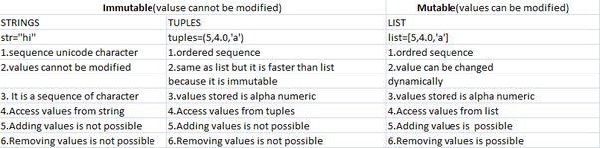
Difference tuple vs list

Slide 27
Notes
Tuples are immutable so it is not possible to modify update or delete elements from the tuple

