Slide 1
FlowControl Loops

Slide 2
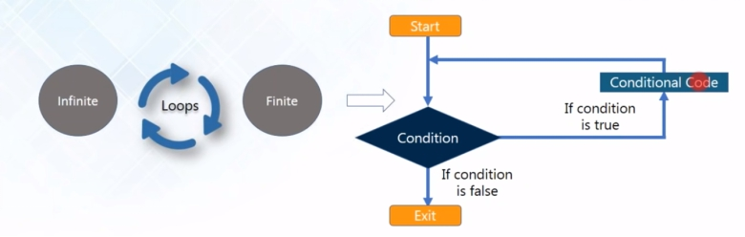
What is loops
in computer programming a loop is a sequence of instructions that is continually repeated untiol a certain condiiton is reached
it is used ot repeat the statments until a certain condition is satisfied. Once the condition because false the loops stops and the control moves out of the loops

Slide 3
The control comes here and check the condition so if the condition is true it will go on and execute the conditional code that is here this is statement which is inside the loops so it is execute that and again it will go back and check the condition if the condition is still true than again it will execute the condition code the inside the loops and it will keep and repeating until the condition will false at the moment condition will became false the control will move out the loops and execute the statement present after the loops.

Slide 4
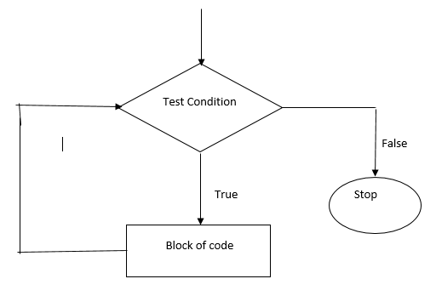
How do loops work?
Check for the condition.
The block of code will be executed as long as the condition is True.
Once the condition becomes False, the loop will be exited.

Slide 5
Types of Loops
Finite – the loop that terminate after the fixed number of times or after the occurrence of specific values. Infinite – in infinite loops what happened the condition will never be false that time the control never come out the loops that mean it will keep repeating and it will never be false that is infinite loops are.

Slide 6
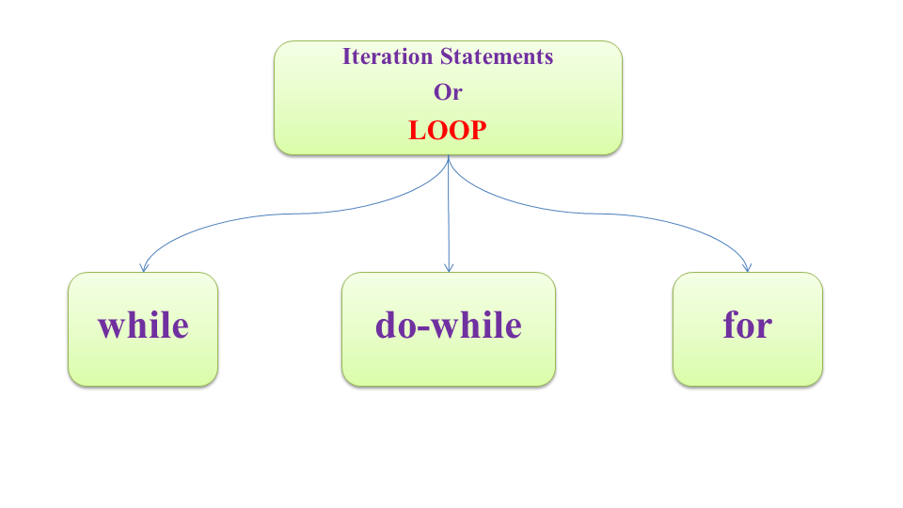
Loops Operation

Slide 7
While loop
in python while loops is used to execute a block of statemetns repeatedly until a given a condition is satisfied and when the condition become false the line immediately after the loops in progdram is executed

Slide 8
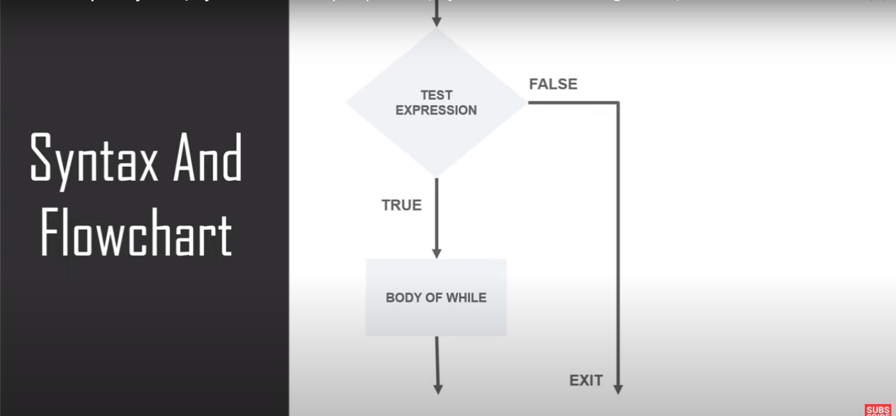
Flow chart

Slide 9
example
# first all i have created one counter variable
counter = 0
#and here i have put the condition using while loops
while counter <10:
#print the values
print(counter)
#incremante
counter = counter+1
# first all i have created one counter variable
counter = 0
#and here i have put the condition using while loops
while counter <=10:
#print the values
print(counter)
#incremante
counter = counter+1

