Slide 1
Python
Operators

Slide 2
AGENDA
Introduction of operators
Types of operators
Example with python id

Slide 3
Python Operators
The operator can be defined as a symbol which is responsible for a particular operation between two operands. Operators are the pillars of a program on which the logic is built in a specific programming language

Slide 4
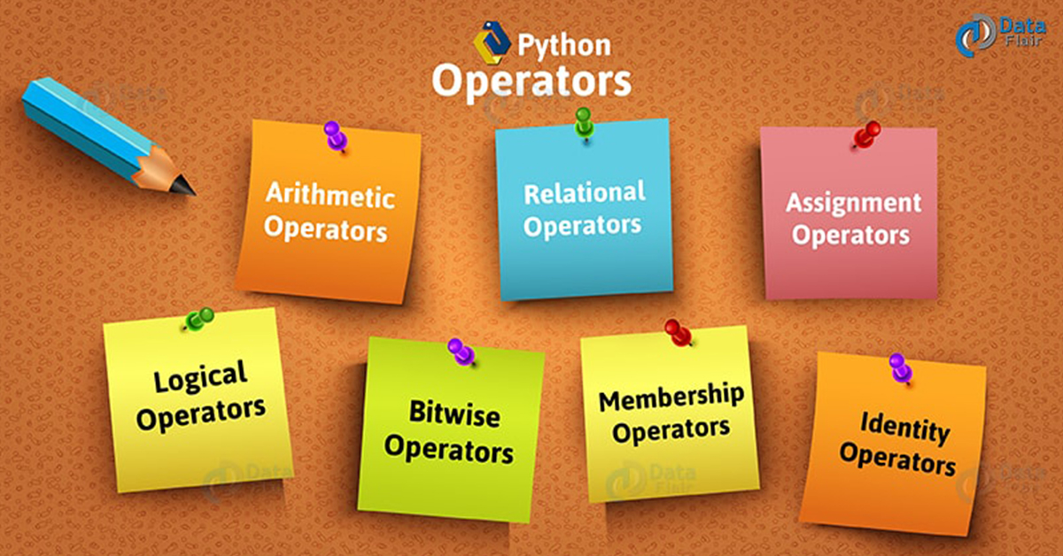
Types of Operator
Python language supports the following types of operators.

Slide 5
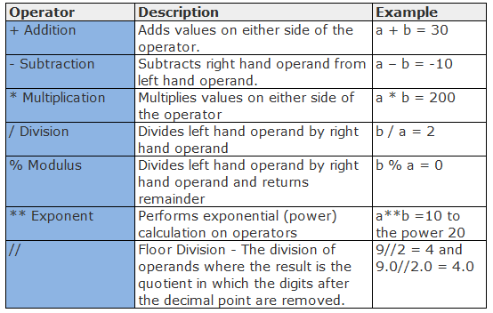
Arithmetic Operators
Arithmetic operators are used to perform arithmetic operations between two operands

Slide 6
Example
A = 10
B = 20
Addition = a+b
Sub traction = a- b
Multiply = a*b
Divide = a/b
Mod = a%b
Exponent = a ** B
Floor = a //b

Slide 7
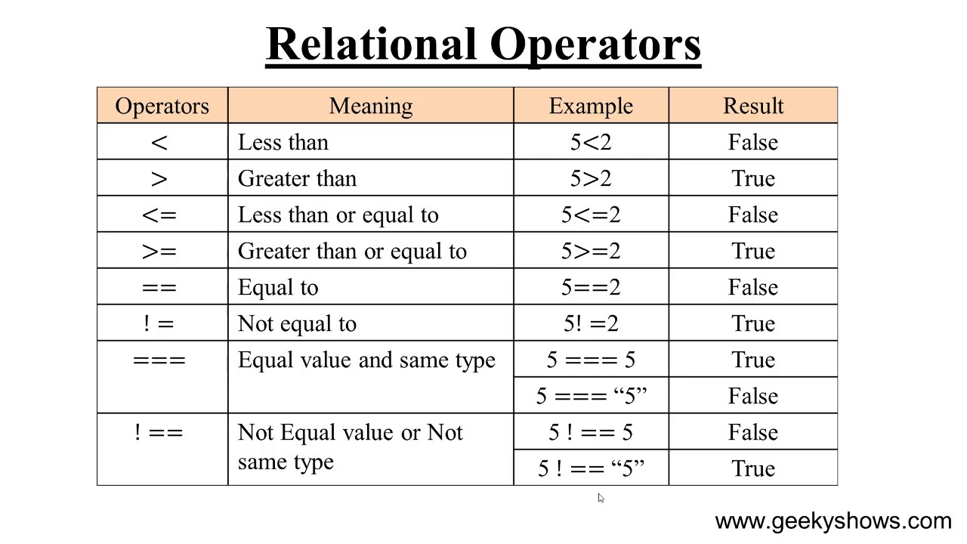
relational operator
Comparison operators are used to comparing the value of the two operands and returns Boolean true or false accordingly. The comparison operators are described in the following table

Slide 8
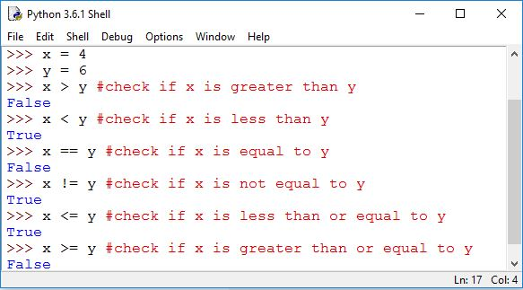
Example

Slide 9
Python Assignment Operators
The Python Assignment Operators are handy to assign the values to the declared variables. Equals (=) operator is the most commonly used assignment operator in Python. For example:

Slide 10
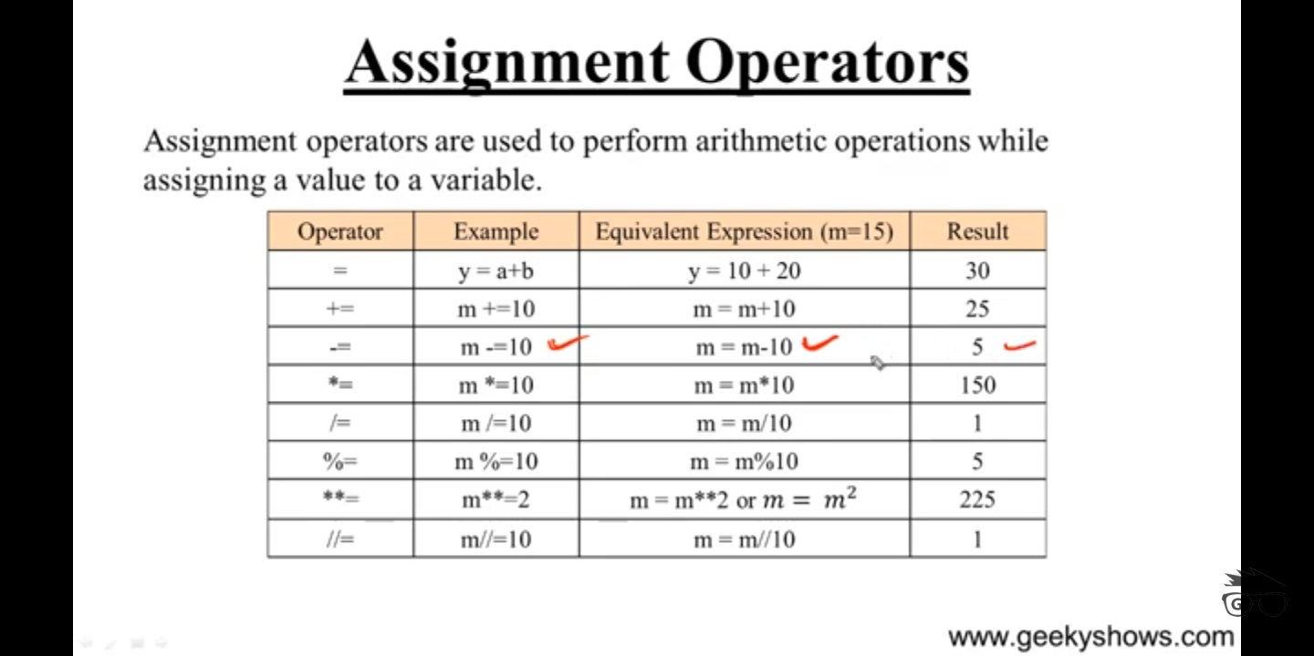

Slide 11
Logical Operators
The logical operators are used primarily in the expression evaluation to make a decision python supports the flowing logical operators ..if one of the expressions is true then the condition will be true if A and B are the two expressions A→ true , B → false that mean A or B is true

Slide 12
Operator | Description
and | If both the expression are true, then the condition will be true. If a and b are the two expressions, a → true, b → true => a and b → true.
or | If one of the expressions is true, then the condition will be true. If a and b are the two expressions, a → true, b → false => a or b → true.
not | If an expression a is true, then not (a) will be false and vice versa.

