Slide 1
PYHTON
variable

Slide 2
AGENDA
what is variable
variable declaration
example with id

Slide 3
Python variable
Variables are nothing but reserved memory locations to store values. This means that when you create a variable you reserve some space in memory.
Based on the data type of a variable, the interpreter allocates memory and decides what can be stored in the reserved memory. Therefore, by assigning different data types to variables, you can store integers, decimals or characters in these variables.

Slide 4
dentifier Naming
Variables are the example of identifiers. An Identifier is used to identify the literals used in the program. The rules to name an identifier are given below.
The first character of the variable must be an alphabet or underscore ( _ ).
All the characters except the first character may be an alphabet of lower-case(a-z), upper-case (A-Z), underscore or digit (0-9).
Identifier name must not contain any white-space, or special character (!, @, #, %, ^, &, *).
Identifier name must not be similar to any keyword defined in the language.
Identifier names are case sensitive for example my name, and MyName is not the same.
Examples of valid identifiers : a123, _n, n_9, etc.
Examples of invalid identifiers: 1a, n%4, n 9, etc.

Slide 5
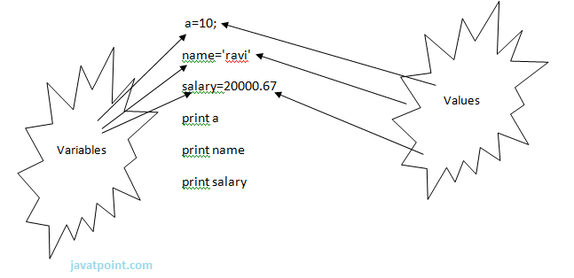
Example

Slide 6
variable id
a = 50
b = a
print(id(a))
print(id(b))
# Reassigned variable a
a = 500
print(id(a))

Slide 7
typss of variable
There are two types of variables in Python - Local variable and Global variable. Let's understand the following variables.
Local Variable
Local variables are the variables that declared inside the function and have scope within the function. Let's understand the following example.
# Declaring a function
def deep():
# Defining local variables. They has scope only within a function
a = 1055
b = 4125
c = a + b
print("The sum is:", c)
# Calling a function
deep()

Slide 8
Global Variables
Global variables can be used throughout the program, and its scope is in the entire program. We can use global variables inside or outside the function.
# Declare a variable and initialize it
x = 101
# Global variable in function
def deep():
# printing a global variable
global x
print(x)
# modifying a global variable
x = 'Welcome To Javatpoint'
print(x)
deep()
print(x)

