Slide 1
FINAL PROJECT TEMPLATE

Slide 2
THREAT SUMMARY
Summary of Situation: (Health organizations are been attacked by hackers after they have endorsed a new legislation, hackers have exploited the vulnerability and have hacked into the log management system and have encrypted most of files and are asking for ransom amount in bitcoins to get the decrypting key.)
Asset: (The patient critical data including medical records and their treatment history. The computers and servers are also asset for health organization. There can be much more asset and depends on the data that is been stored in computer and servers)
Impact: (All parts of CIA are impacted, Confidentiality as the patients records files are encrypted and there might be data breach. Integrity, as the attackers have access to data and there might be loss of data. Availability, attackers have demanded money to provide the key to decrypt the files. Until then, files can’t be accessed)
Threat Actor: (These are Cyber criminals(External threat) who have encrypted the files and are asking for ransom amount. It is also a employee(internal threat) who may have clicked on the phishing email attachment sent by hackers.)
Threat Actor Motivation: (These are financially motivated attackers, who are targeting patient records and hospital servers for monetary reasons. They may also be group who are not in support of the new law)
Common Threat Actor Techniques: (Attacker use spear phishing, where email was sent to the hospital staff with malicious file which have installed ransomware on their system.)

Slide 3
VULNERABILITY SCANNING TARGETS
Summary of scan targets:
Number of devices scanned: 1
Device type: Main Log server (Virtual azure device IP: 168.63.129.16)
Primary purpose of device: (These are Windows systems that contain centralized log files and backups of patients and hospital records)
(insert 2 screenshots from scan configuration window – one of the settings tab and one of the plugins tab)

Slide 4
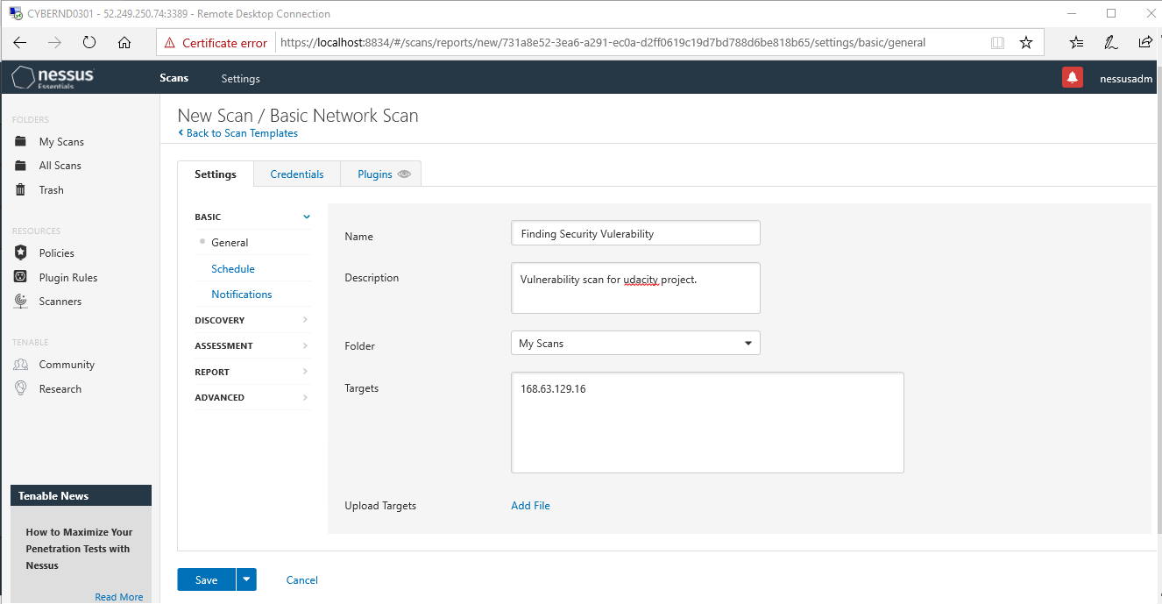

Slide 5
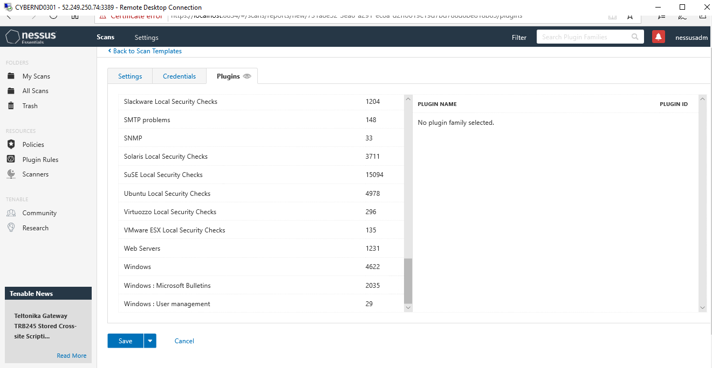

Slide 6
VULNERABILITY SCAN RESULTS
Summary of findings:
Total number of actionable findings: 3(2 Medium 1 Low, 12 info excluded)
Critical: 0
High: 0
Medium: 2
Low: 1
(insert screenshot from scan results dashboard) : Attached in next slides

Slide 7
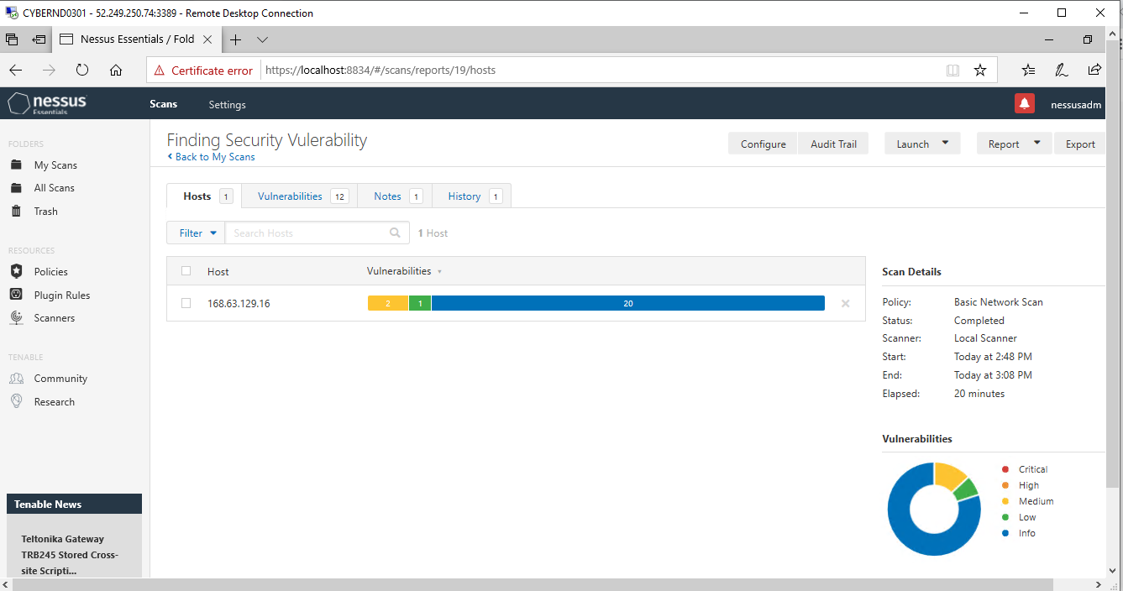

Slide 8
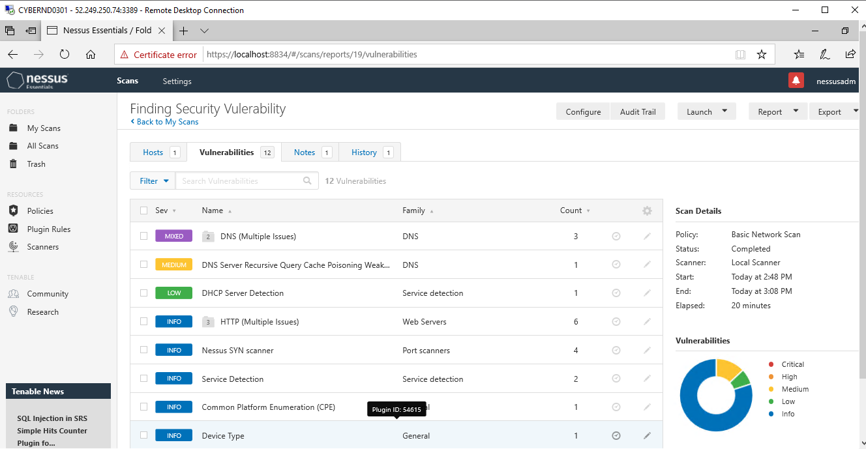

Slide 9
REMEDIATION RECOMMENDATION
Fix within 7 days
Finding | Severity Rating | Recommended Fix
DNS Server Spoofed Request Amplification DDoS | CVSS Rating: 5 (Medium) | Restrict access to your DNS server from public network or reconfigure it to reject such queries.
Fix within 30 days
Finding | Severity Rating | Recommended Fix
DNS Server Recursive Query Cache Poisoning Weakness | CVSS Rating: 5 (Medium) | Restrict recursive queries to the hosts that should use this nameserver (such as those of the LAN connected to it). If you are using bind 8, you can do this by using the instruction 'allow-recursion' in the 'options' section of your named.conf. If you are using bind 9, you can define a grouping of internal addresses using the 'acl' command. Then, within the options block, you can explicitly state: 'allow-recursion { hosts_defined_in_acl }' If you are using another name server, consult its documentation.

Slide 10
REMEDIATION RECOMMENDATION
Fix within 60 days
Finding | Severity Rating | Recommended Fix
DHCP Server Detection | CVSS Rating : 3.3 (Low) | Apply filtering to keep this information off the network and remove any options that are not in use.

Slide 11
PASSWORD PENETRATION TEST OUTCOME
Methodology: (Passwords were hacked with haschat, Command used was -m 0 -a 0 hashes.txt example.txt. CMD terminal was used to run the command and it gives output of the cracked passwords)
-m 0 represents the hash type MD5
-a 0 represents the dictionary attack mode
hashes.txt and example.txt are the target files.
Number of passwords tested: (128416)
Number of passwords cracked: (3)
Evidence of weak passwords: Attached in next slides
Recommended steps to improve passwords security:
Keep password length long, it should be greater than 12 characters.
Keep complex numbers and special characters in password to make it more secure. E.g, "We <3 cyber @tt@cks"
Try to keep password unrelated to individual. There are much greater chance that someone can guess these type of passwords as basic information are easily available.
Don't reuse old passwords. If someone knows individual’s old passwords, it is quite easy to figure out their current password.
Use Password managers to keep track of long and complex passwords.

Slide 12
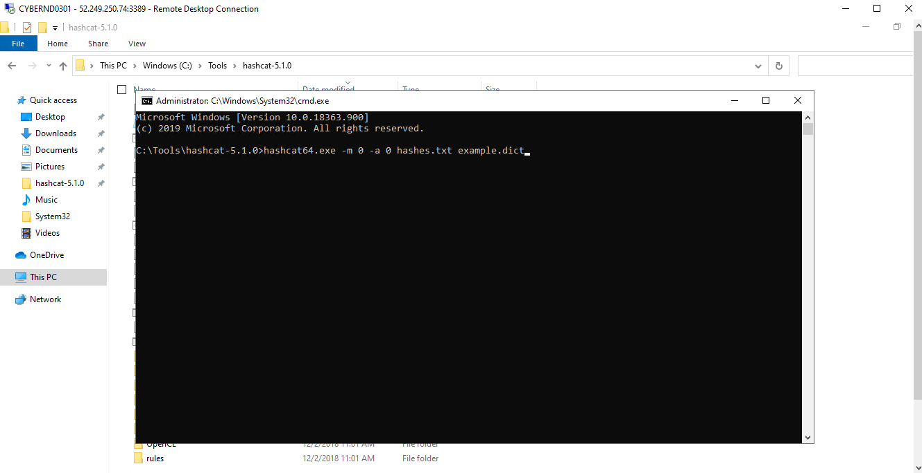

Slide 13
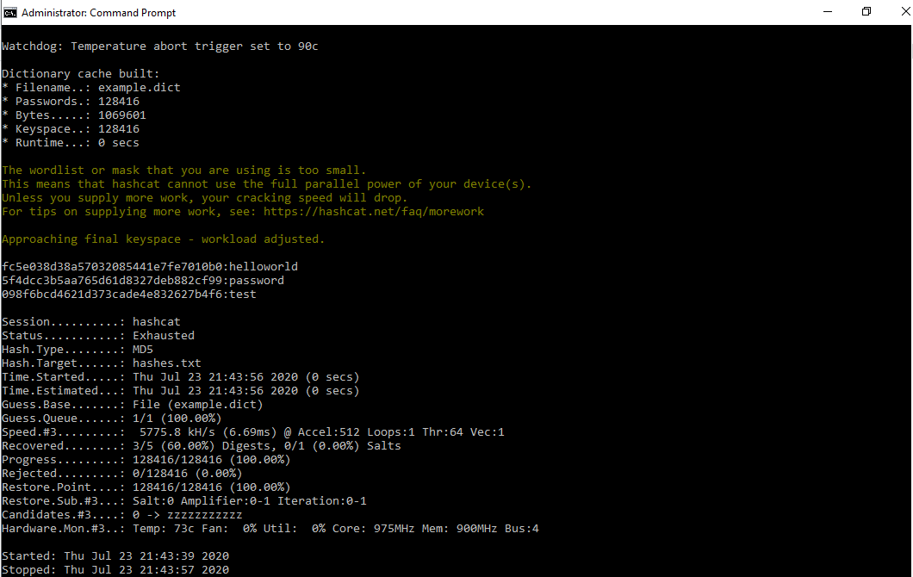

Slide 14
INCIDENT RESPONSE PRELIMINARY ASSESSMENT
Summarize ongoing incident:
Attackers are targeting employees by sending phishing emails, they are installing malicious software and are encrypting the log server files and are asking for ransomware for decryption the files.
Document actions or notes from the following steps of the initial incident response checklist
Step 1: Check for all outdated windows machines and servers for security updates.
Step 2: Notify all employees for the threat of phishing email sent by attackers.
Step 3: Evaluate the security of network and prioritize the vulnerability listed by Nessus.
Step 4: Action plan to notify all govt organization and share holders.
Step 6: Prioritize and document backup plan to recover the patient data.
(Add another slide if needed)

Slide 15
INCIDENT RESPONSE RECOMMENDED ACTION
Summarize recommendation to contain, eradicate, and recover:
Describe the overall recommended containment, eradication, and recovery plan
Attackers are targeting outdated windows system and are targeting employees by phishing email. Urgent alert to all employees and training if required should be given. All systems and log server should be updated with latest security patch. Patient data needs to be backed up so that the operation can resume successfully. Vulnerability discovered by Nessus should be taken on priority and steps should be documented to fix the issue.
Documented actions and notes from the IR checklist
Step 7: (Tip: Select procedures you’d recommend for this type of incident) We can restrict the recursive calls as we have found that the network is vulnerable to recursive queries be performed by the host. The internal provider can also be involved to restrict the attack.
Step 8: We have identified that our DNS server could be used in a distributed denial of service attack. We should restrict our private records to be accessed from public network and reconfigure it to reject. Also use VPN for employees to use the network.
Step 9: FBI can be contacted to report the incident.
Step 10: Backup of the data base and system needed to recover from this attack and start functioning as soon as possible.
Step 11: Employee training needs to be done to educate them not to click on phishing emails which led to attack on other hospitals.
Step 12: Some systems are not updated, the security patches needs to updated immediately, prefer the windows setting to auto update.
Step 13: Passwords should be strong, and updated antivirus should be used.
Step 14: Prepare to notify the affected patients that there is an data breach.
(Add another slide if needed)

