Slide 1




Customer Shopping Behavior Analysis
By Deepak Singh
A full-stack data analytics project showcasing the journey from raw data to executive dashboard.
Python
PostgreSQL
Cleaning & EDA
SQL analysis
Power BI
Insights
Interactive dashboard
Actionable recommendations

Slide 2
Project Overview
Objective & Scope
Project Vitals
Uncover actionable insights into customer spending, product preferences, and subscription behavior to support strategic decisions. The dataset includes 3,900 transactional records across 18 features covering demographics, purchases, and shopping behavior.
3.9K
Records
Key Features Analyzed
Transactional rows analyzed
Age · Gender · Location
Subscription Status · Purchase Amount
18
Season · Discount Applied
Review Rating · Shipping Type · Frequency
Features
Variables per record
37
Nulls
Review Rating imputed with category median
Toolchain
Python → PostgreSQL → Power BI

Slide 3
Data Cleaning & Preparation (Python)
A six-step preparation pipeline ensured clean, analysis-ready data before SQL and visualization work began.
01
02
Data Loading & Exploration
Missing Value Imputation
Imported the 3,900-row dataset with pandas and reviewed structure with df.info() and .describe().
Found 37 nulls in Review Rating and filled them using the median rating by product category.
03
04
Column Standardization
Feature Engineering
Renamed columns to snake_case for consistency across the workflow.
Created age_group and purchase_frequency_days for segmentation analysis.
05
06
Redundancy Check & Column Removal
Database Integration
Confirmed discount_applied and promo_code_used were redundant, then dropped promo_code_used.
Loaded the cleaned DataFrame into PostgreSQL for downstream SQL analysis.

Slide 4
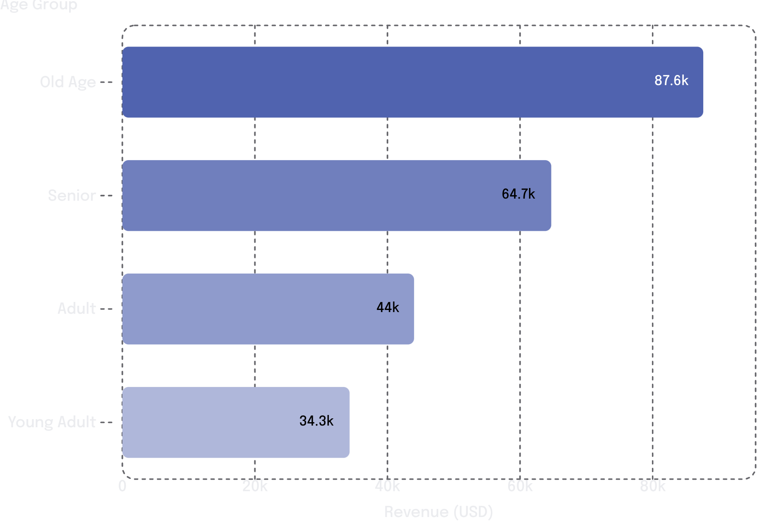


Revenue & Spending Insights (SQL)
Revenue by Age Group
Key SQL Findings
Revenue by Gender
Male: $155,438 vs. Female: $75,191 — about a 2× gap.
Shipping Type Impact
Express avg: $60.34 vs. Standard: $58.41.
High-Spend Discount Users
Discount users who still spend above average are strong upsell candidates.
Older segments drive most revenue. Old Age + Senior = $152,340, or over 65% of total.

Slide 5
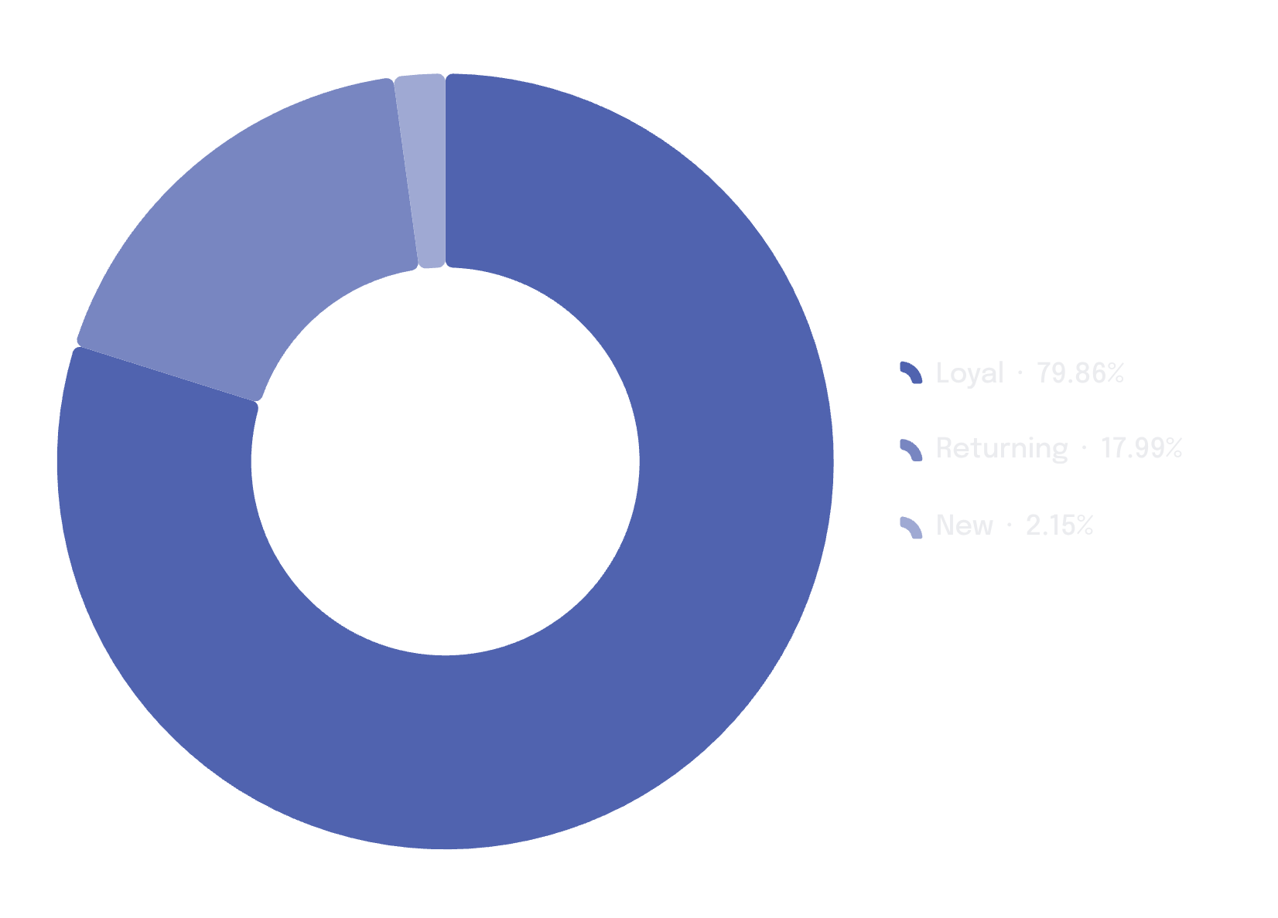

Customer Segmentation & Subscription Analysis
Customer Segment Distribution
Subscription Analysis
Metric
Subscribers
Non-Subscribers
Count
1,033
2,830
Avg Spend
$59.42
$59.81
Total Revenue
$61,377
$169,252
Average spend is nearly identical ($59.42 vs. $59.81), suggesting the subscription program adds little basket-size lift.
Repeat Buyers & Subscriptions
Among customers with >5 purchases, 939 subscribed and 2,503 did not — repeat buying does not strongly predict subscription uptake.
79% Loyal customers show strong retention, while just 83 New customers (2%) points to a weak acquisition funnel.

Slide 6
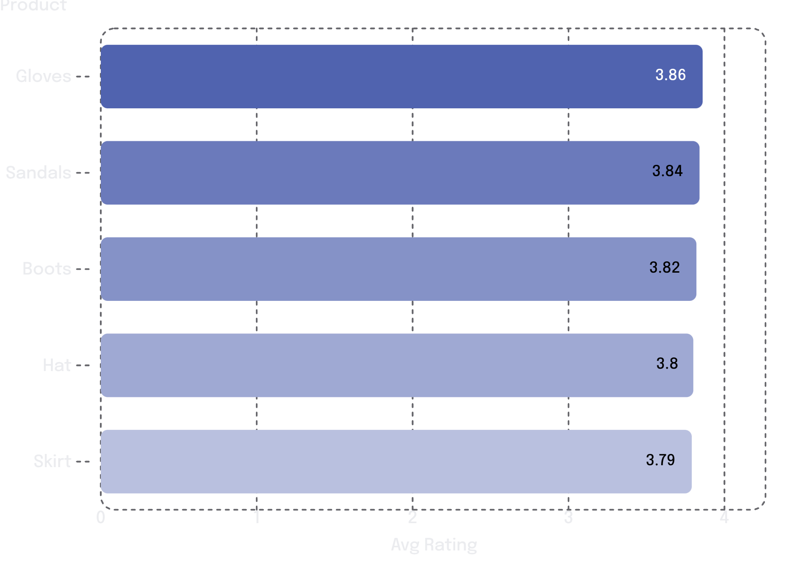
Product Performance & Discount Analysis
Top 5 Products by Avg Review Rating
Top Products by Category (Order Volume)
Category
Top Product
Orders
Accessories
Jewelry
170
Clothing
Blouse
169
Outerwear
Jacket
163
Footwear
Sandals
159
Discount Dependency Risk
49.67%
Hat
49.66%
Sneakers
48.43%
Coat
47.20%
Footwear and accessories lead satisfaction. Gloves rank first at 3.86.
Sweater
46.43%
Pants
Nearly half of purchases for these products are discount-driven, creating a margin risk.

Slide 7
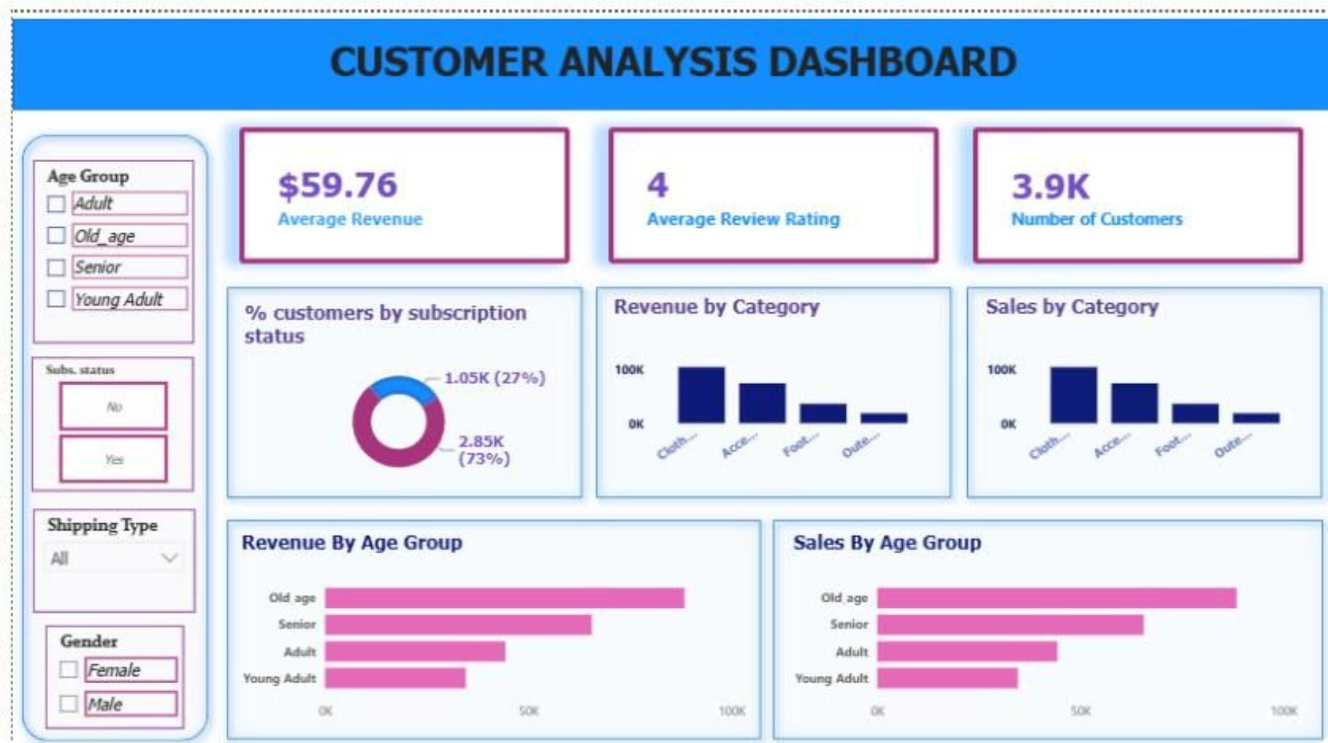
Power BI Dashboard
An interactive Power BI dashboard surfaces key insights for non-technical stakeholders with filters for Age Group, Subscription Status, Shipping Type, and Gender.
$59.76
4.0 ★
Avg Revenue / Transaction
Avg Review Rating
3.9K
73% / 27%
Total Customers
Subscribed vs. Non-Subscribed

Slide 8
Key Findings Summary
Six critical findings emerged from the combined Python EDA and SQL analysis, with direct strategic implications.
1
Revenue Skew
Male customers and the Old Age group drive the most revenue, making them the highest-priority segments for marketing.
2
Loyalty Strength
79% loyal customers shows strong retention. New customer acquisition remains a bottleneck at 2% (83 customers).
3
Subscription Gap
Subscribers and non-subscribers spend nearly the same amount: $59.42 vs. $59.81.
4
Discount Risk
Five products carry 47–50% discounts, creating margin pressure without a more targeted promo strategy.
5
Top Performers
Gloves, Sandals, Boots lead in ratings; Jewelry, Blouse, Jacket lead in order volume.
6
Express Shipping Signal
Express shipping users average $60.34 vs. $58.41 for Standard, suggesting a useful upsell lever.

Slide 9





Business Recommendations
Boost Subscriptions
Revise Discount Policy
Targeted Marketing
Product Positioning
Add subscriber-only discounts, early access, and loyalty points. Focus on the 2,503 repeat buyers who haven’t subscribed yet.
Review Hat, Sneakers, Coat, Sweater, and Pants. Replace blanket discounting with targeted, time-limited promotions to protect margins.
Prioritize Old Age and Senior segments, plus Express shipping users. Tailor campaigns to higher-spending customers.
Feature Gloves, Sandals, and Boots prominently. Use Jewelry, Blouse, and Jacket for cross-sell and bundle campaigns.
New Customer Acquisition
With only 83 new customers, invest in referrals, social ads, and onboarding incentives to rebuild the funnel.

Slide 10





Technical Stack & Skills Demonstrated
This project shows an end-to-end analytical workflow — from raw data to business-ready insights — using industry-standard tools.
Python
SQL (PostgreSQL)
Data cleaning and prep
Feature engineering
Missing value imputation
pandas and database connectivity
Revenue and spend analysis
Customer segmentation queries
CTEs, subqueries, window functions
Aggregations and conditional logic
Power BI
Analytical Skills
Interactive dashboard design
KPI, donut, and bar charts
Dynamic slicers and filters
Data storytelling for stakeholders
EDA and statistical reasoning
Segmentation and cohort thinking
Discount and margin analysis
Actionable recommendation framing
Core competency: turning transactional data into clear, actionable business insights.

Slide 11
THANK YOU

