Slide 1
Smoke Detector and alarm detection
Made By-Harshvardhan Singh
Gursimer Singh
Bhuvan Nawaria
Deepak Soni
Korupolu Deekshitha
Kayitha Saran Yadav

Slide 2
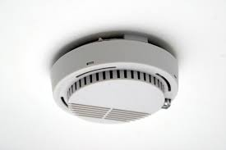
Intro
Smoke detectors play a crucial role in ensuring the safety of people and properties by detecting smoke and alerting occupants to the presence of a potential fire. In the event of a fire, every second counts, and having a dependable smoke detector system can make all the difference in saving lives and minimizing damage.

Slide 3

Function
The basic function of smoke detectors is to detect smoke particles in the air and trigger an alarm to alert occupants of a potential fire. Smoke detectors use different technologies, such as ionization, photoelectric, or a combination of both, to detect smoke particles.

Slide 4

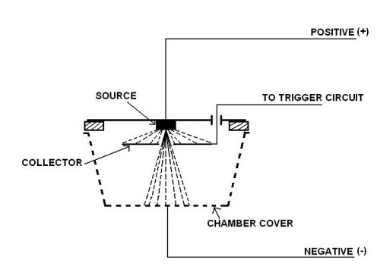
Basic types of smoke detectors
In ionization smoke detectors, a small amount of radioactive material ionizes the air inside the detector, creating a small electric current. When smoke enters the chamber, it disrupts the current, triggering the alarm.
In photoelectric smoke detectors, a beam of light is projected into the chamber, and when smoke enters, it scatters the light, triggering the alarm.

Slide 5
Components of the system
9 volt battery-Smoke detectors typically require a battery or connection to an electrical outlet to operate.
battery connector-for connecting the battery
Small speaker or buzzer- This is the component that detects the presence of smoke in the air.
10K ohm resistor-for controlling the voltage received by the bulb
small breadboard or circuit board-for putting up all the connections
Led lights-We are using the LED lights to detect the presence of smoke or other potential hazards.
ARDUINO/ESP32-to feed the code into the circuit

Slide 6
Conclusion
Through the use of Arduino and gas sensors, we were able to create a reliable and accurate smoke detector that is responsive to different types of smoke and gas emissions. The system was able to detect the presence of smoke or gas in the environment and trigger an alarm to alert the user.Overall, our smoke detector project using Arduino and gas kit has great potential for use in homes, offices, and other public spaces. Its low cost and easy-to-use features make it an excellent solution for enhancing safety and preventing fires. We hope that this project will inspire further research and development in the field of smoke detector technology.

