Slide 1
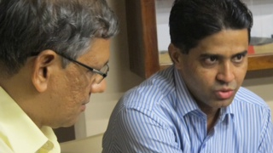
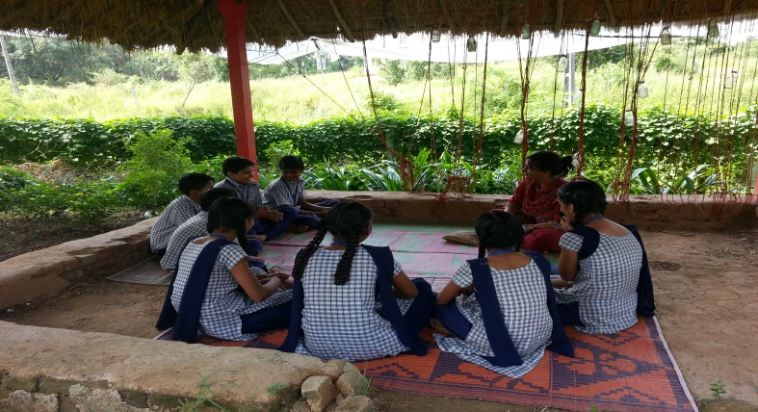
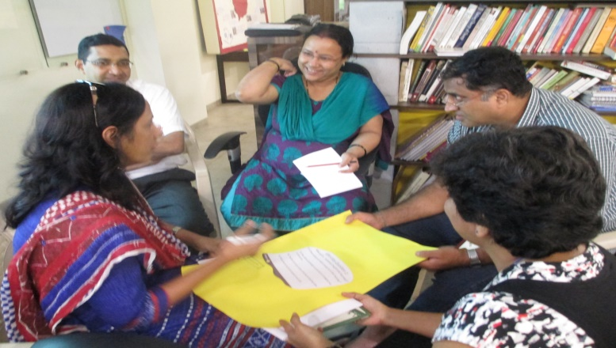

The Assessor Programme
(TAP)
A network of leading educators committed to realising the vision of ‘a good school for every child’

Slide 2
Why join TAP?
Broaden your experience to facilitate your school/network’s quality development
Keep updated with the latest research in education practices
Engage in a school leader peer learning community
Lead your own review based development journey
Share, learn and research, to deepen your understanding and practice of What Good Looks Like in schools
Click here to see Valerie Mascarenhas, St. Dominic Savio High School, Andheri East, speak about her Assessor journey so far

Slide 3
Your contribution to self, peer and community growth
AQS External Reviews
TAP Seminars & Workshops
Independent development:
  Explore through reading and researching
  Engage in resources and development tools on Moodle
  Document and share good practices
  Contribute to discussion forums
  Demonstrate school improvement impact

Slide 4
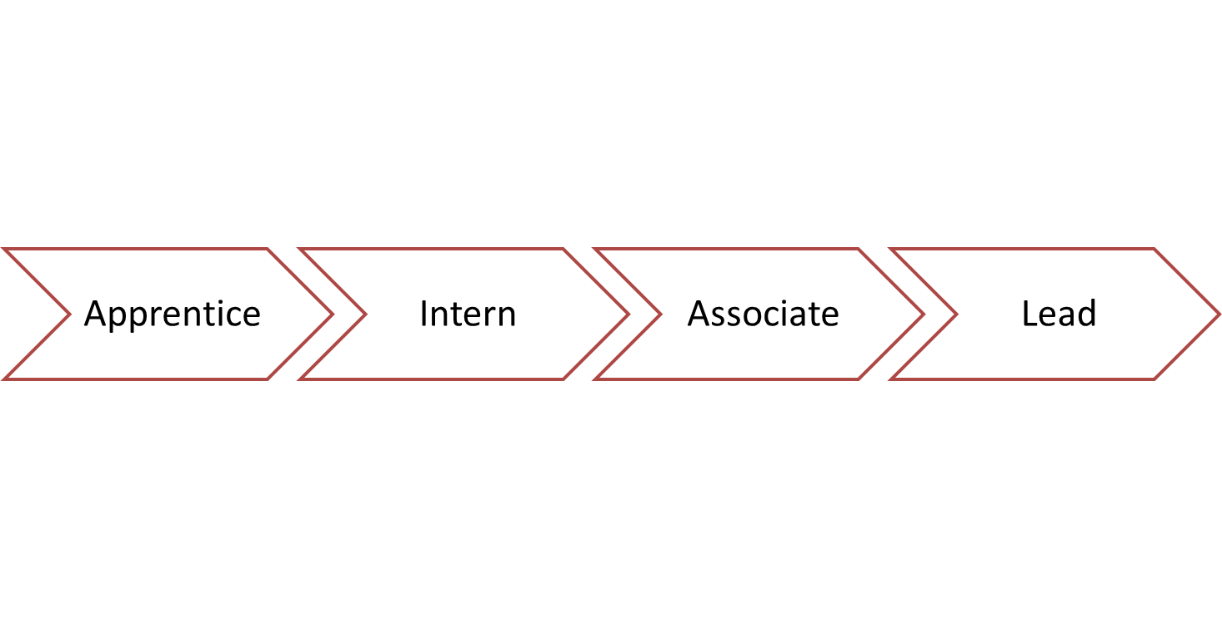
From Apprentice to Lead Assessor
All school leaders join TAP as an Apprentice
Movement from Intern to Lead Assessor is based on the following:
  Demonstrated impact of self, peer and school development
  Commitment to the vision of ‘a good school for every child’
Intern to Lead Assessors receive an honorarium for their time away from their school
Lead Assessors become TAP Faculty at The Leadership Institute

Slide 5
Assessor Stage | Assessor Role Overview
Apprentice | Re-visit the self-review process Document experiences for self learning and programme support | All Assessors engage in self- and peer-review, and share good practices to facilitate growth at an individual, peer and community level
Intern | Practice evidence collection and coming to judgement Develop understanding of What ‘Good’ Looks Like Engage in school improvement programmes
Associate | Lead aspects of the AQS Review programme Mentor peers in What ‘Good’ Looks Like and the self review process Demonstrate impact of school improvement programmes
Lead | Accountable for the AQS External Review Establish inclusive learning environments Facilitate leadership development across peers

Slide 6
How do you join TAP?
Review the attached documents:
  Assessor Agreement
  Assessor Contact Details and supporting documentation
  Confidentiality Agreement
  Adhyayan Code of Conduct
Obtain permission from your Management
Print, complete and return the following documents to the Adhyayan Office:
  Assessor Agreement
  Assessor Contact Details and supporting documentation
  Confidentiality Agreement

