Slide 1
AI
AI Study Buddy
A Personalized Learning Agent for Students
Built with Python, Streamlit & Claude AI
Student AI Track • GitHub: deepaktravels6028/student-ai-track

Slide 2
1
Problem Statement
Every student learns differently — but traditional study methods treat everyone the same way.
📖
📝
🎯
🗓️
Hard to Simplify
No Quick Self-Test
Unclear Weak Areas
No Revision Plan
Dense notes and syllabus content are difficult for students to understand on their own.
Creating quiz questions to check understanding takes time most students don't have.
Without structured feedback, students struggle to identify exactly what to revise.
Building a focused revision plan from scratch feels like an extra burden, not a help.
AI Study Buddy
02

Slide 3
2
Our Solution
AI Study Buddy is an AI-powered learning companion that turns any notes into a simple explanation, a self-test, and a personalized revision plan — in one place.
Tech Stack
Python
Core application logic (OOP)
💡
Explain Like I'm 10 Turns dense notes into a simple, easy explanation on demand.
Streamlit
Interactive web interface
❓
Auto-Generated Quiz Creates multiple-choice questions straight from the student's own notes.
Claude AI API
Explanations & quiz generation
✅
Instant Score & Feedback Grades answers immediately and highlights weak areas.
JSON
🗺️
Personalized Revision Plan Builds a focused plan around the topics that need more work.
Session persistence
pytest
🕘
Session History Saves past study sessions so progress isn't lost.
Unit testing
AI Study Buddy
03

Slide 4
3
How It Works
1
2
3
4
Add Notes
➜
Start Session
➜
Simplify & Quiz
➜
Score & Revise
Paste notes or upload a .txt file, pick a subject category
App confirms the session and stores the content
Request a simple explanation or generate quiz questions
Answer the quiz, get a score, and a revision plan for weak spots
Live Application Walkthrough
Screenshots from the app running locally (localhost:8501) are shown on the following slides.
AI Study Buddy
04

Slide 5
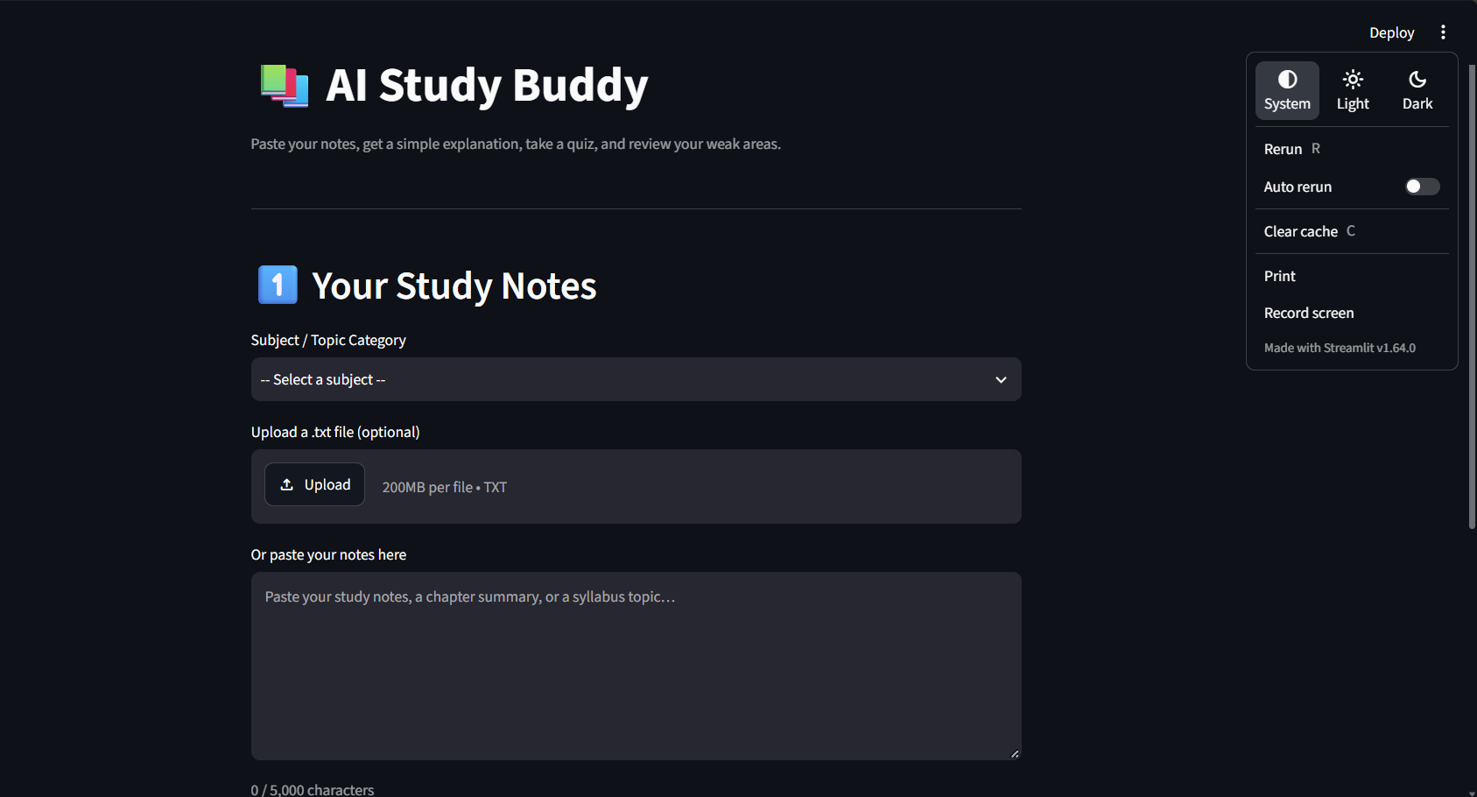
5
Home Screen — Enter Study Notes
What's happening
The student opens the app and sees a clean input area: choose a subject, upload a .txt file, or paste notes directly. This is Step 1 of the workflow.
AI Study Buddy
05

Slide 6
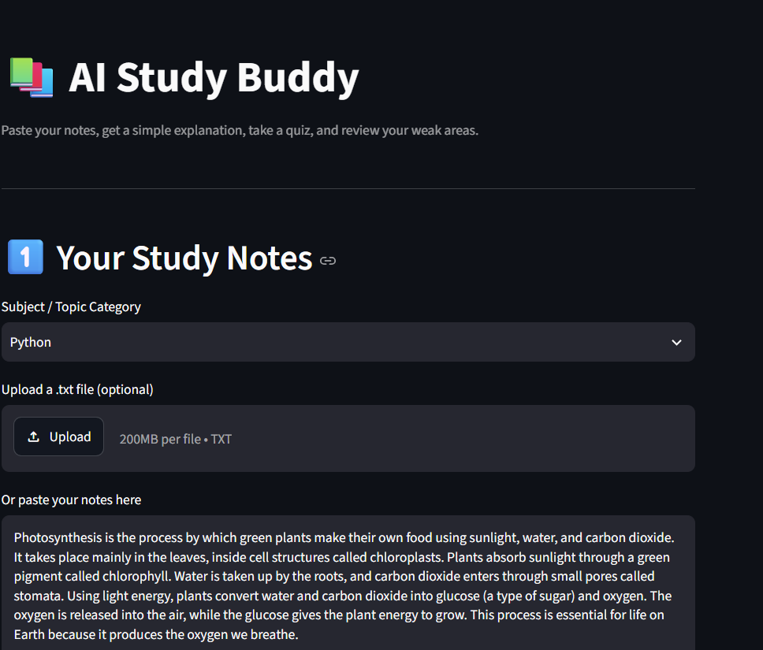
6
Notes Added by the Student
What's happening
The student selects a subject (Python) and pastes study content into the notes box. The app tracks character usage live (633 / 5,000) before the session starts.
AI Study Buddy
06

Slide 7
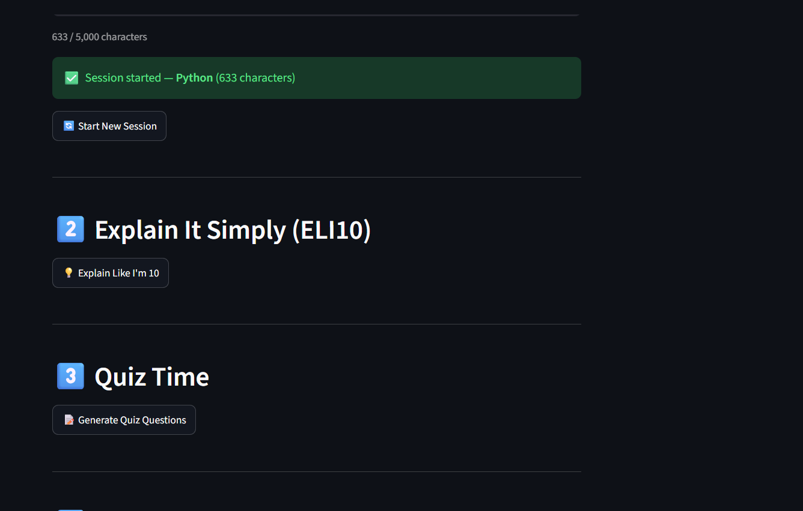
7
Session Started & AI Actions Unlocked
What's happening
Clicking 'Start Session' confirms the subject and note length, then unlocks two AI actions: 'Explain Like I'm 10' and 'Generate Quiz Questions'.
AI Study Buddy
07

Slide 8
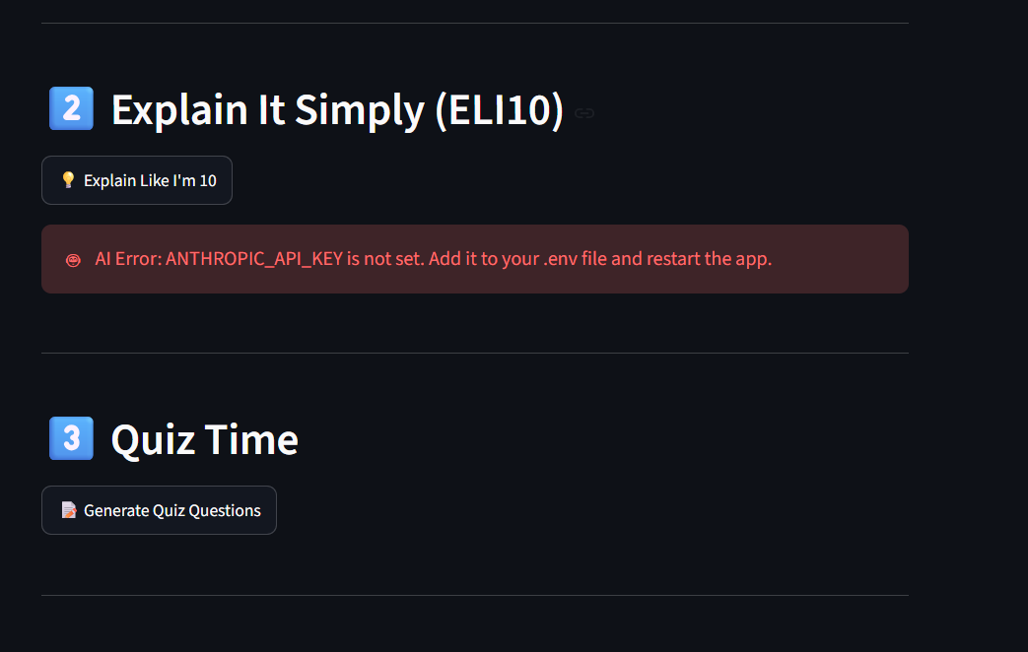
8
Graceful Error Handling
What's happening
If the AI API key isn't configured, the app shows a clear, friendly error instead of crashing — telling the student exactly what to fix (add ANTHROPIC_API_KEY to .env and restart).
AI Study Buddy
08

Slide 9
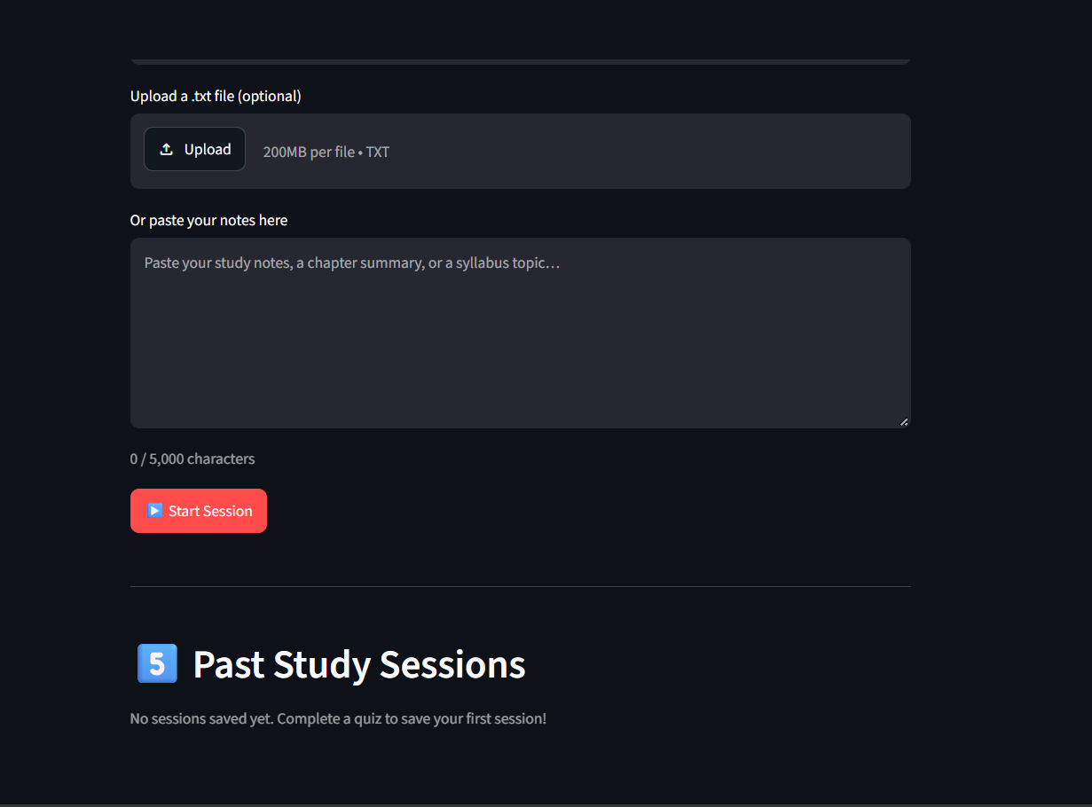
9
Past Study Sessions
What's happening
Completed quiz sessions are saved here for later review, letting students track their study history and revisit topics over time.
AI Study Buddy
09

Slide 10
Thank You
AI Study Buddy — helping students learn smarter, one session at a time.
GitHub Repository: github.com/deepaktravels6028/student-ai-track
Track: Student AI Track
AI Study Buddy
10

