Slide 1
Internet of Things Application Platform
Group 2

Slide 2
Sensor – Gateway Interaction

Slide 3
Overview
Module-1 consists of Sensors and Gateways
Communication medium used between sensor and gateway is Bluetooth
Sensors send data to the Gateway which on receiving processes it and forwards it to the filter server

Slide 4
Sensors
Sensors are simulated using an android application
Sensors generate random values at an interval of 5 seconds
Sensors are paired with the gateways via Bluetooth
Sensors send health ping at regular intervals

Slide 5
Gateways
Gateways are simulated using an android application
When gateways boots up, it loads all the information about the sensors from the repository
Gateways receive data from the sensors via Bluetooth
Gateways communicate to the filter server via socket

Slide 6
Gateway receives the data from the sensors one at a time
After receiving the data from one sensor it disconnects from that sensor
After disconnecting it establishes connection with another active sensor
The data thus received is passed on to the filter server

Slide 7
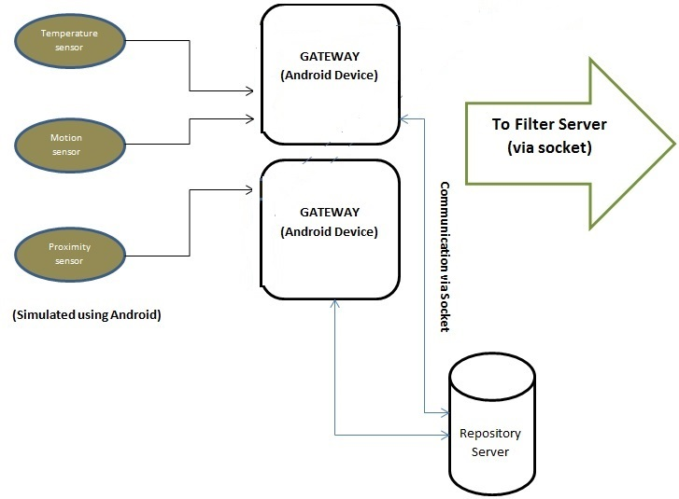

Slide 8
Gateway to Filter Server

Slide 9
Modules Implemented
Filter Server
Repository
Registry
Sensor Data
Helper

Slide 10
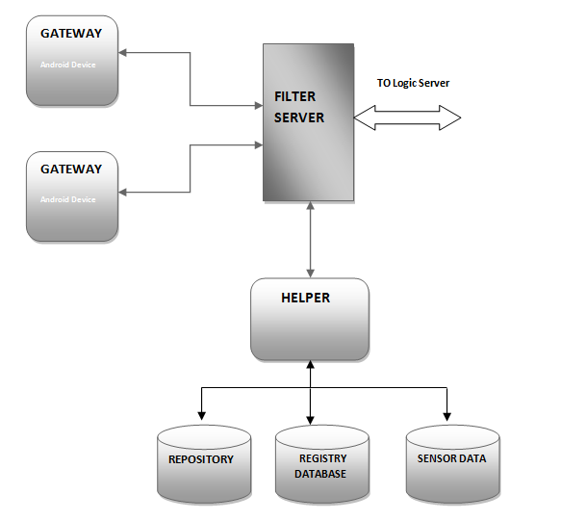
Overall View
Figure-1

Slide 11
FILTER SERVER
URL
Callback : It is used to register a callback query. For now it is hardcoded for only one join operator . Eg:
/callback/?id1=1&val1=50&op1=lt&join=or&id2=2&val2=20&op2=gt
Command : It is used to get data from a particular sensor. Eg:
/command/?id=1
New: It is used to get the data incoming from the gateway. Eg:
/new /?id=1&data=10
Inrange: It is used to get all the sensors within the specified range from the given latitude and longitude. E.g.:
/inrange/?lat=10&lon=12&range=100

Slide 12
FILTER SERVER
In every 5seconds it will receive data from gateway.
The data consists of sensor id and the data.
If the data is valid then the filter server marks the sensor status as active(1) else inactive(0) in the registry database.
The incoming data is also stored in the sensor database.

Slide 13
DATABASE
Registry Database: It contains sensor id, type of sensor, corresponding gateway and the present state of the sensor.
Schema: Id, type, gateway, active(0 or 1)
Repository Database: It contains sensor id, type, position(lat and lon) , and the corresponding gateway.
Schema: id, type, lat, lon, gateway
Sensor Database: It gets refreshed every 5 seconds. It stores the incoming data from gateway.
Schema: id, type, lat, lon, data, timestamp

Slide 14
Logic Server and Application

Slide 15
Brief Description
Logic Server handles query given to the platform.
Logic server processes the query that is meant to be processed by the platform for requesting and getting the desired data.
The logic server has at its disposal three APIs available which are :-
Query API
Command API
Callback API

Slide 16
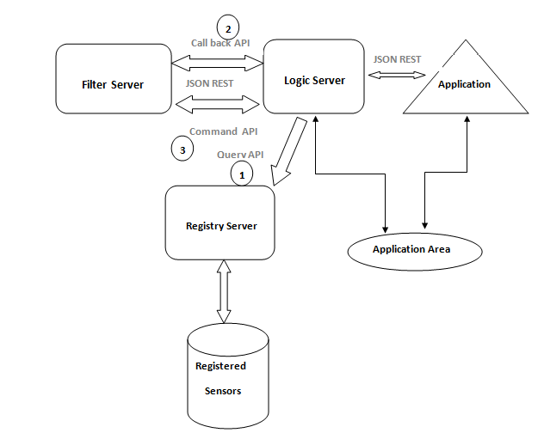
Block Diagram

Slide 17
Query API
URL:
Server_IP/query/?type=”type”&x=”x-coord”&y=”y-coord”&range=”in range”
Gets the list of all the sensors at a particular location in the given range based on the request by the application.
Contains the parameters :- type, location and range.

Slide 18
Command API
URL:
Server_IP/command/?type=”temp”&val=”30”
Logic Server can register commands onto the Filter server to fulfil the user applications demands.
Filter server starts sending the data to logic server when it receives the required data.

Slide 19
Callback API
URL
Server_IP/callback/?id1=2&val1=10&op1=gt&join=or&id2=3&val2=20&op2=40
In CallBack API the data is sent by filter server based on some condition provided by the application.
The response is received in JSON format which needs to be parsed by the developer to display on the application.

