Slide 1
Logic Server and Application Platform

Slide 2
Brief Description
Logic Server handles query given to the platform.
Logic server processes the query that is meant to be processed by the platform for requesting and getting the desired data.
The logic server has at its disposal three APIs available which are :-
Query API
Command API
Callback API

Slide 3
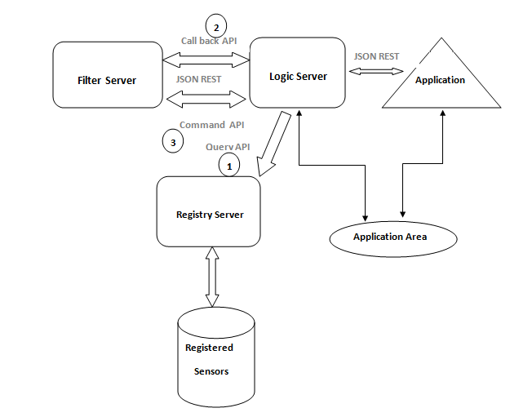
Block Diagram

Slide 4
Query API
URL:
Server_IP/query/?type=”type”&x=”x-coord”&y=”y-coord”&range=”in range”
Gets the list of all the sensors at a particular location in the given range based on the request by the application.
Contains the parameters :- type, location and range.

Slide 5
Command API
URL:
Server_IP/command/?type=”temp”&val=”30”
Logic Server can register commands onto the Filter server to fulfil the user applications demands.
Filter server starts sending the data to logic server when it receives the required data.

Slide 6
Callback API
URL:
Server_IP/callback/?cd1=”$gt|20”&cd2=”$lt|40”&type=”temperature”
In CallBack API the data is sent by filter server based on some condition provided by the application.
The response is received in JSON format which needs to be parsed by the developer to display on the application.

